Slide 1
Periodontal Flap
Jafar Naghshbandi D.D.S;M.S
Diplomate of the American Board of Periodontology

Slide 2
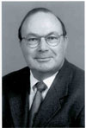
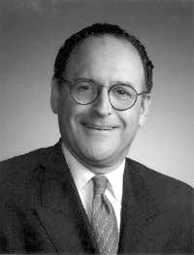
Special Thanks Whoever taught me a word made me his servant.
Dr. Jim Simon
Dr. Raul Caffesse

Slide 3
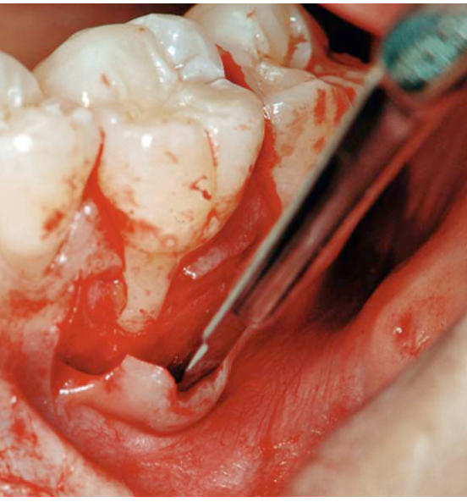
Definition
A periodontal flap is a section of gingiva and/or mucosa surgically-elevated from the underlying tissues to provide visibility of and access to the bone and root surface.

Slide 4
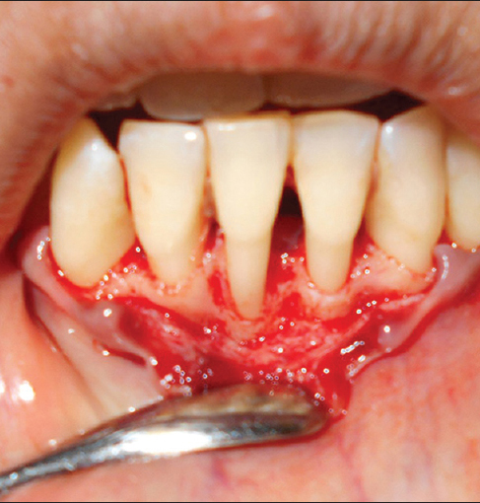
When should one consider for surgical pocket therapy ?
1. For opening up the pocket area in order to remove all the irritants from the tooth surface.
2. For elimination or reduction of the periodontal pocket.

Slide 5
INDICATIONS/OBJECTIVES OF FLAP SURGERY
1. Gain access for root debridement. 2. Reduction or elimination of pocket depth, so that
patient can maintain the root surfaces free of plaque.
3.Reshaping soft and hard tissues to attain a harmonious topography (physiologic architecture).
4.Regeneration of alveolar bone , periodontal ligament and cementum.

Slide 6
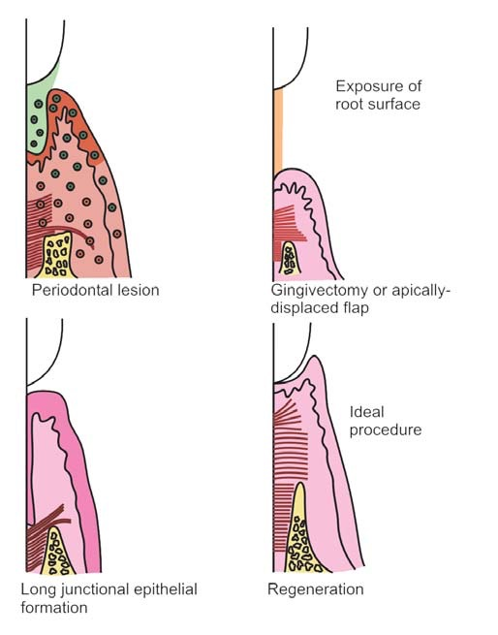

Slide 7
CLASSIFICATION
According to the Thickness of the Flap/Bone Exposure after Flap Reflection
The flaps are classified as:
a. Full thickness/mucoperiosteal flap—All the soft tissues including the periosteum is elevated
b. Partial thickness/mucosal flap/split thickness flap— Reflection of only the epithelium and a layer of underlying connective tissue, the bone is covered by a layer of connective tissue including periosteum

Slide 8
Mucoperiosteal / full thickness flap

Slide 9
Partial / split thickness flap

Slide 10
Indications
I. Full thickness : If osseous surgery is contemplated.
II. Partial thickness : For displacing flaps in the presence of dehiscence and fenestrations.

Slide 11
According to the Placement of Flap after Surgery
a. Nondisplaced flap—The flap is returned and sutured back in its original position.
b. Displaced flaps—The flap is repositioned coronal, apical or lateral to its original position. However, palatal flaps cannot be displaced due to the absence of unattached gingiva.

Slide 12
According to Design of the Flap/Management of the Papilla
The flaps can be:
Conventional flaps—Splitting the papilla into a facial half and lingual/palatal half. For example, modified Widman flap, undisplaced flap, apically-displaced flap.
Indications:
When the interdental areas are too narrow to permit the preservation of flap.
When there is a need for displacing flaps.
Papilla preservation flaps—Entire papilla is incorporated into one of the flaps.
Indications:
Where esthetics is of concern.
Where bone regeneration techniques are
attempted.

Slide 15
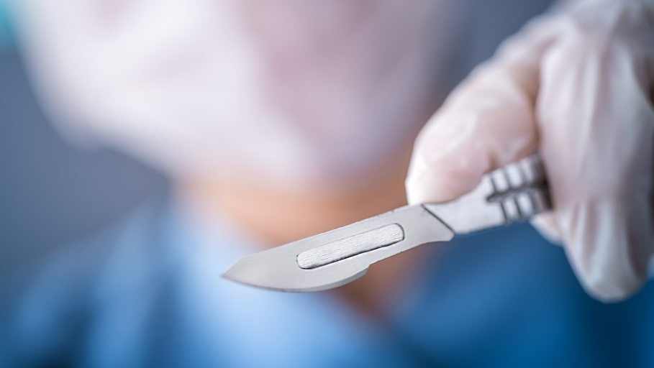
INCISIONS
For Conventional Flap:
1. Horizontal Incision: • Internal bevel incision
• Crevicular incision • Interdental incision
2. Vertical incision • Oblique releasing incision
For Papilla Preservation Flap:
Crevicular incision with no incisions
across the interdental papilla
is given.

Slide 16
Horizontal Incisions
Internal bevel incision: It starts at a distance (1 to 2 mm) from the gingival margin and is aimed at the bone crest. It is a basic incision to most of the flap procedures.
It accomplishes three important objectives:
1. Removes pocket lining. 2. Conserves relatively uninvolved outer surface of the gingiva. 3. It produces a sharp, thin flap margin for adaptation to tooth—bone junction.

Slide 17
Horizontal incisions

Slide 18
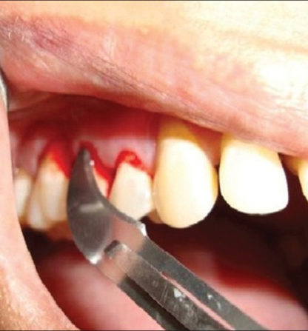
Crevicular Incision
It is also termed as the second incision, is made from the base of the pocket to the crest of the bone.. No. 12B blade is used. This results in V-shaped wedge of tissue containing inflamed granulomatous tissue consisting of lateral wall of the pocket, junctional epithelium and connective tissue fibers between the base of the pocket and crest of the bone.
With this access, the surgeon is able to make the third or interdental incision, to separate the collar of the gingiva that is left around the tooth. The orban knife is usually utilized for this incision. A curette or a large scaler (U15/30) can be used to remove the gingiva around the tooth. If no vertical incisions are made, the flap is called an envelope flap.

Slide 19
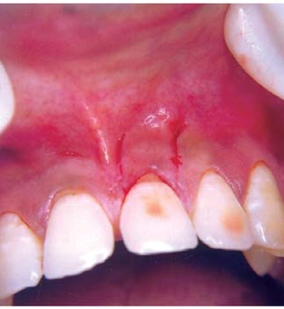
Vertical Incision
It can be done on one or both the ends of the horizontal incision. If the flap has to be displaced the incisions at both ends should be made. Another indication for vertical incision is in the presence of isolated deep pockets. Vertical incisions should be made extending beyond mucogingival junction for easy displacement of flap.
In general, vertical incisions are avoided: a. In lingual or palatal areas. b. At the center of the interdental papilla or over the radicular surface.

Slide 20
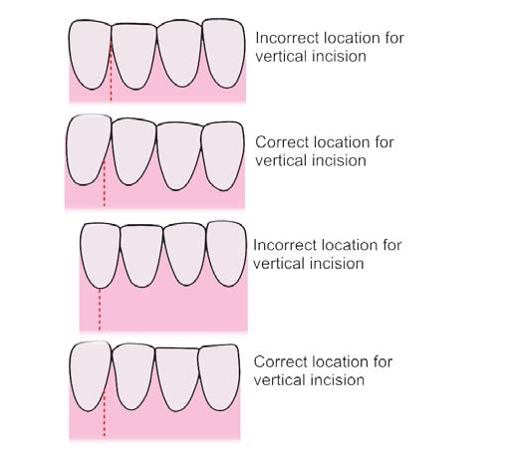
Location of vertical incision

Slide 21
Papilla Preservation Flap
Step 1
Crevicular incision is made around each tooth. No incisions through the interdental papilla.
Step 2
a semi-lunar incision across the interdental papilla in the palatal or lingual surface is made, which is at least 5 mm from the crest of the papilla (the deepest curve).
Step 3
The papilla is dissected from the lingual or palatal aspect using Orban knife and elevated intact with the facial flap.

Slide 22
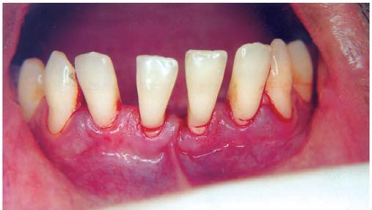
Facial view after sulcular incisions have been made

Slide 23
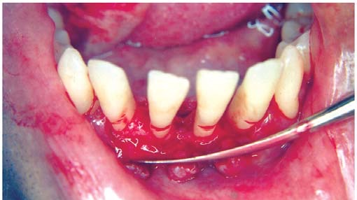
Flap reflection

Slide 24
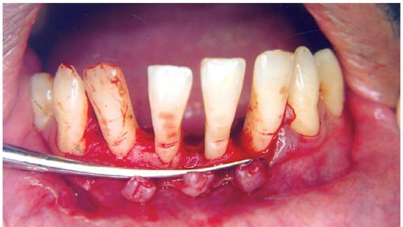
After curettage and root planing

Slide 27
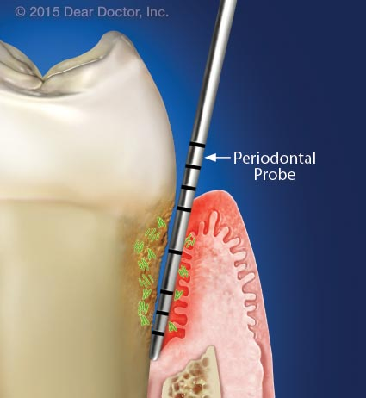
FLAP TECHNIQUES FOR POCKET THERAPY
The periodontal flap is one of the most frequently employed procedure particularly for moderate to deep pockets in posterior areas. They are:
i. Modified Widman flap.
ii. Undisplaced flap.
iii. Apically-displaced flap.

Slide 28
Modified Widman flap technique

Slide 29
Modified Widman flap technique

Slide 35
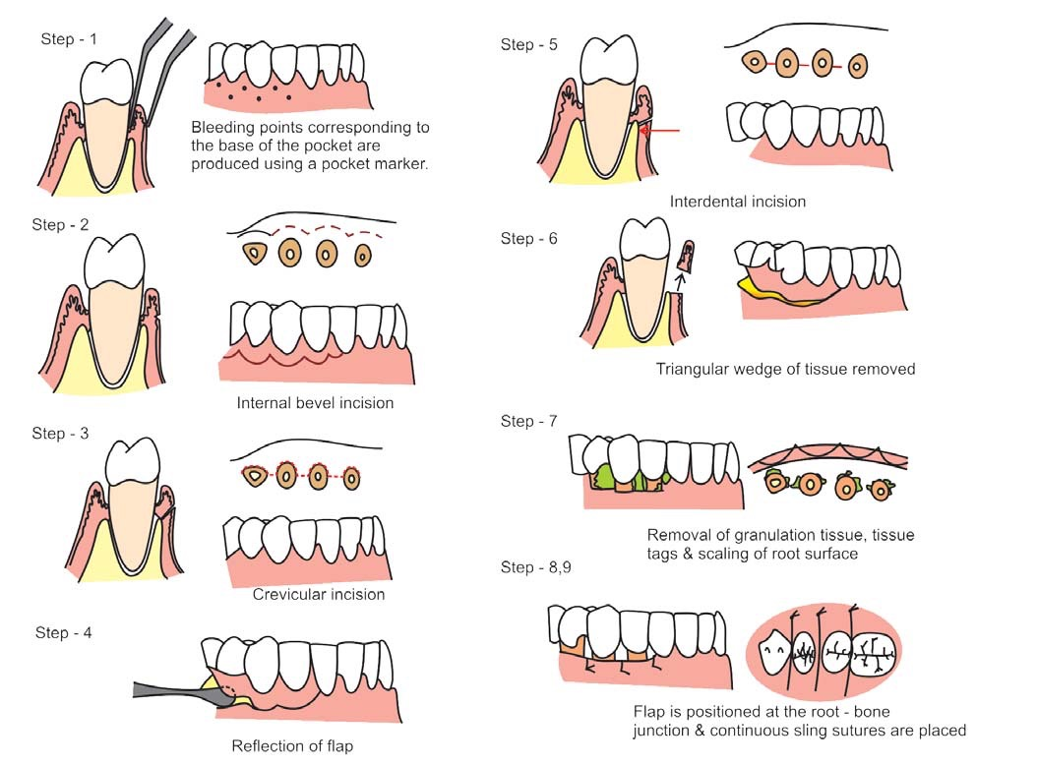
Undisplaced flap

Slide 36
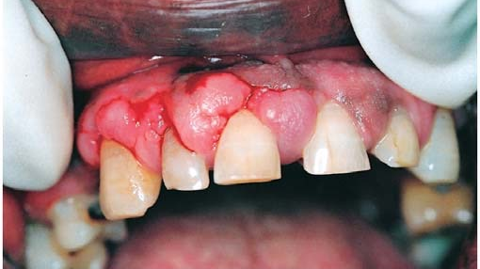
Undisplaced flap

Slide 42
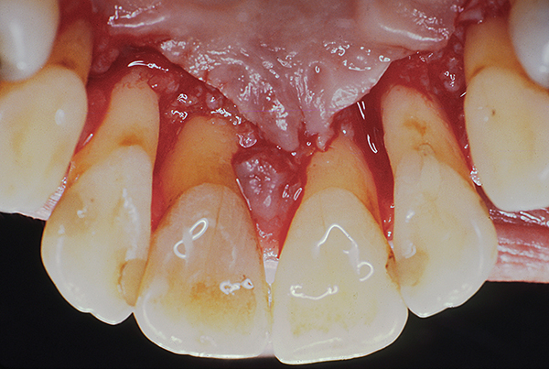
Palatal Flap
The surgical approach is different here because of the nature of the palatal tissue which is attached, keratinized tissue and has no elastic properties associated with other gingival tissues, hence no displacement and no partial thickness flaps.

Slide 47
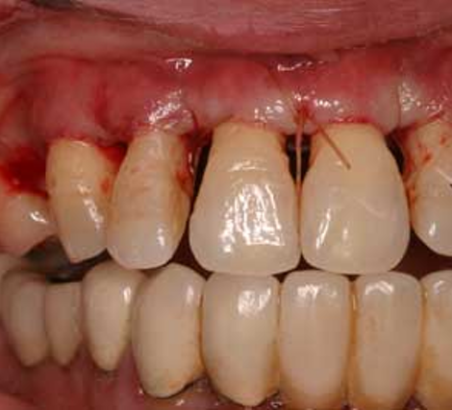
Apically-displaced Flap
Used for both pocket eradication and/widening the zone of attached gingiva.

Slide 48
HEALING AFTER FLAP SURGERY
Immediately after suturing (0 to 24 hours) connection between the flap and the tooth or bone surface is established by the blood clot, which consists of a fibrin reticulum with many polymorphonuclear leukocytes, erythrocytes, debris from injured cells and capillaries at the edge of the wound. There are also bacteria and an exudate or transudate as a result of tissue injury.

Slide 49
HEALING AFTER FLAP SURGERY
One to three days after flap surgery—space between the flap and the tooth or the bone is thinner and epithelial cells migrate over the border of the flap, when the flap is closely-adapted to the alveolar process there is only a minimal inflammatory response.
One week after flap surgery—an epithelial attachment to the root has been established by means of hemi- desmosomes and a basal lamina. The blood clot is replaced by granulation tissue derived from gingival connective tissue, bone marrow and the periodontal ligament.

Slide 50
HEALING AFTER FLAP SURGERY
Two weeks after surgery—collagen fibers begin to appear parallel to the tooth surface. Union of the flap and the tooth is still weak (due to immature collagen fibers) but clinically it appears almost normal.
One month after surgery—a fully-epithelialized gingival crevice with a well-defined epithelial attachment is present. Supracrestal fibers begin to adapt a functional arrangement.

Slide 51
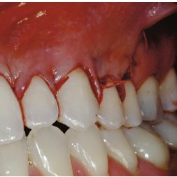
Healing after Full Thickness Flap
Same as above but superficial bone necrosis takes place in one to three days followed by osteoclastic resorption at 4 to 6 days and declines thereafter. This results in bone loss of about 1 mm and greater, if the bone is thin.

