Slide 1
Role of INTERPOL in notices, criminels cases, DNA and corruption, Asset Recovery
Notes:
The INTERPOL Global Complex for Innovation (IGCI) is being built in Singapore to complement the General Secretariat headquarters in Lyon, France. The purpose of the complex is to enhance our capability to tackle the crime threats of the 21st century and strengthen international policing worldwide, notably by:
Innovative research and development to enhance forensics and database capabilities, particularly in the identification of crimes and criminals;
Addressing the demand for technology and innovation-based capacity building and training;
Enhancing INTERPOL’s capacity to provide 24/7 operational support to police across time zones and distances with greater mobility.

Slide 2
INTERPOL – a global organization
Created in 1923, INTERPOL is the world’s largest international police organization,
At INTERPOL today, have a global membership of 192 countries. Each country maintains a National Central Bureau (NCB), staffed by national law enforcement officers. It forms the link with INTERPOL's global network, allowing member countries to work together on cross-border investigations.
General Secretariat in Lyon, France, ,and Special Representatives of INTERPOL to the United Nations and to the European Union in Brussels.
Four official languages: Arabic, English, French and Spanish
A National Central Bureau (NCB) in each member country
Notes:
INTERPOL – an international organization
INTERPOL is the world’s only global law enforcement organization, essentially linking all of the world’s police agencies. It was created in 1923, when police chiefs from 19 countries met in Vienna to discuss how best to counter the increasing international dimension of criminality. Today, it has 188 member countries. Police all around the world use INTERPOL’s secure global police communications system called I-24/7 to share information, co-ordinate their activities and access INTERPOL databases. In addition, INTERPOL provides police with operational support services.
INTERPOL’s mission is to enhance existing police resources around the world by assisting all organizations, authorities and services whose mission is to prevent or combat international crime. INTERPOL carries out this mission by developing and providing database tools through which police can communicate and share information, intelligence and analysis; offering training to help police build their crime-fighting capacity; and helping police co-ordinate their activities worldwide.
INTERPOL has its General Secretariat in Lyon, France INTERPOL operates seven regional offices – in Argentina, Cameroon, Côte d’Ivoire, El Salvador, Kenya, Thailand and Zimbabwe – and two representative offices at the United Nations in New York and at the European Union in Brussels. Each member country maintains a National Central Bureau (NCB) staffed by highly trained law enforcement officers.
About 600 staff members from around 80 different countries work at these facilities, including around 160 police officers seconded to INTERPOL by member countries.

Slide 3
NTERPOL
In order to successfully fight terrorism, and other transnational crimes, organizations need to have information, and they need to share it, in the most timely and effective manner possible. Committed to this view, INTERPOL provides the tools and services necessary to facilitate such exchanges. In order to affect these channels of communication, INTERPOL provides four ‘core services’ or functions. These services are, unto themselves, “best practices”:

Slide 4
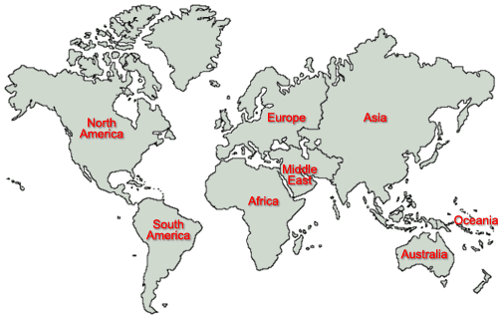
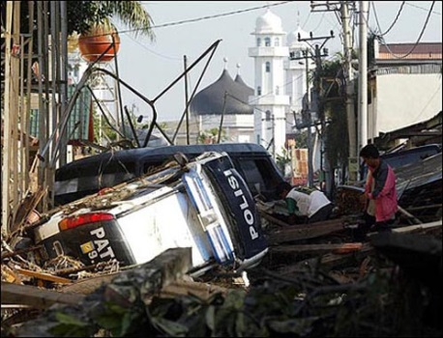
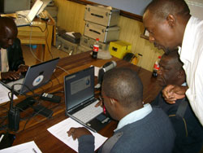
INTERPOL’s 4 Core Functions
Secure Global
Police
Communications
Services I-24/7
Operational Data
Services and
Databases
Operational Police
Support
Services
Police Training
and
Development
Notes:
In order to achieve these objectives, INTERPOL has identified four core functions:
1. a secure global communications system known as I-24/7 to enable police to exchange information in real time,
2. operational databases which are the active memory of police services and,
3. operational support 24h/24 – 7j/7.
4. Police training and development.

Slide 5
Core function #2: Operational data services and databases for police
INTERPOL Notices and Diffusions
Wanted persons
Seeking additional information
Warnings about known criminals
Missing persons
Unidentified bodies
Special INTERPOL-UN Security Council
Warnings of threats
+ Diffusions
Notes:
The INTERPOL Notices System –Please mention that Mr Greenberg will work on cases studies and proposal on day 2 !
At the request of member countries, INTERPOL circulates electronic notices that serve to alert police of fugitives, suspected terrorists, dangerous criminals, missing persons or weapons threats.
Just do not develop but you wanted to mention that it at this stage as Mr Greenberg will explain all what it is about tomorrow

Slide 6
Examples of notices that can be published by INTERPOL on request through NCBs:
Red Notice - To seek the provisional arrest of a wanted person with a view to extradition based on an arrest warrant or court decision.
Blue Notice - To collect additional information about a person’s identity, location, or illegal activities in relation to a criminal matter.

Slide 7
Orange Notice - To warn police, public entities and other international organizations of dangerous materials, criminal acts or events that pose a potential threat to public safety.
Green Notice - To provide warnings or criminal intelligence about persons who have committed criminal offences and are likely to repeat these crimes in other countries.

Slide 8
Notices contain two main types of information:
Identity particulars - comprehensive identity details, physical description, photograph, fingerprints and other relevant information such as occupation, languages spoken, identity document numbers, etc.

Slide 9
Judicial information - offence charged; references to the laws, maximum penalty, in the case of the Red Notice, references to the arrest warrant or sentence by a court; and countries from which the requesting country will seek escapee’s return.
Yet returning escapee’s is not an easy matter !!!

Slide 10
Article 3 – Political offences Extradition
Article 3 – Political offences Extradition shall not be granted if the offence in respect of which it is requested is regarded by the requested Party as a political offence or as an offence connected with a political offence.
The same rule shall apply if the requested Party has substantial grounds for believing that a request for extradition for an ordinary criminal offence has been made for the purpose of prosecuting or punishing a person on account of his race, religion, nationality or political opinion, or that that person's position may be prejudiced for any of these reasons.

Slide 11
Article 11 –
Capital punishment If the offence for which extradition is requested is punishable by death under the law of the requesting Party, and if in respect of such offence the death-penalty is not provided for by the law of the requested Party or is not normally carried out, extradition may be refused unless the requesting Party gives such assurance as the requested Party considers sufficient that the death-penalty will not be carried out.

Slide 12
Core function #3: Operational police support services
Stolen asset recovery
Corruption was named as INTERPOL’s crime priority area in 2007
Since identifying corruption as a priority crime area in 2007, INTERPOL has emerged as a central point of contact for member countries for information on asset recovery and related investigations. Asset recovery is a relatively new area of international legal cooperation, to detect and prevent the movement of stolen assets
multi-purpose tools
Customized tools

Slide 13
End
Thank You
Any Questions?

