Slide 1
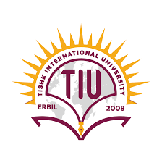
Tishk International University College of science / Medical Analysis Dep Medical Helminthology &Entomology (Ectoparasites) Third Stage By: Dr.Hemdad H. Mawlood

Slide 2
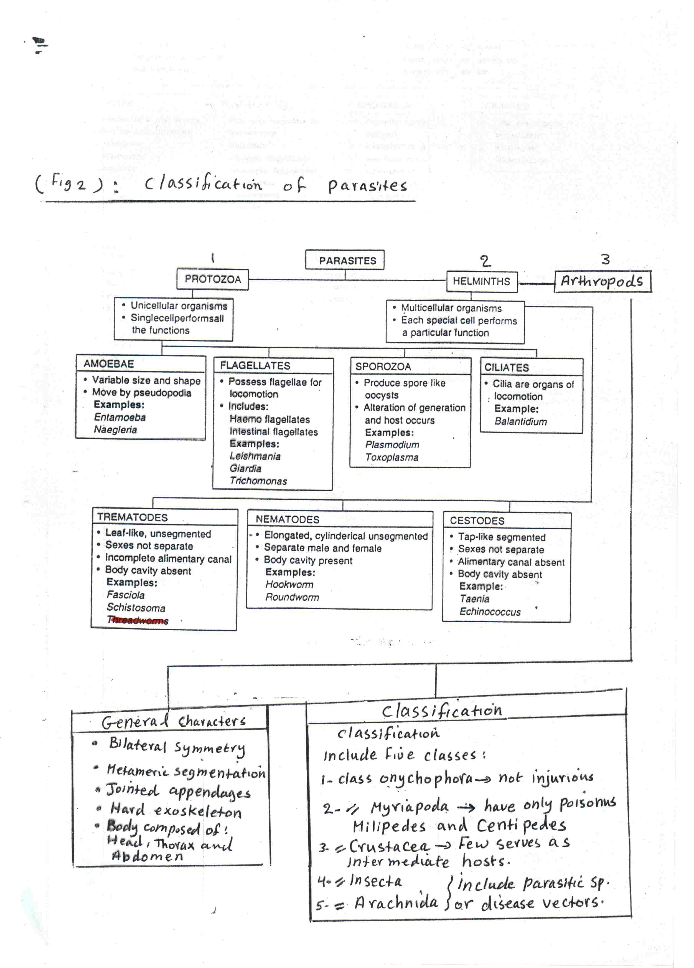

Slide 3
Medical helminthology :
is the field of medicine that pertains to helminthes (worms) capable of disease to human .
The public health impact of medical helminthes because is sizable.
2 billion people are infected by soil-transmitted helminths such as Ascaris, hookworms, and Trichuris trichiura and by schistosomes.
Early childhood infections by soil-transmitted helminths delays physical and cognitive development.

Slide 4
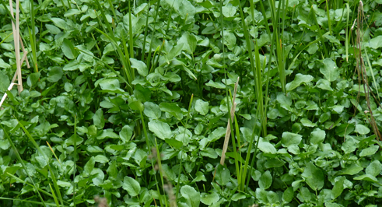
Other widespread helminthic infections include lymphatic filariasis, Dracunculiasis (Guinea worm disease), and food-borne trematode and tapeworm infections.
All of these infections by above worms causes chronic morbidity and debilitation.
Paper not required: Human fascioliasis: review provides fresh perspectives on infection and control
27 July 2018 | Fascioliasis – an infection mainly of the liver – is estimated to affect 2.4 million people in more than 70 countries, with several millions at risk.

Slide 5
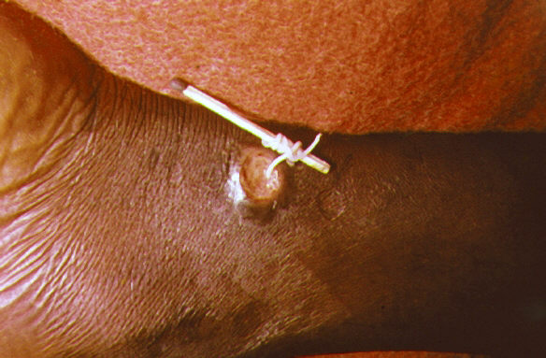
Dracunculus medinensis

Slide 6
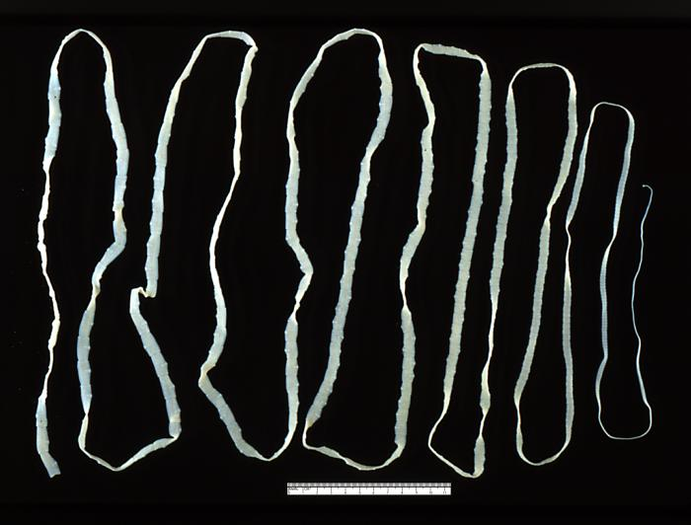
Beef Tape worm

Slide 7
Classification Helminthes (worms)
1.Phylum :Nemathelminthes (roundworms)
Class:Nematodes
2.Phylum: Platyhelminthes ( flatworms), include:
A.Class:Cestodes( tapeworms)
B.Class:Trematodes (flukes)
C.Class:Turbellaria(whirlpools) like Pseudoceros dimidiatus
3.Phylum :Annelida(ringed worms) :like Hirudo medicinalis (Leeches)(hematophagy)

Slide 8
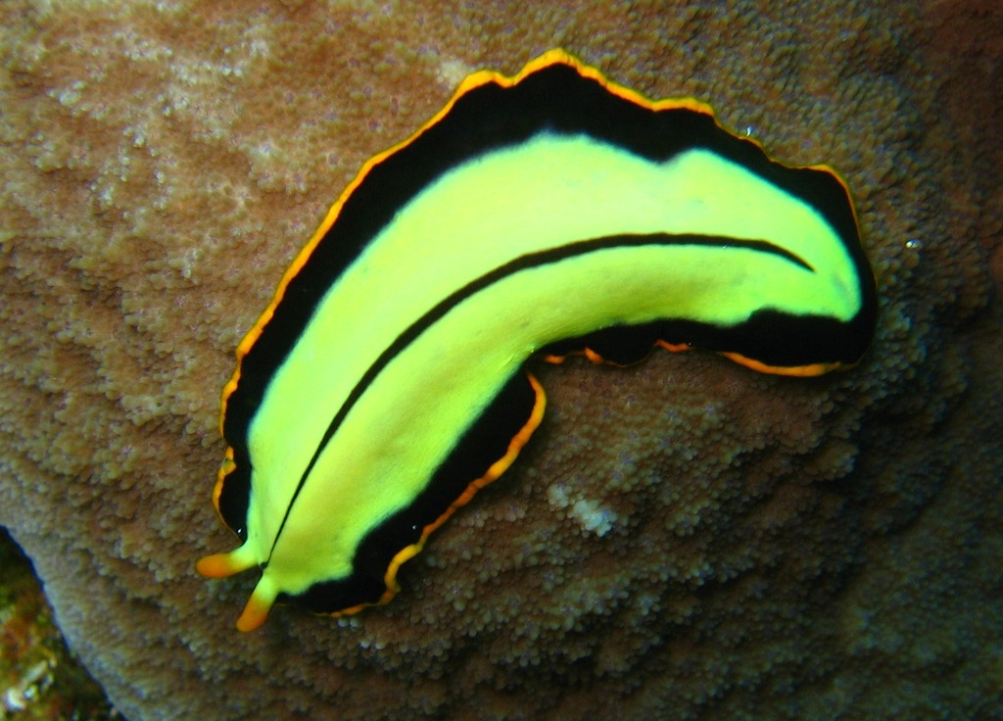
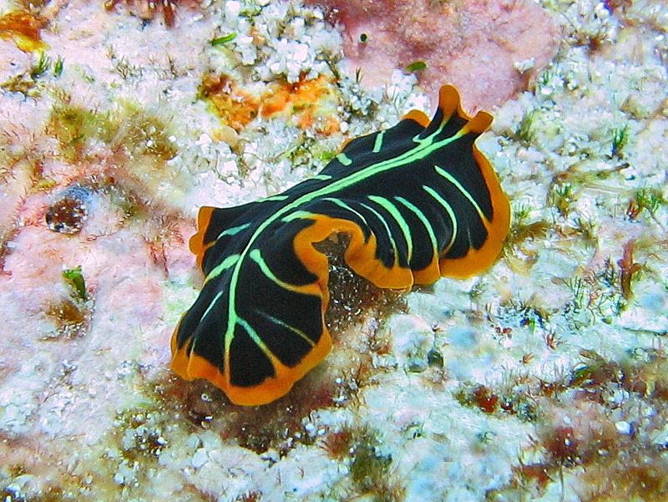
Pseudoceros dimidiatus

Slide 9
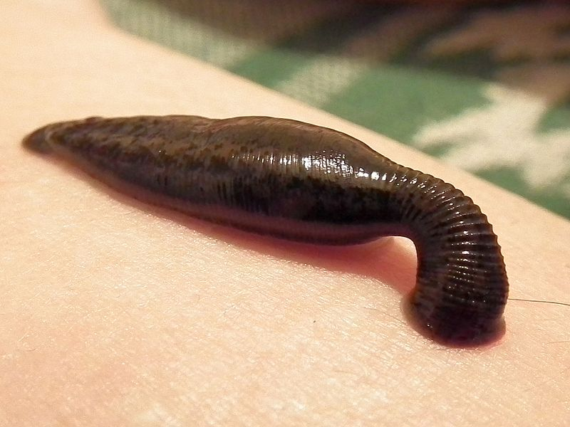

Slide 10
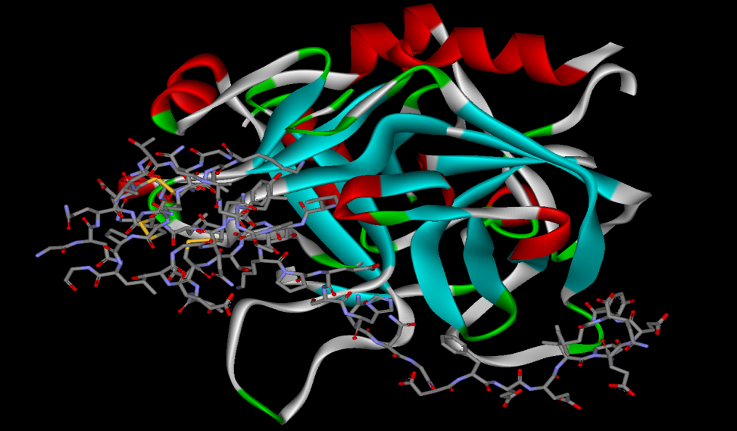
Hirudin: is a naturally occurring peptide in the salivary glands of blood-sucking leeches (such as Hirudo medicinalis) that has a blood anticoagulant property. This is fundamental for the leeches to have habit of hematophagy.

Slide 11
General Characteristics of Nematodes
Include numerous free living and parasitic forms.
Cylindrical body: few mm – meters.
Unsegmented (unlike earthworm and Cestodes ).
Separate sexes - female larger than male.
Complete digestive & reproductive system, life cycle simple or complicated.

Slide 12
Parasitic nematodes are generally white creamy in color.
Certain structural modifications are important for identification, like mouth, the anterior end of digestive tract, the esophagus, posterior end etc.
Stages: Ova( egg), Larva and Adult worm .Larvae include:
no infective &infective Larvae
Rhabditiform – noninfective(hook worm)
Filariform – infective(hook worm)
Eggs and larvae are best seen unstained or with iodine in wet mount. While adult often visible with naked eye.
Body covered with highly resistant coating (cuticle).
Medically important nematodes are Intestinal nematodes

Slide 13
A.The most intestinal species include: 1.Enterobius vermicularis 2. Ascaris lumbricoides 3. Trichuris trichiura 4. Trichinella spiralis 5.Hookworms ( Ancylostoma and Necator) 6. Strongyloides stercoralis. B. Intestinal –Tissue Species 1.Trichinella spiralis 2.Dracunculus medinesis

Slide 14
Go to PIN worm
Thank you for your patient
Keep your lec.

