Slide 1
Sample Collection Mrs:Sara Redar Yasseen Medical Microbiologist

Slide 2
Objective:
At the end of the section students must learn :
What is Sample Collection?
Principles of sample collection
Common types of sample
Labeling of samples
Benefit of transport media with examples
Criteria for rejecting samples

Slide 3
What is Sample Collection?
Specimen collection is the process of obtaining tissue or fluids for laboratory analysis or near-patient testing. It is often a first step in determining diagnosis and treatment. The process must minimise health and safety risk to all staff handling the sample and the risk of erroneous data/results.

Slide 4
Principles of sample collection
The specimen must be:
Collected at the right time;
Collected in a way that minimizes contamination;
Collected in a manner that reduces risk to all staff (including laboratory staff);
Collected using the correct tools;
Stored/transported appropriately.

Slide 5
Common types of sample
Solid sample:such as hard tissue biopsy,stool,and hair….etc
Liquid sample: such as blood ,urine,diarrhea,csf (cerebro spinal fluid),and seminal fluid…….etc
Swabs :such as (throat swab,nasal swab,cervical,and wound swab …..etc

Slide 6
Labeling of samples
Include:
Name
Participant ID
Sample type ex: (blood-urine-feces)
Date of collection
Gender
Age
Recent diet and supplement use

Slide 7
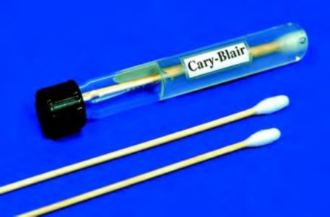
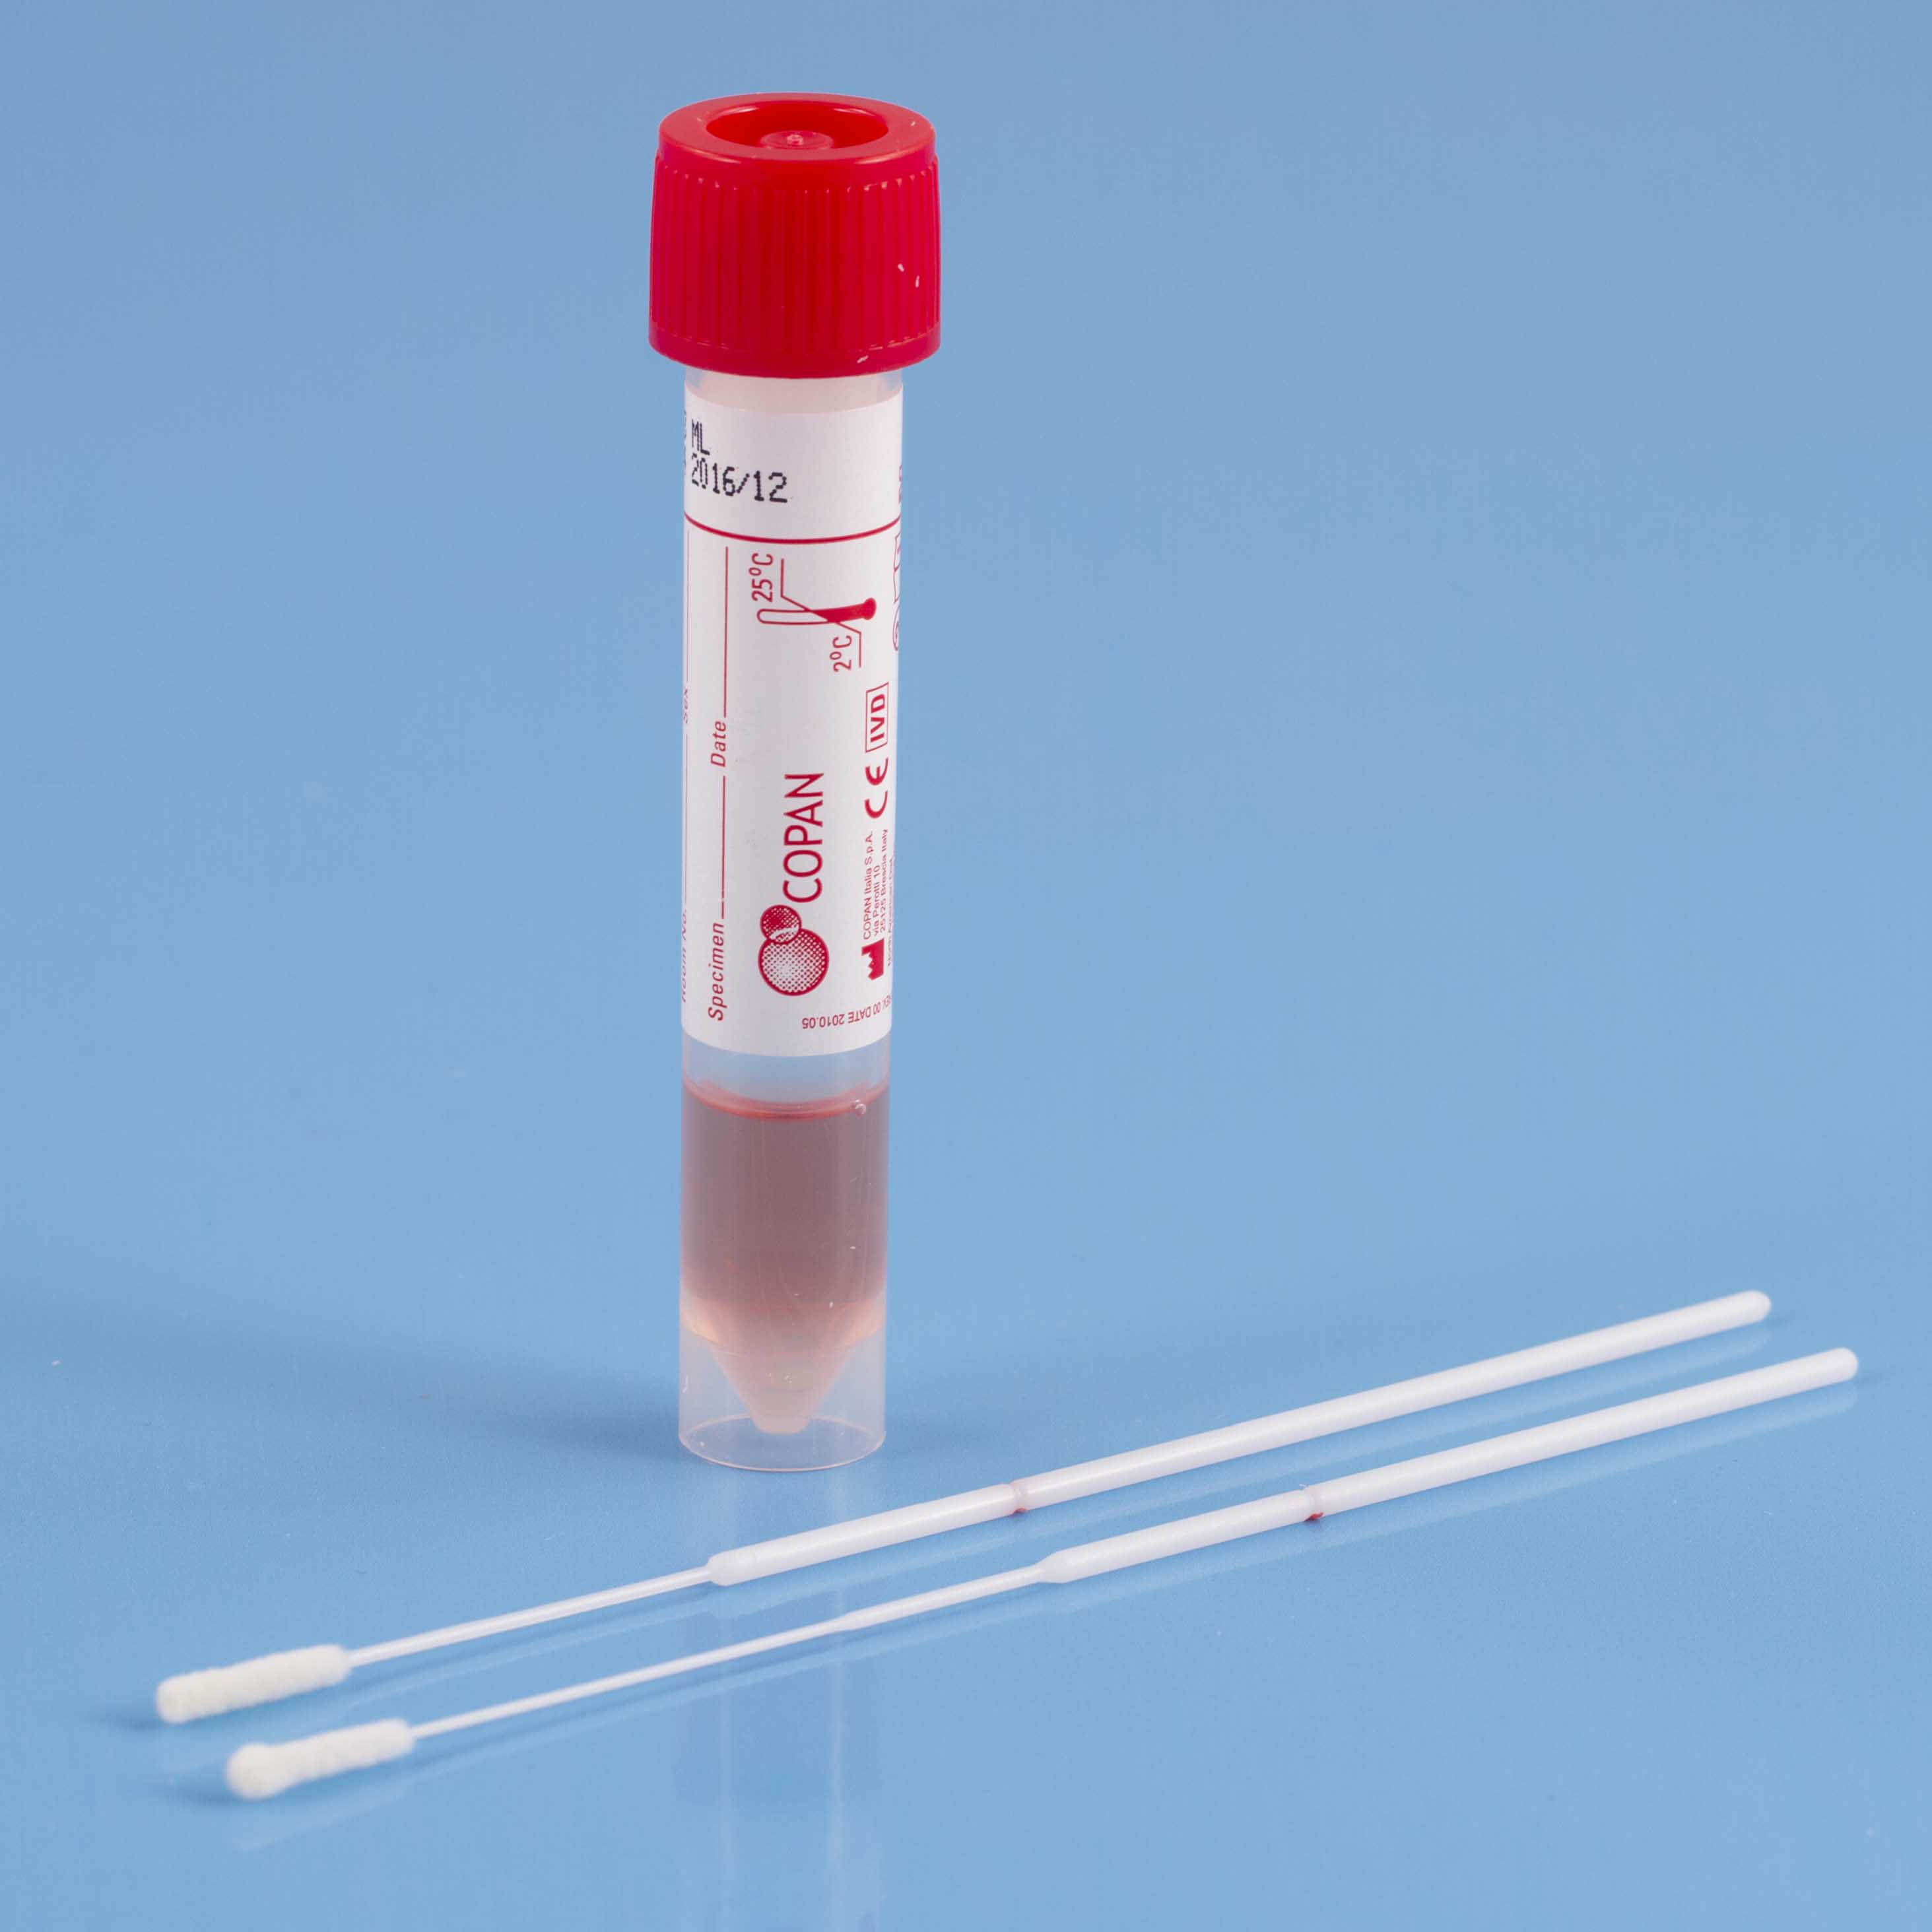
Benefit of transport media with examples
Transport medium is a safe and an appropriate way of carrying the clinical specimens from distances (long or short) for transporting to the lab for examination.
Two important purpose of transport media:
It allows organisms to survive.
It does not allow organisms to proliferate.
Examples:
For bacteria – Cary Blair (Salmonella, Shigella, Vibrio)
For viruses – virus transport media (COVID-19)

Slide 8
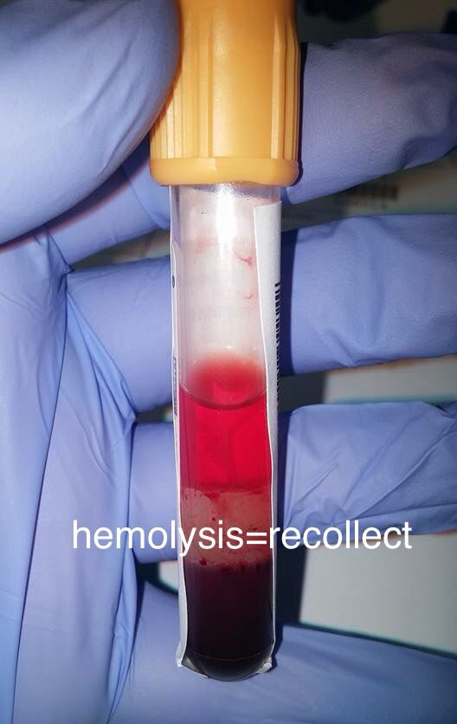
Criteria for rejecting samples
i-Missing or inadequate identification.
ii-Insufficient quantity.
iii-collected in an inappropriate container.
iv-Contamination suspected.
v-Inappropriate transport or storage.
vi-Unknown time delay.
vii-Haemolysed blood sample

Slide 9
Thank you

