Slide 1

Quality Assurance Vs Quality Control
Quality assurance & control
Lecture 1
3rd Grade – Fall Semester 2021-2022
Mr. Goran Noori Saleh
Goran.nori@tiu.edu.iq
20/10/2021

Slide 2

Quality
is an important factor when it comes to any product or service.
Therefore, all manufacturers and service providers out there constantly look for enhancing their product or the service uality.

Slide 3

Quality
In order to maintain or enhance the quality of the oferings, manufacturers use two
These two practices make sure that the end product or the service meets the quality requirements and standards defined for the product or the service.

Slide 4
Are QA and QC same terms?
Big No, This both terms are effectively
different.
Most of the time we use both terms randomly, then to study and understand the difference between them is important.

Slide 5
Are QA and QC same terms?
Let’s differentiate according to below points:
Definition
Focus on
How to Achieve
Example Responsibility

Slide 6
Definition

Slide 7




Definition of quality assurance
Assurance is process oriented
Qual ensuri
Assurance is a set of activities for quality in the processes which
products are developed.

Slide 8



Definition of quality Control
Quality
Control is a set of activities for ensuring
quality in products. The activities focus on identifying defects in the actual products produced.

Slide 9
Focus

Slide 10
Quality assurance focus on
Quality Assurance aims to prevent defects with a focus on the process used to make the product.
It is a proactive
quality process.
It identifies weakness in processes to improve them.

Slide 11

Quality assurance focus on
Quality assurance focus on
Qual
Control aims to identify and correct
elects in the finished product.
is a reactive process.

Slide 12

Goal

Slide 13
Goal of Quality assurance
The goal of Quality Assurance is to improve development and test processes so that defects do not arise when the product is being developed.

Slide 14
Goal of Quality control
The goal of Quality Control is to identify defects after a product is eveloped and before it's released.

Slide 15

How to Achieve

Slide 16
To Achieve QA goals
Establish a good quality management system and the assessment of its adequacy.
Periodic conformance audits of the operations of the system.
Prevention of quality problems through planned and systematic activities including documentation

Slide 17
To Achieve QC goals
Finding & eliminating sources of quality problems through tools & equipment so that customer’s requirements are continually met.
The activities or techniques used to achieve and maintain the product quality, process and service

Slide 18
Example

Slide 19




QA examples
Example:
Process documentation
Establishing standards Developing checklists
Conducting internal audits

Slide 20


Example:
QC- examples
QC review
Pe#orming inspections Preforming testing

Slide 21

Responsibility

Slide 22
Responsibility of QA
Everyone on the team involved in developing the product is responsible for quality assurance

Slide 23
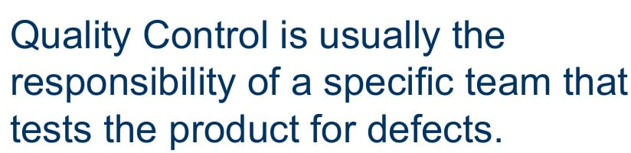
Responsibility of QC

Slide 24

Working together

Slide 25
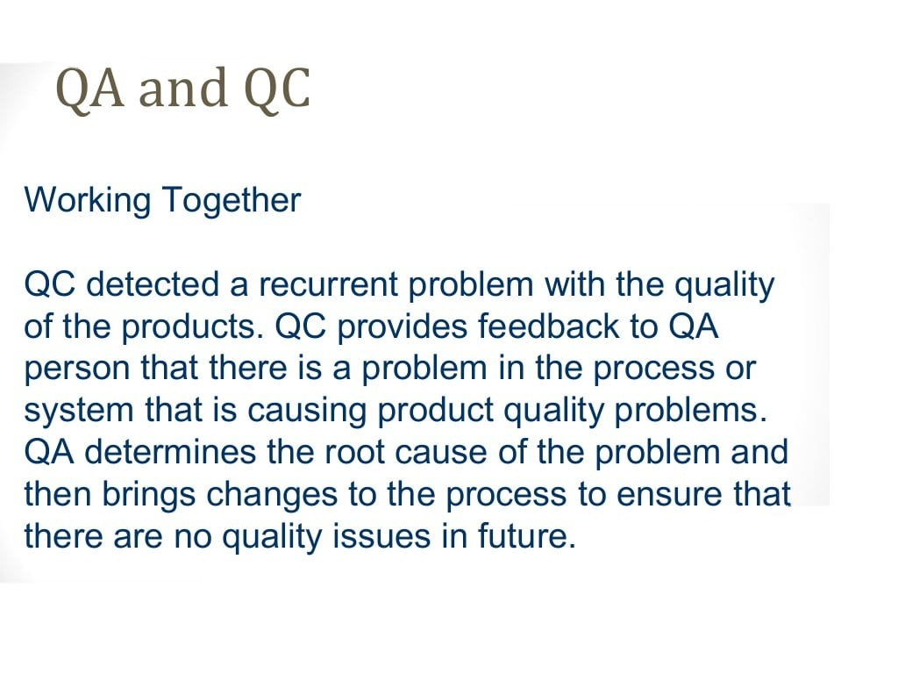

Slide 26


