Slide 1
Fundamental to Artificial Intelligent
IT-456
Dr. Saman Mirza Abdullah
Saman.mirza@tishk.edu.iq

Slide 2
Course Information
Have 12 classes.
12 classes, each 2 hours.
One class is mid term exam, and One class final.
One class for course review
Textbook
S. Russell, P. Norvig. 2010. Artificial intelligence A Modern Approach. Third Edition. USA, Pearson
Kevin Warwick. 2011. Artificial Intelligence: The Basics. 1st edition.
Quizzes
There will be a daily quiz (each week after given the lecture). This will be started on second week
One monthly quiz.
Reports and Assignments
One report should be submitted.
Students will be grouped to (3 members only)
Each group will submit one report.

Slide 3
Edmodo
Class name is Introduction to Artificial Intelligent (AI)
Code of the class is (2xt7y6).

Slide 4
Course Aim
The aim of the course is to introduce IT students to:
The fundamental concepts of artificial intelligence.
The concepts of problem solving,
Knowledge , Reasoning, Planning,
Uncertain Reasoning, Learning, and Natural Language Processing.
Modern tools and algorithms of AI.
State – of – the – Art for the AI.

Slide 5
Class Objectives
Students for this class will learning
The meaning of Artificial Intelligence.
The definition of AI.
How can AI systems think and act?
Do AI systems need to think and do actions like human?
Why AI systems need to think rationally.

Slide 6
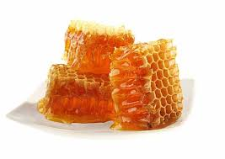
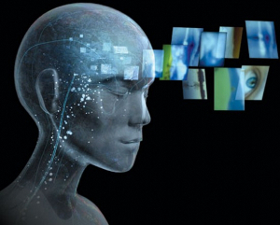
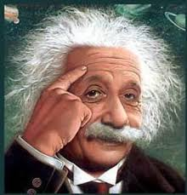
Introduction
AI is shortened from Artificial Intelligence.
Terminology: Artificial and Intelligence.

Slide 7
Introduction
Human have tried to understand how our mind can:
perceive, (Observe, remark, recognize)
understand,
predict, and
manipulate a worldPredict.
Attempts of AI goes further to build intelligent entity (body, unit, agent, model).
AI is a multi-disciplines field.

Slide 8
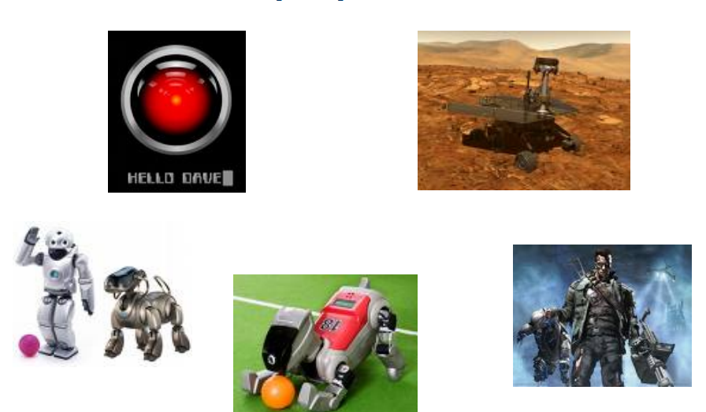
Those can be AI projects?

Slide 9
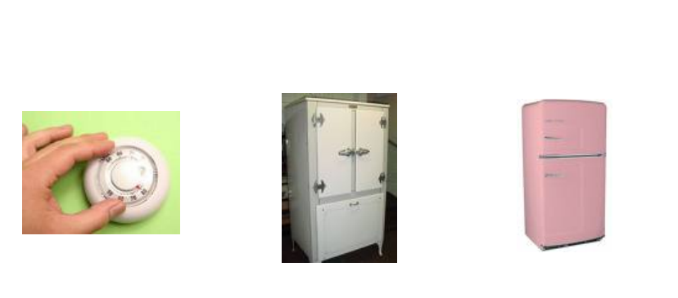
Are they?

Slide 10
And these?

Slide 11
So, what is AI?
It is the theory and development of computer systems that able to perform tasks that normally require human intelligent.
There are more definitions about AI.
Each can define AI in the percept that a scientist believe.
How should an AI model work?
How to think?
How to act?
How to work; humanly or systematically?

Slide 12
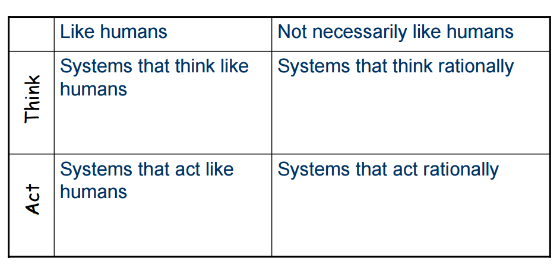
How to define AI?
It is the theory and development of computer systems that able to perform tasks that normally require human intelligent.

Slide 13
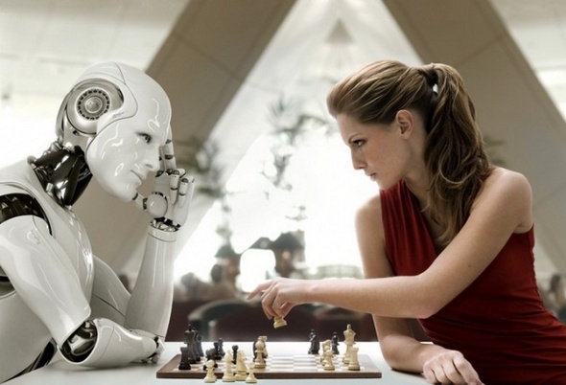
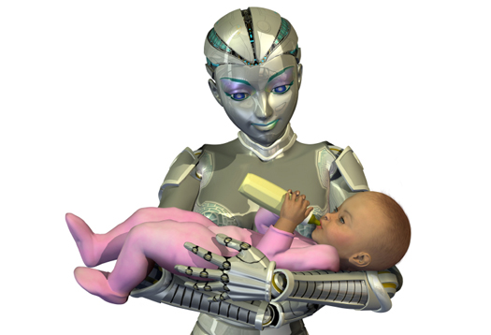
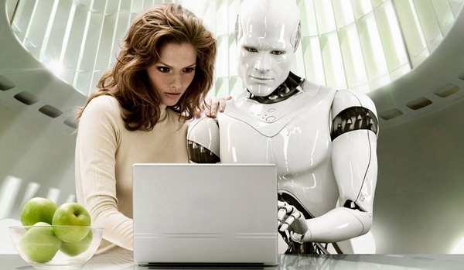
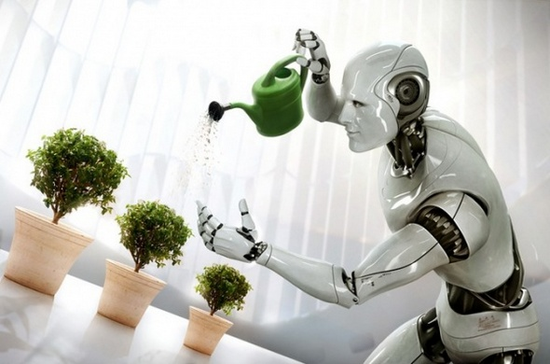
Figure (1) ; Thinking Rationally
Figure (2) ; Human act
Figure (3) ; Humanly and Rationally act

Slide 14
Thinking and Reasoning
How to build
How to measure
Measure against human performance
Measure against ideally or rationality performance
Behaviors / Actions

Slide 15
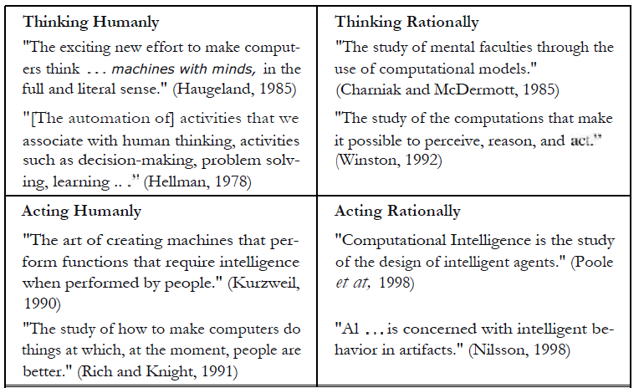
Some approaches

Slide 16
Measuring AI model
Whatever they do and however the think, AI models need to be measured.
AI models measure against the idea that they build for:
If needed to act like human, they should measure against the human activities.
If need to think as human, they should measure against the through of human.
If need to behave rationally, they measured against logic.
Finally, if need to think as rationality the model should be measured against the principle of the logic thinking.

Slide 17
Acting humanly
To test whether a machine is working as human or not, the concept of Turing Test (proposed by Alan Turing, 1958) is followed.
Interrogator can’t realize whether the answer is human or an AI system.

Slide 18
Acting humanly Turing Test
To do Turing test, machines should be able to do:
Natural language processing. (to communicate human language).
Knowledge representation. (to sore what it knows and hears).
Automated Representation. (to draw conclusions form stored information and answering the questions)
Machine learning. (can update information when getting questions).
Total Turing test needs below capabilities besides the four essential ones:
Computer vision, to perceive the objects.
Robotics, to manipulate objects and move around.

Slide 19
Thinking humanly Cognitive Approach
This approach tests a machine or a program against the way that human mind think.
To achieve this test we need, to know how human mind works.
Catching out thought when going by something.
Observing a person when do actions.
Observing the mind when working.
When got theses, we can compare the theory by which the mind is working with the work of the program, and is there any similarity ?
If the program's input—output behavior matches corresponding human behavior, that is evidence that some of the program's mechanisms could also be operating in humans
The idea is not checking whether an AI systems works well, but the idea here is do the trace of thinking done as the same as human do?

Slide 20
Cognitive Science
The interdisciplinary field of cognitive science brings together computer models from AI and experimental techniques from psychology to construct precise and testable theories of the human mind
Cognitive VS Approach
an author would argue that an algorithm performs well on a task and that it is therefore a good model of human performance.
Cognitive theory is a science tells how the human mind can learn through listening, observing, and touch other experiences.

Slide 21
Rationally Thinking Laws of the thought
Codifying the “laws of thought’ was created by Aristotle.
The idea is to get correct conclusion from correct premises (evidences).
It is the correct inference not the best. (can’t work with uncertainty)
The “laws of thought” govern the way of thinking and initiated the field of logic.
The logic field programs problems that described logically. (if no solution found the logic-based AI systems trap in loop).
Logic based AI systems creates Intelligent systems or Expert Systems.

Slide 22
Rationally Thinking
Rationally thinking means Logically thinking.
Apples are fruit, all fruit are useful, apple is useful
The main challenges for such approach
Always, knowledge can not be expressed as logic.
There is a difference between solving problem in principle and solve it in practice.

Slide 23
Acting Rationally
AI systems can achieve actions and activities through something called Agent.
acting rationally means, considering all the possibilities and pros and cons and then judge the circumstances accordingly and act sensibly.
Agents must do the following to act rationally: (2nd Part)
Operate autonomously,
perceive their environment,
persist over a prolonged time period,
adapt to change, and
create and pursue goals.
A rational agent is one that acts so as to achieve the best outcome, when there is un certainty, best expected outcome.

Slide 24
AI State – of – the – Art
Robotic vehicles: A driverless robotic car named STANLEY.
Speech recognition: A traveler calling an airline to book a flight can have the entire conversation guided by an automated speech recognition and dialog management system.
Machine Translation: A computer program automatically translates from Arabic to English.
Robotics: The iRobot Corporation has sold over two million Roomba robotic vacuum cleaners for home use.
Logistics planning: Automated logistics planning and scheduling for transportation.
And more ……….

Slide 25
Class Ended

