Slide 1
Fundamental to Artificial Intelligent
IT-456
Dr. Saman Mirza Abdullah
Saman.mirza@tishk.edu.iq

Slide 2
Intelligent Agents:
The main objective of this class are:
To define an agent.
To define an intelligent agent.
To define a rational agent.
To Discuss different types of environment.
At the end of this class, you will learn
What an agent is?
How an agent interact with its environment?
At the end of the class, students should be able to
Identify percepts available to an agent, and
Identify the actions that the agent can execute.

Slide 3
Intelligent Agents:
In this class, we will focus only on the rational agent.

Slide 4
What is an Agent?
An Agent is a computer system that is capable of independent actions on behave of its user or owner.
figuring out what needs to be done to satisfy design objectives, rather than constantly being told
The main point about agents is “autonomous”: capable of acting independently, exhibiting control over their internal state.
Thus: an agent is a computer system capable of autonomous action in some environment in order to meet its design objectives”.
An agent is anything that can be viewed as perceiving its environment through sensors and acting upon that environment through actuators (effectors).

Slide 5
Agent Components

Slide 6
Agent Components
Fundamental Functionalities of an agent
Sensing.
Understanding, reasoning, and learning.
Acting.
In order to act, agent must sense. Blind actions are not a characterization of intelligence.
Robotic: sense and act.
Dose Understanding necessary?
Senses need understanding to be useful.

Slide 7
Agent Components
An agent operates in environment.
Measures as how and what, but not omniscient.
It receives percept from its environment. (input)
The complete set of inputs at a given time is called percept.
The current percept or a sequence of percept can influence the actions of an agent.
It acts upon environment through its actuators (effectors). (output)
An operation involving an actuator is called an action.
An action can be grouped into action sequences.
An agent's choice of action at any given instant depends on the entire percept sequence observed to date, but not on anything it hasn't perceived.

Slide 8
Agent Function / Program
Agent function describes the behavior of the agent, which is the mapping process of percepts to action.
Achieved through tabulating functions
It can describe the external functionality / behaviors of any given agent.
It contains percepts and actions. (mapping percept to action)
It could be bound or unbound.
Agent program is a code that implements the agent’s functions.
Achieved through Codes.
It is the enteral design of the system. (Embedded System)

Slide 9
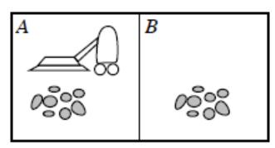
Agent Function / Program
To build an agent function, we depend on tabulating function.
Let us build a tabulating function for this real-world vacuum agent.
Let us built the agent
Program too.

Slide 10
Rational Agent
A rational agent is one that does the right thing, conceptually, every entry in the table for the agent function is filled out correctly .
Rational agent behaves good, right , accurate.
Mapping percepts (sequence) to actions.
Ideal mapping specifying which action an agent ought to take at any point in time.

Slide 11
Rational Agent
A rational agent is one that does the right thing, conceptually, every entry in the table for the agent function is filled out correctly .
Rational agent behaves good, right , accurate.
Mapping percepts (sequence) to actions.
Ideal mapping specifying which action an agent thought to take at any point in time.

Slide 12
Rational Agent
Rational Agent→ is an agent that gives the best solution for a problem.
Performance measure gives indication how good is the agent's solution.
An agent should be designed according to what the environment need, not to thinks how the agent should behave.
To know what environment need → Nature of environment should be studied.

Slide 13
Specify Task Environment
To specify the task environment, you need to know the (PEAS)
Performance measure, (P)
Environment, (E)
Actuators, and (A)
Sensors. (S)
The (PEAS) for the Vacuum cleaner agent:
Type of Agent | Performance Measure | Environment | Actuator | Sensor
Vacuum | Clean / fast | Two tiles (A and B) | Suck Move | Camera

Slide 14
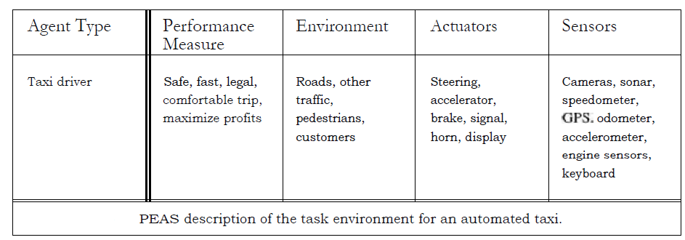
Taxi Driver PEAS
Taxi driver is an open – end problems (unbound environment).
There are no limit for driver ‘s skill and ability.
There are no bound for road issues.
Performance Measure is tradeoffs among different factors

Slide 15
Taxi’s Driver Tasks Specifying Task Environment
Performance Measure is tradeoffs among different factors:
Fuel consumption VS trip time and cost.
Profit VS wear and tear
Passenger comfort
Violation traffic laws
Disturbance to another driver
Safety

Slide 16
Taxi’s Driver Tasks Specifying Task Environment
Environment (complex environment needs complex design)
Different kind of road
Should know traffic law
Recognize pedestrian line
Knows road workers
Knows police cars
Puddles and potholes
The weather of driving
Left or right driving
What actuators and sensors expected for taxi’s driver?

Slide 17
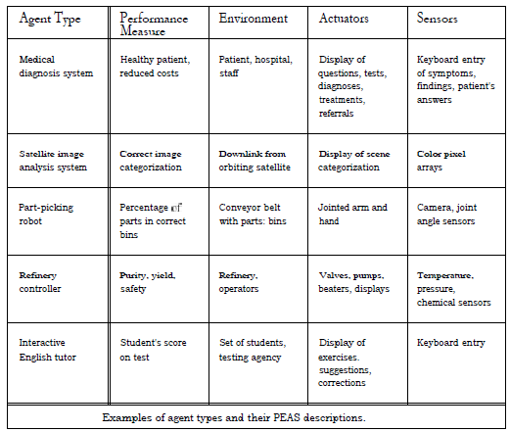
More PEAS Examples

Slide 18
Properties of Task Environments
Task environments in AI are very vast.
They can be categorized into smaller dimensions.
These dimensions are identifying the implementation properties of AI agents.
The design of agent’s program and the capabilities of the agent can be built upon these dimensions.

Slide 19
Properties of Task Environments Fully and Partially Observable
A task environment is effectively fully observable if the sensors detect all aspects that are relevant to the choice of action; relevance, in turn, depends on the performance measure .
Fully observable environments are convenient because the agent need no maintain any internal state to keep track of the world
An environment might be partially observable because parts of the state are simply missing from the sensor data
Vacuum agent with only a local dirt sensor cannot tell whether there is dirt in other squares.
Automated taxi cannot see what other drivers think.
Agent has no sensors at all then the environment is unobservable.

Slide 20
Properties of Task Environments Single VS Multi-agent environment
An agent can solve problems by itself is single agent environment.
solving a crossword puzzle
When a problem cannot be solved with one agent and more than one agent attended is called multi-agent environment.
Chess game
Multi-agent can be :
Competitive.
Cooperative (partially).
Random behavior.

Slide 21
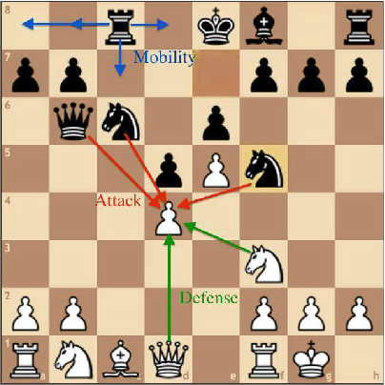
Properties of Task Environments Deterministic VS Stochastic environment
Deterministic vs. stochastic. If the next state of the environment is completely determined by the current state and the action executed by the agent, then we say the environment is deterministic; otherwise, it is stochastic .
We say an environment is uncertain if it is not fully observable or not deterministic
Determined VS Fully observed.
Stochastic VS partially observed.

Slide 22
Properties of Task Environments Episodic VS Sequential environment
In an episodic task environment, the agent's experience is divided into atomic episodes.
In each episode the agent receives a percept and then performs a single actions.
The next episode does not depend on the actions taken in previous episodes.
Car assembly.
In sequential environments, on the other hand, the current decision could affect all future decisions.
Car in the (PVI)
Episodic environments are much simpler than sequential environments because the agent does not need to think ahead

Slide 23
Properties of Task Environments
Static vs. dynamic: If the environment can change while an agent is deliberating, then we say the environment is dynamic for that agent; otherwise, it is static
Discrete vs. continuous: The discrete/continuous distinction applies to the state of the environment, to the way time is handled, and to the percepts and actions of the agent
Chess is discrete
Taxi driver is continuous.

Slide 24
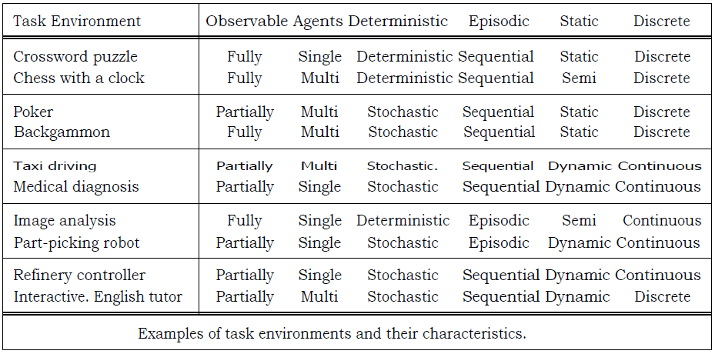
Task Environment examples
I need you to answer, why they are like these?

Slide 25
The Structure of Agents
Agent behaviors: is the action of the agent that performed after any given sequence of percepts. (Agent Function)
Agent Function: it is the process of mapping from percept to actions.
Agent program: is the inside part of the agent that implement the agent function (Do mapping process). (More related to the job of AI designer)
Agent : is covering the agent program that executed on a computing device and the physical sensors and actuators (Known as Architecture).
Agent = Program + Architecture

Slide 26
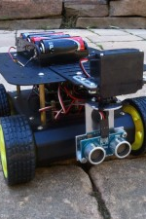
Agent Architecture (Structure)
Agent = Program + Structure

Slide 27
Architecture of Agent
The architecture makes the percepts from the sensors available to the program, runs the program, and feeds the program's action choices to the actuators as they are generated
Program must be appropriate for the architecture.
If the program recommend “Walk” action, the architecture had better have legs .
In all this story, AI designer job is to program an agent.

Slide 28
Agent’s Program
The general Structure of any agent program is like this:
Receiving precept form sensors as input, and
Return actions through actuators as output.
The basic types of Agent Program are:
Simple reflex agents;
Model-based reflex agents;
Goal-based agents; and
Utility-based agents.

Slide 29
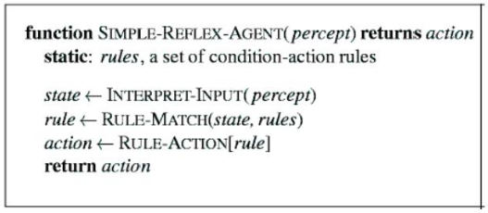
Agent Program Simple – Reflex Agent

Slide 30
Agent Program Simple – Reflex Agent
Select actions on the bases of current precept, ignoring history of precept or past precepts.
The vacuum example is simplest reflex agent.
Depends on current location whether it dirty or not.
If a car braked, I should initiate braking too.
It is a condition action rule. (Rule -1)
For some condition human can learn them. (braking car)
Another condition is innate for human. (blinking when something approaches the eyes)
It is a simplest action rule. (Rule -2)

Slide 31
Agent Program Simple – Reflex Agent
Depends on current percept, and only suitable for fully observable environments.
Doesn’t have previous history.
Small changes makes the model in trouble.
If the brake light doesn’t work.
Diversity of cars has different location for brake light.
Cannot work if part of world is observed.

Slide 32
Agent Program Model Based Reflex Agent

Slide 33
Agent Program Model Based Reflex Agent
Can observe some unseen precepts. Suitable for partially observable environments.
Assumes that the agent can possess a model for the environments.
It should have some states form the previous experience.
They should be able to maintain some internal states that depends on precept history.
They should be able to answer two questions:
How the world evolves:, The changes that made on the environment irrespective of agent actions.
What agent's action do: what changes will be made on the environment be the agent's actions?
Can be implemented as:
Simple logic circuit.
Complex theories.

Slide 34
Agent Program Goal Based Agent

Slide 35
Agent Program Goal Based Agent
Only information about the stat is not enough. Improvements are necessary on the model-based agents.
The traffic junction has left, right, and straight on, with no goal rules, models cannot help you.
Only take actions that depend on goals (goal-based actions).
Goal based agent can be
Simple→ only one agent with a precept can achieve the goal.
Complex→ in which a sequence of percept needed to achieve the goal. In this way the agent needs
Searching
Planning
Here the situation is different
What will happened if such condition available?
Do they make me happy?

Slide 36
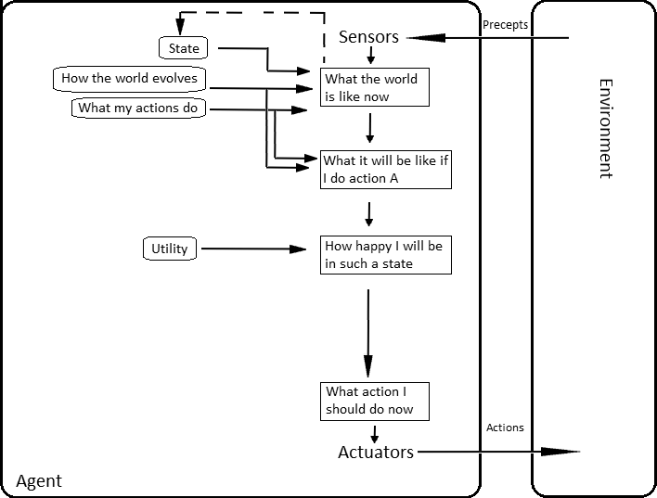
Agent Program Utility Based Agent

Slide 37
Agent Program Utility Based Agent
Goal-based model works as binary decision
Yes or No. (get or not) (happy or no)
Many ways can achieve the goal of a model.
Which one is better, quicker, safer, cheaper, or more reliable.
Which one is more useful (utility).
Utility function shows the internal utility that maximize the external performance measure.
Makes some tradeoff (speed / safe).

Slide 38
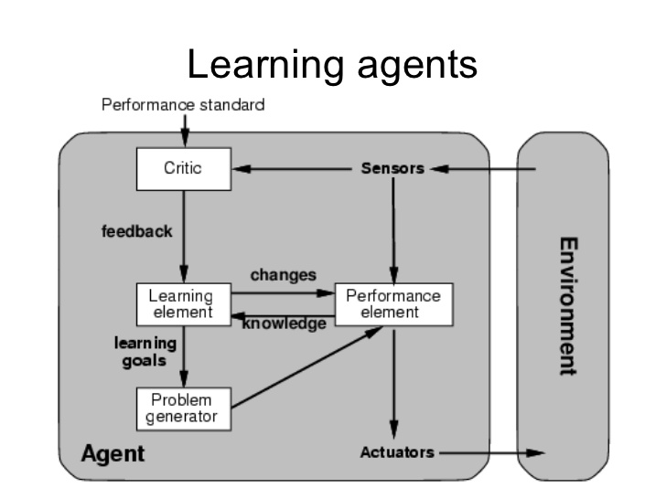
Agent Program Learning Agent

Slide 39
Agent Program Learning Agent
In such agent, learning and teaching agents are the main issues of the programming function.
The important difference between the pervious agents and this type are:
Performance element: responsible for selecting external actions.
Learning element: responsible for making improvements.
Critic: learning element uses feedback from the critic on how the agent is doing, and determines how the performance element should be modified to do better in the future.
problem generator. It is responsible for suggesting actions that will lead to new and informative experiences

Slide 40
Class Ended

