Slide 1
Fundamental to Artificial Intelligent
IT-456
Dr. Saman Mirza Abdullah
Saman.mirza@tiu.edu.iq

Slide 2
Solving Problems by Searching Uninformed Search

Slide 3
Objectives and out comings
The main objective of this class are:
To define the Problem-Solving Agent (PSA).
To Know the parts of PSA.
To learn how to formulate the parts of PSA.
To discuss the searching process and strategy in PSA
To identify Different types of search strategies.
To discuss some examples on search strategies
At the end of the class, students should be able to
Formulate problems, and
Understand different types of search strategies.

Slide 4
Reminders
Agent can do actions based on receiving percepts.
Types of agent (structure) reflexing the ability of the actions that the agent can do.
Simple – Reflex Agent
Model Reflex Agent
Goal Based Agent
All these in “ Smart Home for energy saving”

Slide 5
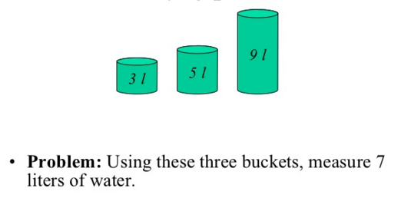
Searching Problems

Slide 6
Introduction
Problem-Solving Agent is a goal-based agent that decides what to do by finding a sequence of actions that leads to desirable states
To build PSA, we need to know
What problem we have? (We need to formulate the Problem)
What solutions we need? (We need to formulate the Goal)
What search tool / technique we should follow?

Slide 7
Pervious Video
WE discussed Problem-solving Agent (Goal base)
The following is needed to design any PSA
Formulating the problem
Defining the solution (Goal)
Searching tool / Techniques.

Slide 8
Goal Formulation
Goal based agent is better than other agents in performance, if the goal exist and well adapted.
Touring vacancy adapting.
Goal formulation, based on the current situation and the agent's performance measure, is the first step in problem solving.
The agent's task is to find out how to act, now and in the future, so that it reaches a goal state

Slide 9
Goal Formulation
Goals can
Simplify the search
Goals help to organize the behaviors by limiting objectives.
Goals should satisfy the performance measure.
Goal formulation is a process of identifying the desirable state of a problem as a solution.
Solution for the tour in a city with flight time limitation

Slide 10
Problem Formulation
Problem formulation is the process of deciding what actions and states to consider, given a goal.
A problem is defined by four components
Initial state is where an agent starts.
In(s)
Possible actions, A description of actions that available for an agent on a state s.
Action (s)
Transition model; A state that can be reachable from initial state after performing the action.
Initial state + Possible actions + Reachable states = problem space.
RESULT {Action (s)} = State (d).

Slide 11
Problem Formulation
Goal test determines if a state is a goal state. Or, if the state that found is among that defined as goal.
In some cases goal are explicit (going to a city)
Other cases, the goal is abstract property (Chess → checkmate)
Path cost function, step cost
c(s,a,d)= ?
The solution quality measured by cost, and the optimal solution has the lowest path cost among all.

Slide 12
Pervious Videos
We discussed Problem-solving Agent (Goal base)
The following is needed to design any PSA
Formulating the problem
Defining the solution (Goal)
Searching tool / Techniques.

Slide 13
Searching Process
Now, the goal and problem have been formulated.
The questions is how to search for actions that leads to goal.
Search is a process of looking for a sequence of actions that reaches the goal.
A search algorithm takes a problem as input and returns a solution in the form of an action sequence (goal).
Finally, implementing the search (or the sequence of action) that recommended or suggested is called the execution phase of an agent.
It calls the search procedure (algorithm) to find the goal or solutions.

Slide 14
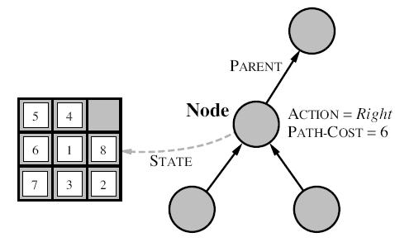
Infrastructure for search algorithms
The structure that contains four components:
n. STATE: the state in the state space to which the node corresponds;
n.PARENT: the node in the search tree that generated this node;
n.Acrion: the action that was applied to the parent to generate the node;
n.PATH-COST: the cost.

Slide 15
Searching for Solutions
Starts with initial state
Check whether it is goal.
Check the expansion.
Based on a strategy, the search do expansion.
Read all frontiers.
Check for the goal.
Stop when reaches the leaf.
Repeated state VS Redundant path
Explored set = Closed set
Graph VS Tree search
A
B
C
D
G

Slide 16
Searching Strategy
Searching strategies are the kind of rules that accordingly a state (or a node in a tree graph) will be identified for exploring.
Repeated state, is a state (or node) that comes on the searching process (path) for more than one time.
Redundant path, is the path which comes in the solution stack for more than one time. It occurs when there are more than one path between states

Slide 17
Evaluation of Search Strategies
Completeness: Is the algorithm guaranteed to find a solution when there is one?
Optimality: Does the strategy find the optimal solution?
Time complexity: How long does it take to find a solution?
Space complexity: How much memory is needed to perform the search?

Slide 18
Type of search strategy
Searches
Uninformed
Informed
Breadth First search
Depth First Search
Depth limited
Iterative Deepening
Uniform Cost
Bi-Directional search

Slide 19
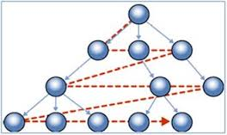
BFS
It is very simple strategy.
Root node is expanded first; then its successors, then their successors.
Nodes at the same level are expanded, then nodes in the next level will start expanding.
The expansion starts at the shallowest node.
The process of expansion achieves through FIFO queue.
New node will go to the back of FIFO, older nodes are shallower than new

Slide 20
BFS – Properties
Completeness: Yes, if b is not infinite.
Time complexity: O(b ^{d}), i.e., exponential in d (Rem: b is no. of branches)
Space complexity : O(b ^{d}), keeps every node in memory
Optimality: Yes, if cost = 1 per step; not optimal in general

Slide 21
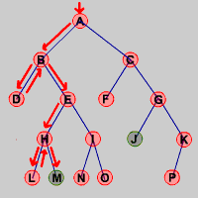
DFS
Completeness: No, fails in infinite state-space
Time complexity: O(b ^{m})
Space complexity: O(bm)
Optimality: No – it may never find the path to the goal!

Slide 22
Iterative deepening search
To avoid the infinite depth problem of DFS, we can
decide to only search until depth L, i.e. we don’t expand beyond depth L.
→ Depth-Limited Search
What of solution is deeper than L? → Increase L iteratively.
→ Iterative Deepening Search
As we shall see: this inherits the memory advantage of Depth-First
search.

Slide 23
Iterative deepening search L=0

Slide 24
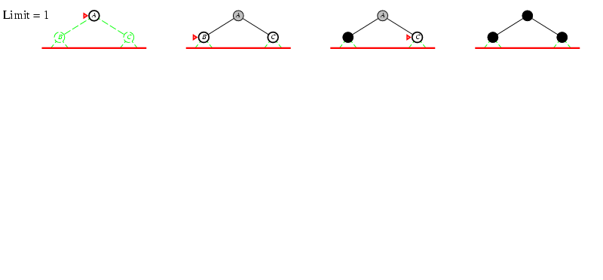
Iterative deepening search L=1

Slide 25
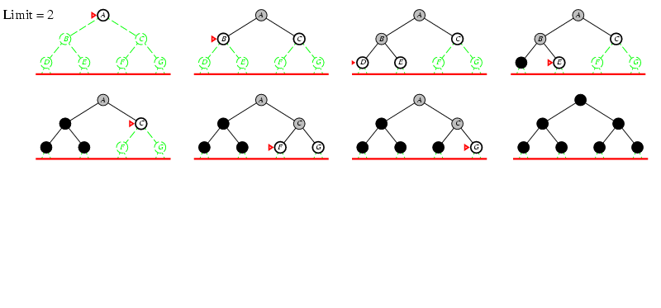
Iterative deepening search lL=2

Slide 26
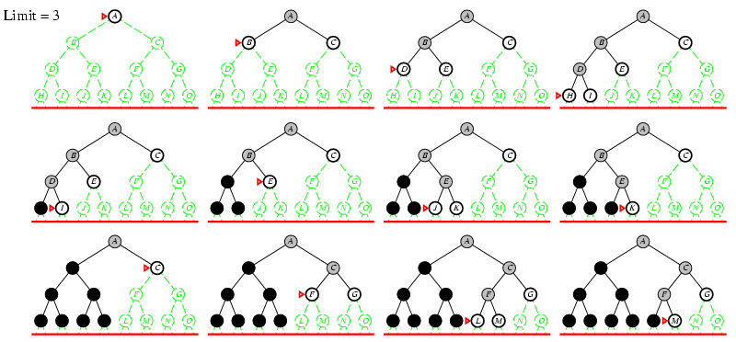
Iterative deepening search lL=3

Slide 27
Class Ended

