Slide 1


Fundamental to Artificial Intelligent
IT-456
Dr. Saman Mirza Abdullah
Saman.mirza@tiu.edu.iq

Slide 2
Solving Problems by Searching
Uninformed Search

Slide 3
Searching Strategy
Searching strategies are the kind of rules that accordingly a state (or a node in a tree graph) will be identified for exploring.
Repeated state, is a state (or node) that comes on the searching process (path) for more than one time.
Redundant path, is the path which comes in the solution stack for more than one time. It occurs when there are more than one path between states

Slide 4
Type of search strategy
Searches
Uninformed
Informed
Breadth First search
Depth First Search
Depth limited
Iterative Deepening
Uniform Cost
Bi-Directional search

Slide 5
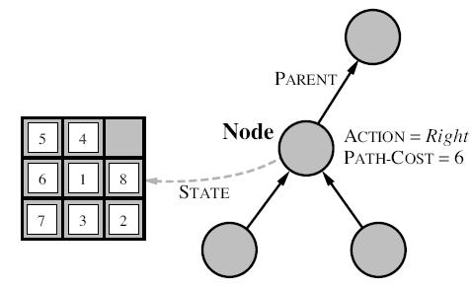
Infrastructure for search algorithms
The structure that contains four components:
  n. STATE: the state in the state space to which the node corresponds;
  n.PARENT: the node in the search tree that generated this node;
  n.Acrion: the action that was applied to the parent to generate the node;
  n.PATH-COST: the cost.

Slide 6
Searching for Solutions
Starts with initial state
  Check whether it is goal.
  Check the expansion.
Based on a strategy, the search do expansion.
  Read all frontiers.
  Check for the goal.
Stop when reaches the leaf.
Repeated state VS Redundant path
Explored set = Closed set
Graph VS Tree search
A
B
C
D
G

Slide 7
Evaluation of Search Strategies
Completeness: Is the algorithm guaranteed to find a solution when there is one?
Optimality: Does the strategy find the optimal solution?
Time complexity: How long does it take to find a solution?
Space complexity: How much memory is needed to perform the search?

Slide 8
BFS
It is very simple strategy.
Root node is expanded first; then its successors, then their successors.
Nodes at the same level are expanded, then nodes in the next level will start expanding.
The expansion starts at the shallowest node.
The process of expansion achieves through FIFO queue.
New node will go to the back of FIFO, older nodes are shallower than new

Slide 9

Class Ended

