Slide 1
Fundamental to Artificial Intelligent
IT-456
Dr. Saman Mirza Abdullah
Saman.mirza@tiu.edu.iq

Slide 2
Objectives
The main of objectives for this class are
Reviewing the purpose of searching algorithms.
Explaining the decision-based searching, and
Solving and coding an example.

Slide 3
Purpose of searching
Artificial agents were built for different purposes based on the complexity of the problems.
They do searches based strategies and information that available.
However, the question is how they can do decision?
For seen percepts and unseen percept.

Slide 4
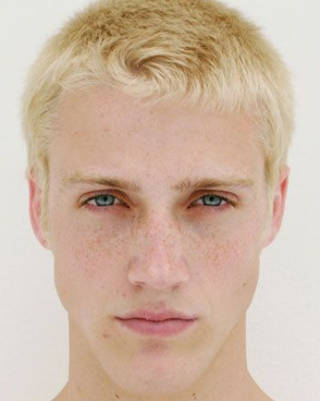
Seen and unseen percepts

Slide 5
What needed for building such graph?
(1) Which to start? (root)
(2) Which node to proceed?
(3) When to stop/ come to conclusion?

Slide 6
Scenario to table
Age | Income | Job | Credit | Class (yes / no)
Young | High | Bad | Bad | No
Young | High | Bad | Good | No
Middle | High | Bad | Bad | Yes
Old | Medium | Bad | Bad | Yes
Old | Low | Good | Bad | Yes
Old | Low | Good | Good | No
Middle | Low | Good | Good | Yes
Young | Medium | Bad | Bad | No
Young | Low | Good | Bad | Yes
Old | Medium | Good | Bad | Yes
Young | Medium | Good | Good | Yes
Middle | Medium | Bad | Good | Yes
Middle | High | Good | Bad | Yes
Old | Medium | Bad | Good | No
A broker in a bank wants to decide on customer for giving him a loan or not.
Available knowledge / Attribute
The age of the customer. (Young, Middle, and Old)
The income of the customer. (High, Low, and Medium)
The job of the customer. (has good or has bad)
The usage of the credit. (Good usage or bad usage)
The decision is (Yes → give loan
No → don’t give loan

Slide 7
Entropy
A measure of homogeneity of the set of examples.
Given a set S of positive and negative examples of some target concept (a 2-class problem), the entropy of set S relative to this binary classification is
$$E\left(S\right)=−p\left(P\right)\log_{2}p\left(P\right)−p\left(N\right)\log_{2}p\left(N\right)$$

Slide 8
Step-1 : Computing Entropy
Class (yes / no)
No
No
Yes
Yes
Yes
No
Yes
No
Yes
Yes
Yes
Yes
Yes
No
We have (9) yes and (5) No
$$E\left(S\right)=−p\left(p\right)\log_{2}p\left(p\right)−p\left(N\right) \log_{2}p\left(N\right)$$
$$E\left(S\right)=−\left(\frac{9}{14}\right)× \log_{2}\left(\frac{9}{14}\right)−\left(\frac{5}{14}\right)× \log_{2}\left(\frac{5}{14}\right)$$
$$E\left(S\right)=−\left(0.6428\right)×\frac{\log\left(0.6428\right)}{0.3}−\left(0.357\right)×\frac{\log\left(0.357\right)}{0.3}$$
$$E\left(S\right)=0.943$$
What if we have three possibilities?

Slide 9
Step-2 : Info for each Column
Age | Class
Young | No
Young | No
Middle | Yes
Old | Yes
Old | Yes
Old | No
Middle | Yes
Young | No
Young | Yes
Old | Yes
Young | Yes
Middle | Yes
Middle | Yes
Old | No
We will find info for (Young) in the column (Age) using
We have (5) young cases, Three of them are (No) and two of them are (Yes).
Info (Age/Young) is :

Slide 10
Step-2 : Info for each Column
Age | Class
Young | No
Young | No
Middle | Yes
Old | Yes
Old | Yes
Old | No
Middle | Yes
Young | No
Young | Yes
Old | Yes
Young | Yes
Middle | Yes
Middle | Yes
Old | No
We have (4) Middle cases, all of them are (Yes).
Info (Age/Young) is :

Slide 11
Step-2 : Gain for each Column
Age | Class
Young | No
Young | No
Middle | Yes
Old | Yes
Old | Yes
Old | No
Middle | Yes
Young | No
Young | Yes
Old | Yes
Young | Yes
Middle | Yes
Middle | Yes
Old | No
The total Info for the column (Age) is:
= 0.347 + 0 + 0.347 = 0.694
Gain is obtained by
Gain (p) = F (Info (T) - Info (p, T))
Gain (Age) = 0.943 – 0.694
Gain (Age) = 0.249

Slide 12
Step-2 : Gain for each Column
Use same process to find out the gain for each column.
Gain (Age) = 0.249
Gain (Income) = 0.0259
Gain (Job) = 0.151
Gain (Credit) = 0.048
Chose the biggest to make it the root node. (Node Age)

Slide 13
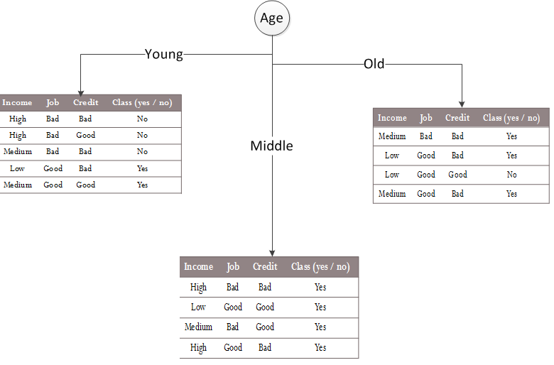
Draw the Tree

Slide 14
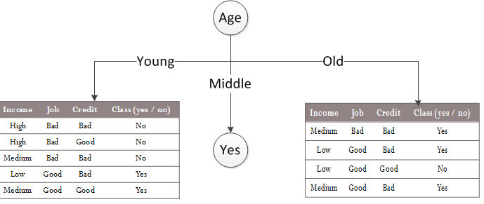
Draw the Tree
We stop for the leave (Middle), however, we will continue the previous process for Young and Old sub table.

Slide 15
Gains for Sub-Tables
Gain (young, Income) = 0.5728
Gain (young, Job) = 0.9741
Gain (young, Credit) = 0.02
Gain (Old, Income) = 0.0199
Gain (Old, Job) = 0.0199
Gain (Old, Credit) = 0.9741

Slide 16
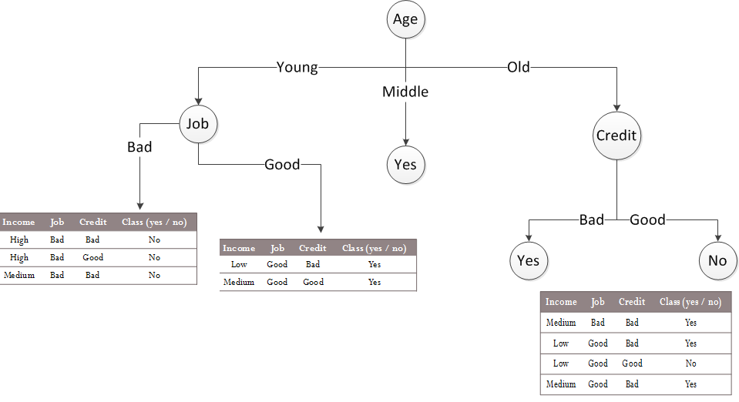

Slide 17
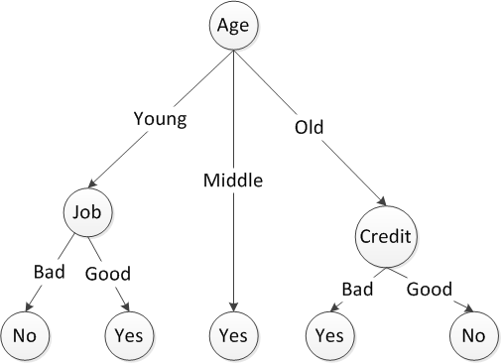
Structure to Code
If Age = Middle Then Yes, else
If Age = Young && Job=Bad Then No, else
If Age=Young && Job=Good Then Yes, else
If Age=Old && Credit=Good Then No, else
If Age=Old && Credit = Bad Then Yes.

Slide 18
Test
Age = Young
Income = high
Job = Good
Credit = Good
If Age = Middle Then Yes, else
If Age = Young && Job=Bad Then No, else
If Age=Young && Job=Good Then Yes, else
If Age=Old && Credit=Good Then No, else
If Age=Old && Credit = Bad Then Yes.

Slide 19
Class Ended

