Slide 1


Fundamental to Artificial Intelligent
IT-456
Dr. Saman Mirza Abdullah
Saman.mirza@tiu.edu.iq

Slide 2

Objectives
The main of objectives for this class of this week are
  Introducing Backpropagation(BP)- ANN
  An example of BP-ANN

Slide 3
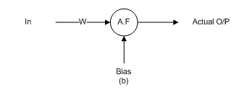

Review Single node iteration
Use the following graph of an artificial neuron to calculate the errors and draw the error-iteration graph.
Given:
In = 2
Weight for first loop=0.1, for the second loop=0.5
Bias (b) = -0.2
Activate Function $=\frac{1}{1+e^{−x}}$
Goal = 0.01.
Desired output = 0.7

Slide 4
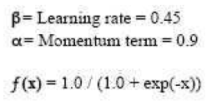
Back Propagation Algorithm
Example
Input 1 | Input 2 | Output
1 | 1 | 1
Initial Weights
W₁₁ | W₁₂
0.4 | -0.1
Stop if error <0.001

Slide 5
Back Propagation Algorithm
Example
Iteration 1:
1st Step: Forward Computation:
in₁=1 and in₂ = 1
P = in₁*w₁ + in₂*W₂
P=1*0.4 + 1*(-0.1)
P = 0.4 – 0.1 = 0.3
Out = 1 / (1+ e^{-0.3})
Out = 0.572
Input 1 | Input 2 | Output
1 | 1 | 1
Initial Weights
W₁₁ | W₁₂
0.4 | -0.1

Slide 6
Back Propagation Algorithm
Example
1st Step: Forward Computation:
2- Computing Errors
Error O/P = O/P *(1- O/P)*( Desired O/P – O/P)
Error O/P = 0.572 *(1- 0.572)*( 1- 0.572) =0.105
Because error is greater than 0.001, we need to
update the weights.
Input 1 | Input 2 | Output
1 | 1 | 1
Initial Weights
W₁₁ | W₁₂
0.4 | -0.1

Slide 7
Back Propagation Algorithm
Example
2nd Step: Back Propagation at output layer:
1- Finding ∆W₁ with ∆W₂ and updating W₁ and W₂
∆W₁=β * Error O/P * Desired O/P
∆W₁=0.45 * 0.105* 1
∆W₁=0.047
NewW₁ = old W₁ +∆W₁+(α* ∆ (t-1))
NewW₁ = 0.4+0.047+(0.9* 0)
NewW₁ =0.447
Input 1 | Input 2 | Output
1 | 1 | 1
Initial Weights
W₁₁ | W₁₂
0.4 | -0.1

Slide 8
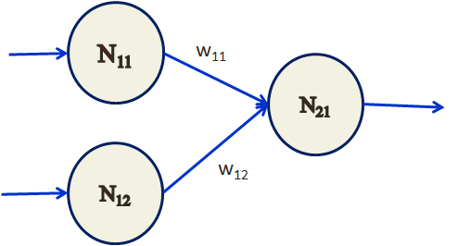
Back Propagation Algorithm
Example
2nd Step: Back Propagation at output layer:
2- Finding ∆W₁₁ with ∆W₁₂ and updating W₁₁ and W₁₂
∆W₁₂=β * ErrorN₂₁ * N₁₂
∆W₁₂=0.45 * 0.105* 1
∆W₁₂=0.047
NewW₁₂ = old W₁₂ +∆W₁₂+(α* ∆ (t-1))
NewW₁₂ = -0.1+0.047+(0.9* 0)
NewW₁₂ =-0.053
Input 1 | Input 2 | Output
1 | 1 | 1
Initial Weights
W₁₁ | W₁₂
0.4 | -0.1

Slide 9
Back Propagation Algorithm
Example
Iteration 2:
1st Step: Forward Computation:
N₁₁=1 and N₁₂ = 1
N₂₁ = N₁₁*w₁₁ + N₁₂*W₁₂
N₂₁=1*0.447 + 1*(-0.053)
N₂₁ = 0.447 – 0.053 = 0.394
Out = 1 / (1+ e^{-0.394})
Out = 0.597
Input 1 | Input 2 | Output
1 | 1 | 1
Updated Weights
W₁₁ | W₁₂
0.447 | -0.053

Slide 10
Back Propagation Algorithm
Example
2nd Step: Back Propagation at output layer:
1- Computing Errors
Error N₂₁ = N₂₁ *(1- N₂₁)*( Desired N₂₁ - N₂₁)
Error N₂₁ = 0.597*(1- 0.597)*( 1- 0.597) =0.0969
Because error is greater than 0.001, we need to
update the weights.
Input 1 | Input 2 | Output
1 | 1 | 1
Updated Weights
W₁₁ | W₁₂
0.447 | -0.053

Slide 11
Back Propagation Algorithm
Example
2nd Step: Back Propagation at output layer:
2- Finding ∆W₁₁ with ∆W₁₂ and updating W₁₁ and W₁₂
∆W₁₁=β * ErrorN₂₁ * N₁₁
∆W₁₁=0.45 * 0.0969* 1
∆W₁₁=0.0426
NewW₁₁ = old W₁₁ +∆W₁₁+(α* ∆ (t-1))
NewW₁₁ = 0.4+0.0426+(0.9* 0.047)
NewW₁₁ =0.4894
Input 1 | Input 2 | Output
1 | 1 | 1
Updated Weights
W₁₁ | W₁₂
0.447 | -0.053

Slide 12
Back Propagation Algorithm
Example
2nd Step: Back Propagation at output layer:
2- Finding ∆W₁₁ with ∆W₁₂ and updating W₁₁ and W₁₂
∆W₁₂=β * ErrorN₂₁ * N₁₂
∆W₁₂=0.45 * 0.0969 * 1
∆W₁₂=0.0426
NewW₁₂ = old W₁₂ +∆W₁₂+(α* ∆ (t-1))
NewW₁₂ = -0.1+0.0426+(0.9* 0.047)
NewW₁₂ =-0.0151
Input 1 | Input 2 | Output
1 | 1 | 1
Updated Weights
W₁₁ | W₁₂
0.447 | -0.053

Slide 13
Back Propagation Algorithm
Example
Iteration 3:
1st Step: Forward Computation:
N₁₁=1 and N₁₂ = 1
N₂₁ = N₁₁*w₁₁ + N₁₂*W₁₂
N₂₁=1*0.4894 + 1*(-0.0151)
N₂₁ = 0.4894 – 0.0151 = 0.4743
Out = 1 / (1+ e^{-0.394})
Out = 0.6164
Input 1 | Input 2 | Output
1 | 1 | 1
Updated Weights
W₁₁ | W₁₂
0.4894 | -0.0151

Slide 14
Back Propagation Algorithm
Example
2nd Step: Back Propagation at output layer:
1- Computing Errors
Error N₂₁ = N₂₁ *(1- N₂₁)*( Desired N₂₁ - N₂₁)
Error N₂₁ = 0.6164*(1- 0.6164)*( 1- 0.6164) =0.0907
Because error is greater than 0.001, we need to
update the weights.
Input 1 | Input 2 | Output
1 | 1 | 1
Updated Weights
W₁₁ | W₁₂
0.4894 | -0.0151

Slide 15
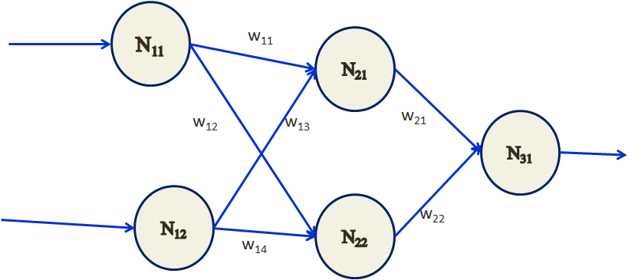
Assignment
Input and output
Input 1 | Input 2 | Output
1 | 1 | 1
Goal < 0.01 OR 4 Iterations
Initial Weights
W₁₁ | W₁₂ | W₁₃ | W₁₄ | W₂₁ | W₂₂
0.4 | 0.1 | -0.1 | -0.1 | 0.06 | -0.4

Slide 16
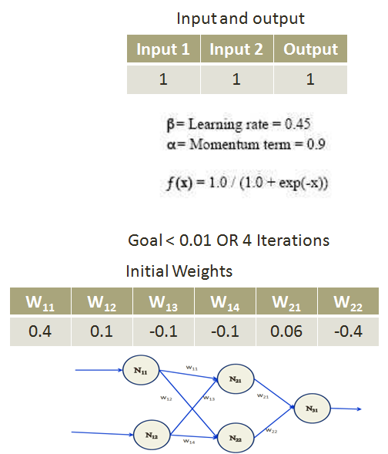
Back Propagation Algorithm
Example
Iteration 1:
1st Step: Forward Computation:
N₁₁=1 and N₁₂ = 1
N₂₁ = N₁₁*w₁₁ + N₁₂*w₁₃
N₂₁=1*0.4 + 1*(- 0.1)
N₂₁ = 0.4 - 0.1 = 0.3
Out = 1 / (1+ e^{-0.3})
Out = 0.5615
N₁₁=1 and N₁₂ = 1
N₂₂ = N₁₁*W₁₂ +N₁₂*W₁₄
N₂₁=1*(0.1) + 1 * (-0.1)
N₂₂ = (0.1)+(-0.1) = 0
Out = 1 / (1+ e⁰)
Out = 0.5

Slide 17
Back Propagation Algorithm
Example
Iteration 1:
1st Step: Forward Computation:
N₂₁=0.5615 and N₂₂ = 0.5
N₃₁ = N₂₁*w₂₁ + N₂₂*w₂₂
N₃₁=0.5615*0.06 + 0.5*(-0.4)
N₃₁ = 0.03369 + (-0.2) = -0.16631
Out = 1 / (1+ e^{0.16631})
Out = 0.5415

Slide 18
Back Propagation Algorithm
Example
2nd Step: Back Propagation at output layer:
1- Computing Errors
Error N₃₁ = N₃₁ *(1- N₃₁)*( Desired N₃₁ - N₃₁)
Error N₃₁ = 0.5415 *(1- 0.5415)*( 1- 0.5415) =0.1344
Because error is greater than 0.001, we need to
update the weights.

Slide 19
Back Propagation Algorithm
Example
2nd Step: Back Propagation at output layer:
2- Finding ∆W₂₁ with ∆W₂₂ and updating W₂₁ and W₂₂
∆W=β * ErrorN₃₁ * N₃₁
∆W=0.45 * 0.1344* 1
∆W=0.0605
NewW₂₁ = old W₁₁ +∆W+(α* ∆ (t-1))
NewW₂₁ = -0.4+0.0605+(0.9* 0) = -0.3395
NewW₂₂ = 0.06 + 0.0605 + (0.9 *0) = 0.1205
NewW₁₁ = 0.4 + 0.0605 + (0.9 *0) = 0.4605
NewW₁₂ = 0.1 + 0.0605 + (0.9 *0) = 0.1605
NewW₁₃ = -0.1 + 0.0605 + (0.9 *0) = -0.0395
NewW₁₄ = -0.1 + 0.0605 + (0.9 *0) = -0.0395

Slide 20

Class Ended

