Slide 1


Fundamental to Artificial Intelligent
IT-456
Dr. Saman Mirza Abdullah
Saman.mirza@tiu.edu.iq

Slide 2

Objectives
The main of objectives for this class of this week are
  More inputs and hidden layer

Slide 3
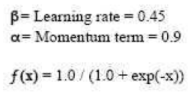
Example
Initial Weights
W₁₁ | W₁₂ | W₂₁ | W₂₂ | W₁₃ | W₂₃
0.4 | 0.1 | -0.1 | -0.1 | 0.06 | -0.4
Input and output
Input 1 | Input 2 | Desired OP
1 | 1 | 1
Goal < 0.01 OR 4 Iterations

Slide 4

Class Ended

