Slide 1

TISHK INTERNATIONAL UNIVERSITY (TIU)
FACULTY OF EDUCATION DEPARTMENT OF COMPUTER EDUCATION FALL, 2021-2022
ICT IN EDUCATION
INTRODUCTION TO ICT
LECTURE - 1
Teacher: Mohammed Abubakr Ahmed
Email: mohammed.bakir@tiu.edu.iq
October 2021

Slide 2

Outline
ICT in Education
What is ICT?
Data vs Information
ICT Procedure
Advantages and Disadvantages of ICT in Education
Classification of ICT Tools in Education
References
2

Slide 3

Objectives
What is ICT?
What is Data and Information?
Advantages and Disadvantages of ICT in Education
3

Slide 4
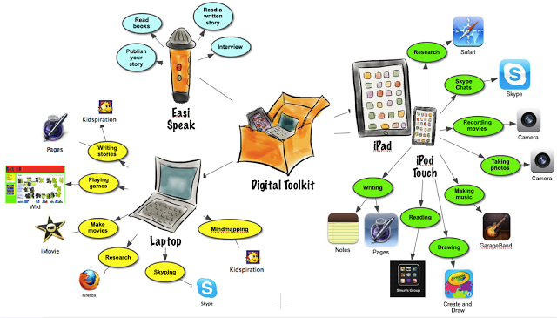
ICT in Education
It means teaching and learning through ICT, that is support and enhance the delivery of information. As well as It can be used as communication tool to improve student learning and better teaching techniques.
4

Slide 5
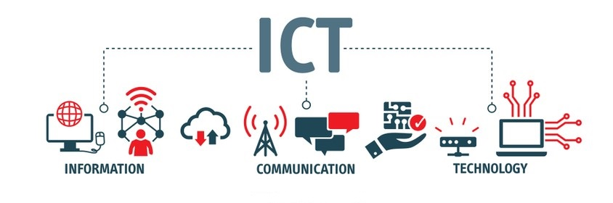
What is ICT?
Information and Communication Technology(ICT) is defined as a diverse set of technological tools and resources used to communicate, and to create, disseminate, store, and manage information.
They include the “old” ICTs of radio, television and telephone, and the “new” ICTs of computers, satellites and wireless technology and the Internet.
5

Slide 6
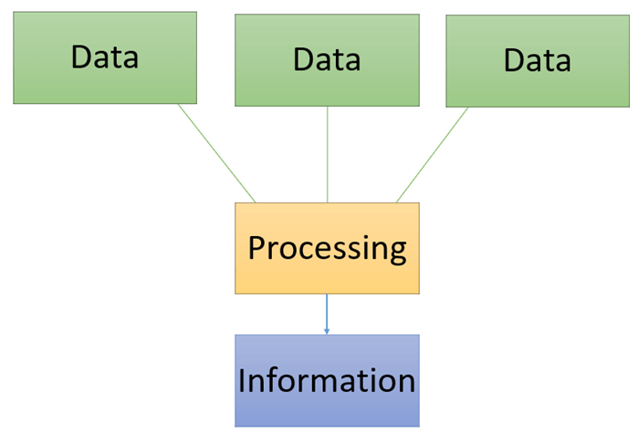
Information
Meaningful data which is obtained after processing, organizing and structuring data, which has some meaningful values for the receiver, and it is used for decision making.
We can get information by so many mediums such as TV, Radio, internet, Newspaper, book, etc.…
Data is a collection of facts, such as numbers, words, measurements, observations or just descriptions of things.
6

Slide 7

Communication
Communication can be defined as the two-way meaningful exchange of ideas, emotions, information, attitudes and experiences.
The exchange carried out by expression signs, pictures, diagrams facial expression, verbal, written, visual etc. There are devices or media such as computer, internet, cell phone, telephone, TV and radio for communication.
7

Slide 8

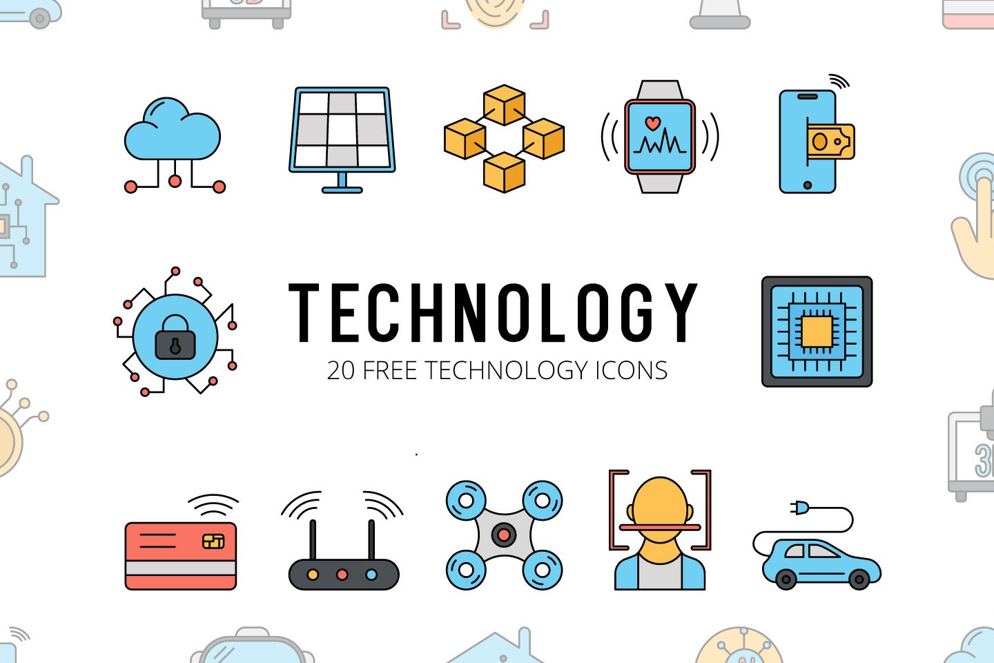
Technologies
Technology is generally defined as making, modifying, adapting, and using tools, techniques, systems, or machines to solve problems or achieve goals in less time, less effort, and less cost.
8

Slide 9
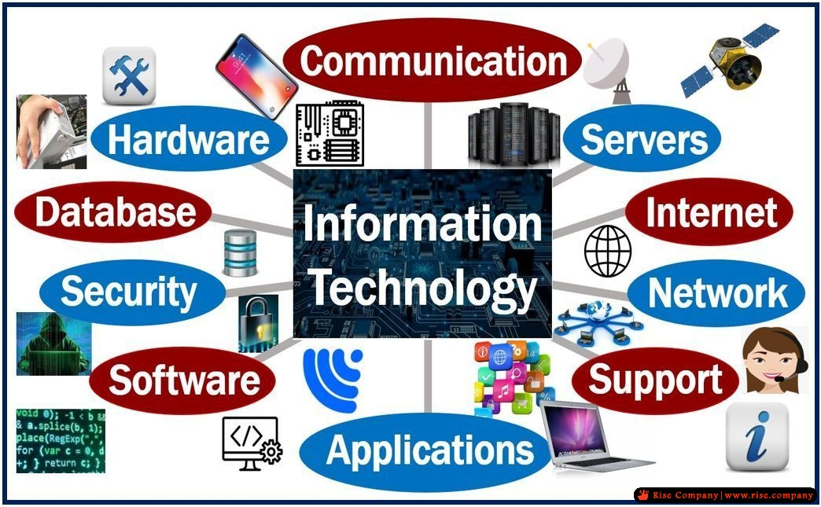
Information Technology (IT)
Information Technology refers to use computers, networking, software, and other equipment to manage information electronically in a digital form. Consider an IT department in an organization. They are equipped with computers, database management Systems, servers, and security mechanisms for storing, processing, retrieving, and protecting information available with the organization.
9

Slide 10
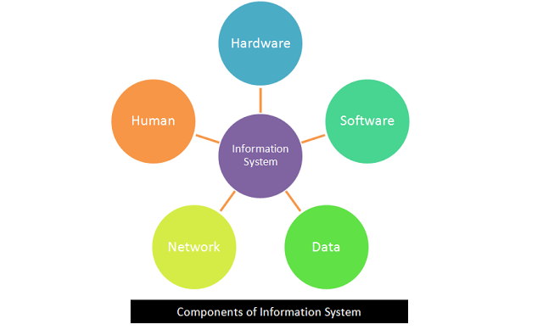
Information System (IS)
Information systems are combinations of hardware, software, database, and networks that people build and use to collect, store, create, process data for providing information, knowledge, and digital products.
10

Slide 11
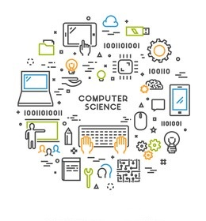
Computer Science
Computer Science is the mother of all computational disciplines (Computer Engineering, Information Technology/Information Science, Software Engineering, ICT etc.). The study of computer and computing, including their theoretical and algorithmic foundations, hardware and software, and their uses for processing information.
11

Slide 12
Data vs Information
The data processing activities can be grouped in four functional activities:
Data input
Data Processing
Information Output
Storage
Data: Johnson, 55, Salome, Mary, 34, Sabrina, 5, 20, 178, 100, 189, 151.
Information:
Name | Age | HEIGHT
Johnson | 4 | 88
Salome | 34 | 180
Mary | 25 | 165
Sabrina | 5 | 100
12

Slide 13
Data vs Information
This table below includes differences between data and information
Data | Information
Is the collection of facts, figures and statistics related to an object | Is a processed data
Is not used in decision making | Used in Decision Making
Data has no meaning | Information has meaning
Data doesn’t rely on the information. | Information rely on the information.
Data is unorganized | information is structured or organized.
May or may not be meaningful | Always meaningful
Data may not be in order. | Always in order
13

Slide 14
ICT Procedure
ICT includes:
Capturing technologies (Microphone, camera).
Storage technologies (Hard drive, CD-Rom, DVDs, Pen drives, etc.)
Processing technologies (application software)
Communication technologies (local area networks)
Dissemination technologies (computer monitors, speaker)
14

Slide 15
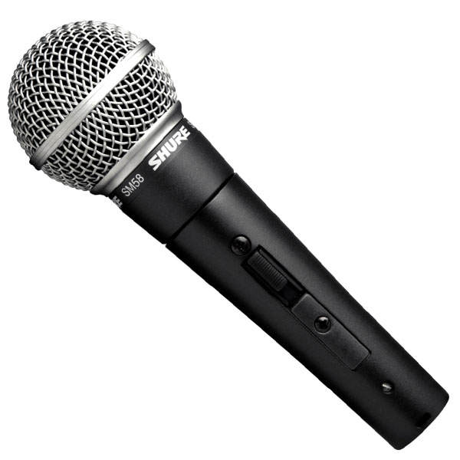
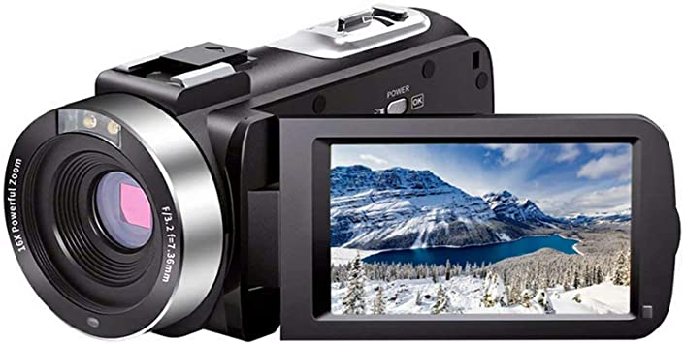
Capturing Technologies
Capturing technologies are those technologies that are used to collect data then those data will be processes for certain purposes.
Example: Microphone, Cam recorders
15

Slide 16
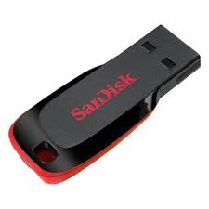
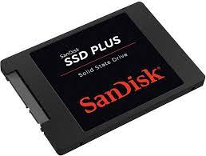
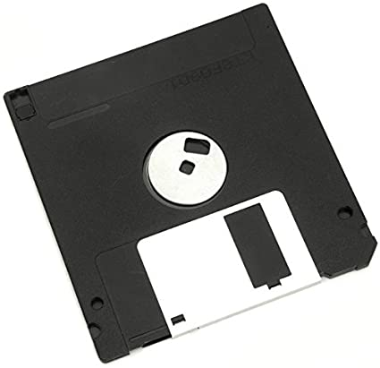
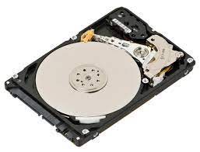
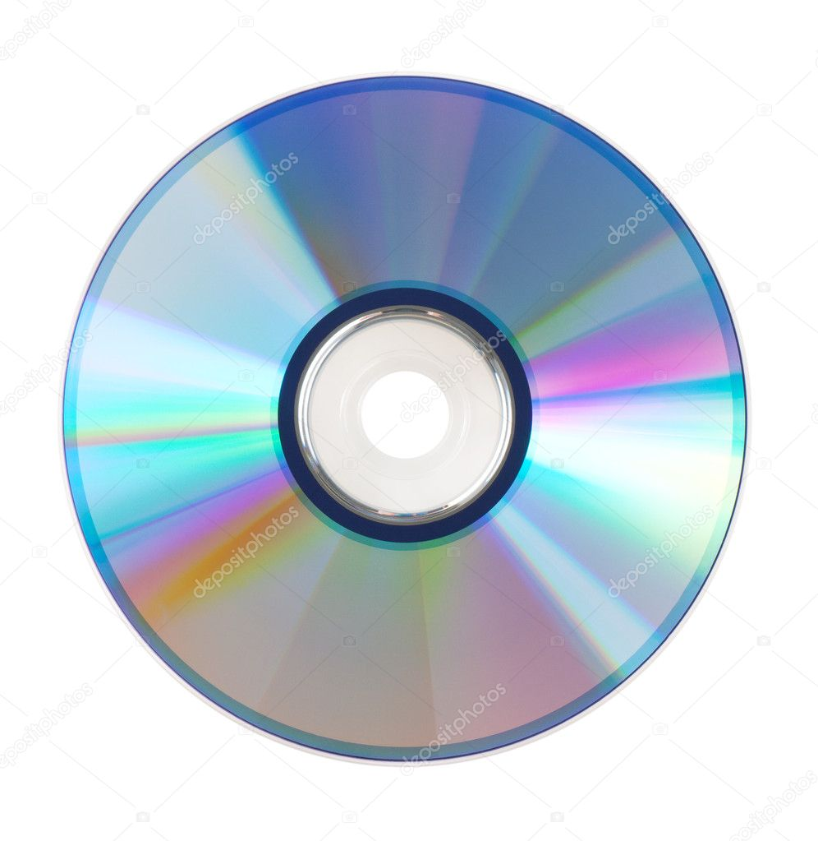
Storage Technologies
Storage technologies are those technologies that are used to store or keep data in specific place. There are three types:
Solid state devices: SSD hard, pen drives.
Magnetic devices: floppy disks, hard-disk drives
Optical devices: CD-ROMs, DVDs
16

Slide 17
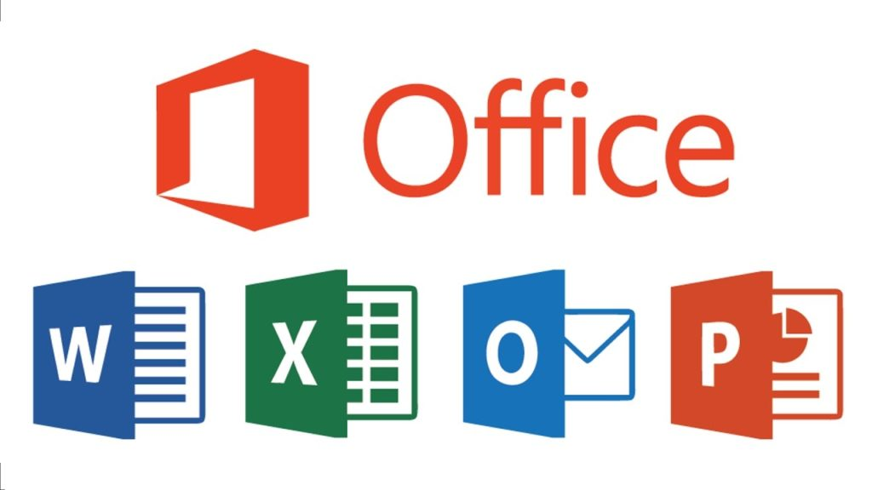

Processing Technologies
Processing technologies are those technologies and software that are used to process data and information in computer.
Examples: Microsoft office, Photoshop
17

Slide 18

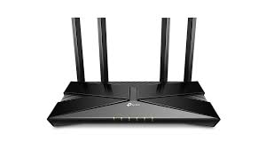
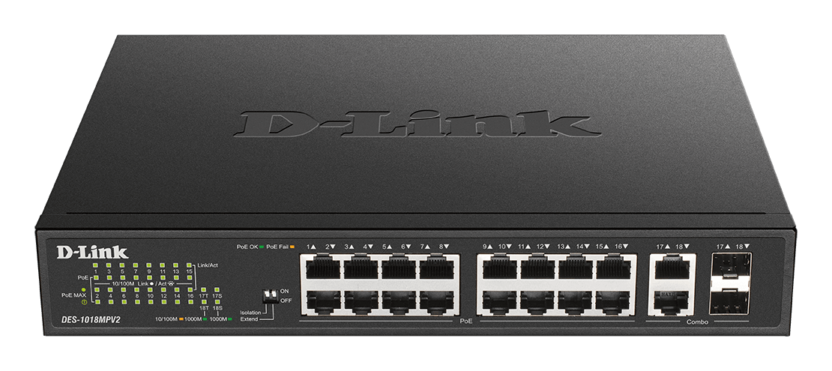
Communication Technologies
Communication technologies are those technologies that are used to make communication and connection in computer.
Examples: Router, Repeater, Switches
18

Slide 19
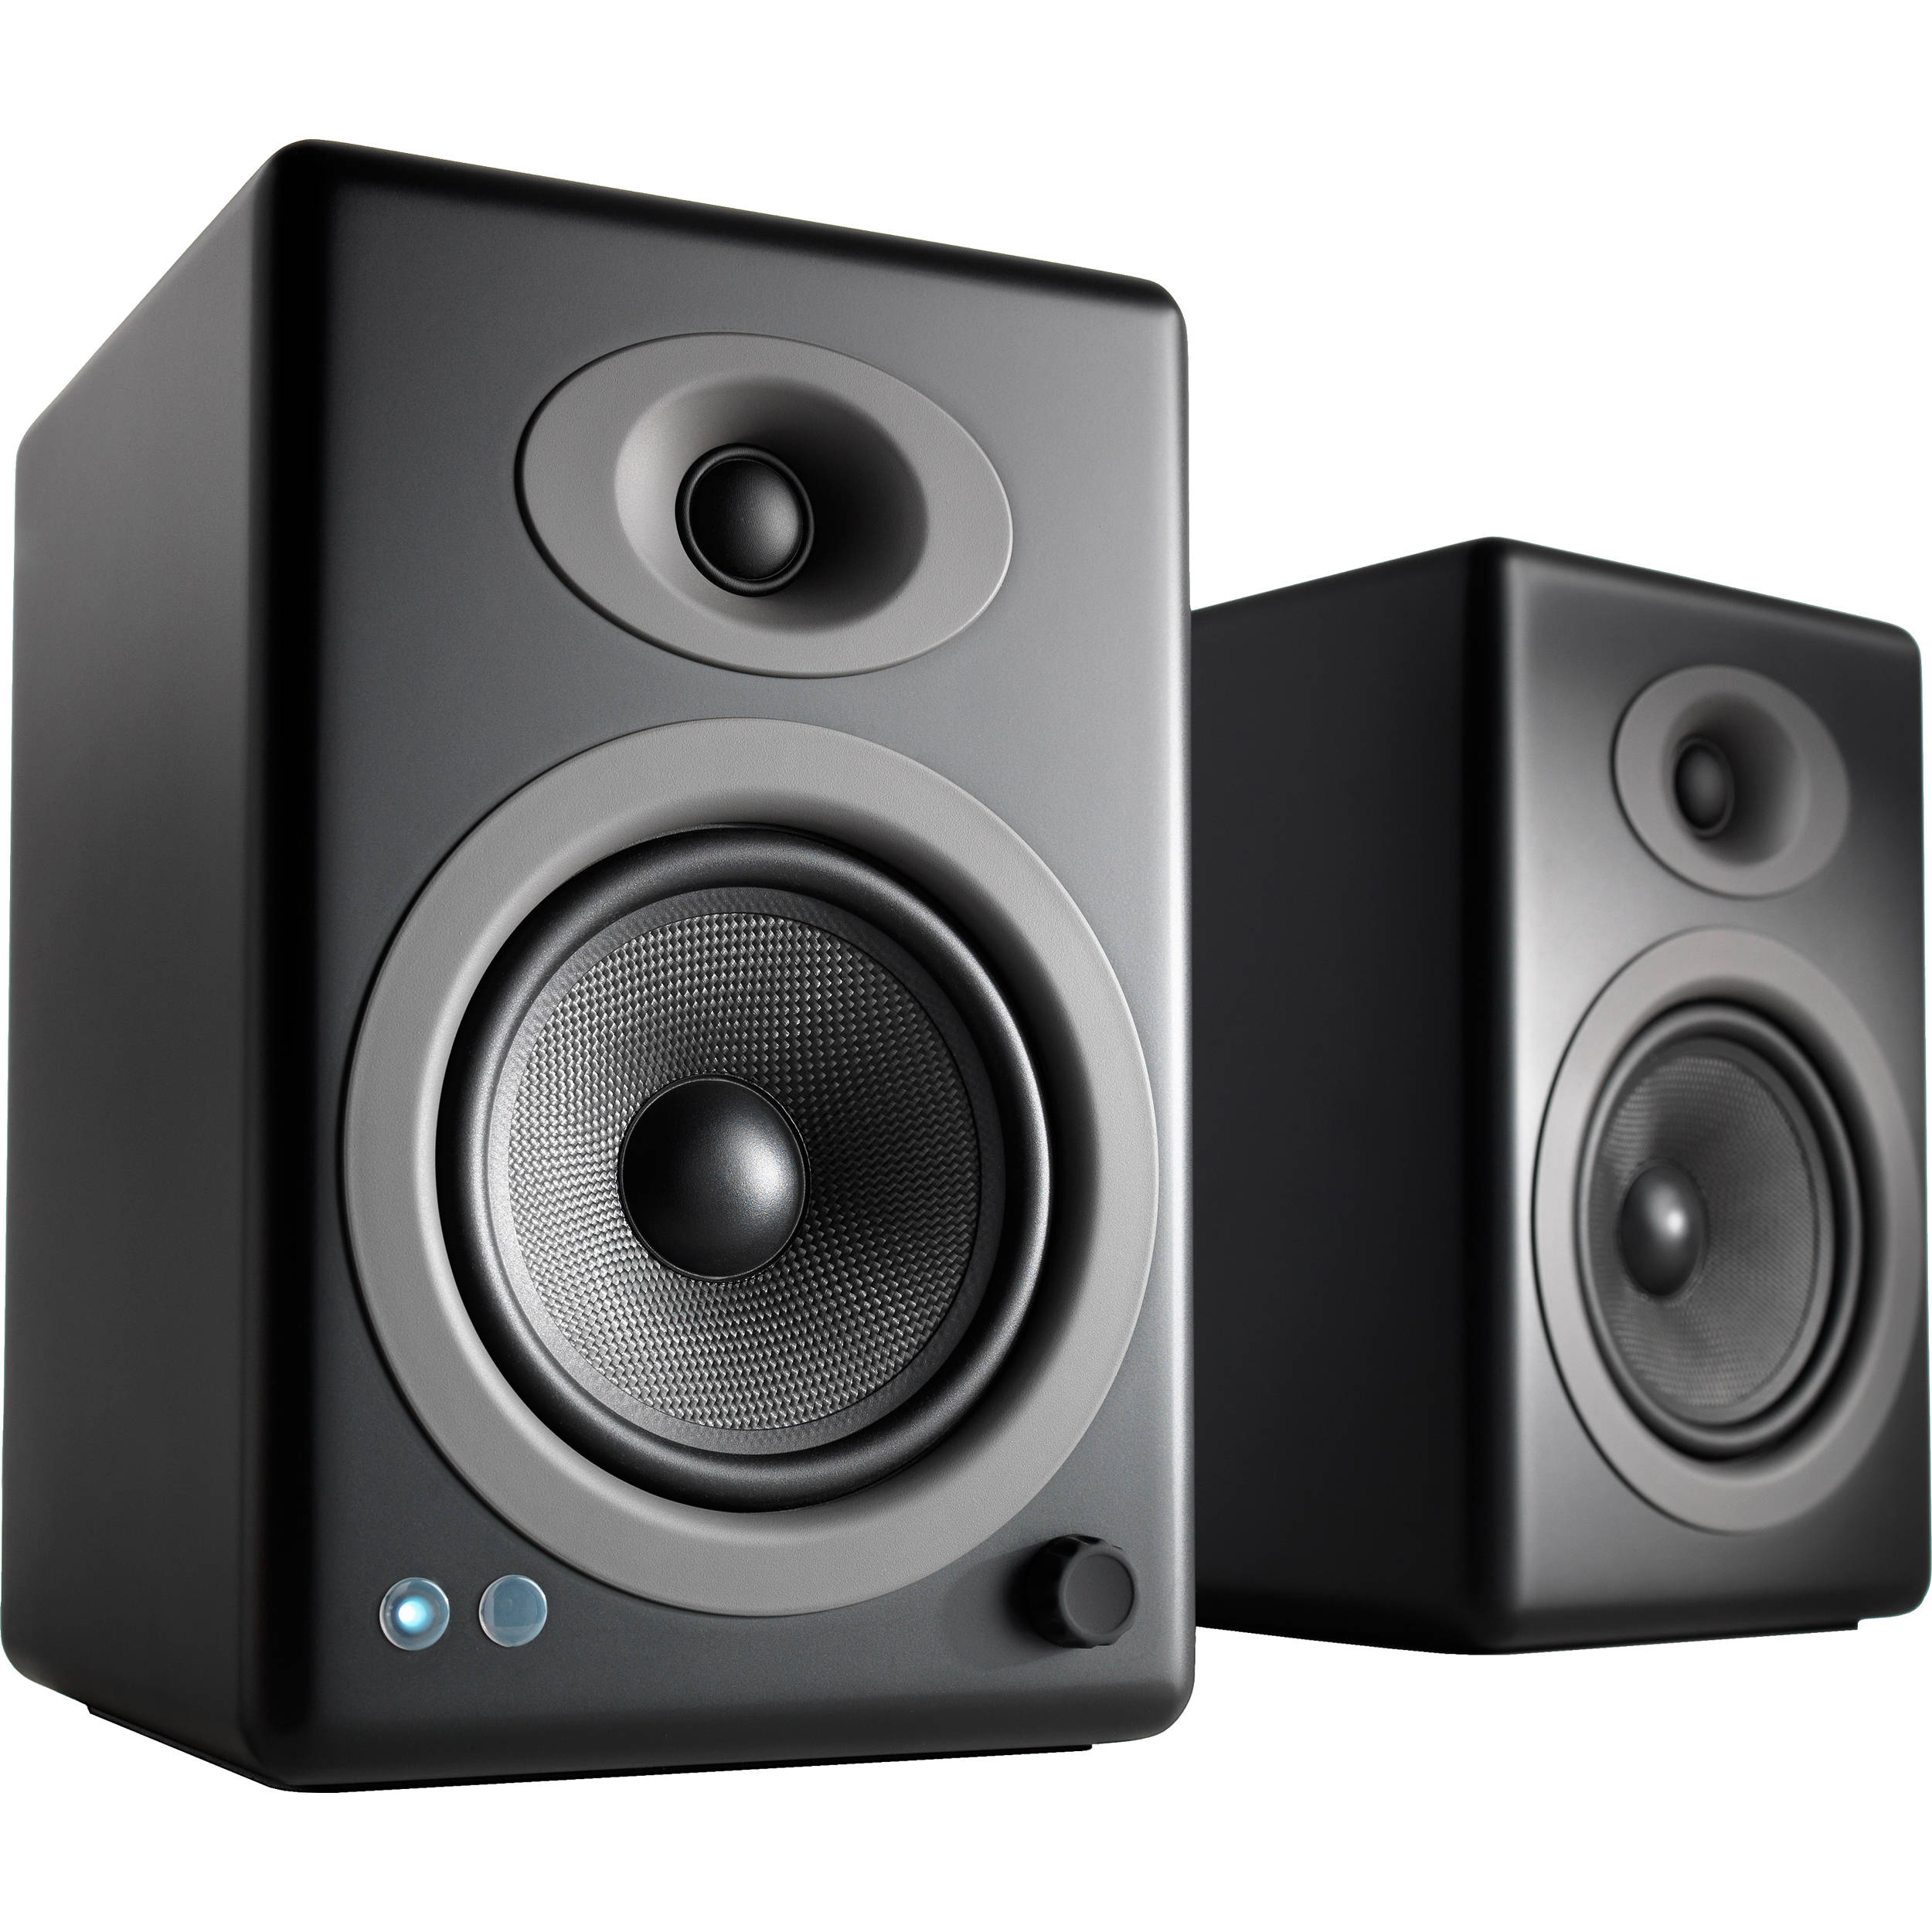
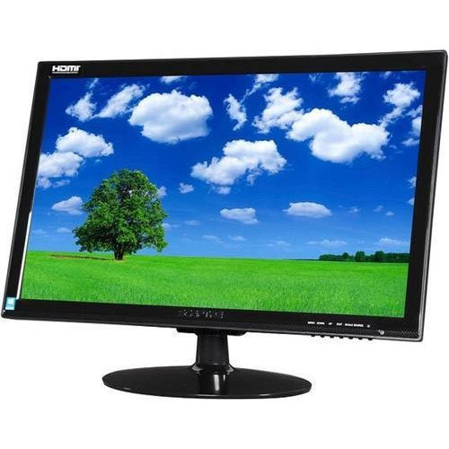
Dissemination Technologies
Dissemination technologies are those technologies that are used to disseminate and share information and data.
Example: Monitor, Speaker.
19

Slide 20
Advantages of ICT in Education
Quick access to information
Easy availability of updated data
Connecting geographically dispersed regions
Catering to the individual differences
Wider range of communication media
Teachers can teach better with graphics, video and graphics
Teachers can create interesting, well-designed and engaging classroom activities
Provide better teaching and learning methods
Independent learning platforms for students
20

Slide 21
Advantages of ICT in Education
Enjoying while learning
Help to stimulate, motivate and engage learner
Promoting and improving the digital culture in universities, colleges, and schools
21

Slide 22
Disadvantages of ICT in Education
Misleading and misguiding information
Risk of cyber attacks and hacks
A risk to the traditional book and handwriting methods
Misuse of technology
Not accessible everywhere
Teachers require experience to handle ICT
Implementing computers and the internet is expensive
Few believe that computers can limit imagination
22

Slide 23
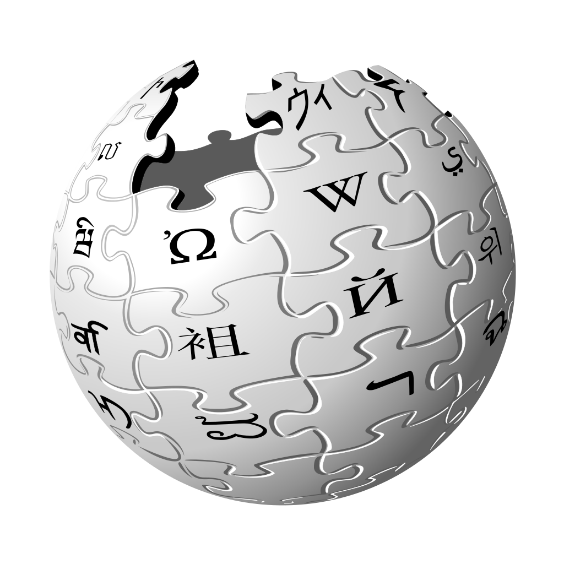


Classification of ICT Tools in Education
Informative Tools: These tools of ICT provide huge information in various formats such as text, sound, graphics, or video.
23

Slide 24
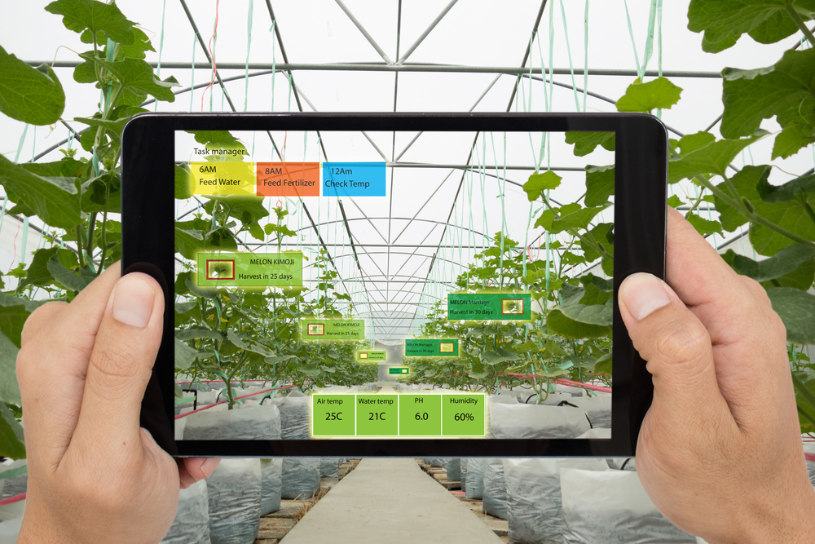
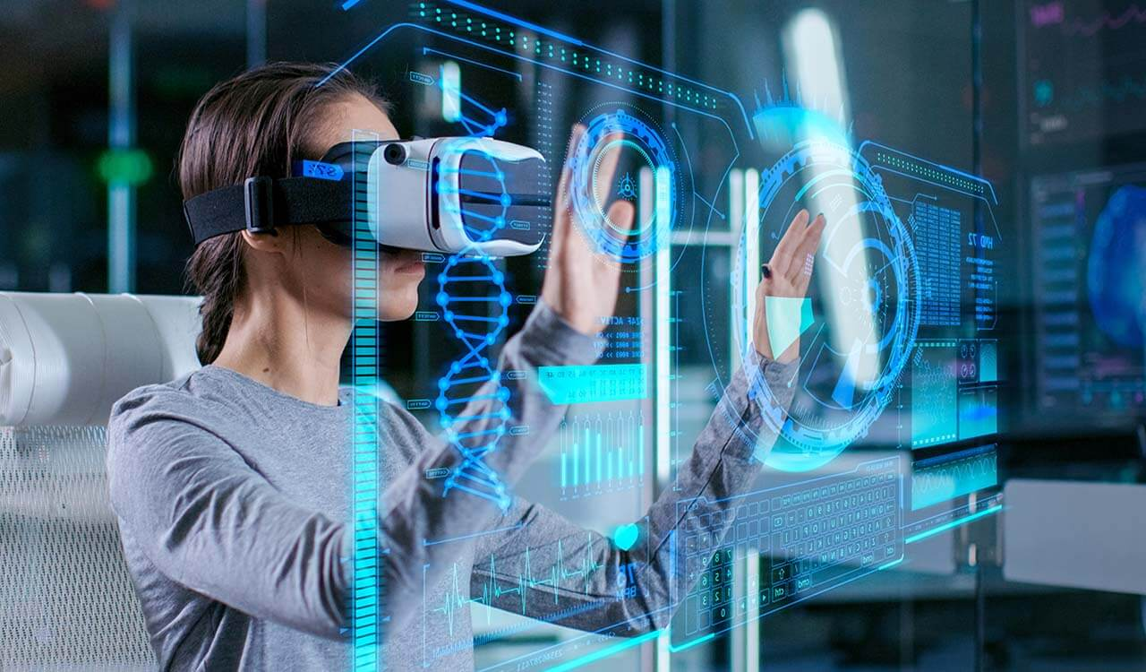
Classification of ICT Tools in Education
Situating Tools: There are some ICT tools like simulation, games, and virtual reality through which students can be placed in an environment where they may get “nearly direct experience” through observation or practice in an artificially created model of real situation.
23

Slide 25
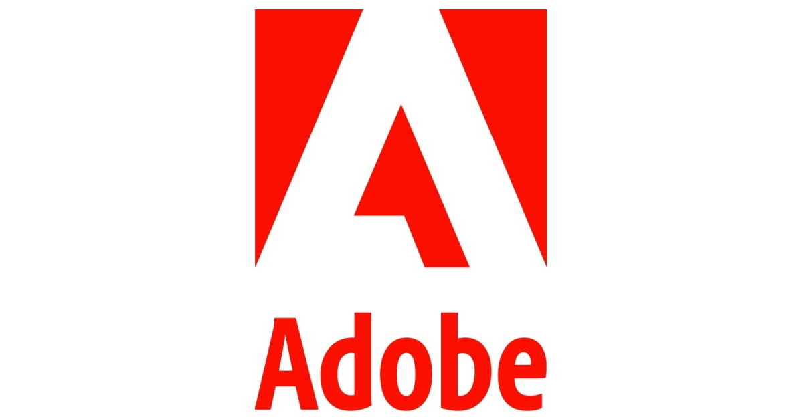
Classification of ICT Tools in Education
Constructive Tools: There are different tools of ICT that you can use for constructing, manipulating as well as visualizing your own knowledge.
23

Slide 26



Classification of ICT Tools in Education
Communicative tools: We communicate our ideas/ knowledge/views with the help of communicative tools.
23

Slide 27
Summery
ICT in Education
What is ICT?
Data vs Information
ICT Procedure
Advantages and Disadvantages of ICT in Education
Classification of ICT Tools in Education
References
24

Slide 28
References
Smaldino, S. E., Lowther, D. L., Russell, J. D., & Mims, C. (2008). Instructional technology and media for learning.
Vanaja, M., Rajasekar, S., & Arulsami, S. (2016). Information & Communication Technology (ICT) in Education.
15

