Slide 1
Tishk International University
Science Faculty
IT Department
Programming I – (IT-203)
Arrays
2nd Grade- Summer School 2019-2020
Instructor: Mohammed Kamal
Email: mohammed.kamal@tiu.edu.iq

Slide 2
Objectives
Array Concept
Defining Array
Array Initialization
Inputting Array Contents
Processing Array Contents
Displaying Array Contents
Notes about Arrays
In which stage we use Arrays?
LAB Exercises

Slide 3
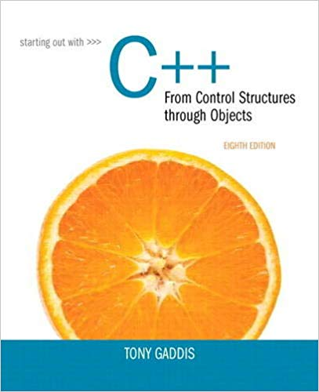
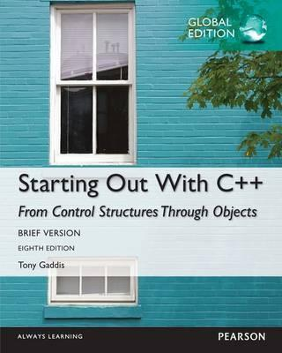
Textbook Source
Tony Gaddis, Starting Out with C++: From Control Structures through Objects, 8th Edition
Chapter 8 (from page 485 to 534)

Slide 4
Array Concept
Array: a variable that can store multiple values of the same type
Values are stored in adjacent memory locations
Declared using [] operator
int A[5];
This allocates the following memory locations
Element 0 | Element 1 | Element 2 | Element 3 | Element 4

Slide 5
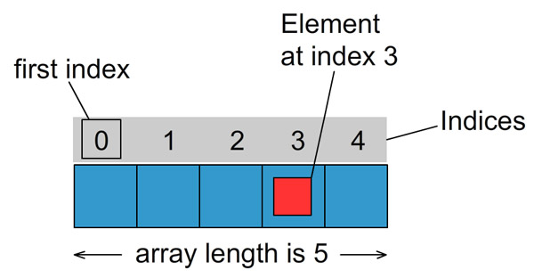

Slide 6
Array Size Declarators

Slide 7
Accessing Array Elements
Array elements (accessed by array name and subscript) can be used as regular variables
A[0] = 79;
cout << A[0];
cin >> A[1]; //user puts 88
A[4] = A[0] + A[1];
A
0 1 2 3 4
A
79
88
167
0 1 2 3 4

Slide 8
Array Subscripts
Array subscript (index) can be an integer constant, integer variable, or integer expression
Examples:
#include <iostream>
using namespace std;
int main()
{
int A[5];
int i = 1;
int j = 2;
cout << "Hi" << endl;
cin >> A[2]; // int constant
cout << A[i]; // int variable
cout << A[i + j]; // int expression
return 0;
}

Slide 9
Defining Array
In the definition
int A[5]; //holds 5 integer cells
int is the data type of the array elements
A is the name of the array
5 is the number of elements. It shows the number of elements in the array.
Other Example
double volumes[10];//holds 10 double cells

Slide 10
Array Initialization
Can be initialized during program execution with assignment statements
A[0] = 79; A[1] = 82; // etc.
Can be initialized at array definition with an initialization list
int A[5] = {79,82,91,77,84};
Or
int A[5] = {0};//all have zero value
int A[5] = {4};//only the first element has value 5, others are zero
Notes:
See pr8-05.cpp, pr8-06.cpp, and pr8-07.cpp

Slide 11
Implicit Array Sizing
Can determine array size by the size of the initialization list
short quizzes[]={12, 17, 15, 11};
Must use either array size declarator or initialization list when array is defined
12 | 17 | 15 | 11

Slide 12
Inputting Array Contents
cin can be used to input values from keyboard and store these values into an array element
int A[5]; // Define 5-cells array
cout << "Enter first number ";
cin >> A[0];
Notes:
See pr8-01.cpp

Slide 13
Processing Array Contents
Array elements can be
treated as ordinary variables of the same type as the array
used in arithmetic operations, in relational expressions, etc.
Example:
if (A[3] >= 10000) interest = A[3] * intRate1;
else interest = A[3] * intRate2;
Notes:
See pr8-09.cpp

Slide 14
Displaying Array Contents
cout can be used to display value of the value of an array element
int A[5]; // Define 5-cells array
cout >> "A[0]= " << A[0] <<endl;
Notes:
See pr8-01.cpp

Slide 15
Inputting All Array Elements
To access each element of an array
Use a loop
Let the loop control variable be the array subscript
A different array element will be referenced each time through each cycle of the loop
int A[5];
int i;
for (i = 0; i < 5; i++)
{
cout << “Enter Some numbers in to the array ";
cin >> A[i];
}
Notes:
See pr8-02.cpp

Slide 16
Displaying All Array Elements
To display each element of an array
Use a loop
Let the loop control variable be the array subscript
A different array element will be referenced each time through each cycle of the loop
int A[5];
for (int i = 0; i < 5; i++)
{ cout << A [i] << endl;
}
Notes:
See pr8-02.cpp

Slide 17
Sample input and output program of array
// This program stores employee work hours in an int array. It uses
// one for loop to input the hours and another for loop to display them.
#include <iostream>
using namespace std;
int main()
{
const int NUM_EMPLOYEES = 6;
int hours[NUM_EMPLOYEES]; // Holds hours worked for 6 employees
int count; // Loop counter
// Input hours worked by each employee
cout << "Enter the hours worked by " << NUM_EMPLOYEES
<< " employees: ";
for (count = 0; count < NUM_EMPLOYEES; count++)
cin >> hours[count];
// Display the contents of the array
cout << "The hours you entered are:";
for (count = 0; count < NUM_EMPLOYEES; count++)
cout << " " << hours[count];
cout << endl;
system("pause");
return 0;
}
Program Output with Example Input Shown in Bold Enter the hours worked by 6 employees: 20 12 40 30 30 15[Enter] The hours you entered are: 20 12 40 30 30 15

Slide 18
NOTE 3: Strings and string Objects
String is a special type of array of characters.
It Can be processed using array name
Entire string at once, or
One element at a time by using a subscript
string city;
cout << "Enter city name: ";
cin >> city;
'E' | 'r' | 'b' | 'i' | 'l'
city[0] | city[1] | city[2] | city[3] | city[4]
Notes:
See pr8-12.cpp

Slide 19
Months and Days Example
// This program displays the number of days in each month. It uses an
// array of string objects to hold the month names and an int array
// to hold the number of days in each month. Both are initialized with
// initialization lists at the time they are created.
#include <iostream>
#include <iomanip>
#include <string>
using namespace std;
int main()
{
const int NUM_MONTHS = 12;
string name[NUM_MONTHS] = { "January", "February", "March",
"April", "May", "June",
"July", "August", "September",
"October", "November", "December" };
int days[NUM_MONTHS] = { 31, 28, 31, 30,
31, 30, 31, 31,
30, 31, 30, 31 };
for (int month = 0; month < NUM_MONTHS; month++)
{
cout << setw(9) << left << name[month] << " has ";
cout << days[month] << " days.\n";
}
system("pause");
return 0;
}
Program Output
January has 31 days. February has 28 days. March has 31 days. April has 30 days. May has 31 days. June has 30 days. July has 31 days. August has 31 days. September has 30 days. October has 31 days. November has 30 days. December has 31 days

Slide 20
Notes about Arrays
NOTE 1: No Bounds Checking
There are no checks in C++ that an array subscript is in range
An invalid array subscript can cause program to overwrite other memory locations
Example:
int num[3]; //composed of =>num[0], num[1], num[2]
int i = 4;
num[i] = 25;//we don’t have num[4]
num
25
[0] [1] [2]
Notes:
See pr8-04.cpp

Slide 21
NOTE 2: Using Increment and Decrement Operators with Array Elements
When using ++ and -- operators, don’t
confuse the element with the subscript
A[i]++; // adds 1 to A[i]
A[i++]; // increments i, but has // no effect on A
int score[5] = {7, 8, 9, 10, 11};
++score[2]; // Pre-increment operation on the value in score[2]
score[4]++; // Post-increment operation on the value in score[4]

Slide 22
Array direct Initialization using pointer
int array[10]; // fine, size of array known to be 10 at compile time
const int size = 5; //(using (int size=5;) to determine array size is an error)
int array[size]; // error, size not known at compile time
int size; // set size at runtime
cin >> size;
int* array = new int[size];
However, this 'raw' usage of new is not recommended as you must use delete to recover the allocated memory.
delete[] array;

Slide 23
Direct Array Initialization using pointer
#include<iostream>
using namespace std;
int main()
{ int size;
cin >> size;
int * array = new int[size];
for (int i = 0; i < size; i++)
{ array[i] = i;
}
for (int i = 0; i < size; i++) {
cout << array[i] << "\t";
}
delete[] array; //important
system("pause");
return 0; }

Slide 24
int A1[5]= {1,2,3,4,5}; int A2[5];
NOTE 4: : Copying One Array to Another
Cannot copy with an assignment statement:
A2=A1 ; //Not allowed
But we can copy with an assignment statement inside a loop:
for (int i=0; i < 5; i++)
A2[i] = A1[i];
Notes:
See ArrayCopy.cpp

Slide 25
Comparing Two Arrays
Write a program to compare the contents of one array to another and show to the user if the arrays are equal or not.
//Comparing two arrays
#include <iostream>
using namespace std;
int main()
{
const int size = 5; //Array size
int A[size] = { 1,2,3,4,5 };
int B[size] = { 1,2,3,44,5 };
int i; //index
bool areEqual;
areEqual = true;
for (i=0; i < size; i++)
{
if (A[i] != B[i])
{ areEqual = false;
}
}
if (areEqual)
{
cout << "The Arrays are equal.\n";
}
else {
cout << "The Arrays are not equal.\n";
}
system("pause"); return 0; }

Slide 26
Search inside an array
Write a program to search for an input inserted by user
#include<iostream>
using namespace std;
int main()
{
const int size = 5;
int number;
int array[size] = { 1,2,3,4,5 };
bool found = false;
cout << "search for a number: ";
cin >> number;
for (int i = 0; i < size; i++)
{
if (array[i] == number)
{
found = true;
cout << "at index " << i ;
break;
}
}
if (found)
{
cout << " Element found Successfully" << endl;
}
else
{
cout << "Element not exist" << endl;
}
system("pause");
return 0;
}

Slide 27
Vowel counter application
// This program illustrates how a string can be processed as an array of individual characters. It reads //in a string, then counts the number of vowels in the string.
//useing the toupper or tolower functions is important to either uppercase or lowercase each letter in
//the string and the string class member. function length() to determine how many characters are in the string.
#include <iostream>
#include <string> // Needed to use string objects
using namespace std;
int main()
{
char ch;
int vowelCount = 0;
string sentence;
cout << "Enter any sentence you wish and I will \n"
<< "tell you how many vowels are in it.\n";
getline(cin, sentence);
for (int pos = 0; pos < sentence.length(); pos++)
{
ch = toupper(sentence[pos]);//tolower(sentence[pos])
// If the character is a vowel, increment vowelCount
switch (ch)
{
case 'a’:
case 'e’:
case 'i’:
case 'o’:
case 'u': vowelCount++;
}
}
cout << "There are " << vowelCount << " vowels in the sentence.\n";
return 0;
}

Slide 28
Finding The largest of Array elements
Q\ Write a program to find the largest element in array of integers
Hints:
Use a loop to examine each element and find the largest element (i.e., one with the largest value)
A similar algorithm exists to find the smallest element

Slide 29
//Finding The largest of Array elements
#include <iostream>
using namespace std;
int main()
{
int largest;
int A[10] = { 7,6,5,9,4,11,3,150,20,12 };
int i, n = 10; //index and Array size
largest = A[0];
for (i = 1; i < n; i++)
{
if (A[i] > largest)
largest= A[i];
}
cout << "Largest= "<< largest<<endl;
system("pause");
return 0;
}

Slide 30
Summation of array elements
Write a program to find the sum of all elements in a one dimensional integer array of 5 elements. The elements values should be given by the user.
//Calculating sum of Array
#include <iostream>
using namespace std;
int main()
{ //Define Stage
int A[5];
int i; //index
int n = 5; //Array size
int sum=0; //sum accumulation
for (i = 0; i < n; i++)
{
cout << "A["<<i<<"] = ";
cin >> A[i];
}
for (i = 0; i < n; i++)
{
sum = sum + A[i];
}
cout << "The sum = "<< sum<<endl;
system("pause");
return 0;
}

Slide 31
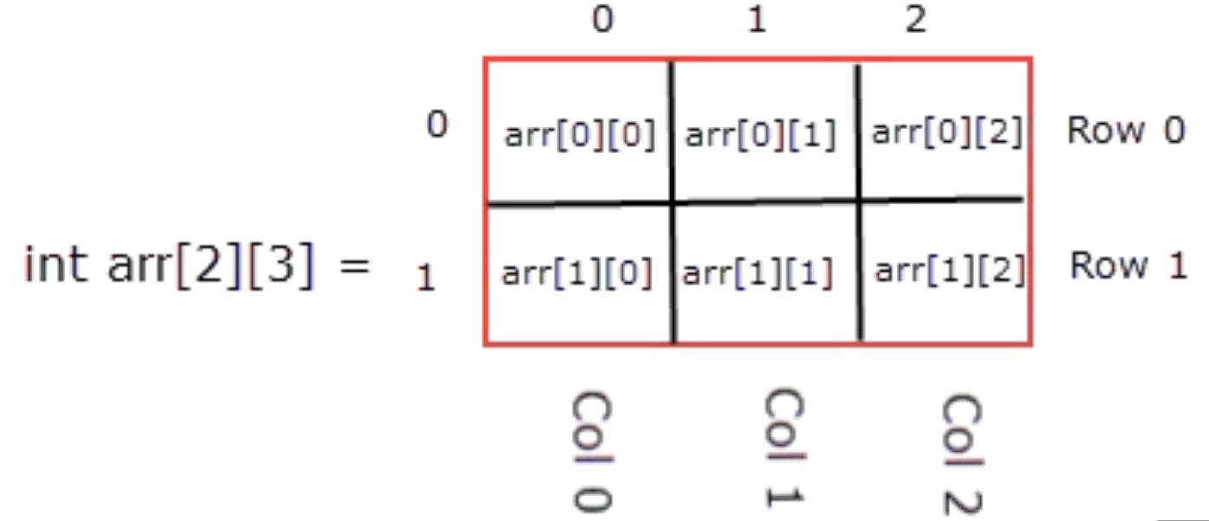
Two Dimensional Array
A two-dimensional array can be think of as a table, which will have x number of rows and y number of columns.
int arr[2][3];

Slide 32
Two Dimensional Array
int test[2][3]= { {2, -5, 6},{4, 0, 9} };
int test[2][3]= { {2, -5, 6},
{4, 0, 9}
};
0
1
2
0
2 | -5 | 6
4 | 0 | 9
1

Slide 33
Two Dimensional Array
#include <iostream>
using namespace std;
int main()
{
for(int i = 0; i < 2; ++i)
{
for(int j = 0; j < 3; ++j)
{
cout<<"Enter your number = ";
cin>> test[i][j];
}
}
for(int i = 0; i < 2; ++i)
{
for(int j = 0; j < 3; ++j)
{
cout<< test[i][j] << “\t”;
}
}
system("pause");
return 0;
}

Slide 34
Multi Dimensional Array
#include <iostream>
using namespace std;
int main()
{
int array[2][3][4];
for(int i = 0; i < 2; ++i)
{
for(int j = 0; j < 3; ++j)
{
for(int k = 0; k < 4; k++)
{
cout<<"Enter your number = ";
cin>> array [i][j][k];
}
}
}
system("pause");
return 0;
}

Slide 35
Multi Dimensional Array
Q- create 3 arrays for name, surname and country. Let the user decide the size of them and let him insert the data. After that create a double dimensional array and send all the data in to the double dimentional array.

Slide 36
LAB Exercises
LAB 6-1: Write a program to add two arrays of type double filled by programmer and put the result in a third array. Display the third array. The size of all arrays is 8.
LAB 6-2: Write a C++ program to count how many 2s are there in the array of 10 elements. The elements values should be given by the programmer.
LAB 6-3: Write a C++ program to find how many times an input number have been repeated inside an array and at which indexes. The elements values is inserted by the user.

Slide 37
2- create a search, if an element have been found in an array. You may use random number. to find an element in an index.
4- sort an array in from biggest to smallest and vice versa.
5- put two (one dimensional array) elements in to double dimensional array automatically.

