Slide 1
Linked lists

Slide 2
Definition of LL
A linked list is a collection of components called nodes
Every node (except the last one) contains the address of the next node
The address of first node is stored in separate location called as head or first
Every node in linked list has 2 components:
one to store relevant information (data)
and other to store the address called as link

Slide 3
Declaration of LL
Because the node of linked list contains 2 components it should be declared as class or struct
struct nodeType
{
int info;
nodeType *link;
};

Slide 4
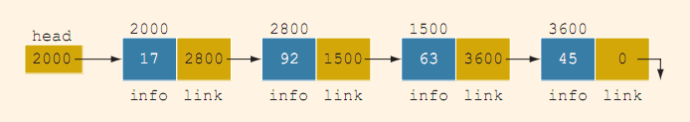
Properties of LL
 | VALUE | EXPLANATION
head | 2000
head -> info | 17 | Because head is 2000 and the info of the node at location 2000 is 17
head -> link | 2800
head -> link -> info | 92 | Because head -> link is 2800 and the info of the node at location 2800 is 92

Slide 5
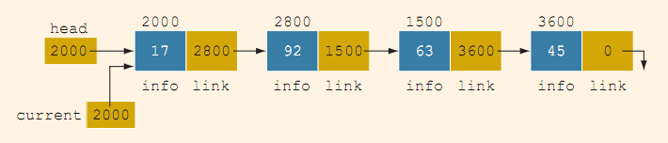
Suppose that current is a pointer which has type as pointer head. Then, the statement : current=head copies the value of head into current
 | value
current | 2000
current -> info | 17
current -> link | 2800
current -> link -> info | 92

Slide 6
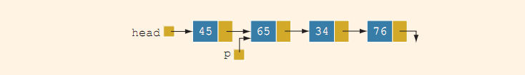
Item insertion to LL
Consider linked list before insertion
variable declaration
nodeType *head, *p, *q, *newnode;
Suppose that p points to the node with info 65, and a new node with info 50 is to be created and inserted after p

Slide 7
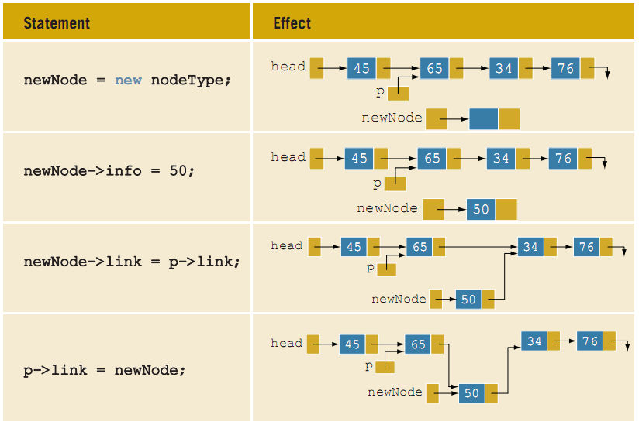
newNode = new nodeType;//create newNode newNode -> info = 50;//store 50 in the new node newNode -> link = p -> link; p -> link = newNode;

Slide 8
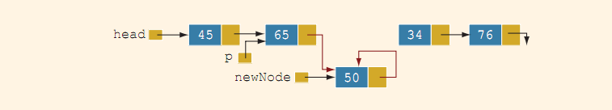
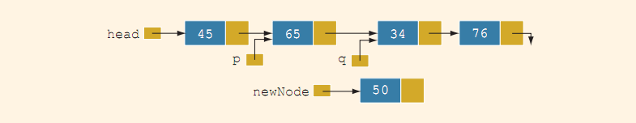
p -> link = newNode; newNode -> link = p -> link;
newNode points back to itself and the remainder of the list is lost
by using to pointers insertion code can be simplified
suppose q points to the node with info 34

Slide 9
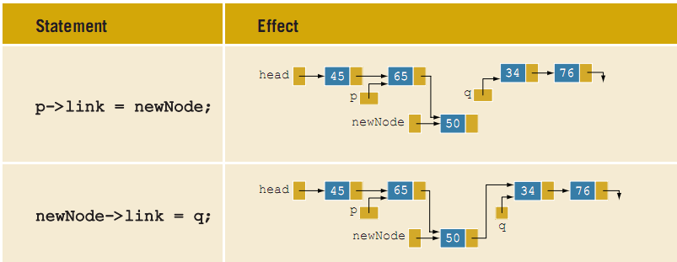
newNode -> link = q;
p -> link = newNode;
Above statements insert newNode between p and q

Slide 10
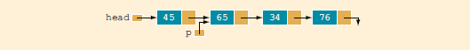
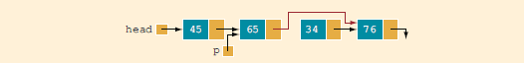
Deletion
We have LL shown below
How to delete node with info 34
p->link = p->link->link;
the node with info 34 is removed from the list. However, the memory is still occupied by this node, and this memory is inaccessible; that
is, this node is dangling. To deallocate the memory, we need a pointer to this node.

Slide 11
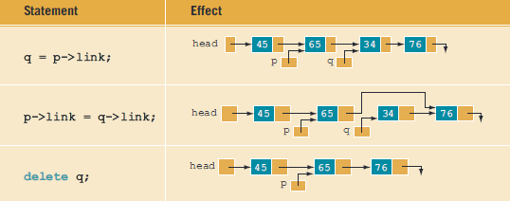
Deallocate deleted node
The following statements delete the node from the list and deallocate the memory occupied by this node.
q = p->link;
p->link = q->link;
delete q;

Slide 12
Operations on LL
Print the LL
Destroy the LL
current = first;
//set current so that it points to
//the first node
while (current != NULL)
//while more data to print
{
cout << current->info << " ";
current = current->link;
}
}//end print
while (first != NULL)
//while there are nodes in the list
{
temp = first;
//set temp to the current node
first = first->link;
//advance first to the next node
delete temp;
//deallocate the memory occupied by temp
}
last = NULL;
//initialize last to NULL; first has already
//been set to NULL by the while loop

Slide 13
Building LL
Suppose that the nodes are in the usual info-link form, and info is of type int.
Assume to process the following data: 2, 15, 8, 24, 34
Will be needed:
three pointers to build the list: one to point to the first node in the list, which cannot be moved;
one to point to the last node in the list;
and one to create the new node.
nodeType *first, *last, *newNode;
int num;

Slide 14
Building LL…
nodeType *first, *last, *newNode;
int num;
/*Suppose that first points to the first node in the list. Initially, the list is empty, so both first and last are NULL*/
first = NULL;
last = NULL;
cin >> num; //read a number in num
newNode=new nodeType;
/*allocate memory of type nodeType
and store the address of the
allocated memory in newNode*/
newNode->info = num;
/*copy the value of num into the
info field of newNode*/
newNode->link = NULL;
/*initialize the link field of newNode to NULL*/
if (first == NULL)
//if first is NULL, the list is empty;
//make first and last point to newNode
{
first = newNode;
last = newNode;
}
else //list is not empty
{
last->link = newNode;
//insert newNode at the end of the list
last = newNode;
//set last so that it points to the
//actual last node in the list
}

Slide 15
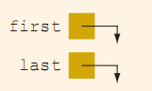
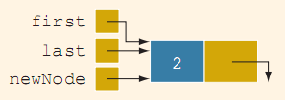
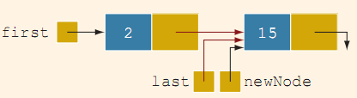

Building LL…
nodeType *first, *last, *newNode;
int num;
/*Suppose that first points to the first node in the list. Initially, the list is empty, so both first and last are NULL*/
first = NULL;
last = NULL;
1 cin >> num; //read a number in num
2 newNode=new nodeType;
/*allocate memory of type nodeType
and store the address of the
allocated memory in newNode*/
3 newNode->info = num;
/*copy the value of num into the
info field of newNode*/
4 newNode->link = NULL;
/*initialize the link field of newNode to NULL*/
5 if (first == NULL)
//if first is NULL, the list is empty;
//make first and last point to newNode
{
5a first = newNode;
5b last = newNode;
}
6 else //list is not empty
{
6a last->link = newNode;
//insert newNode at the end of the list
6b last = newNode;
//set last so that it points to the
//actual last node in the list
}

Slide 16
After statement 1 executes, num is 2. Statement 2 creates a node and stores the address of that node in newNode. Statement 3 stores 2 in the info field of newNode, and statement 4 stores NULL in the link field of newNode
Because first is NULL, we execute statements 5a and 5b.
We now repeat statements 1 through 6b. After statement 1 executes, num is 15. Statement 2 creates a node and stores the address of this node in newNode. Statement 3 stores 15 in the info field of newNode, and statement 4 stores NULL in the link field of newNode
Because first is not NULL, we execute statements 6a and 6b.

Slide 17
Operations over LL
Print the LL
Destroy the LL
current = first;
//set current so that it points to
//the first node
while (current != NULL)
//while more data to print
{
cout<<current->info<<" ";
current = current->link;
}
//end print
while (first != NULL)
//while there are nodes in the list
{
temp = first;
//set temp to the current node
first = first->link;
//advance first to the next node
delete temp;
//deallocate the memory occupied by temp
}
last = NULL;
//initialize last to NULL; first has already been set to NULL by the while loop

Slide 18
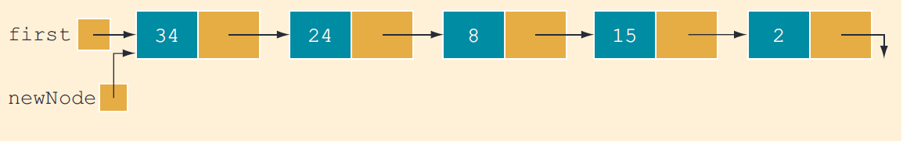
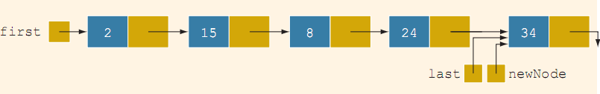
Building LL Backward
For the previously given data 2, 15, 8, 24, 34 the linked list is as shown below as
Backward LL
Forward LL

Slide 19
Pseudo code of building Backward LL
1. Initialize first to NULL.
2. For each item in the list,
Create the new node, newNode.
Store the item in newNode.
Insert newNode before first.
Update the value of the pointer first.

Slide 20
C++ function to build Backward LL
nodeType* buildListBackward()
{
nodeType *first, *newNode;
int num;
cout<<"Enter a list of integers ending with -1."<<endl;
cin >> num;
first = NULL;
while (num != -1)
{
newNode = new nodeType; //create a node
newNode->info = num; //store the data in newNode
newNode->link = first; //put newNode at the beginning of the list
first = newNode; //update the head (first) pointer of the list
cin >> num; //read the next number
}
return first;
} //end buildListBackward

Slide 21
QUICK REVIEW
A linked list is a list of items, called nodes, in which the order of the nodes is determined by the address, called a link, stored in each node.
The pointer to a linked list—that is, the pointer to the first node in the list—is stored in a separate location called the head or first.
A linked list is a dynamic data structure.
The length of a linked list is the number of nodes in the list. Item insertion and deletion from a linked list do not require data movement; only the pointers are adjusted.
A (single) linked list is traversed in only one direction.

