Slide 1
Doubly Linked Lists
Linking in double direction

Slide 2
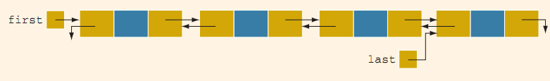
Doubly Linked Lists
A doubly linked list is a linked list in which every node has a next pointer and a back pointer.
A doubly linked list can be traversed in either direction. That is, we can traverse the list starting at the first node or, if a pointer to the last node is given, we can traverse the list starting at the last node.

Slide 3
Typical operations over Double LL
The typical operations on a doubly linked list are:
Initialize the list.
Destroy the list.
Determine whether the list is empty.
Search the list for a given item.
Retrieve the first element of the list.
Retrieve the last element of the list.
Insert an item in the list.
Delete an item from the list.
Find the length of the list.
Print the list.
Make a copy of the doubly linked list.

Slide 4
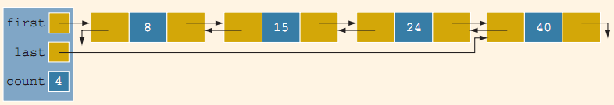
Insert a node
Because we are inserting an item in a doubly linked list, the insertion of a node in the list requires the adjustment of two pointers in certain nodes. As before, we find the place where the new item is supposed to be inserted, create the node, store the new item, and adjust the link fields of the new node and other particular nodes in the list. There are four cases:
Case 1: Insertion in an empty list
Case 2: Insertion at the beginning of a nonempty list
Case 3: Insertion at the end of a nonempty list
Case 4: Insertion somewhere in a nonempty list
Both Cases 1 and 2 require us to change the value of the pointer first. Cases3 and 4 are similar. After inserting an item, count is incremented by 1. Next, we show Case 4.

Slide 5
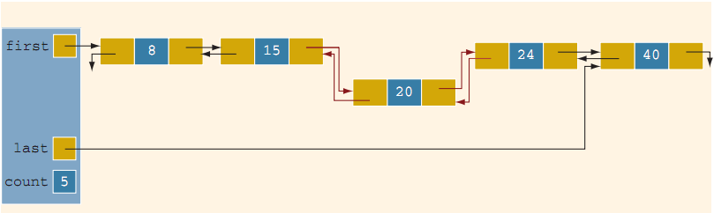
Insert a node
Suppose that 20 is to be inserted in the list. After inserting 20, the resulting list is as shown in
From Figure it follows that the next pointer of node 15, the back pointer of node 24, and both the next and back pointers of node 20 need to be adjusted.

Slide 6
template <class Type>
void doublyLinkedList<Type>::insert(const Type& insertItem)
{
nodeType<Type> *current; //pointer to traverse the list
nodeType<Type> *trailCurrent; //pointer just before current
nodeType<Type> *newNode; //pointer to create a node
bool found;
newNode = new nodeType<Type>; //create the node
newNode->info = insertItem; //store the new item in the node
newNode->next = NULL;
newNode->back = NULL;
if (first == NULL) //if the list is empty, newNode is
//the only node
{
first = newNode;
last = newNode;
count++;
}
else
{
found = false;
current = first;
while (current != NULL && !found) //search the list
if (current->info >= insertItem)
found = true;
else
{
trailCurrent = current;
current = current->next;
}

Slide 7
if (current == first) //insert newNode before first
{
first->back = newNode;
newNode->next = first;
first = newNode;
count++;
}
else
{
//insert newNode between trailCurrent and current
if (current != NULL)
{
trailCurrent->next = newNode;
newNode->back = trailCurrent;
newNode->next = current;
current->back = newNode;
}
else
{
trailCurrent->next = newNode;
newNode->back = trailCurrent;
last = newNode;
}
count++;
} //end else
} //end else
} //end insert

Slide 8
#include<iostream>
using namespace std;
struct node
{
int data;
node *next;
node *back;
};
void addnode();
void display();
void backward();
void search();
void delnode();
node *start=NULL, *temp1, *temp2, *temp3;
void main()
{
char ch;
do
{
char input;
cout<<"Type 'a' to add node\n"
<<"Type 'd' to display LL\n"
<<"Type 'b' to display LL backward\n"
<<"Type 's' to search element\n"
<<"Type 'x' to delete node\n";
cin>> input;

Slide 9
switch (input)
{
case 'a':
addnode();
break;
case 'd':
display();
break;
case 'b':
backward();
break;
case 's':
search();
break;
case 'x':
delnode();
break;
}
cout<<"Do you want to process again (y/n)?\n";
cin>>ch;
} while(ch != 'n');
system("pause");
}

Slide 10
void addnode()
{
char r;
temp1 = new node;
cout<<"Enter number to LL, please\n";
cin>>temp1->data;
cout<<"Type 's' to add in start, 'e' to end\n";
cin>>r;
switch (r)
{
case 's':
if(start == NULL)
{
start=temp1;
temp1->next=NULL;
temp1->back=NULL;
}
else
{
temp2=start;
temp1->next=temp2;
temp1->back=NULL;
start=temp1;
temp2->back=temp1;
}
break;

Slide 11
case 'e':
if(start == NULL)
{
start=temp1;
temp1->next=NULL;
temp1->back=NULL;
}
else
{
temp2=start;
while(temp2->next !=NULL)
temp2=temp2->next;
temp2->next=temp1;
temp1->back=temp2;
temp1->next=NULL;
}
break;
}
}
void display()
{
temp3=start;
if(start == NULL)
cout<<"LL is empty\n";
else
while (temp3->next != NULL)
{
cout<<"Data stored "<<temp3->data<<" at "<<temp3<<endl;
temp3=temp3->next;
}
cout<<"Data stored "<<temp3->data<<" at "<<temp3<<endl;
}

Slide 12
void backward()
{
temp3=start;
if(start == NULL)
cout<<"LL is empty\n";
else
while (temp3->next != NULL)
{
temp3=temp3->next;
}
while (temp3->back != NULL)
{
cout<<"Data stored "<<temp3->data<<" at "<<temp3<<endl;
temp3=temp3->back;
}
cout<<"Data stored "<<temp3->data<<" at "<<temp3<<endl;
}
void search()
{
int num;
cout<<"Type number to search in LL\n";
cin>>num;
temp1=start;
while(temp1 != NULL)
{
if(temp1->data == num)
{
cout<<temp1->data<<" is stored in "<<temp1<<endl;
}
temp1=temp1->next;
}
}

Slide 13
void delnode()
{
char d;
cout<<"Type 's' to delete from start, 'e' from end\n";
cin>>d;
switch (d)
{
case 's':
if(start == NULL)
{
cout<<"No node to delete\n";
}
else
{
temp1=start;
start=start->next;
start->back=NULL;
delete temp1;
}
break;
case 'e':
if(start == NULL)
{
cout<<"No node to delete\n";
}
else
{
temp1=start;
while(temp1->next != NULL )
{
temp2=temp1;
temp1=temp1->next;
}
delete temp1;
temp2->next=NULL;
}
break;
}
}

