Slide 1
Stacks
TIU Faculty of Science IT Department
Savriddin Khalilov

Slide 2
Characteristics of Data Structures
Disadvantages | Advantages | Data Structure
Slow search, slow deletion, fixed size. | Quick insertion, very search, Fast access if index known. | Array
Slow insertion and deletion, fixed size. | Quicker search than unsorted array. | Ordered array
Slow access to other items. | Provides last-in, first-out access. | Stack
Slow access to other items. | Provides first-in, first-out access. | Queue
Slow search. | Quick insertion, quick deletion. | Linked list
Deletion algorithm is complex. | Quick search, insertion, deletion (if tree is complex. Remains balanced). | Binary tree
Complex. | Quick search, insertion, deletion. Tree always balanced. | Red-black tree

Slide 3
Characteristics of Data Structures
Disadvantages | Advantages | Data Structure
Complex. | Quick search, insertion, deletion. Tree always balanced. Similar trees good for disk storage. | 2-3-4 tree
Slow deletion, non-efficient memory usage. | Quick insertion, quick deletion. | Hash table
Slow access to other items. | Fast insertion, deletion, slow access to largest item. | Heap
Some algorithms are slow and complex. | Models real-world situations. | Graph

Slide 4
Abstract Data Types
The data structures shown above table, except the arrays, can be thought of as Abstract Data Types (ADT)
ADT is a mathematically specified entity that defines a set of its instances, with:
a specific interface – a collection of signatures of operations that can be invoked on an instance,
a set of axioms (preconditions and post conditions) that define the semantics of the operations (i.e., what the operations do to instances of the ADT, but not how)

Slide 5

Stack
A stack is a list like a structure in which all insertions and deletions are made at one end, called the top. The last element to be inserted into the stack will be the first to be removed. Thus stacks are sometimes referred to as Last In First Out (LIFO) lists.
Basic operations are push and pop.
Often top and isEmpty are available, too.
Also known as "last-in, first-out" or LIFO

Slide 6
Stack
More applications related to computer science
stack Program execution
Evaluating expressions
Palindrome finder
Parentheses matcher
A Palindrome is a string that reads the same in either direction
Examples: “Able was I ere I saw Elba”
Real life
Pile of books
Plate trays
CD stack

Slide 7
Stack Terminologies
Push (inserting An element In Stack)
Pop (Deleting an element in stack)
Top ( The last entered value)
Max Stack ( maximum value, a stack can hold)
isEmpty ( either stack has any value or not)
isEmpty()=True-> empty
isEmpty()=False-> contain elements
Overflow (stack is full, elements can’t be pushed due to absence of space)

Slide 8
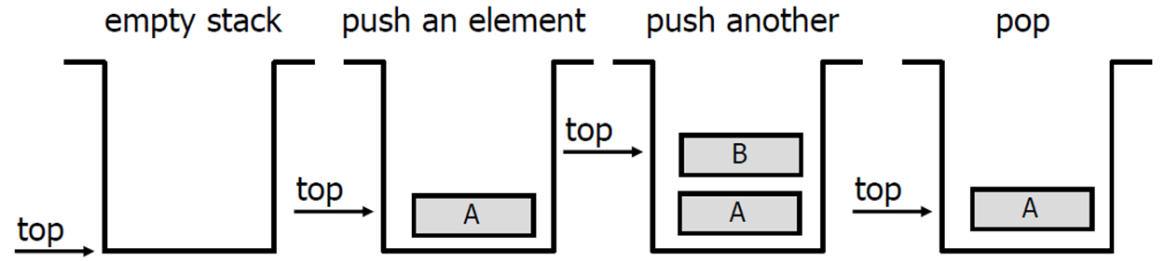
Operations perform on stack
Primary operations: Push and Pop
Push
Add an element to the top of the stack.
Pop
Remove the element at the top of the stack.

Slide 9
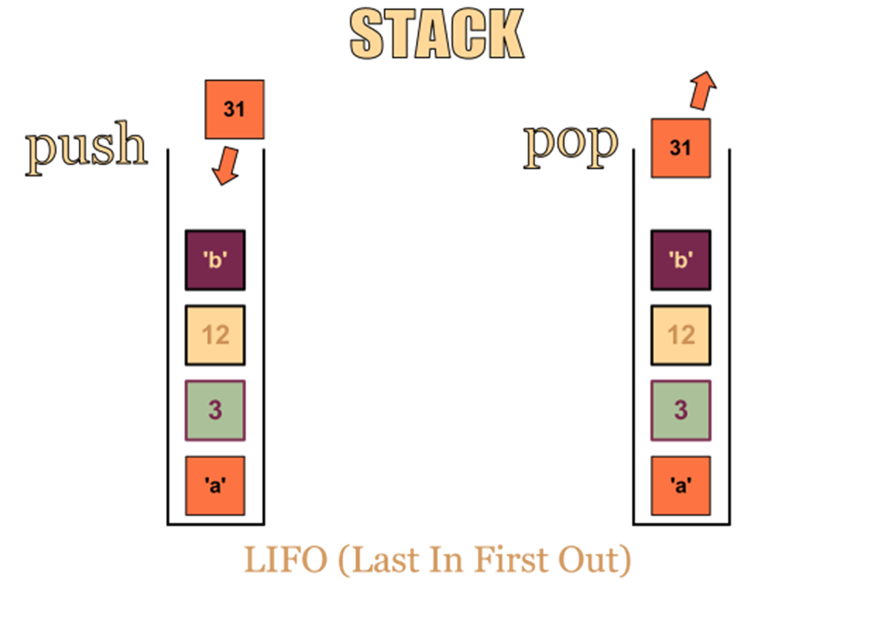
Operations perform on stack

Slide 10
Stack-Related Terms
Top
A pointer that points the top element in the stack.
Stack Underflow
When there is no element in the stack or stack holds elements less than its capacity, the status of stack is known as stack underflow.
TOP=NULL
Stack Overflow
When the stack contains equal number of elements as per its capacity and no more elements can be added, the status of stack is known as stack overflow.
TOP=MAXSTK

Slide 11
Stack sample pseudo-code
objects: a finite ordered list with zero or more elements. methods: Stack createS (max_stack_size) ::= create an empty stack whose maximum size is max_stack_size
Boolean isFull(stack, max_stack_size) ::= if (number of elements in stack == max_stack_size) return TRUE else return FALSE
Stack push(stack, item) ::= if (IsFull(stack)) stack_full else insert item into top of stack and return

Slide 12
Stack sample pseudo-code
Boolean isEmpty(stack) ::= if(stack == CreateS(max_stack_size)) return TRUE else return FALSE Element pop(stack) ::= if(IsEmpty(stack)) return else remove and return the item on the top of the stack.

Slide 13
Array-based Stack Implementation
Allocate an array of some size (pre-defined)
Maximum N elements in stack
Bottom stack element stored at element 0
last index in the array is the top
Increment top when one element is pushed, decrement after pop

Slide 14
Array-based Stack Implementation
int stack[MAXSIZE];
int top;//index pointing to the top of stack
void main()
{
void push(int);
int pop();
int will=1, popValue, num;
while(will ==1)
{
cout<<" MAIN MENU:\n"
<<"1.Add element to stack\n"
<<"2.Delete element from stack\n";
cin>>will;
switch(will)
{
case 1:
cout<<"Enter the data... ";
cin>>num;
push(num);
break;
case 2:
popValue=pop();
cout<<"Value returned from pop function is:\t"
<< popValue <<endl;
break;
default:
cout<<"Invalid Choice ";
}
cout<<"Do you want to do more operations on Stack\n"
<<"(1 for yes, any other key to exit)";
cin>>will;
} //end of outer while
} //end of main

Slide 15
Array-based Stack Implementation
void push(int y)
{
if(top>=MAXSIZE)
{
cout<<"STACK FULL !!!\n";
return;
}
else
{
stack[top]=y;
top++;
}
}
int pop()
{
int a;
if(top<=0)
{
cout<<"STACK EMPTY !!!\n";
return 0;
}
else
{
top--;
a=stack[top];
}
return(a);
}

Slide 16
Linked List based Stack
#include<iostream>
using namespace std;
struct node
{
int info;
struct node *ptr;
}*top,*top1,*temp;
int topelement();
void push(int data);
void pop();
void empty();
void display();
void destroy();
void stack_count();
void create();
int count = 0;
void main()
{
int no, ch, e;
cout<<("\n 1 - Push");
cout<<("\n 2 - Pop");
cout<<("\n 3 - Top");
cout<<("\n 4 - Empty");
cout<<("\n 5 - Exit");
cout<<("\n 6 - Dipslay");
cout<<("\n 7 - Stack Count");
cout<<("\n 8 - Destroy stack");
create();

Slide 17
while (1)
{
cout<<"\n Enter choice : ";
cin>>ch;
switch (ch)
{
case 1:
cout<<("Enter data : ");
cin>>no;
push(no);
break;
case 2:
pop();
break;
case 3:
if (top == NULL)
cout<<"No elements in stack";
else
{
e = topelement();
cout<<"\n Top element : ", e;
}
break;
case 4:
empty();
break;
case 5:
exit(0);
case 6:
display();
break;
case 7:
stack_count();
break;
case 8:
destroy();
break;
default :
cout<<" Wrong choice, Please enter correct choice ";
break;
}
}
}

Slide 18
void create()
{
top = NULL;
}
/* Count stack elements */
void stack_count()
{
cout<<"\n No. of elements in stack : "<<count;
}
/* Push data into stack */
void push(int data)
{
if (top == NULL)
{
top =(struct node *)malloc(1*sizeof(struct node));
top->ptr = NULL;
top->info = data;
}
else
{
temp =(struct node *)malloc(1*sizeof(struct node));
temp->ptr = top;
temp->info = data;
top = temp;
}
count++;
}

Slide 19
/* Display stack elements */
void display()
{
top1 = top;
if (top1 == NULL)
{
cout<<"Stack is empty";
return;
}
while (top1 != NULL)
{
cout<<top1->info;
top1 = top1->ptr;
}
}
/* Pop Operation on stack */
void pop()
{
top1 = top;
if (top1 == NULL)
{
cout<<"\n Error : Trying to pop from empty stack";
return;
}
else
top1 = top1->ptr;
cout<<"\n Popped value :"<< top->info;
free(top);
top = top1;
count--;
}

Slide 20
/* Return top element */
int topelement()
{
return(top->info);
}
/* Check if stack is empty or not */
void empty()
{
if (top == NULL)
cout<<"\n Stack is empty";
else
cout<<"\n Stack is not empty with %d elements"<<count;
}
/* Destroy entire stack */
void destroy()
{
top1 = top;
while (top1 != NULL)
{
top1 = top->ptr;
free(top);
top = top1;
top1 = top1->ptr;
}
free(top1);
top = NULL;
cout<<"\n All stack elements destroyed";
count = 0;
}

