Slide 1
QUEUES

Slide 2
Definition
A queue is a set of the same type in which elements are added at one end, called back or rear, and deleted from the other end, called front.
Queue is used in a system which is modeled on the First In First Out
The rear of the queue is accessed whenever a new element is added to the queue, and the front of the queue is accessed whenever an element is deleted from the queue.

Slide 3
Queue operations
initializeQueue: Initializes the queue to an empty state
isEmptyQueue: Determines whether the queue is empty
isFullQueue: Determines whether the queue is full.
front: Returns the front, that is the first element
back: Returns the last element of the queue
addQueue: Adds a new element to the rear of the queue
deleteQueue: Removes the front element from the queue3

Slide 4
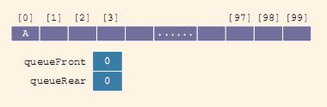
Implementation of Queues as Arrays
Initially, the queue is empty. After operation:
addQueue(Queue, ‘A’);
After two more addQueue operations:
addQueue(Queue, ‘B’);
addQueue(Queue, ‘C’);

Slide 5
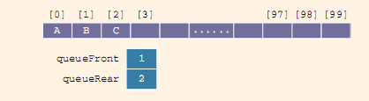
deletion
Consider the deleteQueue operation:
deleteQueue();
Will this design work?
Suppose A stands for adding and D stands for deleting.
AAADADADADADADADA…

Slide 6
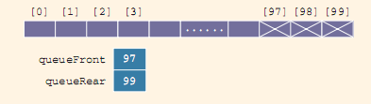
problem...
AAADADADADADADADA…
The sequence of operations would eventually set the index queueRear to point to the last array position, giving the impression that the queue is full.

Slide 7
solution…
One solution to this is that when the queue overflows to the rear (that is, queueRear points to the last array position), we can check the value of the index queueFront indicates that there is room in the front of the array, then when queueRear gets to the last array position, we can slide all of the queue elements toward the first array position.
This solution is good if the queue size is very small; otherwise, the program may execute more slowly.

Slide 8
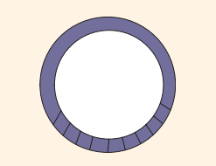
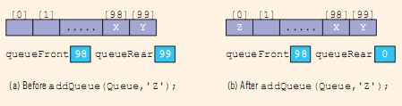
another solution…
Other solution to this problem is to assume that the array is circular – that is, the first array position immediately follows the last array position
We will consider the array containing the queue to be circular, although we will draw the figures of the array holding the queue elements as before

Slide 9
Implementation to arrays 1
#include<iostream>
#include<cstdlib>
//#define MAX 5
using namespace std;
void insert();
void del();
void display();
int const MAX=5;
int queue[MAX];
int rear=-1;
int front=-1;
int main()
{
int choice;
while(1)
{
cout<<"\n\nMAIN MENU\n";
cout<<"1.Insert\n";
cout<<"2.Delete\n";
cout<<"3.Display\n";
cout<<"4.Exit";
cout<<"\n\nEnter Your Choice: ";

Slide 10
cin>>choice;
switch(choice)
{
case 1:
insert();
display();
break;
case 2:
del();
break;
case 3:
display();
break;
case 4:
exit(0);
default:
cout<<"\nWrong Choice!!! Try Again.\n";
}
}
return 0;
}
void insert()
{
int item;
if(rear==MAX-1)
{
cout<<"\nQueue Full!!!\n";
}
else
{
if(front==-1)
{
front=0;
}
cout<<"\nEnter the Element: ";
cin>>item;
rear=rear+1;
queue[rear]=item ;
}
}

Slide 11
void del()
{
if(front==-1||front>rear)
{
cout<<"\nQueue Empty!!!\n";
return ;
}
else
{
cout<<"\nElement Deleted from Queue is "<<queue[front]<<"\n";
front=front+1;
display();
}
}
void display()
{
int i;
if(front==-1||front>rear)
{
cout<<"\nQueue Empty!!!\n";
}
else
{
cout<<"\nQueue is:\n";
for(i=front;i<=rear;i++)
{
cout<<queue[i]<<" ";
}
cout<<"\n";
}
}

Slide 12
Implementation using LL
while (c < n)
{
cout<<"Enter the value to be entered into queue\n";
cin>>x;
push(x);
c++;
}
cout<<"\n\nRemoved Values\n\n";
while(true)
{
if (front != NULL)
cout<<remove()<<endl;
else
break;
}
}
#include<iostream>
#include<stdio.h>
#include<conio.h>
using namespace std;
struct node
{
int data;
node *next;
}*front = NULL,*rear = NULL,*p = NULL,*np = NULL;
int main()
{
int n, c = 0, x;
cout<<"Enter the number of values to be pushed into queue\n";
cin>>n;

Slide 13
int remove()
{
int x;
if(front == NULL)
{
cout<<"empty queue\n";
}
else
{
p = front;
x = p->data;
front = front->next;
delete(p);
return(x);
}
}
void push(int x)
{
np = new node;
np->data = x;
np->next = NULL;
if(front == NULL)
{
front = rear = np;
rear->next = NULL;
}
else
{
rear->next = np;
rear = np;
rear->next = NULL;
}
}

