Slide 1
Structural Organization of the body
Dr. Pinar Khalis
BDS, M.Sc. (Conservative Dentistry)

Slide 2
Content
Human Body
Body Systems
Body Cavities
Divisions of the back
Planes of the body
Positional And Directional Terms
Terminologies

Slide 3
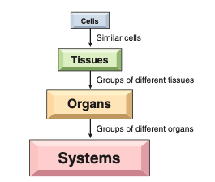
Human Body

Slide 4
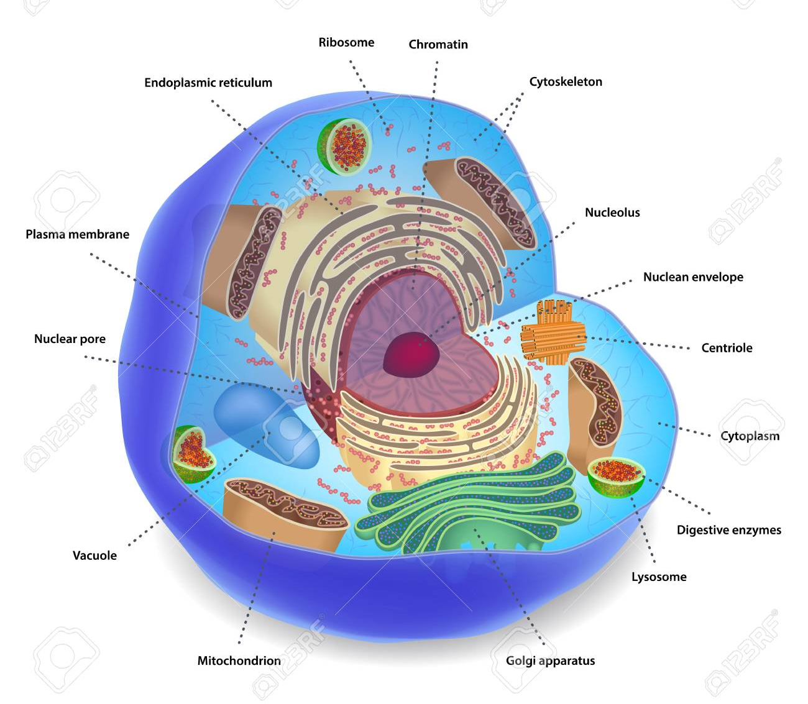
1. Cell
All the parts of your body are composed of individual units called cells.
Examples → muscle, nerve, skin, and bone cells.
Cells are the basic building blocks of all living things. The human body is composed of trillions of cells.
Notes:
They provide structure for the body,
take in nutrients from food,
convert those nutrients into energy, and
carry out specialized functions

Slide 5
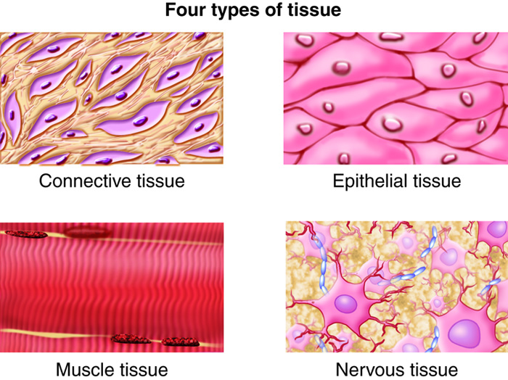
2. Tissue
Similar cells grouped together are tissues.
Example → Connective Tissue
Nervous Tissue
Muscle Tissue
Epithelial Tissue
Notes:
Tissue that supports, protects, and gives structure to other tissues and organs in the body. Connective tissue also stores fat, helps move nutrients and other substances between tissues and organs, and helps repair damaged tissue. Connective tissue is made up of cells, fibers, and a gel-like substance.

Slide 6
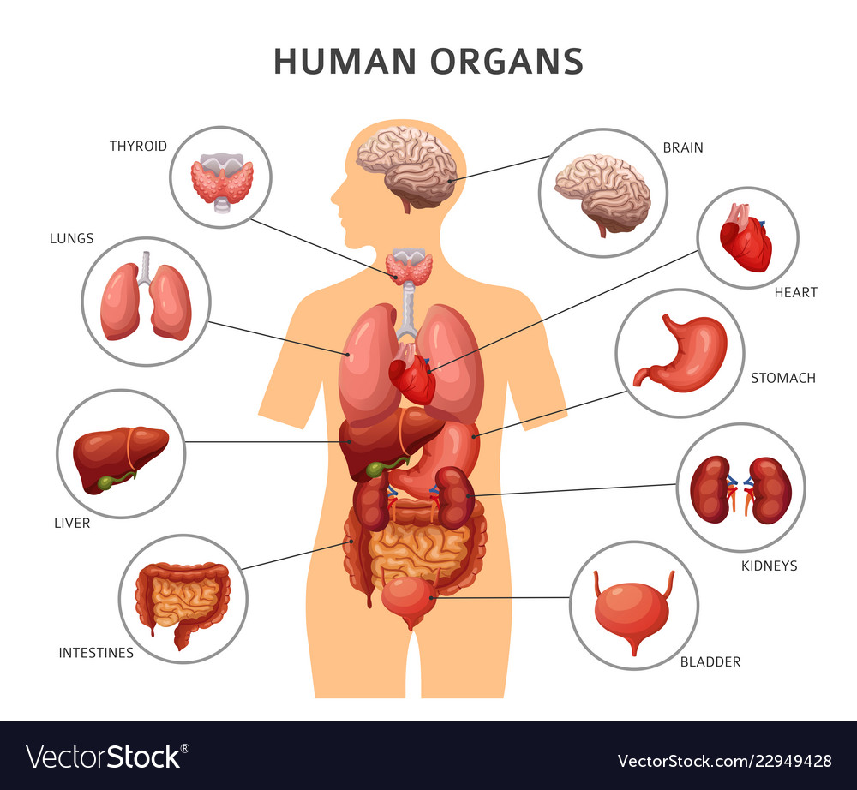
3. Organ
Collections of different tissues working together are organs.
Example → Stomach, that has specialized tissues, such as muscle, epithelial and nerve, that help the organ function.

Slide 7
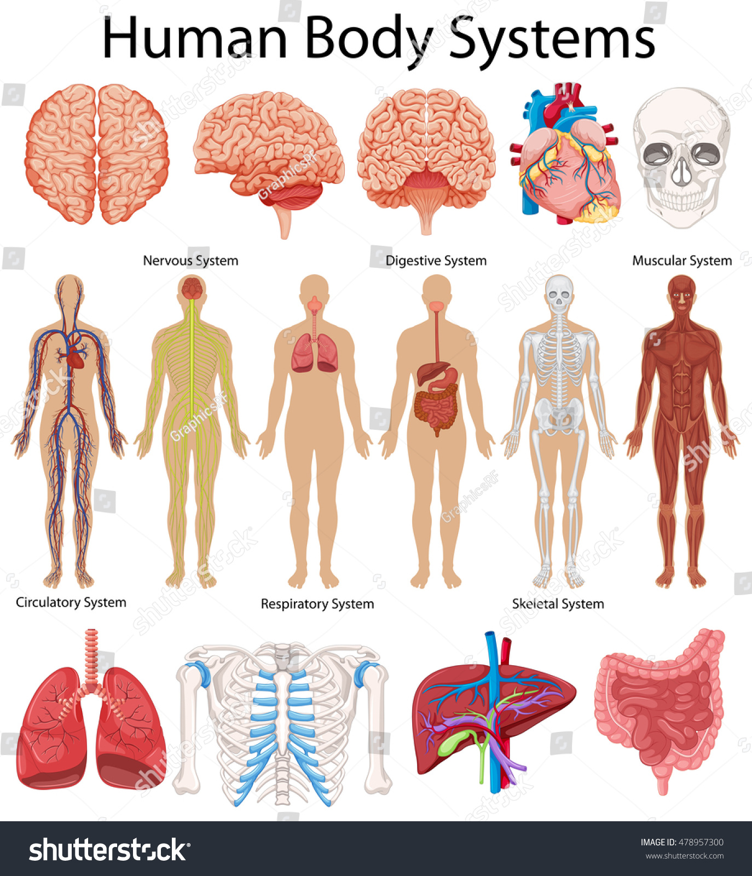
4. Body System
Groups of organs working together are the systems of the body.
The digestive system, for example, includes the mouth, throat (pharynx), esophagus, stomach, and intestines,
Notes:
There are 11 systems of the body, and each plays an important role in the way the body works.

Slide 8
1. Body Systems
The circulatory system (heart, blood, and blood vessels) transports blood throughout the body.
The lymphatic system includes lymph vessels, and nodes that carry a clear fluid called lymph.
Notes:
(heart, blood, and blood vessels such as arteries, veins, and capillaries)
(containing all types of blood cells)
Lymph contains white blood cells called lymphocytes that fight against disease and play an important role in immunity.

Slide 9
Body Systems
The endocrine system, composed of glands, sends chemical messengers called hormones into the blood to act on other glands and organs.
The reproductive systems produce the cells (eggs and sperm) that join to form the embryo.

Slide 10
Body Systems
The nervous system carries electrical messages to and from the brain and spinal cord.
The respiratory system controls breathing, a process by which air enters and leaves the body.

Slide 11
Body Systems
The digestive system brings food into the body and breaks it down then it enters the bloodstream. Food that cannot be broken down is removed from the body at the end of the system as waste.
The musculoskeletal system, including muscles, bones, joints, and connective tissues, supports the body and allows it to move.

Slide 12
Body Systems
The urinary system produces urine and sends it out of the body through the kidneys, ureters, bladder, and urethra.
The skin and sense organ system, including the skin, nose, tongue, eyes and ears, receives messages from the environment and sends them to the brain.

Slide 13
ORGANS/ STRUCTURES AND SYSTEMS
Organ/Structure | System
1. Bronchial tubes | Respiratory
2. Cerebrum | Nervous
3. Coccyx (tailbone) | Musculoskeletal
4. Colon (large intestine) | Digestive
5. Esophagus (food tube) | Digestive
6. Kidneys | Urinary
7. Larynx (voice box) | Respiratory
8. Lungs | Respiratory
9. Ovaries | Female reproductive/endocrine
10. Pharynx (throat) | Digestive/respiratory
11. Pituitary gland | Endocrine
12. Prostate gland | Male reproductive
13. Spinal cord | Nervous
14. Trachea (windpipe) | Respiratory
15. Ureters | Urinary
16. Urethra | Urinary
17. Uterus | Female reproductive
18. Vertebrae (backbones) | Musculoskeletal

Slide 15
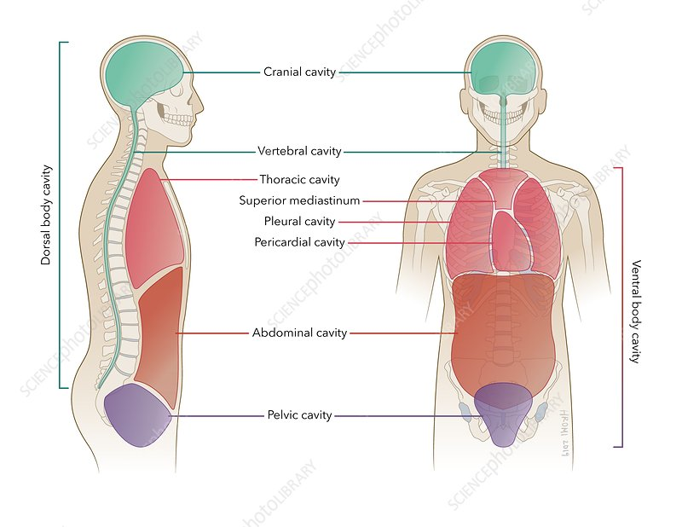
2. Body Cavities
A body cavity is a space that contains organs.

Slide 16
Classification of Body Cavities

Slide 17
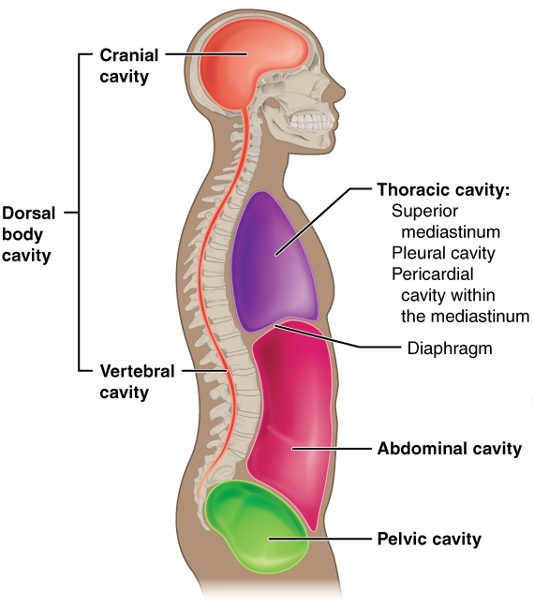
The cranial cavity is located in the head and surrounded by the skull (CRANI/O means skull). The cranial cavity contains the brain and other organs.
The spinal cavity is the space surrounded by the spinal column (backbones). The spinal cord is the nervous tissue within the spinal cavity. Nerves enter and leave the spinal cord and carry messages to and from all parts of the body.

Slide 18
3. The thoracic cavity, also known as the chest cavity (THORAC/O means chest), is surrounded by the breastbone and ribs. The lungs, heart, trachea, bronchial tubes and other organs are in this cavity.
4. The abdominal cavity is the space below the thoracic cavity. The diaphragm is the muscle that separates the abdominal and thoracic cavities. Organs in the abdomen include the stomach, liver, gallbladder, and small and large intestines.

Slide 19
5. The pelvic cavity, below the abdominal cavity. The pelvic cavity is surrounded by the pelvis (bones of the hip). The major organs located within the pelvic cavity are:
The urinary bladder
Ureters: tubes from the kidneys to the bladder
Urethra: tube from the bladder to the outside of the body
Rectum
Anus
The uterus: muscular organ that nourishes the developing embryo and fetus in females.

Slide 20
Activity
Abdominal cavity
Pelvis
Mediastinum
Pleura
Spinal cavity
Membrane surrounding the lungs
Space between the lungs, containing the heart
Bones of the hip
Space containing the liver, gallbladder, and stomach.
Space within the backbones, containing the spinal cord

Slide 21
Activity
Membrane surrounding the organs in the abdomen
Space within the skull, containing the brain
Space below the abdominal cavity, containing the urinary bladder
Muscle between the thoracic and abdominal cavities
Entire chest cavity, containing the lungs, heart, trachea, esophagus, and bronchial tubes
Pelvic cavity
Cranial cavity
Peritoneum
Diaphragm
Thoracic cavity

Slide 22
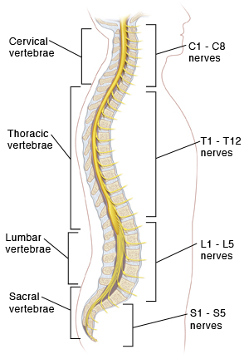
3. Divisions of the Back
Cervical (neck) region → 7 bones → C1-C7
Thoracic (chest) region → 12 bones → T1-T12
Lumbar (loin or waist) region → 5 bones → L1-L5
Sacral (sacrum or lower back) region → 5 fused bones → S1-S5
Coccygeal (coccyx or tailbone) region → 4 fused bones

Slide 23
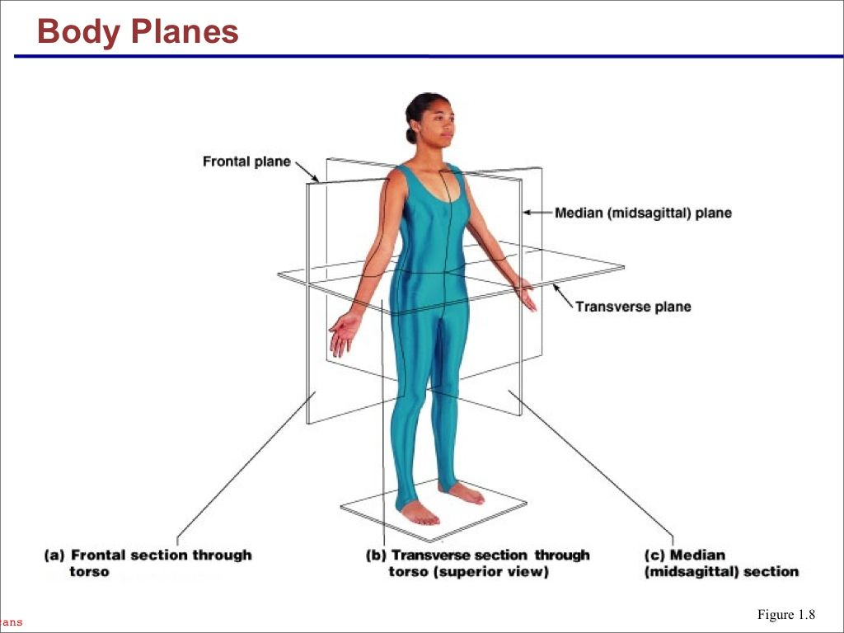
4. Planes of the Body
A plane is an imaginary flat surface.
Organs appear in different relationships to one another according to the plane of the body in which they are viewed.

Slide 24
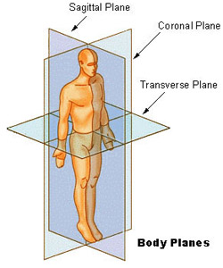
4. Planes of the Body
1. Frontal (coronal) plane
A vertical plane that divides the body, or body part such as an organ, into front and back portions.
Anatomically, anterior means the front portion and posterior means the back portion.

Slide 25
4. Planes of the Body
2. Sagittal (lateral)
A vertical plane that divides the body or organ into right plane and left plane.
The midsagittal plane divides the body vertically into right and left halves.

Slide 26
4. Planes of the Body
3. Transverse (axial)
A horizontal plane that divides the body or organ into upper portion and lower portions, as in a cross section.

Slide 27
5. POSITIONAL AND DIRECTIONAL TERMS
Location` | Relationship
Anterior (ventral) [1] | Front side of the body. Example: The forehead is on the anterior side of the body
Posterior (dorsal) [2] | The back side of the body. Example: The back of the head is posterior (dorsal) to the face.
Deep [3] | Away from the surface. Example: The stab wound penetrated deep into the abdomen.

Slide 28
Cont..
Location` | Relationship
Superﬁcial [4] | On the surface. Example: Superﬁcial veins can be viewed through the skin
Proximal [5] | Near the point of attachment to the trunk or near the beginning of a structure. Example: The proximal end of the thigh bone (femur) joins with the hip socket.
Distal [6] | Far from the point of attachment to the trunk or far from the beginning of a structure. Example: At its distal end, the femur joins with the knee.

Slide 29
Cont..
Location` | Relationship
Inferior [7] | Below another structure. Example: The feet are at the inferior part of the body. They are inferior to the knees. The term caudal (pertaining to the tail, or to the lower portion of the body) also means away from the head or below another structure.
Superior [8] | Above another structure. Example: The head lies superior to the neck. Cephalic (pertaining to the head) also means above another structure.
Medial [9] | Pertaining to the middle, or nearer the medial plane of the body.

Slide 30
Cont..
Location` | Relationship
Lateral [10] | Pertaining to the side. Example: When in the anatomic position (palms of the hands facing outward), the thumb is lateral.
Supine [11] | Lying on the back. Example: The patient lies supine during an examination of the abdomen. (The face is up in the supine position.
Prone [12] | Lying on the belly. Example: The backbones are examined with the patient in a prone position. (The patient lies on his or her stomach in the prone position.)

Slide 31
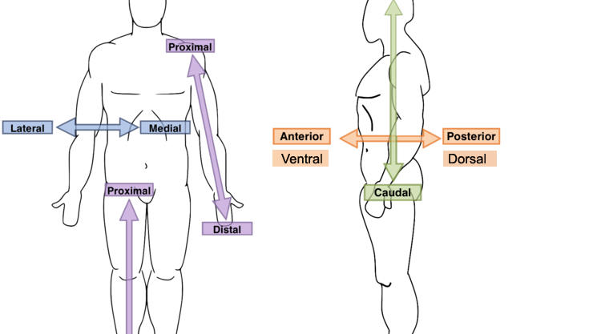
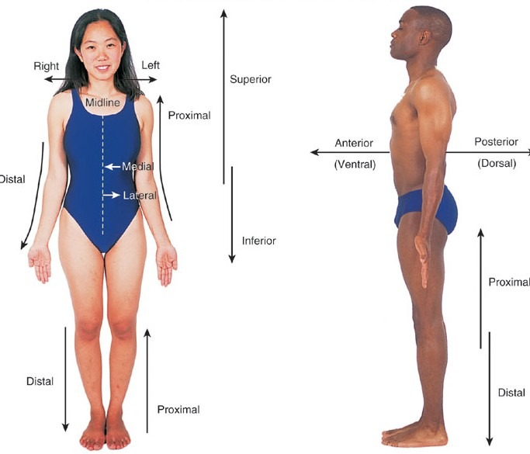

Slide 32
Terminology
COMBINING FORM | MEANING | MEDICAL TERM | MEANING
abdomin/o | abdomen | abdominal | Pertaining to the abdomen.
anter/o | front | anterior The suffix -IOR means pertaining to. | Located in the front
bronch/o | bronchial tubes (leading from the windpipe to the lungs) | bronchoscopy | Visual examination of bronchial tubes
cervic/o | neck of the body or neck (cervix) of the uterus | cervical | pertaining to the neck of the body pertaining to the uterine cervix (lower portion of the uterus

Slide 33
Terminology
COMBINING FORM | MEANING | MEDICAL TERM | MEANING
coccyg/o | coccyx, tailbone | coccygeal -EAL means pertaining to. | Tailbone
crani/o | skull | craniotomy | Incision of the skull.
epitheli/o | skin, surface tissue | epithelial | The term epithelial was used to describe the cells on the outer layer (surface) of the skin as well as the lining of the internal organs that lead to the outside of the body.

Slide 34
Terminology
COMBINING FORM | MEANING | MEDICAL TERM | MEANING
esophag/o | esophagus (tube from the throat to the stomach) | esophageal | Pertaining to the esophagus.
hepat/o | liver | hepatitis | Inflammation of the liver.
lapar/o | abdomen | laparoscopy | Visual examination of the abdomen.
laryng/o | larynx (voice box) | laryngeal Laryngectomy | Removal of the larynx (voice box).

Slide 35
Terminology
COMBINING FORM | MEANING | MEDICAL TERM | MEANING
later/o | Side | Lateral | Pertaining to the side.
lymph/o | lymph (clear fluid in tissue spaces and lymph vessels) | lymphocyte | Lymphocytes are white blood cells that fight disease.
mediastin/o | mediastinum (space between the lungs) | mediastinal | Pertaining to the mediastinum.
pelv/o | pelvis (bones of the hip) | pelvic | Pertaining to the bones of the hip area.

Slide 36
Terminology
COMBINING FORM | MEANING | MEDICAL TERM | MEANING
peritone/o | peritoneum (membrane surrounding the abdominal organs) | peritoneal | Peritoneal fluid, produced by the peritoneal membrane, lubricates the surfaces of the peritoneum to prevent friction.
pharyng/o | pharynx (throat) | pharyngeal | The pharynx (pronounced FAR-inks) is the common passageway for food from the mouth and air from the nose.

Slide 37
Terminology
COMBINING FORM | MEANING | MEDICAL TERM | MEANING
poster/o | back, behind | posterior | Located in the back portion of a structure or of the body.
sacr/o | sacrum | sacral | five fused bones in the lower back
spin/o | spine (backbone) | spinal | Pertaining to the spine (backbone).
thorac/o | chest | thoracotomy | Incision of the chest.
trache/o | trachea (windpipe) | tracheotomy | Incision of the trachea.
vertebr/o | vertebra (backbone) | vertebral | Pertaining to a backbone.

Slide 38
References
Medical terminology: short course (6th edition) by Davi-Ellen Chabner
The Language of Medicine (10th Edition) by Davi-ellen Chabner

