Slide 1
Tishk International University
Engineering Faculty
Petroleum & Mining Eng. Department
Introduction To Mining PTR-318
Lecture 1
3rd. Grade- Fall Semester 2022-2023
Instructor: Professor, Dr. Hamed M. Jassim

Slide 2
Course Information
Academic Year | 2022-2023
Stage | Fall Term-Fifth Semester
Course Title | Introduction To Mining
Course Code | PTR-318
Weekly Load | 2 hrs – 2 hrs
Class Times | Theory: Mondays 12:00 – 12:50 + 13:30 – 14:20 Tutorial: Tuesdays 11:00 – 12:50 + 13:30 – 15:20
Office Hours | 2 hrs: ( Tuesdays 9:00 – 11:00 )
Instructor | Professor, Dr. Hamed Muhammed JASSIM
College /Department | Faculty of Engineering | Petroleum & Mining Eng. Department
Contact / Instructor | Email: hamed.jassim@tiu.edu.iq
Coordinator
Text Book | Elements of Mining, by G. Young, McGraw-Hill Book C. Inc. Courses in Mining Geology, by R.N.P. Arogyaswawy, Oxford & IBH Publishing Co. SME Mining Engineering Handbook, Vol. 1 & 2, by Cummins & Given, AIMM, New York, 1973

Slide 3
Course Overview
The course will cover the basic principles of Mining Engineering. Mine design and the factors affecting it will be explained for which the physical and mechanical properties of ores and rocks need to be outlined. The factors affecting the selection of mining method will also be outlined. The basic mining terms are explained and illustrated with explanation of the different types of ore bodies. Mine shafts and their jobs, types, selection of sites, shapes, sizes and shaft sinking methods will be explained. A summarized overview of mining methods classification and the main types of mines ( surface mines, underground mines and special mining methods ) and the method of choice between them, with some examples will be presented.
Course Objectives
This course is intended for third year petroleum & mining engineering students. It provides them with some understanding of the basics of mining engineering and the different mining methods and their classification and applications. It is intended to provide the petroleum & mining engineering student with the basic mine design factors and parameters and some understanding of the major physical and mechanical properties of ores and rocks to help in the design of mine and the selection of mining methods. The students will be introduced to the main mining technical terms to help them better understand and have an idea about this field.
References
Books
Excavations of Mine Openings, by D. Onika, Translated by Victor Shiffers, MIR Publisher, Moscow. · اسس ھندسة المناجم ، ترجمة: د. حامد محمد جاسم العيساوي و د. سمير ابراھيم يوسف، مطبعة جامعة الموصل،1984

Slide 4
Weeks | Contents
1 | References ; Introduction ; Presentation of Course Information.
2 | Mineral Wealth in Koya & Kurdistan Region-Part 1.
3 | Mineral Wealth in Koya & Kurdistan Region-Part 2.
4 | Mineral Wealth in Koya & Kurdistan Region-Part 3.
5 | Mine Design and the Factors Affecting it.
6 | Physical and Mechanical Properties of Ores & Rocks.
7 | Other Physical & Mechanical Properties of Ores & Rocks.
8 | Other Physical & Mechanical Properties of Ores & Rocks.
9 | Other Physical & Mechanical Properties Of Ores & Rocks.
10 | Overall Factors for Mining Method Selection, The Elements of Discovered Ore Body with Some Mining Terms.

Slide 5
11 | Other Mining Terms, Mine Shafts: Their Jobs, Their Site Selection & Their Shapes.
12 | Sizes Of Mine Shafts, Shaft Pillar, Shaft Collar & Sinking Of Mine Shafts.
13 | Shaft Sinking in Soft Ground: Freezing Method, Cementation Method & Other Shaft Sinking Methods.
14 | Classification of Mining Methods, Mineral Deposits and their Mining Methods.

Slide 6
1st Lecture: References, Introduction,Objectives:
Overview of the references and their importance.
To outline the importance of mining engineering in the exploitation of mineral resources and their role in the economy of the country.
To outline the main parameters and factors related to the design of mine and the choice of mining method.
References:
The following references will be outlined and their importance will be indicated.
1- Elements of Mining, by G. Young, McGraw-Hill Book C. Inc. 2-Courses in Mining Geology, by R.N.P. Arogyaswawy, Oxford &
IBH Publishing Co.
SME Mining Engineering Handbook, Vol. 1 & 2, by Cummins & Given, AIMM, New York.
Excavations of Mine Openings, by D. Onika, Translated by Victor Shiffers, MIR Publisher,
Moscow.
Surface Mining and Quarrying, by IMM ( Institute of Mining & Metallurgy ).

Slide 7
Introduction:
The exploitation of industrial rocks, minerals and ore deposits represents an essential source of strengthening the economy and helping development in any country.
The optimum exploitation of such ores, minerals and industrial rocks is an important matter in order to reduce expenditure to the lowest level and to increase profitability of the mining activity.
Many factors play part in the optimization of the mining activity. Some of these factors are related to:
1- The type of ore, mineral and industrial rock and their grade or assay value.
2- Their proven reserve and extractable ore quantities.
3- Their market value.
4- Other factors are related to the selected mining method, its safety, cost of execution.
5- The cost of processing or upgrading of raw material.
6- Some other socio-economic factors may play a role in that as well, such as availability of manpower.
7- The availability of internal and external manpower and technical expertise and the availability of transport facilities and their costs.
8- The types of excavation machines and equipment and their production rate may play a part in the economic feasibility of the investment for ore and mineral extraction.

Slide 8
Mineral Wealth In Koya & Kurdistan Region-Part 1:
Economic Geology of Koya Area:-
Oil: Koisanjaq vicinity shows high potential for oil discovery, especially the southern and southwestern parts. The Taq Taq and Cham Chamal North anticlines are known oil fields.
The drilled oil wells indicate the presence of oil in economic amounts. In Taq Taq anticline, the Pila Spi, Shiranish and Qamchuqa Formations are considered as three pay zones (I.P.C., 1963).
Many other anticlines, like Bana Bawi may also form traps for oil accumulation, but in deeper zones, i.e. deeper than Cretaceous formations. Those, in which Triassic rocks are exposed, could be potentials for Paleozoic reservoir. To ascertain this, different types of works must be executed.

Slide 9
Limestone for cement industry is another economic aspect in Koisanjaq vicinity.
The limestone beds of the Fatha Formation show very good suitability for cement industry (Sissakian and Youkanna, 1979).
Because the involved area shows the plunge of Bana Bawi anticline; therefore, all quarrying factors are courageous, the thickness, the areal coverage, the low dip amount, no overburden and presence of all other facilities like roads, electricity, man power….etc. in the vicinity. Moreover, the limestone of the Khurmala Formation is proved to be suitable for cement industry.

Slide 10
Claystone for brick industry is another economic aspect.
Different formations may contain suitable claystone for brick industry.
The Bai Hassan Formation is an example. Towards west of Koisanjaq vicinity, the chemical analysis of such claystone revealed excellent results.
It is worth to mention that claystones in Injana and Mukdadiya formations in different parts of Iraq include industrial clay minerals, like montmorillonite, kaolinite; therefore, it is highly recommended to perform special studies to discover such industrial claystones, especially there are oil exploration activities in the vicinity and near surroundings.

Slide 11
Gypsum is present within the Fatha Formation, but the thickness and extension of the beds are not favorable for large industries; however, they may cover the local demands.
Another economic aspect is the sand and gravel in the main valleys.
They are almost free of SO₄, due to very rare gypsum exposures.
They could be used in different constructions.

Slide 12
MINERALS POTENTIAL IN KURDISTAN:
The Kurdistan Region’s mineral profile is characterized by the occurrence of diverse metallic mineral deposits, such as Lead (Pb), Zinc (Zn), Copper (Cu), Chrome (Cr), Nickel (Ni), Cobalt (Co), Manganese (Mn) and Iron (Fe) which are believed to have
derived from magmatic, hydrothermal and sedimentary origins, beside or in association with some other non-metallic mineral deposits like Barite, Talc & Asbestos.
Most of the metallic deposits are in the suture zone which is related to various phases of the plate tectonic history (Neo-Tethys Oceanic event) of the region, where igneous activities with deep-seated fault are more probable for the origin of mineralization to the north east of the region, while hydrothermal activities are the likely cause of metallic deposits to the north of the region.

Slide 13
According to the existence and concentration of metallic ore deposits and the availability of the information and data , the Region is divided in to seven (7) blocks for
exploration and investment as follows: Figures A, B, C.
DUHOK GOVERNORATE
1- BLOCK 1
2- BLOCK 2
ERBIL GOVERNORATE
1- BLOCK 3
2- BLOCK 4
SULAYMANIA GOVERNORATE
1- BLOCK 5
2- BLOCK 6
3- BLOCK 7.

Slide 14
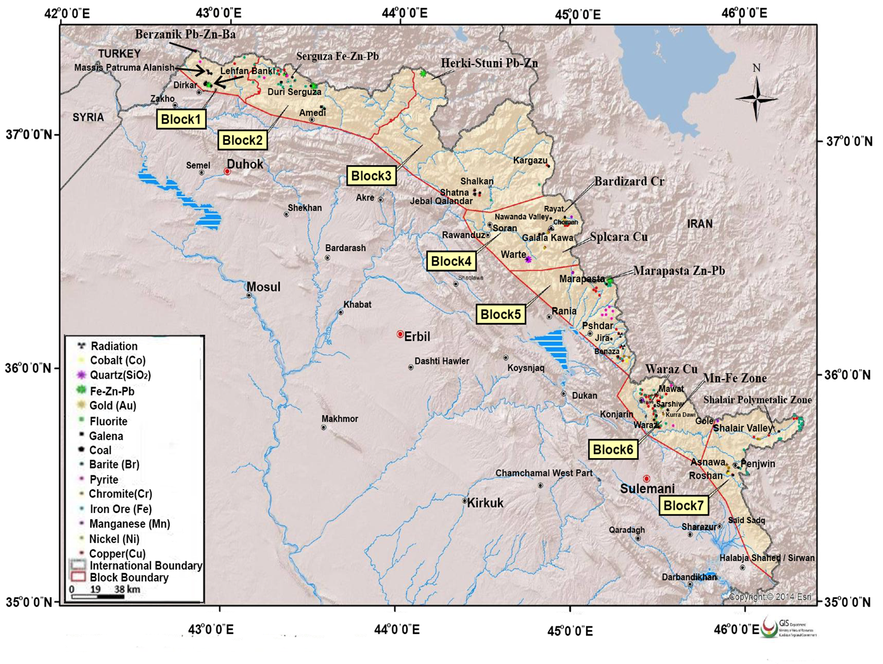

Slide 15
