Slide 1
Lecture 1: Algorithms and Pseudocode

Slide 2
Objectives
Algorithms
Flowcharts
Types of Algorithms:
Searching (Linear, Binary)
Sorting (Bubble, Insertion)
Optimization (Greedy, Whale Optimization Algorithms (WOA))
Recursive
Big-O Notation

Slide 3
Algorithm
An algorithm is a finite sequence of precise instructions for performing a computation or for solving a problem.

Slide 4
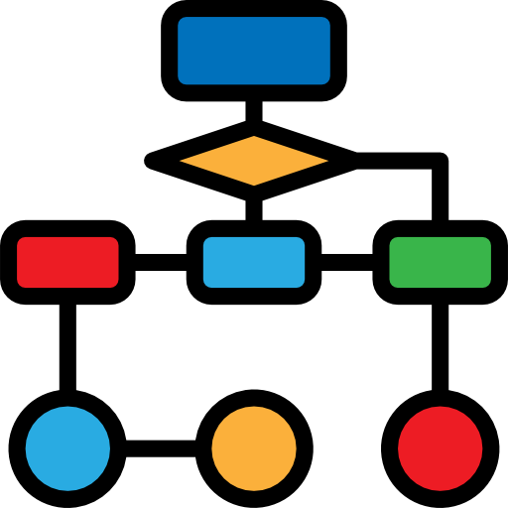
Flowchart
A flowchart is a diagram that depicts a process, system or computer algorithm. They are widely used in multiple fields to document, study, plan, improve and communicate often complex processes in clear, easy-to-understand diagrams.
https://app.diagrams.net/
https://www.lucidchart.com/pages/what-is-a-flowchart-tutorial

Slide 5
Flowcharts can:
Demonstrate the way code is organized.
Visualize the execution of code within a program.
Show the structure of a website or application.
Understand how users navigate a website or program.

Slide 6
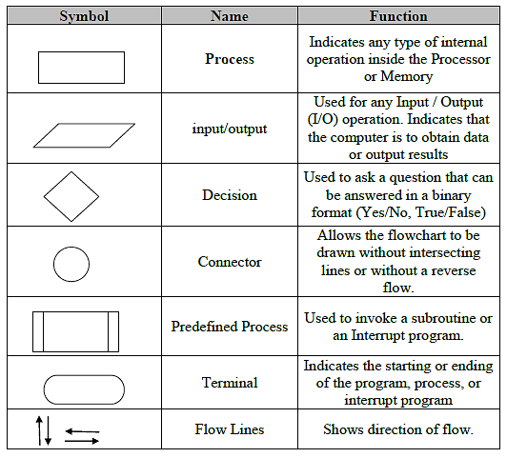

Slide 7
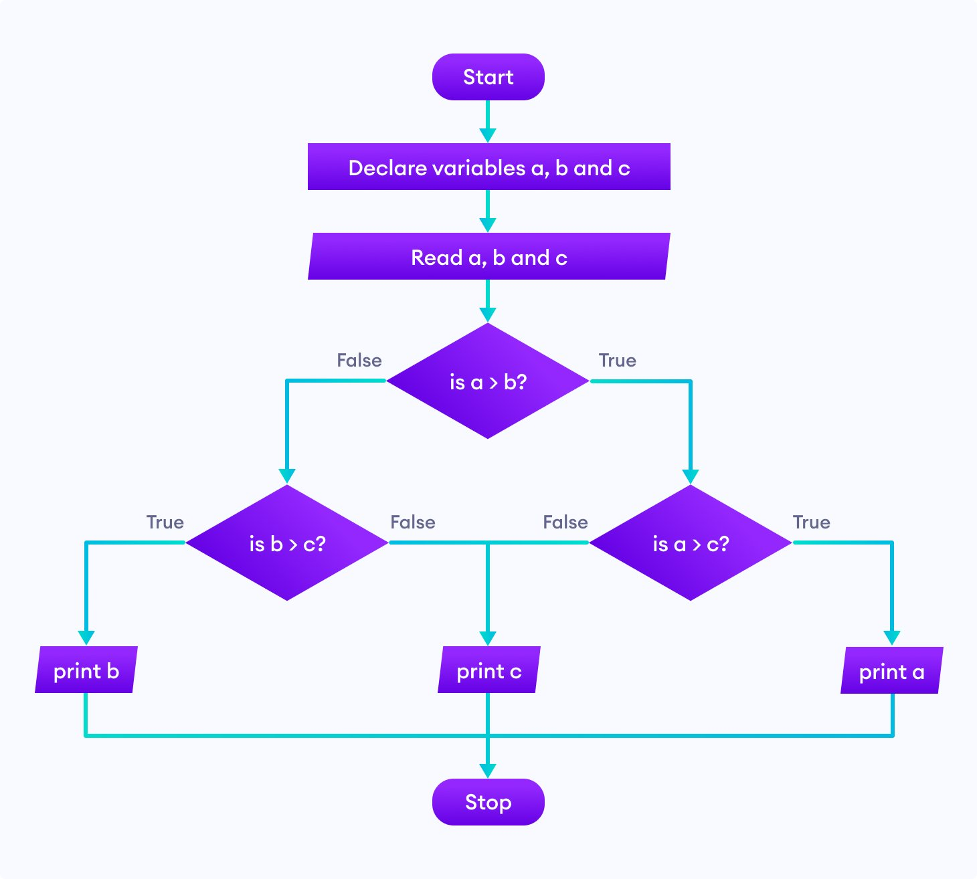
Finding the largest number

Slide 8
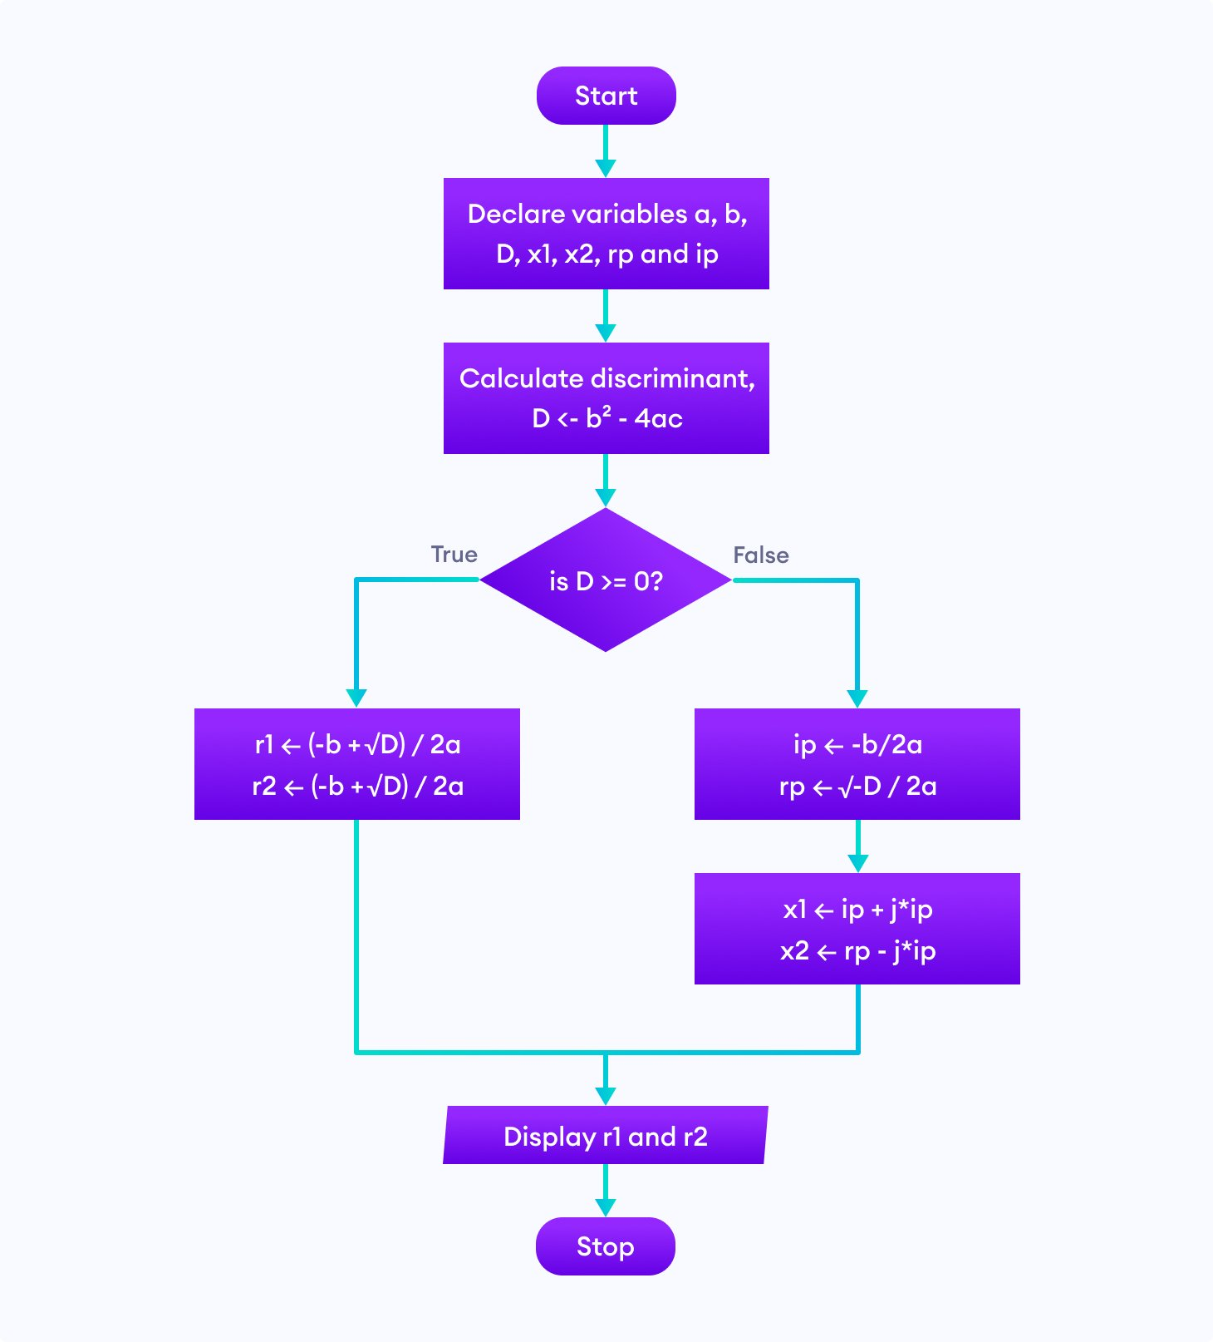
Quadratic Equation

Slide 9
Searching Algorithm

Slide 10
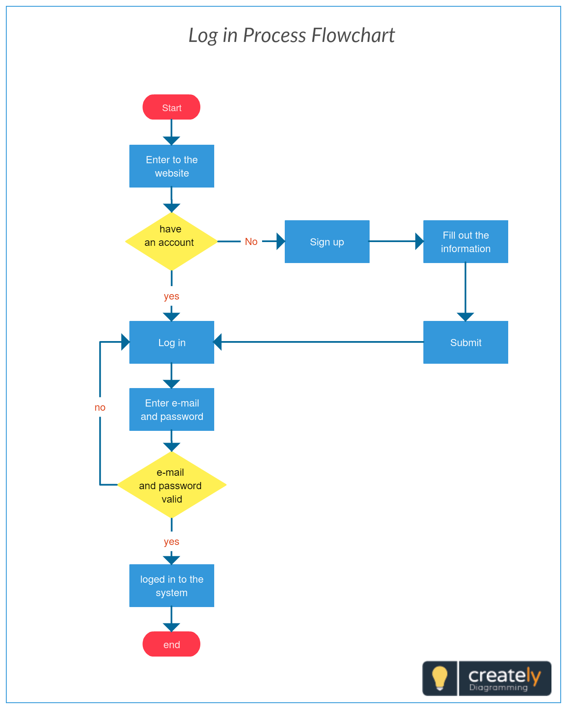
Flowchart for the Website Login Page

Slide 11
EXAMPLE 1:
Set the temporary maximum equal to the first integer in the sequence. (The temporary maximum will be the largest integer examined at any stage of the procedure.)
Compare the next integer in the sequence to the temporary maximum, and if it is larger than the temporary maximum, set the temporary maximum equal to this integer.
Repeat the previous step if there are more integers in the sequence.
Stop when there are no integers left in the sequence. The temporary maximum at this point is the largest integer in the sequence.
Describe an algorithm for finding the maximum (largest) value in a finite sequence of integers.
Notes:
Page: A-12, Appendix 3 – form of Pseudocode will be used to describe algorithms.

Slide 12
https://app.diagrams.net/

Slide 13
Input: $arr[ ] = \{10, 324, 45, 90,9808\}; Output: 9808$
Input : $arr[ ] = \{20, 10, 100, 20, 4\};$ $Output : 100$
Go through each step of the given algorithm to find the max value in array (show every step).

Slide 14
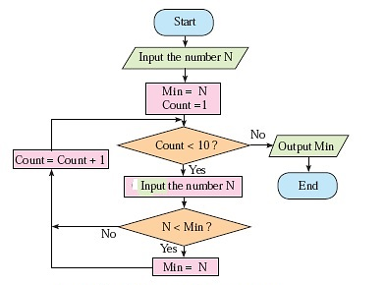
Flowchart to find a minimum value

Slide 15
Create a flowchart, where you have to build a program: sum of n natural numbers.

Slide 17
Pseudocode (Appendix 3)
procedure algorithm name (list $∗$ description of input variables)
{comments}
variable : = expression
if condition then statement or block of statements
if condition then statement 1
else statement 2
if condition 1 then statement 1
else if condition 2 then statement 2
else if condition 3 then statement 3 …
for variable := initial value to final value
block of statements
while condition
statement or block of statements
return output of algorithm

Slide 18
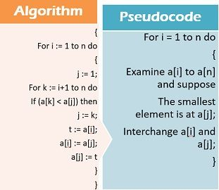
In computer science, pseudocode is a plain language description of the steps in an algorithm or another system. Pseudocode often uses structural conventions of a normal programming language but is intended for human reading rather than machine reading.

Slide 19
Types of Algorithm Problems
Searching
Sorting
Optimization
Looking through a list to find something that needs a specific characteristic
Sort things from least to greatest or greatest to least or biggest to smallest
Looking for the least or the greatest

Slide 20
Facial Recognition
Facial recognition is the mechanics behind iPhone logins and Snapchat filters, and it runs on an algorithm. The system works by using a biometrics map to plot facial features from a photo or video. It then takes this information and compares it to a known database of faces to find a match. This is how it can verify identity. When it is just used for Instagram or Snapchat filters, there is no database search. It simply makes a biometric map of the face and applies the filter to it.
Recipes
Just like sorting papers and even tying your shoes, following a recipe is a type of algorithm. The goal of course being to create a duplicated outcome. In order to complete a recipe, you have to follow a given set of steps. Say you are making bread. You need flour, yeast and water. After you have your ingredients, you need to combine them in a certain way that will create a predictable outcome, in this case a loaf of bread.
Sorting Papers, Traffic Signals, Bus Schedules, GPS, Google Search, Facebook, etc.

Slide 21
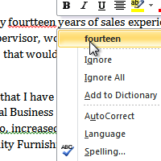
Searching Algorithms
The goal is to locate an element $x$ in the list of distinct elements or determine that it is not in the list.
The goal is to locate an element 𝑥 in the list of distinct elements or determine that it is not in the list.
The solution is the location of the term that equals $x$ or $0$ if $x$ is not in the list.
The solution is the location of the term that equals 𝑥 or 0 if 𝑥 is not in the list.
Example: Spell check
essentially looks through all items in the list, compares it to the dictionary and then the output: it is going to put squiggly little red line under something that is not spelled correctly, or it is not going to do anything if everything is spelled correctly

Slide 22
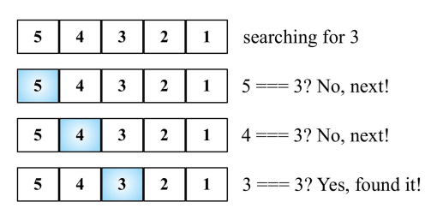
Linear Search
This algorithm checks each term in the sequence, in order, with the desired term, $x$.
Let $x=9$
$$4, 7, 3, 2, 1, 0, 9$$
$$a_{2}$$
$$a_{4}$$
$$a_{6}$$
$$a_{1}$$
$$a_{3}$$
$$a_{5}$$
$$a_{7}$$
Output: 7
Notes:
7 means it is a value in seventh location

Slide 23
Trace the linear search algorithm to look for 12 in the list:
4, 7, 2, 1, 9, 11, 12, 8, 5
$$a_{1}$$
$$a_{3}$$
$$a_{5}$$
$$a_{7}$$
$$a_{9}$$
$$x=12$$
$$a_{2}$$
$$a_{4}$$
$$a_{6}$$
$$a_{8}$$
$i=1$:
$$1≤9?$$
$$12≠4?$$
$i=2$:
$$2≤9?$$
$$12≠7?$$
$i=3$:
$$3≤9?$$
$$12≠2?$$
$i=4$:
$$4≤9?$$
$$12≠1?$$
$i=5$:
$$5≤9?$$
$$12≠9?$$
$i=6$:
$$6≤9?$$
$$12≠11?$$
$i=7$:
$$7≤9?$$
$$12≠12?$$
$$7≤9?$$
$$location=7$$

Slide 24
Trace the linear search algorithm to look for 3 in the list:
4, 7, 2, 1, 9, 11, 12, 8, 5
$$a_{1}$$
$$a_{3}$$
$$a_{5}$$
$$a_{7}$$
$$a_{9}$$
$$x=3$$
$$a_{2}$$
$$a_{4}$$
$$a_{6}$$
$$a_{8}$$
$i=8$:
$$8≤9?$$
$$3≠4?$$
$i=1$:
$$1≤9?$$
$$3≠4?$$
$i=9$:
$$9≤9?$$
$$3≠7?$$
$i=2$:
$$2≤9?$$
$$3≠7?$$
$i=10$:
$$10≤9?$$
$i=3$:
$$3≤9?$$
$$3≠2?$$
$$10≤9?$$
$$location=0$$
$i=4$:
$$4≤9?$$
$$3≠1?$$
$i=5$:
$$5≤9?$$
$$3≠9?$$
$i=6$:
$$6≤9?$$
$$3≠11?$$
$i=7$:
$$7≤9?$$
$$3≠12?$$

Slide 25
Flowchart for a Linear Search

Slide 26
Given a list of array:
$$22, 11, 5, 6, 7, 3, 9, 1$$
Using a Linear Search Algorithm
a) Find the location of $x$, where $x=3$
b) Find the location of $x$, where $x=10$
c) Create a flowchart for a given problem.

Slide 27
Binary Search
In a list of items in increasing order, the binary search algorithm begins by comparing the desired element $x$ with the middle value.
The algorithm then chooses the upper or lower half of the data by comparing the desired value with the middle value.
The process continues until a list of size 1 is found.
Let $x=9$
Output: 7
$$a_{2}$$
$$a_{4}$$
$$a_{6}$$
$$0, 1, 2, 3, 4, 7, 9$$
$$a_{1}$$
$$a_{3}$$
$$a_{5}$$
$$a_{7}$$
$$\frac{1+7}{2}=4 →a_{4}$$
$$3<9 →works only with the right$$
$$side of the list$$
$$\frac{5+7}{2}=6 → a_{6}$$
$$7<9 →works only with the right$$
$$side of the list$$

Slide 28
Search for the umber 8 in the list using the binary search algorithm :
Floor function used for m value in binary search:
|_ 4 _|=4
|_ 4.01 _|=4
|_ 4.99 _|=4
4, 7, 2, 1, 9, 11, 12, 8, 5
$$1, 2, 4, 5, 7, 8, 9, 11, 12$$
$$i=1$$
$$j=9$$
$$x=8$$
$$1<9?$$
$$m=|_\frac{1+9}{2} _|=5$$
$$8>7?$$
$$i=6, j=9$$
$$6<9?$$
$$m=|_\frac{6+9}{2} _|=7$$
$$8>8?$$
$$i=6, j=6$$
$$8=8?$$
$$8>9?$$
$$i=6, j=7$$
$$6<6?$$
$$location=6$$
$$8<9?$$
$$m=|_\frac{8+9}{2} _|=8$$

Slide 29
Search for $the number 3$ in the list using the binary search algorithm :
Floor function used for m value in binary search:
|_ 4 _|=4
|_ 4.01 _|=4
|_ 4.99 _|=4
4, 7, 2, 1, 9, 11, 12, 8, 5
$$1, 2, 4, 5, 7, 8, 9, 11, 12$$
$$i=1$$
$$j=9$$
$x=$3
$$3>2?$$
$$i=3, j=3$$
$$1<9?$$
$$m=|_\frac{1+9}{2} _|=5$$
$$3<3?$$
$$3=4?$$
$$location=0$$
$$3>7?$$
$$i=1, j=5$$
$$1<5?$$
$$m=|_\frac{1+5}{2} _|=3$$
$$3>4?$$
$$i=1, j=3$$
$$1<3?$$
$$m=|_\frac{1+3}{2} _|=2$$

Slide 30
Flowchart for a Binary Search

Slide 31
Given a list of array:
$$22, 11, 5, 6, 7, 3, 9, 1$$
Using a Binary Search Algorithm
a) Find the location of $x$, where $x=3$
b) Find the location of $x$, where $x=10$
c) Create a flowchart for a given problem.

Slide 32
More Practice
Use linear and binary searching algorithms to locate $n=22$ and $n=5$ in set A.
$$A=\{0, 2, 4, 11, 22, 8, 14, 9, 27, 30\}$$

Slide 33
Sorting Algorithms
Used often for large databases like sorting customer or part numbers, prices, etc.
Phone directories (by last name)
Over 100 sorting algorithms have been devised
An algorithm that sorts the elements of a list into increasing order (numerical, alphabetical, etc.)

Slide 34
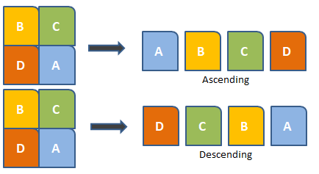
Sorting Algorithms
Bubble Sort
Insertion Sort

Slide 35
Bubble Sort Algorithm
An example of a computer algorithm is bubble sort. This is a simple algorithm used for taking a list of jumbled up numbers and putting them into the correct order. The algorithm runs as follows:
Look at the first number in the list.
Compare the current number with the next number.
Is the next number smaller than the current number? If so, swap the two numbers around. If not, do not swap.
Move to the next number along in the list and make this the current number.
Repeat from step 2 until the last number in the list has been reached.
If any numbers were swapped, repeat again from step 1.
If the end of the list is reached without any swaps being made, then the list is ordered, and the algorithm can stop.

Slide 36
Bubble Sort Algorithm
A simple algorithm that successively compares adjacent elements, interchanging them if they are in the wrong order. This may require several passes.
Pass 1:
Pass 2:
Pass 3:
Pass 4:
Pass 5:
$$4$$
3
5
2
1
$$3$$
4
5
2
1
$$3$$
4
2
5
1
$$3$$
4
2
1
5
$$3$$
4
2
1
5
✔
$$3$$
2
4
1
5
$$3$$
2
1
4
5
$$3$$
2
1
4
5
❌
$$2$$
3
1
4
5
$$2$$
1
3
4
5
$$2$$
1
3
4
5
❌
$$1$$
2
3
4
5
$$1$$
2
3
4
5
❌
✔
❌
❌
❌
❌
❌
✔
Notes:
Is not necessarily efficient, but it is effective Is slow sorting algorithm

Slide 37
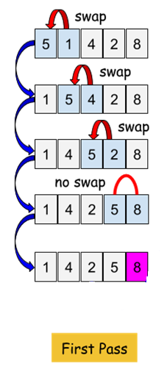
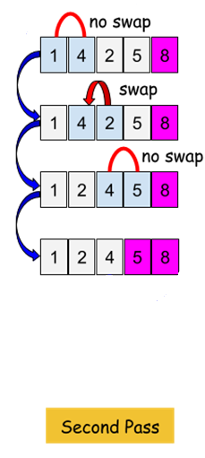
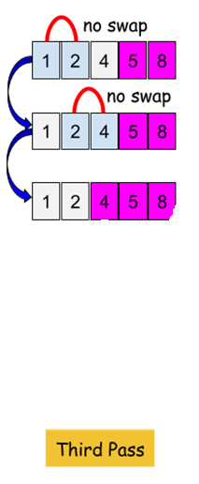
$$5, 1, 4, 2, 8$$
Now, the array is already sorted, but our algorithm does not know if it is completed. The algorithm needs one whole pass without any swap to know it is sorted.

Slide 39
$$0, 5, 7, 6, 9, 4, 3, 2$$

Slide 40
Sort the list using Bubble Sort:
$$3, 1, 7, 5, 2$$
$$3, 1, 7, 5, 2$$
$$1, 3, 5, 2, 7$$
$$1, 3, 2, 5, 7$$
$$1, 2, 3, 5, 7$$
$$1, 3, 7, 5, 2$$
$$1, 3, 5, 2, 7$$
$$1, 3, 2, 5, 7$$
$$1, 2, 3, 5, 7$$
$$1, 3, 7, 5, 2$$
$$1, 3, 5, 2, 7$$
$$1, 2, 3, 5, 7$$
$$1, 3, 5, 7, 2$$
$$1, 3, 2, 5, 7$$
$$1, 3, 5, 2, 7$$

Slide 41
Try!
Use the bubble sort to put 3, 2, 4, 1, 5 into increasing order.

Slide 42
Insertion Sort Algorithm
Another simple sorting algorithm that begins with the second element, comparing it to the first and ordering it appropriately. The third element is then compared with the first and, if necessary, the second to order it. This pattern repeats.
1st pass:
2nd pass:
3rd pass:
4th pass:
$$4$$
3
5
2
1
$$3$$
4
5
2
1
$$3$$
4
5
2
1
2
$$3$$
4
5
1
1
2
$$3$$
4
5

Slide 43
$$7, 4, 5, 2$$

Slide 45
Sort the list using Insertion Sort:
$$3, 1, 7, 5, 2$$
sorted
unsorted
$$3, 1, 7, 5, 2$$
$$1, 3, 7, 5, 2$$
$$1, 3, 7, 5, 2$$
$$1, 3, 5, 7, 2$$
$$1, 2, 3, 5, 7$$

Slide 46
Practice
Use the Bubble and Insertion Sorting algorithms to sort the elements of set A.
$$A=\{42, 19, 32, 11, 8, 1\}$$

Slide 47
Answer: Bubble Sort
Use the Bubble and Insertion Sorting algorithms to sort the elements of set A.
$$A=\{42, 19, 32, 11, 8, 1\}$$
Pass 1:
Pass 2:
Pass 3:
Pass 4:
Pass 5:
$$19, 42, 32, 11, 8, 1$$
$$19, 32, 11, 8, 1, 42$$
$$19, 11, 8, 1, 32, 42$$
$$11, 8, 1, 19, 32, 42$$
$$8, 1, 11, 19, 32, 42$$
$$19, 32, 42, 11, 8, 1$$
$$19, 11, 32, 8, 1, 42$$
$$11, 19, 8, 1, 32, 42$$
$$8, 11, 1, 19, 32, 42$$
$$1, 8, 11, 19, 32, 42$$
$$19, 32, 11, 42, 8, 1$$
$$19, 11, 8, 32, 1, 42$$
$$11, 8, 19, 1, 32, 42$$
$$8, 1, 11, 19, 32, 42$$
$$19, 32, 11, 8, 42, 1$$
$$19, 11, 8, 1, 32, 42$$
$$11, 8, 1, 19, 32, 42$$
Pass 6:
$$19, 32, 11, 8, 1, 42$$
$$1, 8, 11, 19, 32, 42$$

Slide 48
Answer: Insertion Sort
Use the Bubble and Insertion Sorting algorithms to sort the elements of set A.
$$A=\{42, 19, 32, 11, 8, 1\}$$
Pass 1:
Pass 2:
Pass 3:
Pass 4:
Pass 5:
$$19, 42, 32, 11, 8, 1$$
$$19, 32, 42, 11, 8, 1$$
$$11, 19, 32, 42, 8, 1$$
$$8, 11, 19, 32, 42, 1$$
$$1, 8, 11, 19, 32, 42$$

Slide 49
Try!
Use the insertion sort to put the elements of the list 3, 2, 4, 1, 5 in increasing order.
$$3>2,$$
2, 3, 4, 1, 5
$$4>2 \& 4>3,$$
2, 3, 4, 1, 5
$$1<2,$$
1, 2, 3, 4, 5
$$5>4,$$
1, 2, 3, 4, 5

Slide 50
Optimization Algorithms: Greedy Algorithms
These algorithms makes the “best” choice at each step. We must specify what that “best” choice is.
Finding shortest path between two points
Connect network using least amount of fiber-optic cable
Scheduling
There are perhaps hundreds of popular optimization algorithms

Slide 51
Design a greedy algorithm for making change of n U.S. cents with quarter s, dimes, nickels and pennies.
$\$0.97$ – Making Change
At each step, use the largest possible value coin that does not exceed the amount of change left.
$$\$0.97$$
Quarter
$$\$0.97−\$0.25$$
$$\$0.72$$
Quarter
$$\$0.72−\$0.25$$
1 dollar $100$ cents
half dollar $50$ cents
quarter $25$ cents
dime $10$ cents
nickel $5$ cents
penny $1$ cent
$$\$0.47$$
Quarter
$$\$0.47−\$0.25$$
$$\$0.22$$
Dime
$$\$0.22−\$0.10$$
$$\$0.12$$
Dime
$$\$0.12−\$0.10$$
$$\$0.02$$
Penny
$$\$0.02−\$0.01$$
$$\$0.01$$
Penny
$$\$0.01−\$0.01$$

Slide 53
Greedy Algorithm: scheduling
A greedy algorithm makes the best choice at each step according to a specified criterion. However, it also can be difficult to determine which of many possible criteria to choose:
To use a greedy algorithm to schedule the most talks, that is, an optimal schedule, we need to decide how to choose which talk to add at each step. There are many criteria we could use to select a talk at each step, where we chose from the talks that do not overlap talks already selected. For example, we could add talks in order of earliest start time, we could add talks in order of shortest time, we could add talks in order of earliest finish time, or we could use some other criterion.
Talk 1 starts at 8 a.m. and ends at 12 noon,
Talk 2 starts at 9 a.m. and ends at 10 a.m.,
Talk 3 starts at 11 a.m. and ends at 12 noon.

Slide 54
8 am – 12 pm
9 am – 10 am
11 am – 12 am
We first select the Talk 1 because it starts earliest. But once we have selected Talk 1 we cannot select either Talk 2 or Talk 3 because both overlap Talk 1. Hence, this greedy algorithm selects only one talk. This is not optimal because we could schedule Talk 2 and Talk 3, which do not overlap.

Slide 56
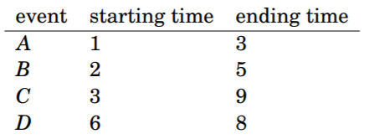
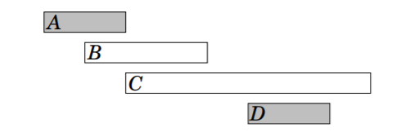
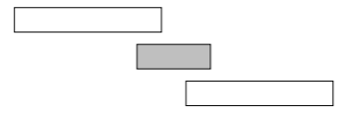
Algorithm 1:
The first idea is to select as short events as possible. In the example, this algorithm selects the following events:
However, selecting short events is not always a correct strategy. For example, the algorithm fails in the below case:

Slide 57
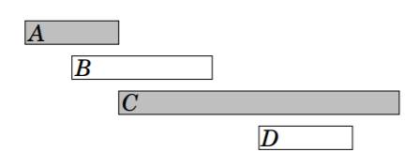
Algorithm 2:
Another idea is to always select the next possible event that begins as early as possible. This algorithm selects the following events:
However, given a counter example for this algorithm. In this case, the algorithm only selects one event:

Slide 58
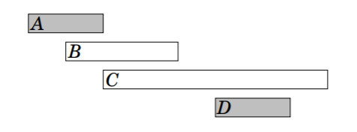
Algorithm 3:
The third idea is to always select the next possible event that ends as early as possible. This algorithm selects the following events:
It turns out that this algorithm always produces an optimal solution.
The reason for this is that it is always an optimal choice to first select an event that ends as early as possible.
After this, it is an optimal choice to select the next event using the same strategy, etc., until any other event can’t be selected.
One way is the algorithm works is to consider what happens if first select an event that ends later than the event that ends as early as possible.
Now, with having at most an equal number of choices how the next event can be selected.
Hence, selecting an event that ends later can never yield a better solution, and the greedy algorithm is correct.

Slide 59
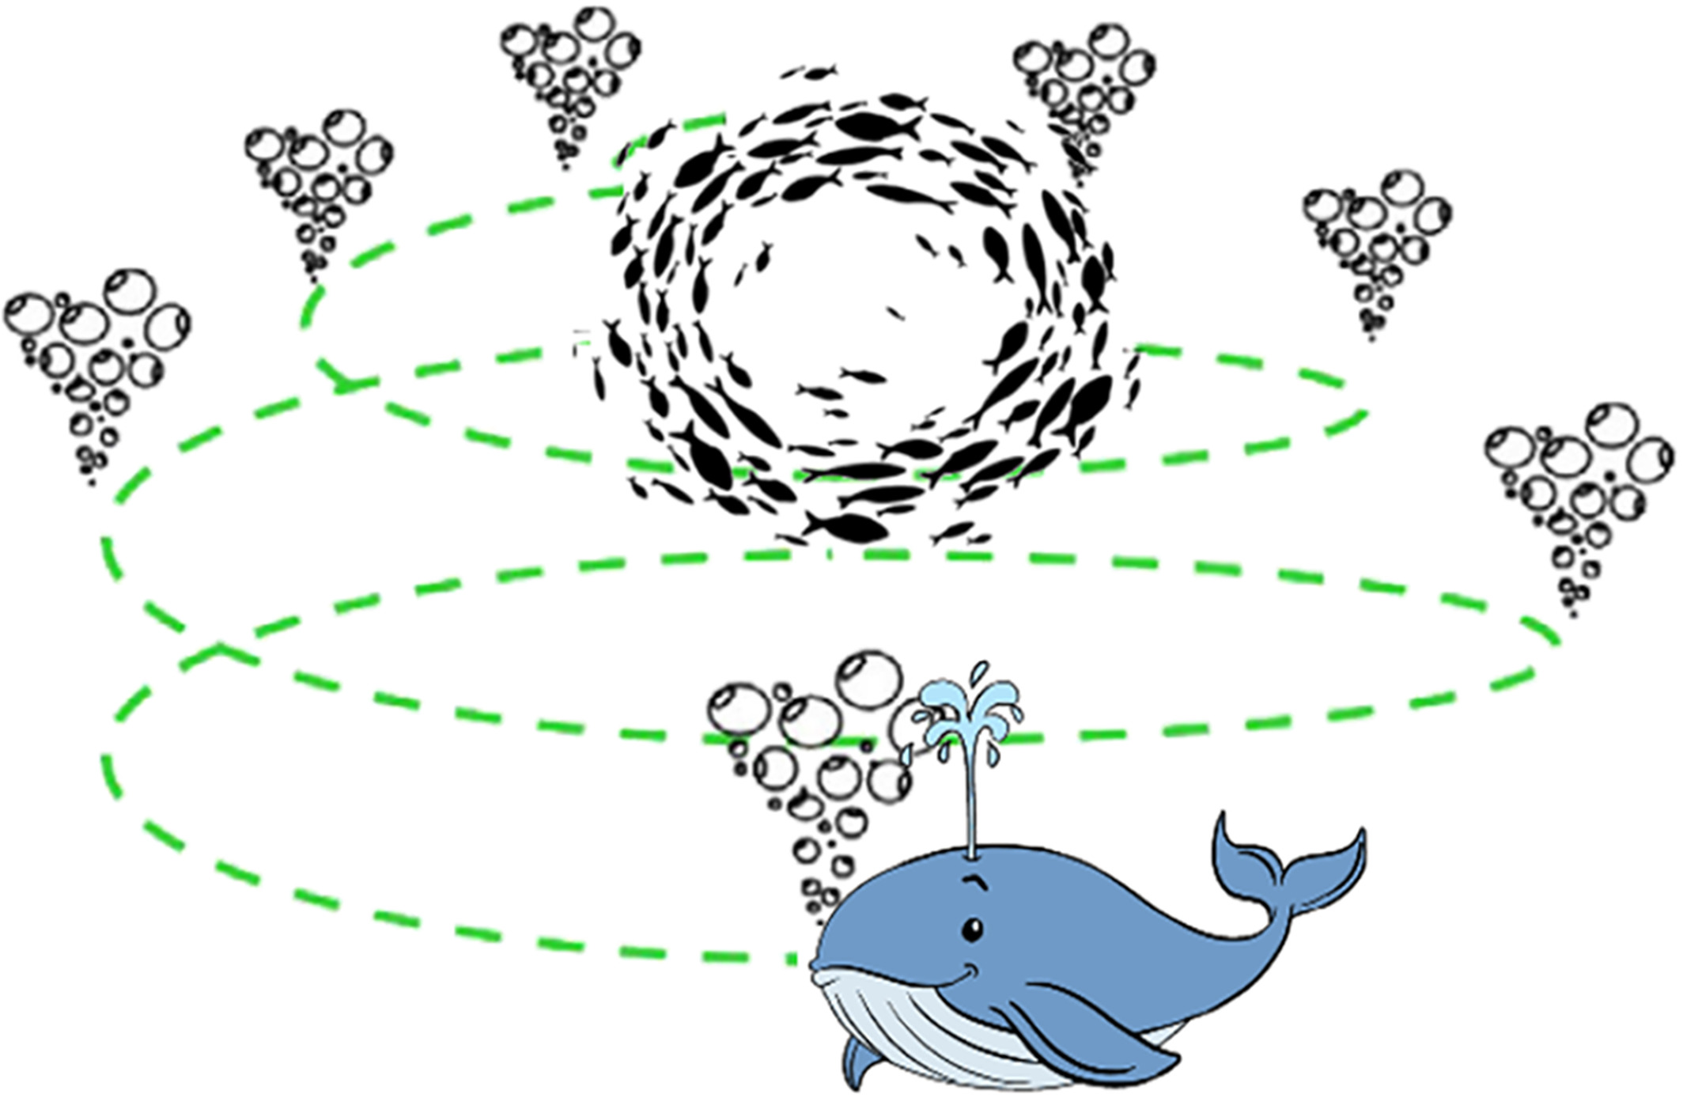
Hunting strategy of Humpback Whale
Whale Optimization Algorithm (WOA)
Humpback Whale dive 12 meters deep.
They create bubble around the target.
Target will be captured by bubbles.
Ready to eat.
To catch their prey, whales use Bubble Net Feeding method

Slide 60
Applications of WOA
The WOA is a new swarm intelligence optimization algorithm, which was proposed by Australian scholars Mirjalili and Lewis in 2016. Inspired by the hunting behavior of humpback whales in nature, the algorithm simulates the shrinking encircling, spiral updating position, and random hunting mechanisms of the humpback whale population. The algorithm includes three stages: encircling prey, bubble net attack and search for prey.

Slide 61
Humpback Whale: Hunting Technique

Slide 63
Practice
1. List all the steps used by Algorithm 1 (procedure max) to find the maximum of the list: 1, 8, 12, 9, 11, 2, 14, 5, 10, 4.
2. Devise an algorithm that finds the sum of all the integers in a list.
3. Describe an algorithm that takes as input a list of n integers and finds the location of the last even integer in the list or returns 0 if there are no even integers in the list.

Slide 65
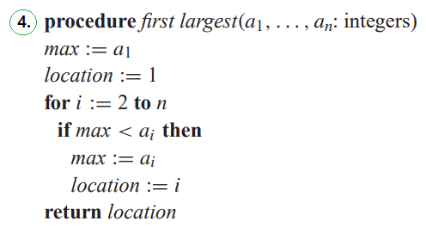
4. Describe an algorithm that locates the first occurrence of the largest element in a finite list of integers, where the integers in the list are not necessarily distinct.

Slide 66
5)
6)

Slide 67
5)
1, 5, 4, 3, 2;
1, 2, 4, 3, 5;
1, 2, 3, 4, 5;
1, 2, 3, 4, 5
b) 1, 4, 3, 2, 5;
1, 2, 3, 4, 5;
1, 2, 3, 4, 5;
1, 2, 3, 4, 5
c) 1, 2, 3, 4, 5;
1, 2, 3, 4, 5;
1, 2, 3, 4, 5;
1, 2, 3, 4, 5
6)

Slide 68
7)
Use the greedy algorithm to make change using quarters,
dimes, nickels, and pennies for:
51 cents
69 cents
76 cents
60 cents
Use the greedy algorithm to make change using quarters,
dimes, and pennies (but no nickels) for each of the amounts given
in 7) question above. For which of these amounts does the greedy
algorithm use the fewest coins of these denominations possible?
8)
9)

Slide 69
7)
a) Two quarters, one penny
b) Two quarters, one dime, one nickel, four pennies
c) A three quarters, one penny
d) Two quarters, one dime
8) Greedy algorithm uses fewest coins in parts (a), (c), and (d). a) Two quarters, one penny b) Two quarters, one dime, nine pennies c) Three quarters, one penny d) Two quarters, one dime
9) The 9:00–9:45 talk, the 9:50–10:15 talk, the 10:15–10:45 talk, the 11:00–11:15 talk

Slide 70
Links for additional and detailed information about Optimization
https://machinelearningmastery.com/tour-of-optimization-algorithms/
https://algorithmsbook.com/optimization/files/optimization.pdf

Slide 71
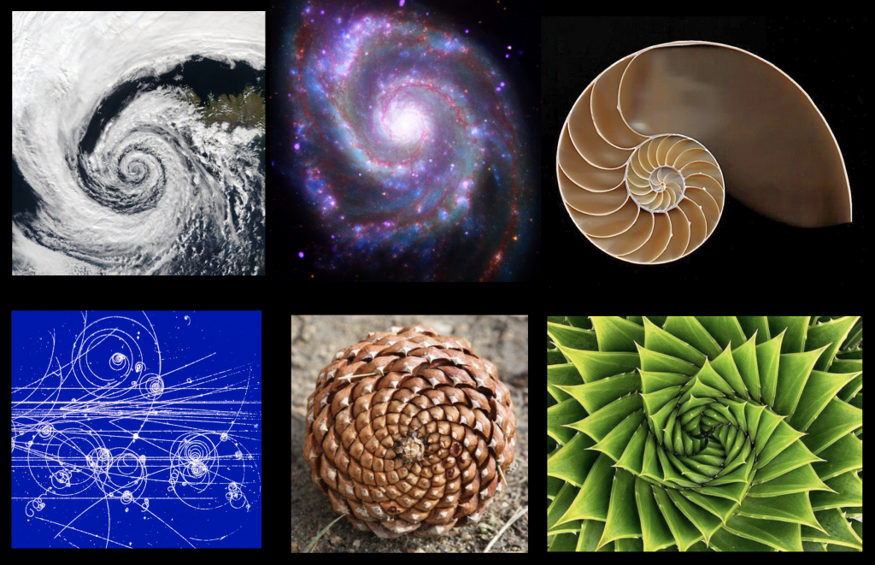
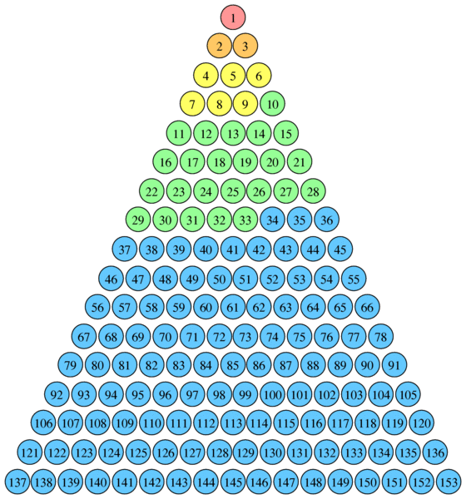
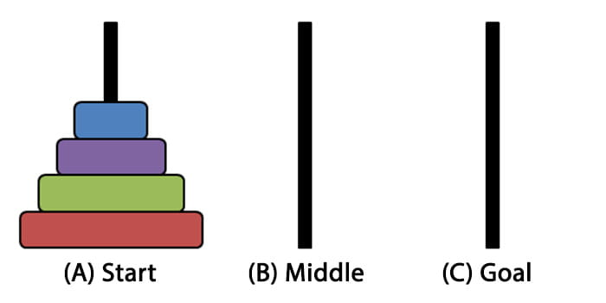
Recursive
Fibonacci
Triangular Numbers
Towers of Hanoi
Sequences

Slide 72
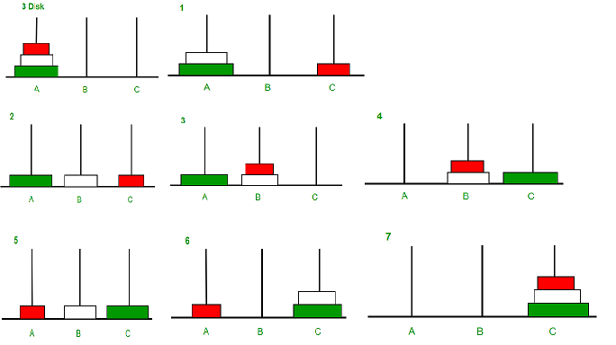
Towers of Hanoi
$$n=3:$$

Slide 73
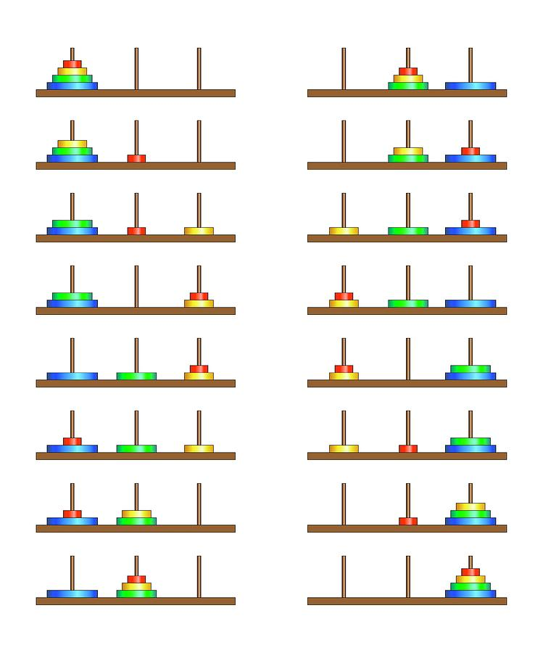
$$n=4:$$

Slide 74
Towers of Hanoi
$$1,3,7,15,31,63, 127, 255…$$
$$2^{n}−1$$
If you had $64$ golden disks you would have to use a minimum of $2^{64}−1$ moves. If each move took one second, it would take around $585 billion$years to complete the puzzle!

Slide 75
Towers of Hanoi animations
Play and make sure you get minimum moves for certain number of discs:
https://www.mathsisfun.com/games/towerofhanoi.html
You can check your solutions comparing with this one:
http://towersofhanoi.info/Animate.aspx

Slide 76
$$1, 3, 6, 10, 15, 21, 28, 36, 45, 55, …$$
$$x_{n}=\frac{n(n+1)}{2}$$
$$0, 1, 1, 2, 3, 5, 8, 13, 21, 34, 55, 89, 144, 233, 377, 610, 987, 1597, 2584, 4181, …$$
$$F_{n}=F_{n−1}+F_{n−2}$$

Slide 77
$\{5, 11, 17, 23, …\}$
$\{3, 6, 12, 24, …\}$
$\{2, 6, 14, 30, 62, …\}$
Find the Factorial of a Number and Fibonacci series using Recursion (PseudoCode or Algorithm)
$\{1,2,6, 24, 120, 720,…\}$
$\{2, 4, 16, 256, 65536,…\}$
$\{2, 3, 6, 18, 108, 1944, 209952,…\}$

Slide 78
Find the Factorial of a Number using Recursion
#include <iostream>
using namespace std;
unsigned int factorial(unsigned int n)
{
if (n == 0 || n == 1)
return 1;
return n * factorial(n - 1);
}
int main()
{
int num = 5;
cout << "Factorial of "
<< num << " is " << factorial(num) << endl;
return 0;
}

Slide 79
// Fibonacci Series using Recursion
#include <iostream>
using namespace std;
int fib(int n)
{
if (n <= 1)
return n;
return fib(n - 1) + fib(n - 2);
}
int main()
{
int n = 9;
cout << fib(n);
return 0;
}
// Fibonacci Series using Space Optimized Method
#include<bits/stdc++.h>
using namespace std;
int fib(int n)
{
int a = 0, b = 1, c, i;
if( n == 0)
return a;
for(i = 2; i <= n; i++)
{
c = a + b;
a = b;
b = c;
}
return b;
}
int main()
{
int n = 9;
cout << fib(n);
return 0;
}
#include<iostream>
using namespace std;
class GFG{
public:
int fib(int n)
{
int f[n + 2];
int i;
f[0] = 0;
f[1] = 1;
for(i = 2; i <= n; i++)
{
f[i] = f[i - 1] + f[i - 2];
}
return f[n];
}
};
int main ()
{
GFG g;
int n = 4;
cout << g.fib(n);
return 0;
}

Slide 80
Big-O Notation

Slide 81
Big-O Notation
Time Complexity
In the time complexity analysis, we define the time as a function of the problem size and try to estimate the growth of the execution time with the growth in problem size.

Slide 82
Big-O Notation
Memory Space
The space require by the program to save input data and results in memory (RAM).

Slide 83
Big-O Notation
History
Big O notation (with a capital letter O, not a zero), also called Landau’s symbol, is a symbolism used in complexity theory, computer science, and mathematics to describe the basic behavior of functions. Basically, it tells you how fast a function grows or declines.
Landau’s symbol comes from the name of the German mathematician Edmund Landau who invented the notation.
The letter O is used because the rate of growth of a function is also called its order.

Slide 84
Big-O Notation
It Describes:
Efficiency of an Algorithm.
Time Factor of an Algorithm.
Space Complexity of an Algorithm.
It is represented by $O(n)$, where $n$ is the number of operations.

Slide 85
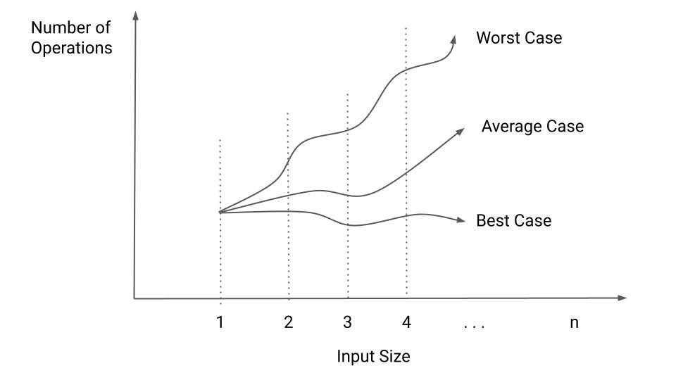

Slide 86
Execution Time
Let us consider that every operation can be executed in 1 ns (${10}^{−9}$s).

Slide 87
Big-O Notation
https://www.youtube.com/watch?v=__vX2sjlpXU

Slide 88
Big-O Notation
We use Big-O notation to classify algorithms based on the number operations or comparisons they use.
For large values of x: $x^{2}, 3x^{2}+25, 4x^{2}+7x+10$ are all very similar, so we will consider them of the same order: O($x^{2}$)
f(x) is O(g(x)) if there exist constants (witnesses) C and k such that
|f(x)|$≤$ C|g(x)| whenever x > k.

Slide 89
Example 1 (Version 1)
Show that $3x^{2}+25$ is O($x^{2}$)
Let:
$$x=5:$$
$$3x^{2}+25=3{(5)}^{2}+25=75+25=100$$
$$k$$
$$C{(5)}^{2}≥100$$
Let
$$C=4, k=5$$
$$25C≥100$$
when $x>5$.
$$\left|3x^{2}+25\right|≤4|x^{2}|$$
$$C≥4$$
$$x=6:$$
$$3x^{2}+25=133$$
$$4x^{2}=144$$

Slide 90
Example 1 (Version 2)
Show that $3x^{2}+25$ is O($x^{2}$)
$$3x^{2}+25≤$$
$3x^{2}+25x^{2}$,
$$x>1$$
$$3x^{2}+25≤$$
$28x^{2}$,
$$x>1$$
$$C=28, k =1$$

Slide 91
Example 2
Show that
$$4x^{3}+7x^{2}+12$$
is O($x^{3}$) by finding the witnesses, C and k.
$$4x^{3}+7x^{2}+12≤$$
$4x^{3}+7x^{3}+12x^{3}$,
$$x>1$$
$$|4x^{3}+7x^{2}+12|≤$$
${|23x}^{3}|$,
$$x>1$$
$$C=23, k =1$$

Slide 92
Example 3
Show that
$$x^{3}+5x$$
is not O($x^{2}$)
$$|x^{3}+5x|≤$$
$C|x^{2}|$,
$$x>k$$
$$if C=x:$$
$x^{3}+5x>x∙x^{2}$,
$$x>0$$
C has to be a constant and this inequality has to hold for all x > k. So, no matter what you pick for C, x can always get large enough to overcome that.
No fixed C that will keep
$$x^{3}+5x≤$$
$$Cx^{2}$$
Once $x>C,$calculation will have a problem

Slide 93
Time complexity calculations
$$\log{10=1}$$
Suppose a computer can perform ${10}^{12}$ bit operations per second. Find the largest problem size that could be solved in 1 second if an algorithm requires:
$n^{4}$ bit operations
$2^{n}$ bit operations
$$n^{4}={10}^{12}$$
$$2^{n}={10}^{12}$$
$$2^{n}={10}^{12}$$
$$(n^{4})^{\frac{1}{4}}=({10}^{12})^{\frac{1}{4}}$$
$$2^{39}≈5.5∙{10}^{11}$$
$$\log{2^{n}=\log{{10}^{12}}}$$
$$2^{40}≈1.1∙{10}^{12}$$
$$n∙\log{2}=12$$
$$n={10}^{3}=1000$$
$$n=39$$
$$n=\frac{12}{\log{2}}≈39.86$$

Slide 94
Time complexity calculations
$$\log{n=\log_{2}{n}}$$
Suppose a computer can perform ${10}^{12}$ bit operations per second. Find the time it would take an algorithm that requires $n^{3}+\log{n}$ operations with a problem size of:
$$n=1000$$
$${n=10}^{8}$$
$$f\left(n\right)=n^{3}+\log{n}$$
$$f\left(n\right)=n^{3}+\log{n}$$
${1000}^{3}+\log_{2}{1000}≈{10}^{9}+10$ bit operations
${{(10}^{8})}^{3}+\log_{2}{{10}^{8}}≈{10}^{24}+26.6$ bit operations
$${10}^{24 }b.o∙\frac{1 sec}{{10}^{12} b.o}={10}^{12}sec.$$
$${10}^{9 }b.o∙\frac{1 sec}{{10}^{12} b.o}=\frac{1}{1000}sec.$$
$${10}^{12}sec∙\frac{1min}{60sec}∙\frac{1hr}{60 min}∙\frac{1 day}{24 hour}∙\frac{1yr}{365 days}≈31710 years$$

Slide 96
Notes:
https://slideplayer.com/slide/14952628/

Slide 97
References
https://www.enjoyalgorithms.com/blog/time-complexity-analysis-in-data-structure-and-algorithms
Discrete Mathematics explained in Kurdish:
https://www.youtube.com/watch?v=A4dq1rVwcF4&list=PLxIvc-MGOs6gZlMVYOOEtUHJmfUquCjwz&index=17
Discrete Mathematics and its Applications by Kenneth H.Rosen, Chapter 3, page 191:
https://www.houstonisd.org/cms/lib2/TX01001591/Centricity/Domain/26781/DiscreteMathematics.pdf

