Slide 1
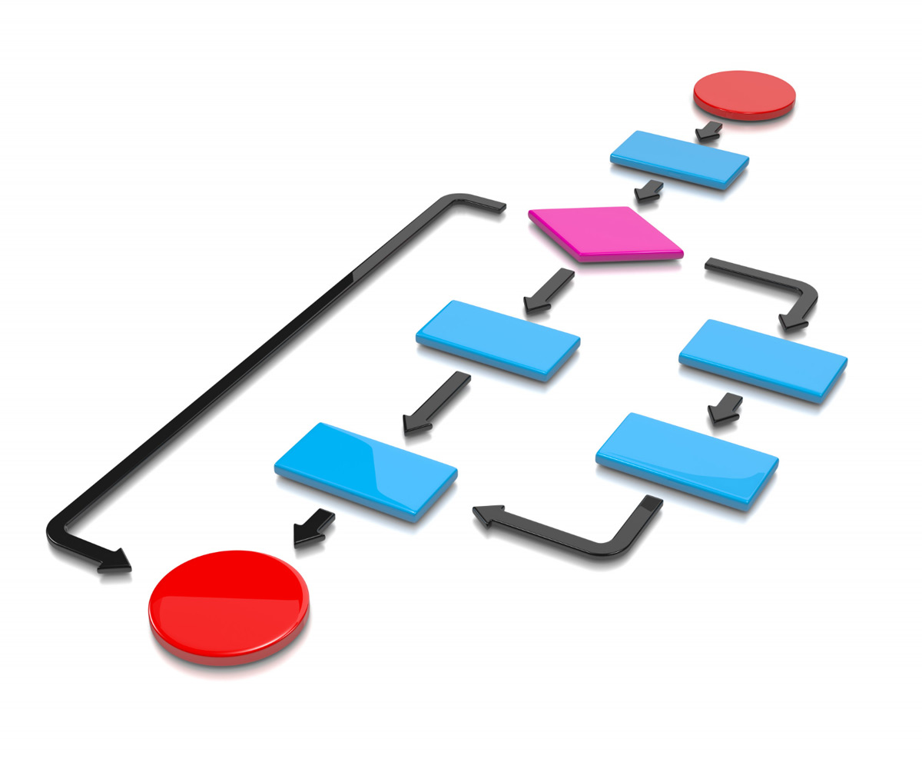
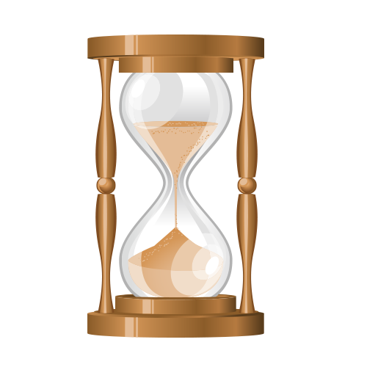
Lecture 2: Big-O Notation
Time Complexity and Space Complexity of an Algorithm

Slide 2
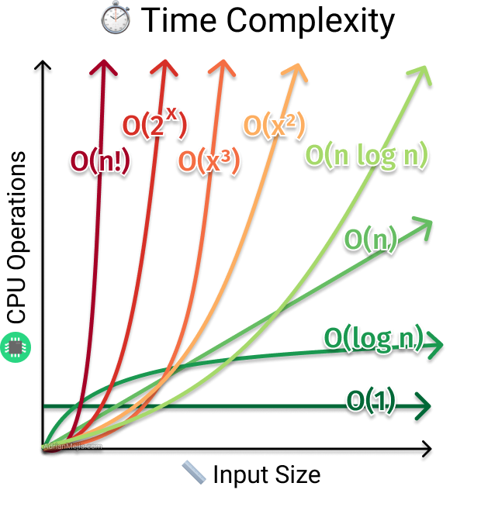

Slide 3
Two criteria are used to judge algorithms:
Time complexity
Space complexity
Time complexity of an algorithm is the amount of CPU time it needs to run completion.
Space complexity of an algorithm is the amount of memory it needs to run completion.
TIME:
- Operations
Comparisons
Loops
Pointer references
Function calls to outside
SPACE:
- Variables
Data structures
Allocations
Function call

Slide 4
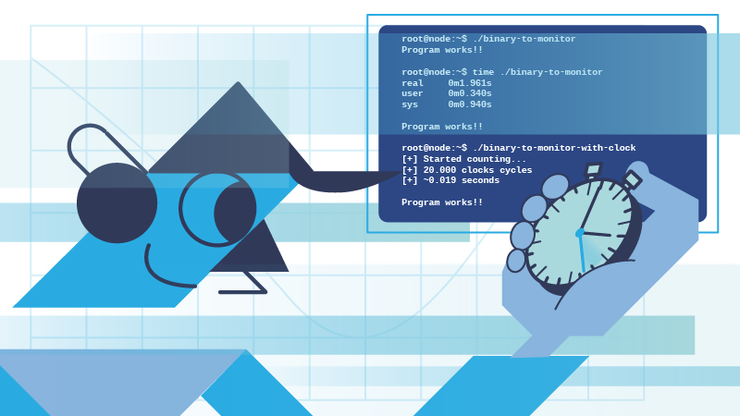
Time complexity of an algorithm is the amount of time (or number of steps) needed by a program to complete its task (to execute a particular algorithm).
The time taken for an algorithm is comprised of two times:
Compilation time
Run time
Limits
Better
Solutions
Less
More
Time
Space

Slide 5
Compile Time
Compilation time is the time taken to compile an algorithm
While compiling it checks for the syntax ($int → itn$) and semantic errors ($int 12 →int 12.5$) in the program and links it with the standard libraries
Run Time
It is the time to execute the compiled program
The run time of an algorithm depends on the number of instructions present in the algorithm
Note that run time is calculated only for executable statements and not for declaration statements

Slide 6
Types of Time Complexity
Time complexity of an algorithm is generally classified into three types:
Worst Case (Longest Time)
Average Case (Average Time)
Best Case (Shorter Time)
Big Oh Notation: Upper bound
Omega Notation: Lower bound
Theta Notation: Tighter bound

Slide 7
Standard Analysis Techniques
Constant time statements
Analyzing Loops
Analyzing Nested Loops
Analyzing Sequence of Statements
Analyzing Conditional Statements
Time and Space are dependent on these analysis

Slide 8
Basic Example for Time Complexity
// Input: int A[n], array of n integers
// Output: sum of all numbers in array A
int Sum (int A[], int N){
int s = 0;
for (int i = 0 ; i < N ; i++ )
s = s + A[i] ;
return s;
}
1
1, 2, 8: Once
3, 4, 5, 6, 7: Once per each iteration of for loop, N iteration
4
2
Total: $5N + 3$
3
7
The complexity function of the algorithm is:
$$f\left(N\right)=5N+3$$
5
6
8

Slide 9
Space Complexity of Algorithm
Space Complexity of a program is the amount of memory consumed by the algorithm until it completes its execution.
The space occupied by the program is generally by the following:
A fixed amount of memory occupied by the space for the program i.e. data types
Code and space occupied by the variables used in the program.
A variable amount of memory occupied by the component variable whose size is dependent on the problem being solved.
This space increases or decreases depending on whether the program uses iterative or recursive procedures.
Space Complexity = Auxiliary Space + Input Space

Slide 10
Types of Space Complexity
Type 1: A fixed part that is a space required to store certain data and variables, that are independent of the size of the problem.
For example, simple variables and constant used, program size, etc.
Type 2: A variable part is a space required by variables, whose size depends on the size of the problem.
For example, dynamic memory allocation, recursion stack space, etc.
Space Complexity S(P) of any algorithm P is S(P) = C + SP (I)
Where,
C is the fixed part
S(I) is the variable part
Algorithm: SUM (A, B)
Step 1 – Start
Step 2 – C $←$A+B+10
Step 3 - Stop

Slide 11
Other Types of Space
Instruction Space: is the space in memory occupied by the complied version of the program. We consider this space as a constant space for any value of n. The instruction space is independent of the size of the problem.
Data Space: is the space in memory, which used to hold the variables, data structures, allocated memory and other data elements. The data space is related to the size of the problem.
Environment Space: is the space in memory used on the run time stack for each function call. This is related to the run time stack and holds the returning address of the previous function. Stored return value and pointer on it.

Slide 12
Basic Example for Space Complexity
$$Type$$ | Size
bool, char, unsigned char, signed char, _int8 | 1 byte
_int16, short, unsigned short, wchar_t, _wchar_t | 2 bytes
float, _int32, int, unsigned int, long, unsigned long | 4 bytes
double, _int64, long double, long long | 8 bytes
To store program instructions.
To store constant values.
To store variable values.
And for few other things like function calls, jumping statements, etc.
int sum(int a[], int n)
{
int x = 0;
for (int i = 0; i < n; i++)
{
x = x + a[i];
}
return (x);
}
{
int z = a + b + c;
return (z);
}
4n +12
(4(4)+4) = 20 bytes

Slide 13
Difference Between
Space Complexity
Time Complexity
Space Complexity is the space (memory) needed for an algorithm to solve the problem. An efficient algorithm take space as small as possible.
Time Complexity is the time required for an algorithm to complete its process. It allows comparing the algorithm to check which one is the efficient one.

Slide 14
Time complexity of a program is a simple measurement of how fast the time taken by a program grows, if the input increases.
Method 1
Method 2
$$n−2$$
$$\sqrt{n}−2$$
The second method is faster. That’s why time complexity is important. In real life we want software to be fast & smooth.

Slide 15
Space complexity of a program is a simple measurement of how fast the space taken by a program grows, if the input increases.
Method 2
Method 1
$$O(1)$$
$$O(n)$$
The second method is better. There is no point in using more space to solve a problem if, we can do the same with lesser space complexity.

Slide 16
Calculating Time complexity of Algorithms

Slide 17
Time complexity
Calculations in different Cases
1. Loop
2. Nested Loop
for ($i = 1$to $n$){
x = y + z;
}
// $n$
for ($i = 1$ to $n$){
for ($j = 1$ to $n$){
x = y + z;
}
}
// $n$
// $constant time$
// $n$
// $constant time$
$$O(n)$$
$$O(n^{2})$$
constant time can be neglected

Slide 18
Time complexity
Calculations in different Cases
3. Sequential Statements
4. If-else Statements
i) a = a+ b;
// $constant time=c_{1}$
if (condition){
}
else
{
}
// $n$
ii) for ($i = 1$to $n$){
x = y + z;
}
// $n$
// $constant time=c_{2}$
// $n^{2}$
iii) for ($j = 1$to $n$){
c = d + e;
}
// $n$
// $constant time=c_{3}$
$$O(n)$$
$$O(n^{2})$$
$$=c_{1}+c_{2}n+c_{3}n=n$$

Slide 19
Time complexity
More Examples
Algo1 ()
{
int $i$;
for ($i = 1$to $n$)
print (“Hello World”);
}
Algo2 ()
{
int $i$;
for ($i = 1$ to $n$)
for ($j = 1$ to $n$)
print (“Hello World”);
}
//nested loop
$$O(n)$$
$$O(n^{2})$$

Slide 20
Time complexity
Algo3 ()
{
int $i$;
for ($i = 1; i < n; i = i∗2$)
print (“Hello World”);
}
Algo4 ()
{
int $i$;
for ($i = 1; i < n; i = i∗5$)
print (“Hello World”);
}
$$i →1, 2, 4, 8, 16, 32, …n$$
$$O(\log_{5}{n})$$
$$2^{0}, 2^{1}, 2^{2}, 2^{3}, 2^{4}, 2^{5}… 2^{k}$$
Algo5 ()
{
int $i$;
for ($i = 1; i < n^{3}; i = i∗5$)
print (“Hello World”);
}
$$n=2^{k}$$
$$2^{k}=n$$
$$k=\log_{2}{n}$$
$$O(\log_{2}{n})$$
$$O(\log_{5}{n^{3}})$$

Slide 22
Time complexity
Algo6 ()
{
int $i$;
for ($i = 1; i^{2} <= n; i++$)
print (“Hello World”);
}
Algo7 ()
{
int $i = 1, k = 1;$
while ($k <= n$)
{
$i++;$
$k = k + i;$
print (“Hello World”);
}
}
// all operations inside any loop considered
$$i^{2}<=n$$
$$\sqrt{i^{2}}<=\sqrt{n}$$
$$i<=\sqrt{n}$$
$$k$$ | $$1$$ | $$3$$ | $$6$$ | $$10$$ | $$15$$ | $$…$$ | $$n$$
$$i$$ | $$1$$ | $$2$$ | $$3$$ | $$4$$ | $$5$$ | $$…$$ | $$z$$
$$O(\sqrt{n})$$
$$\frac{z(z+1)}{2}=n$$
$$z^{2}+z=2n$$
$$z=\sqrt{2n}$$
$$=\sqrt{2}∙\sqrt{n}$$
$$O(\sqrt{n})$$

Slide 23
Time complexity
Algo8 ()
{
int $i, j, k$;
for ($i = n/2; i<= n; i++)$
for ($j = 1; j<= n/2; j++)$
for ($k = 1; k<= n; k = k ∗ 2)$
print (“Hello World”);
}
Algo9 ()
{
int $i, j, k, n$;
for ($i = 1; i<= n; i++)${
for ($j = 1; j<= i; j++)${
for ($k = 1; k<= 100; k++)${
print (“Hello World”);
} } } }
// $n/2$
// $n/2$
// $\log_{2}{n}$
$$k/2$$
$$\frac{n}{2}∙\frac{n}{2}∙\log_{2}{n}=\frac{n^{2}\log_{2}{n}}{4}$$
$$i$$ | $$1 time$$ | $$2 times$$ | $$3 times$$ | $$…$$ | $$n times$$
$$j$$ | $$1 time$$ | $$2 times$$ | $$3 times$$ | $$…$$ | $$n times$$
$$k$$ | $$1 ∗ 100$$ | $$2∗100$$ | $$3∗100$$ | $$…$$ | $$n∗100$$
$$O(n^{2}\log_{2}{n})$$
$$TC=100+200+300…n\left(100\right)=100(1+2+3…+n)$$
$$=100\left(\frac{n\left(n+1\right)}{2}\right)=100(\frac{n^{2}+n}{2})$$
$$O(n^{2})$$

Slide 24
Time complexity
Algo11 ()
{
int $i = n;$
while $(i > 1)$
{
print (“Hello World”);
$i = i/2;$
}
}
Algo10 ()
{
int $i, j, k;$
for ($i = n/2; i< n; i++)$
for ($j = 1; j<= n; j = 2 ∗ j$)
for ($k = 1; k<= n; k = k ∗ 2$)
print (“Hello World”);
}
// $n/2$
// $\log_{2}{n}$
// $\log_{2}{n}$
// $\log_{2}{n}$
$$\frac{n}{2}∙\log_{2}{n}∙\log_{2}{n}=\frac{n(\log_{2}{n)^{2}}}{2}$$
$$O(\log_{2}{n})$$
$$O(n{(log}_{2}{n})^{2})$$

Slide 25
Time complexity
Independent Loop
Dependent Loop
Algo12 ()
for ($i = 1$to $n$){
for (k = 1 to m)
print (“Hello World”);
}
Algo13 ()
for ($i = 1;i≤n;i++$){
for ($k = 1; k <= i; k = k + 1$)
print (“Hello World”);
}
$$i$$ | $$1 time$$ | $$2 times$$ | $$3 times$$ | $$…$$ | $$n times$$
$$k$$ | $$1 time$$ | $$1, 2 times$$ | $$1, 2, 3 times$$ | $$…$$ | $$1, 2, 3, …, n times$$
$$O(nm)$$
$$=\left(\frac{n\left(n+1\right)}{2}\right)= (\frac{n^{2}+n}{2})$$
$$TC=1+2+3…+n$$
$$O(n^{2})$$

Slide 26
Time complexity
$$\sum_{k=1}^{n}{\frac{1}{k}}≈\int_{1}^{n}{\frac{dx}{x}}=logn$$
Algo14 ()
for ($i = 1;i≤n;i++$){
for ($j = 1; j<=n;j =j +i$)
$x=x+1;$
}
$$i$$ | $$1$$ | $$2$$ | $$3$$ | $$…$$ | $$n$$
$$j$$ | $$n$$ | $$n/2$$ | $$n/3$$ | $$…$$ | $$n/n$$
$$TC=n\left(1+\frac{1}{2}+\frac{1}{3}+…+\frac{1}{n}\right)=nlogn$$
$$O(nlogn)$$

Slide 27
Time complexity
$$\sum_{1}^{n}{\frac{n(n+1)}{2}}=\sum_{1}^{n}{\frac{n^{2}}{2}}+\sum_{1}^{n}{\frac{n}{2}}=\frac{1}{2}\left(\frac{n\left(n+1\right)\left(2n+1\right)}{6}\right)+\frac{1}{2}(\frac{n(n+1)}{2})$$
Algo15 ()
$x=0;$
for ($i = 1;i≤n;i++$){
for ($j = 1; j≤i;j =j ++$)
for ($k = 1;k≤j;k =k ++$)
$x=x+1;$
}
$$1+\left(1+2\right)+\left(1+2+3\right)+…+\left(1+2+3+…+n\right)=\frac{n(n+1)(n+2)}{6}$$
$$O(n^{3})$$
$$i$$ | $$1$$ | $$2$$ | $$3$$ | $$…$$ | $$n$$
$$j$$ | $$1$$ | $$1; 2$$ | $$1;2; 3$$ | $$…$$ | $$1, 2, 3, …, n$$
$$k$$ | $$1$$ | $$1; 1, 2$$ | $$1;1, 2;1, 2, 3$$ | $$…$$ | $$1;1, 2;…1,2, 3…n$$

Slide 29
int fun(int n)
{
int count = 0;
for (int i = n; i > 0; i /= 2)
for (int j = 0; j < i; j++)
count += 1;
return count;
}
int a = 0, b = 0;
for (i = 0; i < N; i++) {
a = a + rand();
}
for (j = 0; j < M; j++) {
b = b + rand();
}
$$O(N + M)$$
$$T\left(n\right)=n+\frac{n}{2}+\frac{n}{4}+…+1=O(n)$$

Slide 30
for (int i = n; i > 0; i = i / 2)
{
for (int j = 1; j < n; j = j * 2)
{
for (int k = 0; k < n; k = k + 2)
{
//some logic with complexity X
}
}
}
int i, j, k = 0;
for (i = n / 2; i <= n; i++) {
for (j = 2; j <= n; j = j * 2) {
k = k + n / 2;
}
}
$$O(nlogn)$$
$$O(n{(log}_{2}{n})^{2})$$

Slide 31
int value = 0;
for(int i=0;i<n;i++)
for(int j=0;j<i;j++)
value += 1;
for(int i=0;i<n;i++){
i*=k;
}
$$O(n^{2})$$
$$O(\log_{k}{n})$$
int a = 0, i = N;
while (i > 0) {
a += i;
i /= 2;
}
$$O(log⁡N)$$

Slide 32
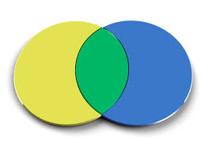
Calculating Space complexity of Algorithms

Slide 33
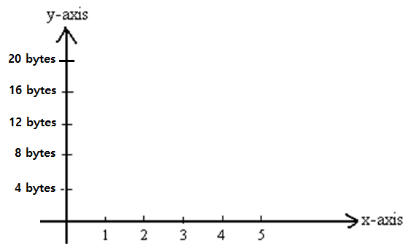
Space complexity
Space Complexity = Auxiliary Space + Input Space
y axis: size in bytes
x axis: N value
Algo1 () – Addition of two numbers
function add(n1, n2)
{
sum = n1 + n2
return sum
}
Constant Space (behavior)
n1 – 4 bytes
n2 – 4 bytes
sum – 4 bytes
Aux (function call, return) – 4 bytes
$$O(1)$$
Total (estimated): 16 bytes = C

Slide 34
Space complexity
Space Complexity = Auxiliary Space + Input Space
Algo2 () – Sum of all elements in array
function sumOfNumbers(arr[], N)
{
sum = 0
for (i = 0 to N)
{
sum = sum + arr[i]
}
print (sum)
}
Linear Space Complexity
arr – N * 4 bytes
sum – 4 bytes
i – 4 bytes
Aux (initializing for loop, function call, return) – 4 bytes
$$O(n)$$
Total (estimated): 4N + 12 bytes

Slide 35
Space complexity
Space Complexity = Auxiliary Space + Input Space
Algo3 () – Factorial of a number (iterative)
int fact = 1;
for (int i = 1; i <= n; i++)
{
fact *= i;
}
return fact;
Constant Space (behavior)
fact – 4 bytes
n – 4 bytes
i – 4 bytes
Aux (initializing for loop, function call, return) – 4 bytes
$$O(1)$$
Total (estimated): 16 bytes

Slide 36
Space complexity
Space Complexity = Auxiliary Space + Input Space
Algo4 () – Factorial of a number (recursive)
factorial(n){
if (n <= 1) {
return 1;
} else {
return (n*factorial(n-1));
}
}
$$O(n)$$
Linear Space Complexity
1
assume n = 5
$$fn(5)$$
2*f(1)
3*f(2)
n – 4 bytes
Aux (function call) – 5 * 4 bytes
4*f(3)
120
5*f(4)
Call Stack
Total (estimated): 4 bytes + 4*n bytes

Slide 37
Space – Time Tradeoff and Efficiency
All efforts made by analyzing time and space complexity lead to the algorithm’s efficiency.
But, when we can say that an algorithm is efficient? The answer seems to be obvious: it should be fast, and it should take the least amount of memory possible.
Unfortunately, in algorithmics, space and time are like two separate poles. Increasing speed will most often lead to increased memory consumption and vice-versa.
On the one side, we have merge sort, which is extremely fast but requires a lot of memory. On the other side, we have bubble sort, a slow algorithm but one that occupies minimal space. There are also some balanced ones like in-place heap sort. Its speed and space usage are not the best, but they’re acceptable.
Maximizing both the algorithm’s space and time complexity is impossible. We should adjust those parameters according to our requirements and environment.

Slide 38
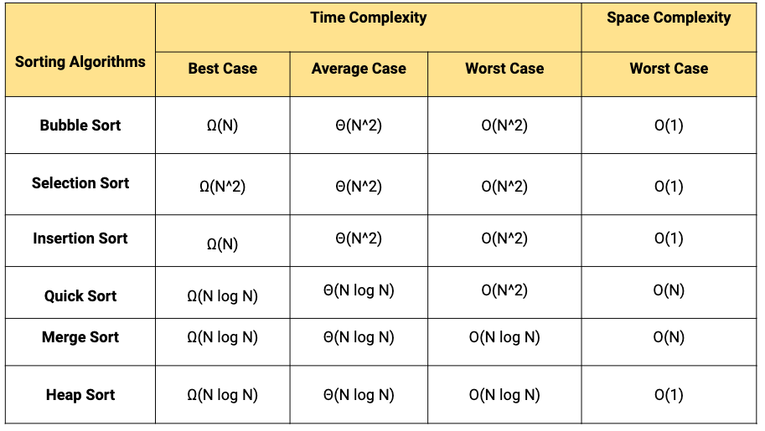

Slide 39
5 Basic Sequences and Their Sums
Adding positive integers
Summing up the squares
$$S=\frac{n(n+1)}{2}$$
$$S=\frac{n(n+1)(2n+1)}{6}$$
Finding the sum of the cubes
Adding up even numbers
Summing odd numbers
$$S=n(n+1)$$
$$S=\frac{n^{2}{(n+1)}^{2}}{4}$$
$$S=n^{2}$$

Slide 41
What is the time and space complexity of the following codes:
a)
b)
c)

Slide 42
What is the time and space complexity of the following codes:
a)
b)
c)
Time Complexity: O(n + m)
Space Complexity: O(1)
Time Complexity: O(n²)
Space Complexity: O(1)
Time Complexity: O(n²)
Space Complexity: O(1)

Slide 43
What is the time complexity of the following codes:
a)
b)
c)

Slide 44
What is the time complexity of the following codes:
a)
Time Complexity: O(log n)
b)
Time Complexity: O(log n)
c)
Time Complexity: O(nlog n)

Slide 45
What is the time complexity of the following code:

Slide 46
What is the time complexity of the following code:
Time Complexity: O(2^n)

Slide 47
What is the time complexity of the following code:

Slide 48
What is the time complexity of the following code:
Time Complexity: O(log n)

