Slide 1
Revision of anatomy and physiology of female reproductive system
Prepared by : Rayan Qasim
Supervisor : Sahar Ismail Abdulla

Slide 2
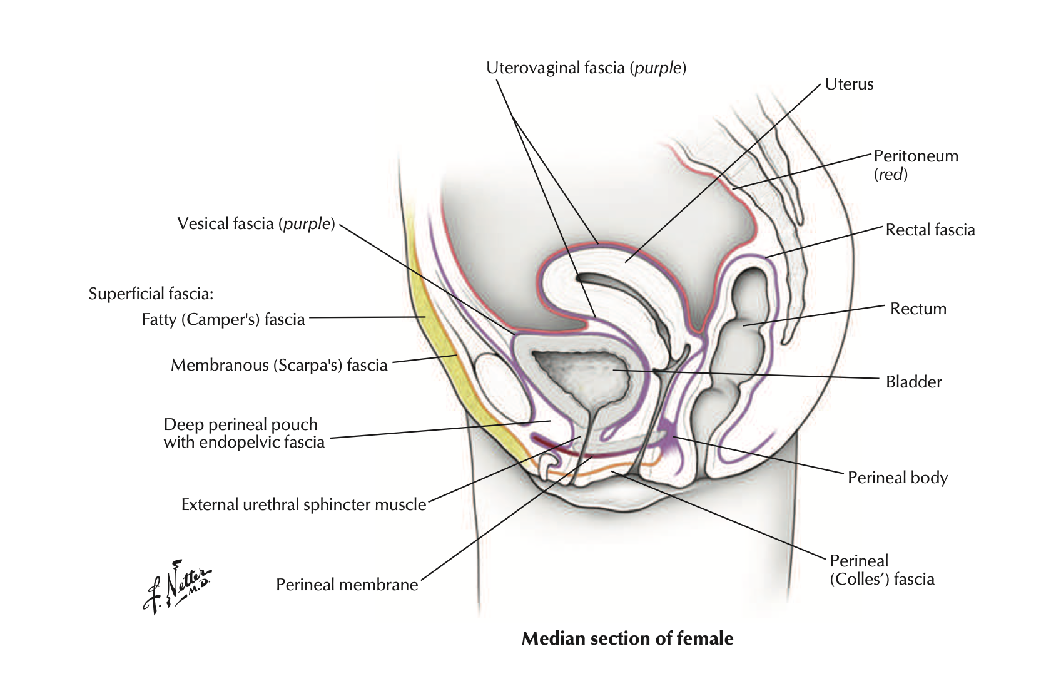
introduction
The female reproductive system is the system that responsible for the production and fertilization of gametes (eggs) and carrying of a fetus.
It also contain internal and external parts to make up this system

Slide 3
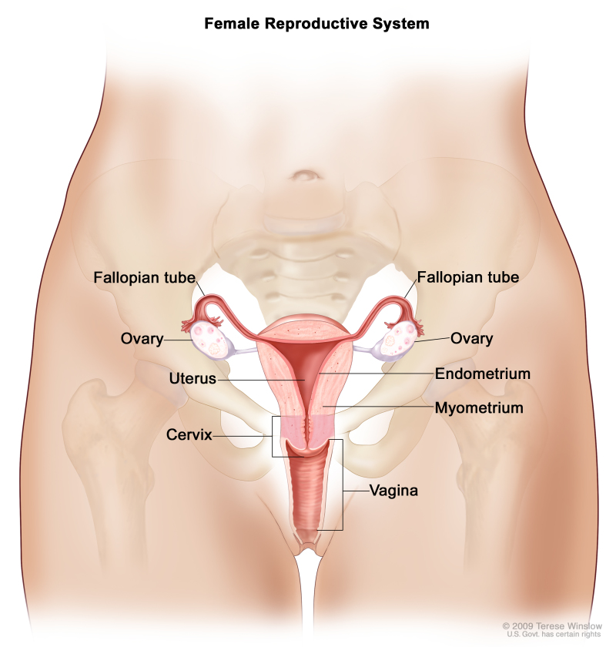
Cont...
Vagina
Uterus
Fallopian tubes
Ovaries
We are going to talk about each part in anatomy and physiology

Slide 4
Vagina
The vagina is an elastic muscular tube of 7 to 10 cm in length that extends from the vulva (female external genitalia) to the cervix of the uterus , vagina is a passage for sperm for fertalization and also a passage for fetus

Slide 5
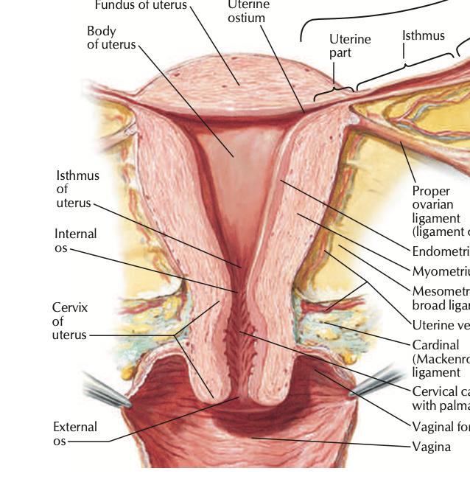
uterus
uterus (or womb) is a pear-shaped organ that plays a critical role in menstruation, fertility and pregnancy. It's hollow and muscular and sits between rectum and bladder in pelvis
One of most important function is holding fetus

Slide 6
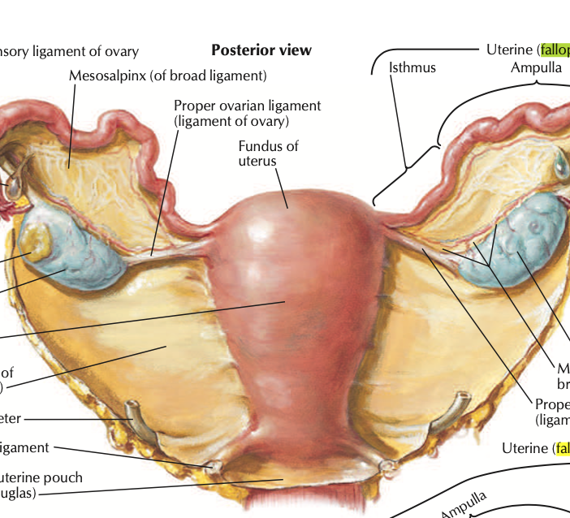
Fallopian tube
The fallopian tubes are bilateral conduits between the ovaries and the uterus in the female pelvis. They function as channels for oocyte transport and fertilization. Given this role, the fallopian tubes are a common etiology of infertility as well as the target of purposeful surgical sterilization.

Slide 7
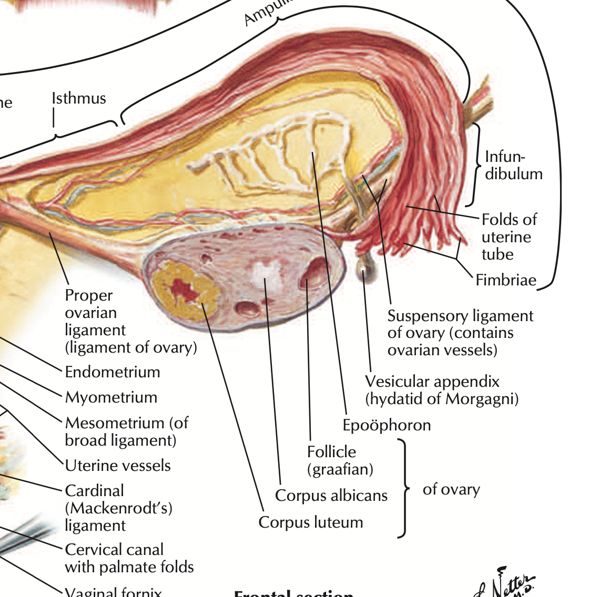
ovaries
Your ovaries play a critical role in both menstruation and conception. They produce eggs for fertilization and they make the hormones estrogen and progesterone. An ovary releases an egg around the middle of your menstrual cycle (around day 14 of a 28-day cycle) in a process called ovulation

Slide 8
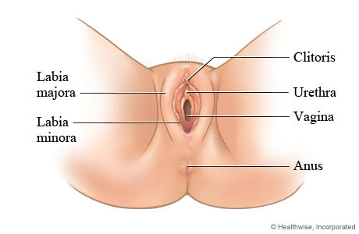
External parts
Clitoris
External vagina
Labia majora
Labia minora

Slide 9
clitoris
clitoris has a single purpose: to enable you to experience sexual pleasure
Clitoris is a really sensitive part of external

Slide 10
Labia majora
The labia majora are a prominent pair of cutaneous skin folds that will form the lateral longitudinal borders of the vulval clefts. The labia majora forms the folds that cover the labia minora, clitoris, vagina, urethra

Slide 11
Labia minora
The labia minora are the two inner skin folds that surround the opening of the vagina. Their main function is to protect the vaginal and urethral openings from mechanical irritation, dryness, and infections.

Slide 12
Estrogen & progesterone
Estrogen and progesterone are steroid hormones that play a pivotal role in the regulation of mammalian reproduction. One primary action of these hormones is to regulate the development and function of the uterus. These hormones act by regulating the transcription of specific genes in the uterus.

Slide 13
Menstruation
Menstruation, or period, is normal vaginal bleeding that occurs as part of a woman's monthly cycle. Every month, your body prepares for pregnancy. If no pregnancy occurs, the uterus, or womb, sheds its lining. The menstrual blood is partly blood and partly tissue from inside the uterus.

Slide 14
reference
Anatomy and physiology for nursing
Introduction to maternity & pediatric nursing
Atals of human anatomy

Slide 15
Thank you for your time..

