Slide 1
Revision of Anatomy & physiology of male reproductive system
Prepared by : Suhaib Sabir
Supervisor : Sahar Ismail Abdulla

Slide 2
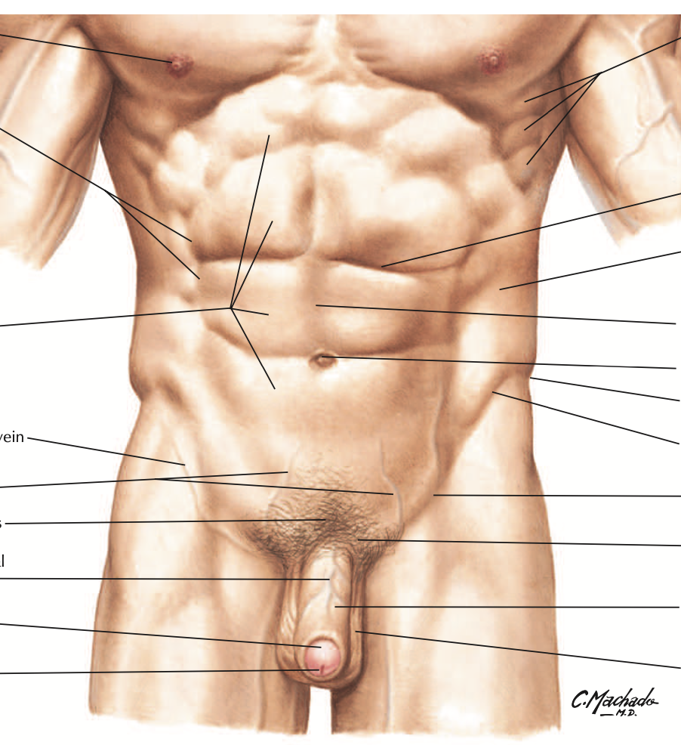
Introduction...
The male reproductive system contains the external parts (the penis, testes and the scrotum) and internal parts, including the (prostate gland, vas deferens and urethra).
A man's fertility and sexual traits depend on the normal functioning of the male reproductive system, as well as hormones released from the brain.

Slide 3
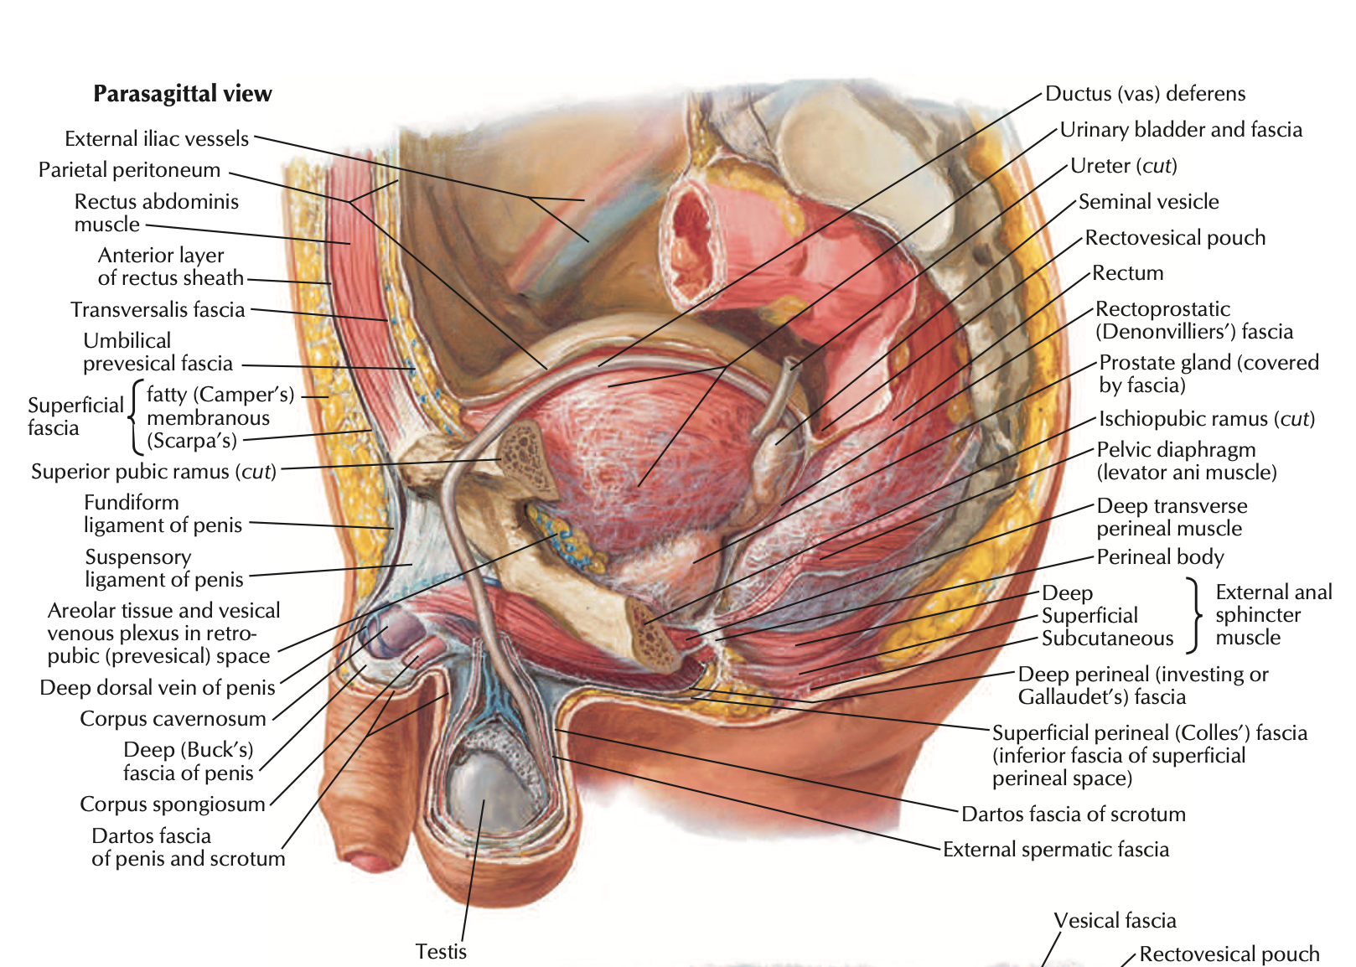
Anatomy...
Male reproductive system part :
Scrotum
Testes
Epididymis
Vas deferens
Prostate
Seminal vesicles
Bulbourethral
Penis

Slide 4
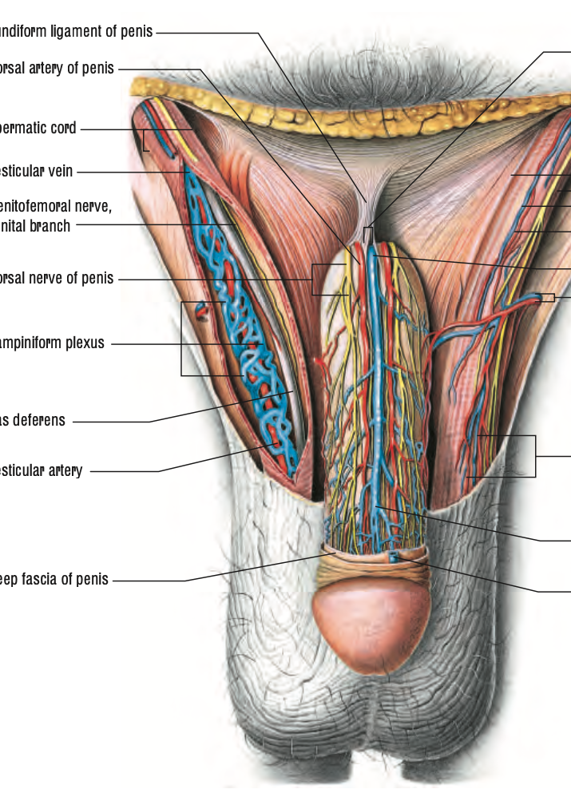
Anatomy & physiology of scrotum
Scrotum. The bag of skin that holds and helps to protect the testicles. The testicles make sperm and, to do this, the temperature of the testicles needs to be cooler than the inside of the body. This is why the scrotum is located outside of the body.

Slide 5
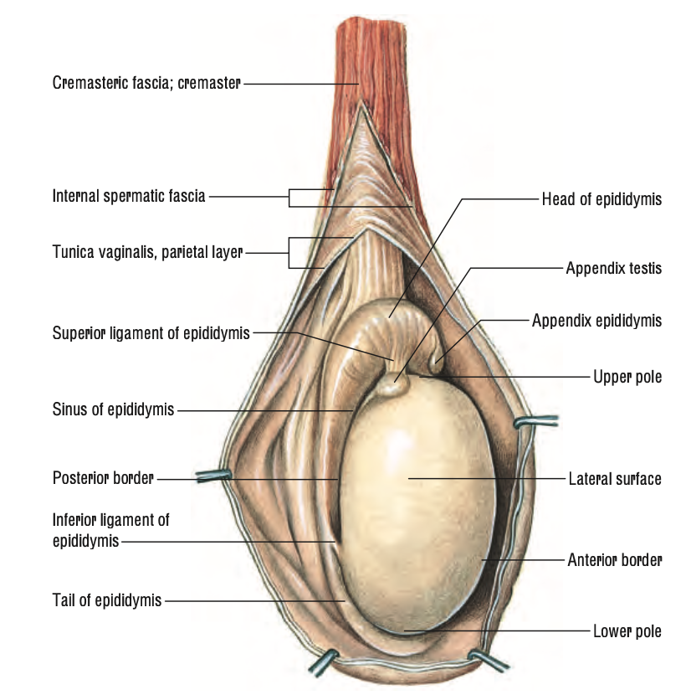
Anatomy & physiology of testes....
The Testis functions :
produces spermatozoa, the male gametes
synthesizes testosterone, the principal male sex hormone
it participates with the hypothalamus-pituitary unit in regulating reproductive function

Slide 6
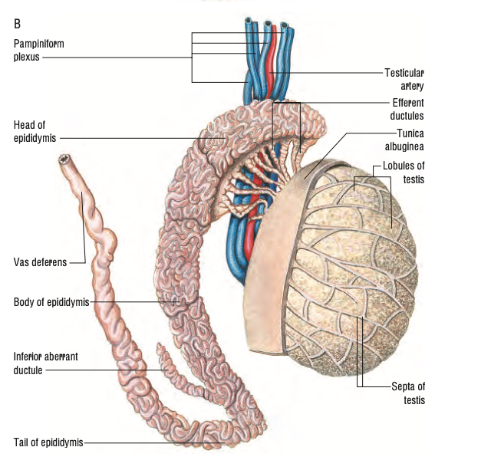
Cont...

Slide 7
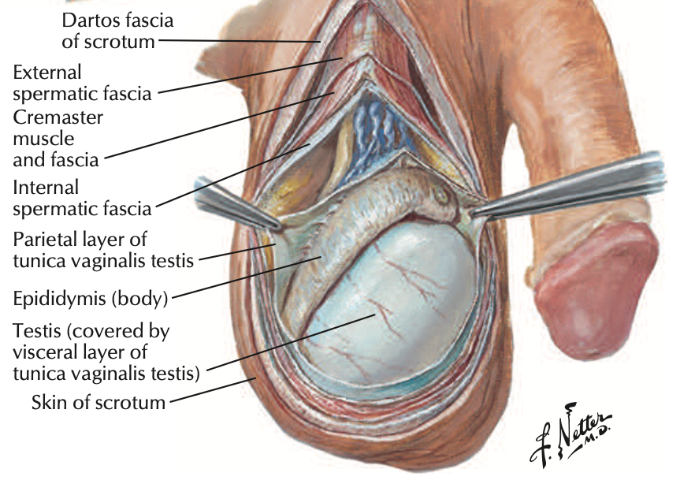
Anatomy & physiology of epididymis
The function of the epididymis is to transport sperm from the testes to the vas deferens. Total transit time through the epididymis is generally between 10–15 days . Transport is achieved primarily by rhythmic contractions of the smooth muscle layers surrounding the epididymis.
Another function is maturing the sperm

Slide 8
Cont...

Slide 9
Anatomy & physiology of vas deferens
Typically, a vas deferens (also called a sperm duct or a ductus deferens) in each testicle. The job of these ducts is to move sperm away from its storage place in the epididymis.

Slide 10
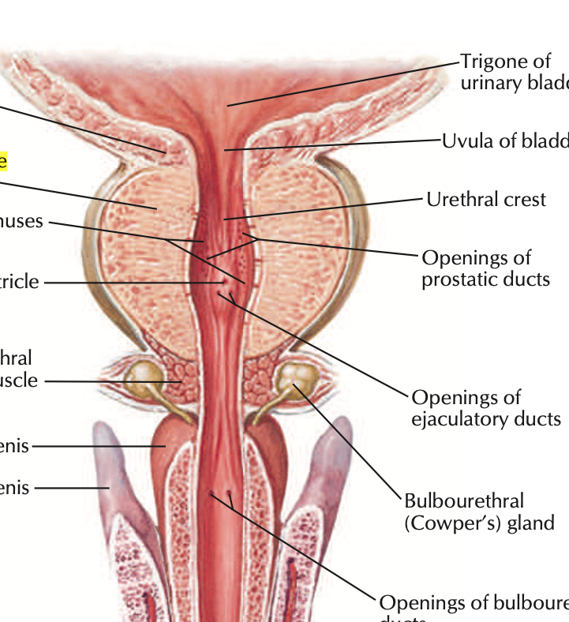
Anatomy & physiology of prostate
The prostate gland is located just below the bladder and surrounds the top portion of the tube that drains urine from the bladder (urethra). The prostate's primary function is to produce the fluid that nourishes and transports sperm (seminal fluid).
And Closing the urethra during ejaculation

Slide 11
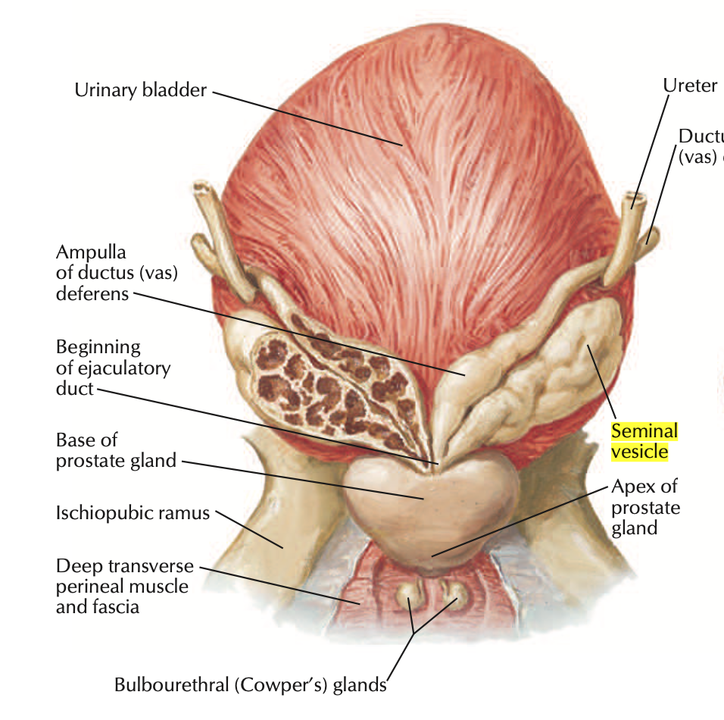
Anatomy & physiology of seminal vesicle
seminal vesicles. The two seminal vesicles are glands that produce the fluids that will turn into semen. The vesicles may also be called seminal glands or vesicular glands.
The fluids that develop in your seminal vesicles make up an estimated 50% to 80% of your semen's volume. The substances in these fluids are designed to help sperm stay alive once they enter the vagina. The fluids carry: Fructose, which provides energy.

Slide 12
Anatomy & physiology of bulbourethral
The bulbourethral glands function to lubricate the spongy urethra for the passage of the ejaculate. Due to the alkaline pH of the excreted fluid, they also act to neutralize residual acidic urine that remains in the spongy urethra.

Slide 13
Anatomy & physiology of penis
The penis is the male organ used for urination and sexual intercourse. The penis is located above the scrotum. It is made of spongy tissue and blood vessels. The shaft of the penis surrounds the urethra

Slide 14
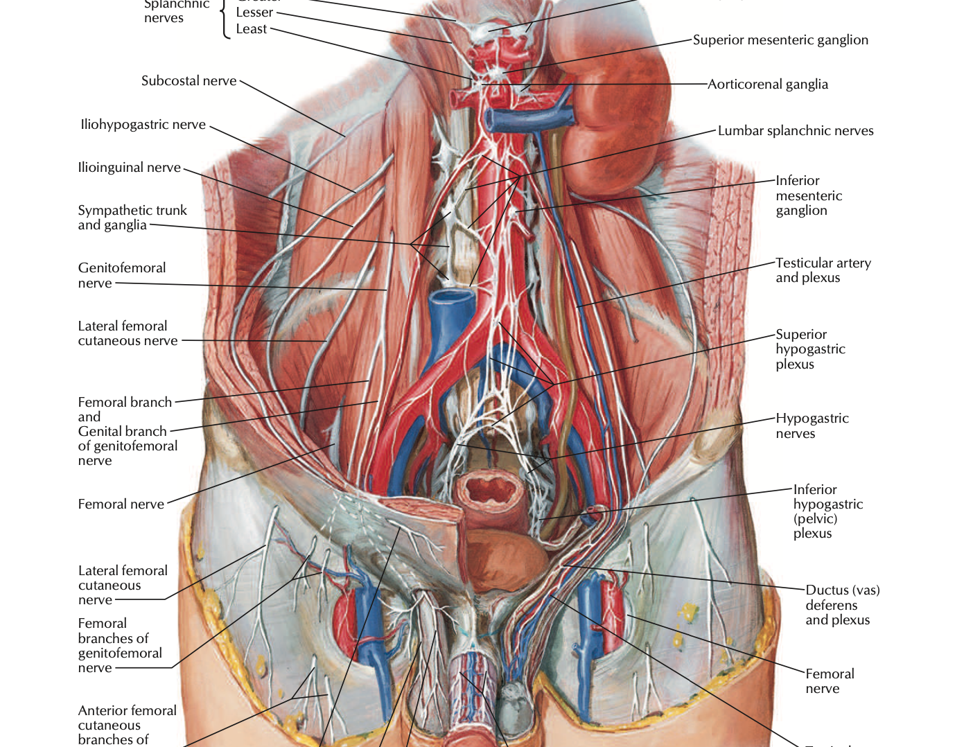
Physiology...
The primary hormones involved in the functioning of the male reproductive system are follicle-stimulating hormone (FSH), luteinizing hormone (LH) and testosterone

Slide 15
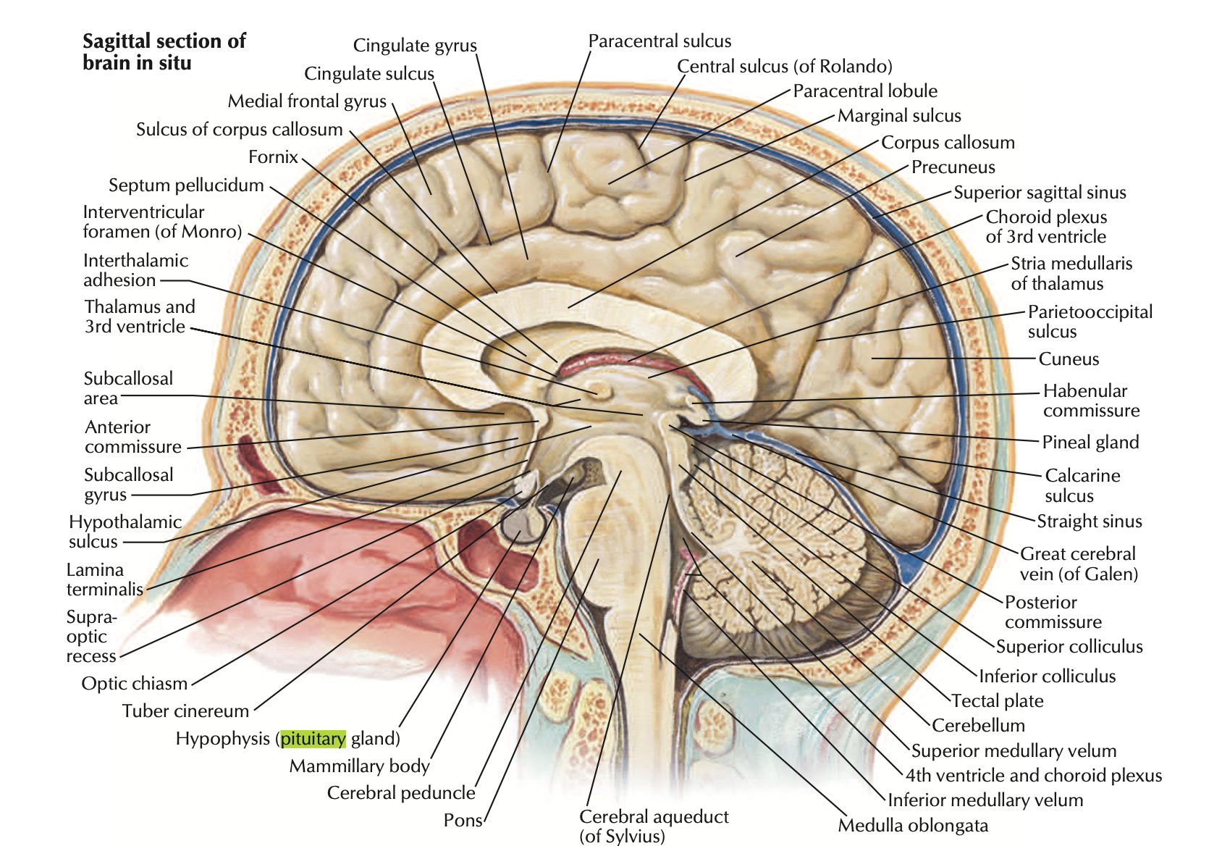
fsh
In men, FSH helps control the production of sperm. Normally, FSH levels in men do not change very much. In children, FSH levels are usually low until puberty, when levels begin to rise. In girls, it helps signal the ovaries to make estrogen.

Slide 16
lh
In men, LH causes the testicles to make testosterone, which is important for producing sperm. Normally, LH levels in men do not change very much. In children, LH levels are usually low in early childhood, and begin to rise a couple of years before the start of puberty.

Slide 17
Ejaculation
Ejaculation is the expulsion of semen from the body.
Sexual stimulation and friction provide the impulses that are delivered to the spinal cord and into the brain. Ejaculation is a reflex action controlled by the central nervous system. It is triggered when the sexual act reaches a critical level of excitement

Slide 18
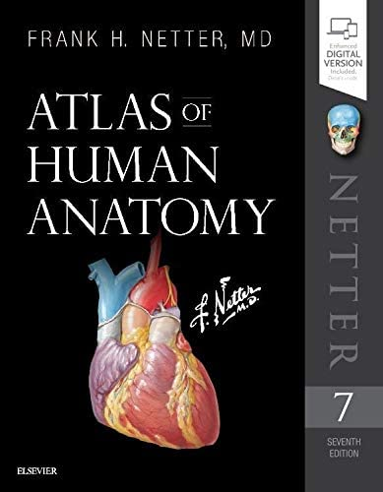
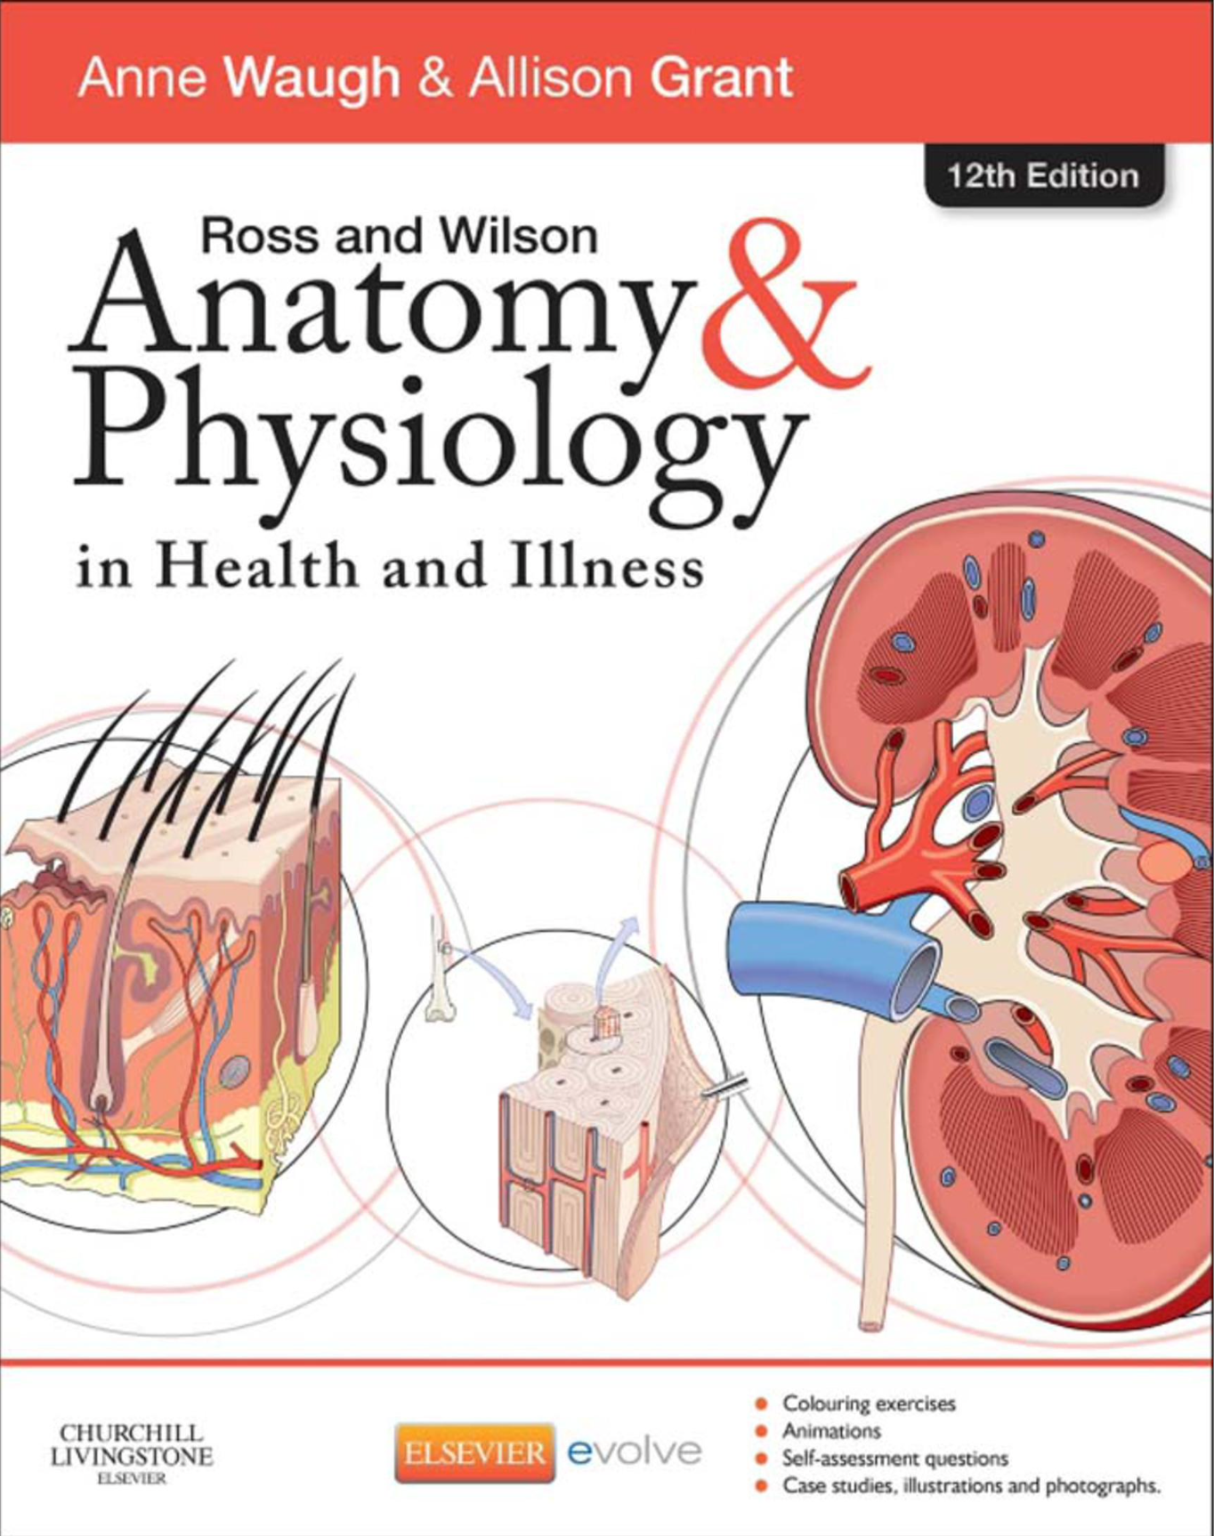
references

Slide 19
Thank you all for your time

