Slide 1
Antimicrobials
Antibiotic, Antifungal, Antihelminth
Assist. Prof. Dr. Sewgil S. Anwer
TIU- Nursing
Lec.

Slide 2
Antimicrobial Drug:
Antimicrobial drug is a drug used to treat microbial infection. "Antimicrobial" is a general term that refers to a group of drugs that includes antibacterial, antifungals, antiprotozoals, and antivirals. that destroys disease-causing microorganisms with minimal damage to host tissues.

Slide 3
Antibiotics ( Antibacterial)
Antibiotics are drugs that kill or inhibit the growth of bacteria and are used to treat bacterial infections. Most of them produced in nature by soil bacteria (Polymyxin B, Colistin, Bacitracin, Aztreonam, fungi (Penicillin, Griseofulvin, Cephalosporin) and actinomycetes (Aminoglycosides, Macrolides, Tetracyclines, Polyenes, Chloramphenicol)
Antibiotics
- Fight pathogens
- Interfere with formation of cell walls
- Many obtained from bacteria or fungi
- Others produced synthetically

Slide 4
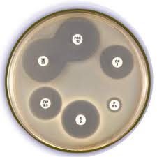
History
-The discovery of the first antibiotic was an accident. In 1928, sir Alexander Fleming, , a Scottish biologist accidentally contaminated a plate with a fungus.
-He observed a clearly defined region of no bacterial growth where the fungi had contaminated the plate.

Slide 5
Zone of inhibition
- If an antibiotic stops the bacteria from growing or kills the bacteria, there will be an area around discs. where the bacteria have not grown enough to be visible. This is called a zone of inhibition.
The area around the fungus was eventually referred to as a zone of inhibition
Zone of inhibition due to the diffusion of a substance with antibiotic properties from the microorganism

Slide 6
Narrow and Broad Spectrum antibiotics
Narrow-spectrum drugs affect only a select group of microbes—gram-positive cells, for example ( Clarithromycin, Clindamycin, Erythromycin,
Advantages :
The narrow-spectrum antibiotic will not kill as many of the normal microorganisms in the body as the broad spectrum antibiotics.
- The narrow spectrum antibiotic will cause less resistance of the bacteria as it will deal with only specific bacteria.
Disadvantages :
-Narrow spectrum antibiotics can be used only if the causative organism is identified.
- If you don't choose the drug very carefully, the drug may not actually kill the microorganism causing the infection.

Slide 7
Broad-spectrum drugs affect a large number of microbes. Example : Azithromycin, Vancomycin, Amoxicillin, Levofloxacin, Gatifloxacillin, Streptomycin
Tetracycline, Chloramphenicol
ADVANTAGES :
- A clear advantage to the use of broad-spectrum antibiotics is that there is less of a need (as compared with narrow-spectrum antibiotics) to identify the infecting pathogen.
DISADVANTAGES :
- Children who receive broad-spectrum antibiotics during their first year of life are at increased risk of developing childhood asthma.
- Broad Spectrum antibiotics may give rise to drug resistance.

Slide 8
Antibiotic targets
Antibiotic targets can be subdivided into five major groups:
The bacterial cell wall
The bacterial plasma membrane
Synthesis of bacterial proteins
Bacterial nucleic acids and metabolism

Slide 9
- Inhibitors of Cell Wall Synthesis:
1. All penicillins contain a b-lactam ring. Penicillins inhibit peptidoglycan synthesis.
2. Natural penicillins produced by Penicillium are effective against gram-positive coccus and spirocheates.
3. Some bacteria produce Penicillinases (b -lactamases) which are bacterial enzymes that destroy natural penicillin's.
4- Semisynthetic penicillin's are made in the laboratory by adding different side chains onto the b -lactam ring made by the fungus. Semisynthetic penicillin's are resistant to penicillinases and have a broader spectrum of activity than natural penicillin's.

Slide 10
5. Cephalosporins inhibit cell wall synthesis and are used against penicillin-resistant strains.
6. Polypeptides such as bacitracin and polymyxin B ( colisin) are applied topically to treat superficial infections. Bacitracin inhibits cell wall synthesis primarily in gram-positive bacteria. Polymixin B are used in the treatment of Gram-negative bacterial infections. They work mostly by breaking up the bacterial cell membrane.
7. Vancomycin inhibits cell wall synthesis and may be used to kill penicillinase-producing Staphylococci.

Slide 11
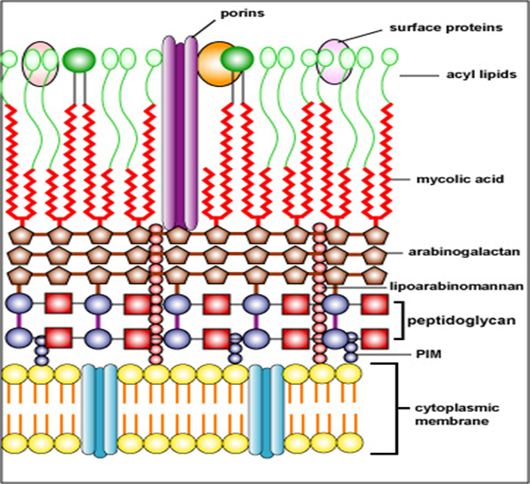
8- Injury to Plasma Membrane: Polymyxin B and bacitracin cause damage to plasma membranes
9. Isoniazid (INH) inhibits mycolic acid synthesis in mycobacteria. INH is administered with rifampin or ethambutol
to treat tuberculosis.

Slide 12
- Inhibitors of Protein Synthesis:
Aminoglycosides, tetracyclines, chloramphenicol, and macrolides inhibit protein synthesis at 70S ribosomes.
- Inhibitors of Nucleic Acid (DNA/RNA) Synthesis
Rifamycin inhibits mRNA synthesis; it is used to treat tuberculosis (Mycobacterium tuberculosis).
2. Quinolones and fluoroquinolones inhibit DNA gyrase for treatment of urinary tract infections

Slide 13
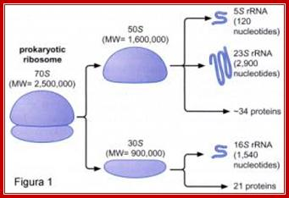

Slide 14
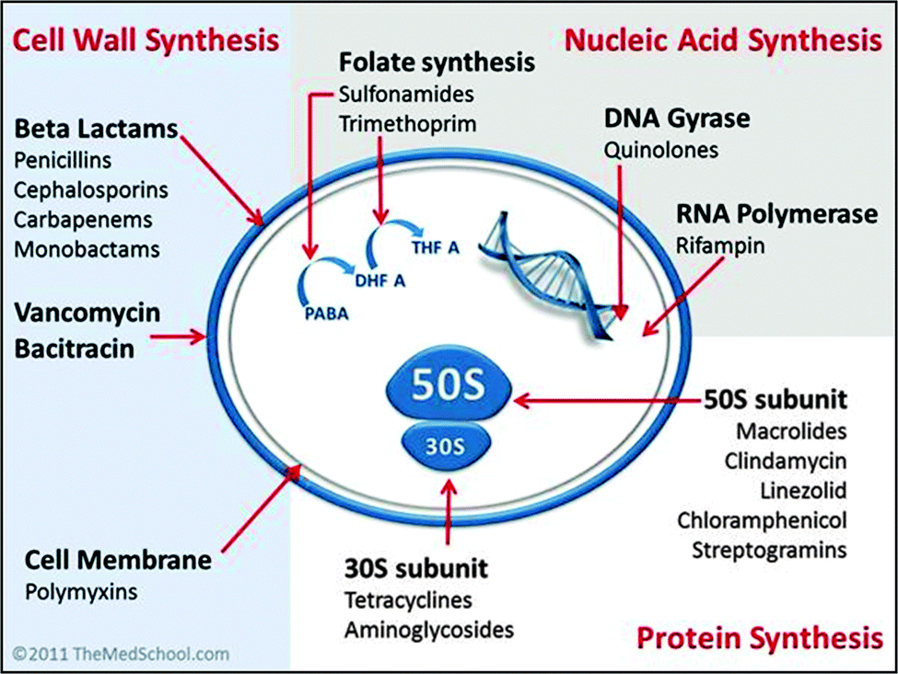

Slide 15
Bacteriostatic Agents
Sulphonamides
Tetracyclines
Chloramphenicol
Erythromycin
Ethambutol
Bactericidal Agents
Penicillins/Cephalosporins/Carbapenems
Aminoglycosides
Rifampin
Isoniazid
Pyrazinamide
Cephalosporins
Vancomycin
Nalidixic acid
Ciprofloxacin
Metronidazole
& Cotrimoxazole

Slide 16
Resistance to antibiotics
Bacteria are constantly finding ways to counteract antibiotics.
One of the most important bacterial defense mechanisms is the production of enzyme β-lactamase.
Organisms that produce β-lactamase are resistant to penicillin.

Slide 17
How is resistance spread?
Antibiotic resistance can either be inherent or acquired.
Inherent resistance: Some bacteria are naturally resistant to some antibiotics due to their physiological characteristics.
Acquired resistance occurs when a bacterium that was originally sensitive to an antibiotic develops resistance. For example resistance genes can be transferred from one plasmid to another plasmid or chromosome, or resistance can occur due to a random spontaneous chromosomal mutation.

Slide 18
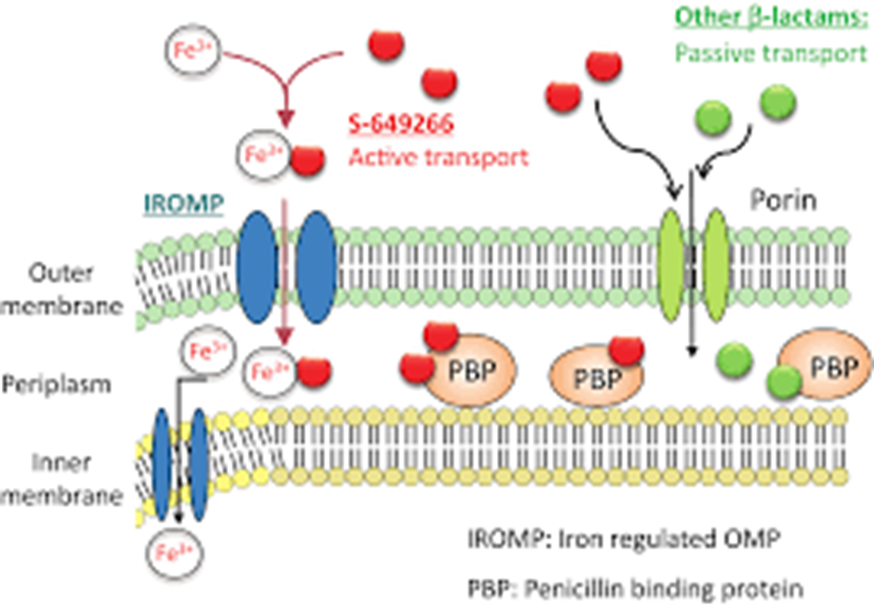
1- Production of Enzymes
a- Beta-lactamases: are enzymes that hydrolyze beta-lactam drugs. As a result the cell is resistant to the action of the beta lactam drugs.

Slide 19
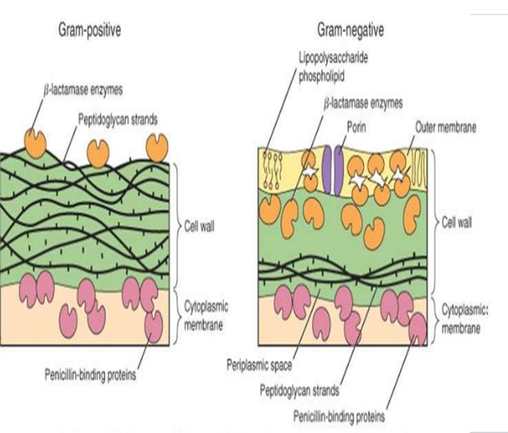
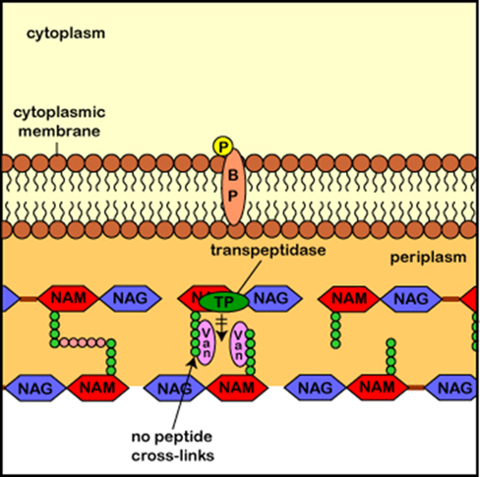
In gram-negative bacteria the beta lactam drugs enter the cell through the porin channels and encounter beta-lactamases in the periplasmic space. The beta-lactamases destroy the beta-lactam molecules before they have a chance to reach their PBP(Penicillin-binding proteins) targets.
-In gram-positive bacteria the beta-lactamases are secreted extracellularly into the surrounding medium and destroy the beta-lactam molecules before they have a chance to enter the cell.

Slide 20
• b-Aminoglycoside-modifying enzymes: Gram-negative bacteria may produce adenylating, phosphorylating or acetylating enzymes that modify an aminoglycoside so that it is no longer active.
c- Chloramphenicol acetyl transferase: Gram-negative bacteria may produce an acetyl transferase that modifies chloramphenicol so that it is no longer active. Bacterial Outer Membrane Impermeability
2- PBPs in both gram-positive and gram-negative bacteria may be altered through mutation so that beta lactams can no longer bind to them; thus the cell is resistant to these antibiotics.
3- Mutation in DNA gyrase and topoisomerase: Mutations in the chromosomal genes for DNA gyrase and topoisomerase IV confer quinolone resistance.

Slide 21
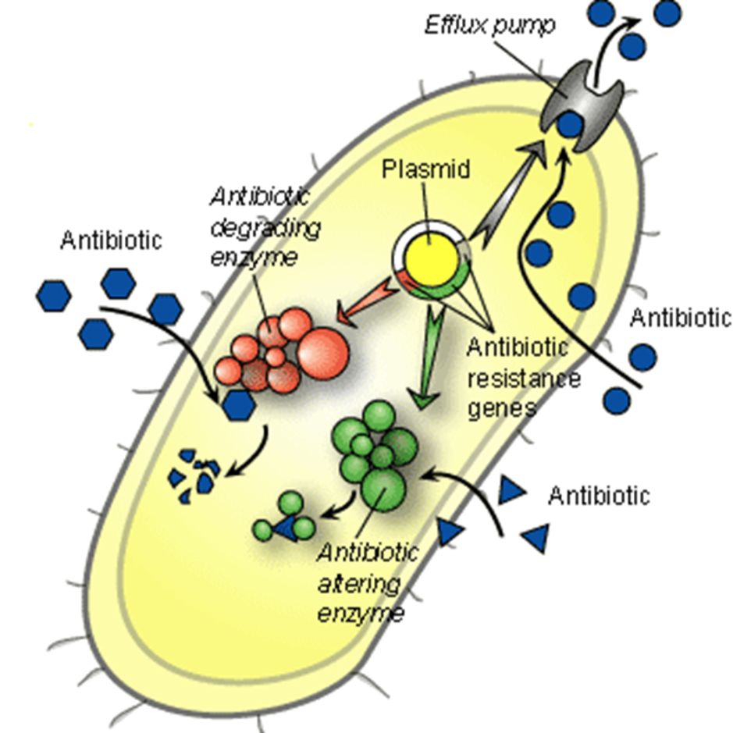
4- Efflux Pumps
• A wide variety of efflux pumps provide antimicrobial resistance in both gram positive and gram-negative bacteria. Active efflux of antibiotics is mediated by trans-membrane proteins inserted in the cytoplasmic membrane and, in the case of gram-negative organisms, in the outer membrane and the periplasm.

Slide 22
Allergy testing - skin
Allergy skin tests are used to find out which substances cause a person to have an allergic reaction.
Such as skin prick test and patch test
- The skin prick test involves:
Placing a small amount of substances that may be causing your symptoms on the skin, most often on the forearm, upper arm, or back.
The skin is then pricked so the allergen goes under the skin's surface.
The health care provider closely watches the skin for swelling and redness or other signs of a reaction. Results are usually seen within 15 to 20 minutes.
Several allergens can be tested at the same time.

Slide 23
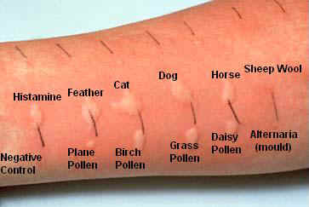
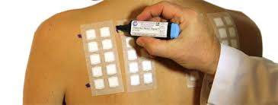
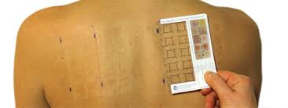
Patch testing is a method to diagnose the cause of skin reactions that occur after the substance touches the skin:
Possible allergens are taped to the skin for 48 hours.
The health care provider will look at the area in 72 to 96 hours.

Slide 24
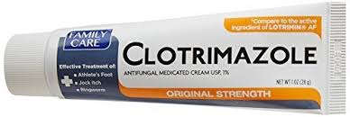
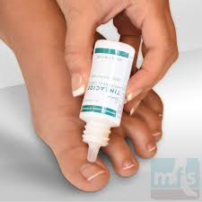
Antifungal Drugs: An antifungal medication is a pharmaceutical fungicide or fungistatic used to treat and prevent mycoses such as athlete's foot, ringworm, candidiasis (thrush), serious systemic infections such as cryptococcal meningitis, and others. Such drugs are usually obtained by a doctor's prescription, but a few are available OTC (over-the-counter).

Slide 25
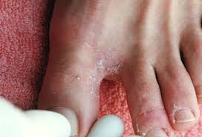
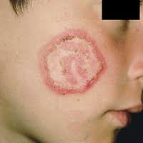
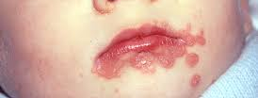
The most significant difference between human and fungal cell membranes is in the sterols present. Ergosterol, instead of cholesterol, is the primary component of the cell membrane in fungi. The primary function of ergosterols is to modulate membrane fluidity and provide a "sparking" function used to initiate growth and increase the size of the yeast cell.

Slide 26
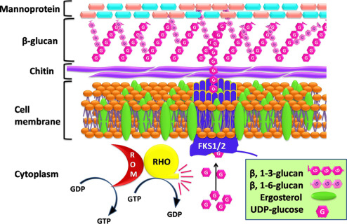

Slide 27
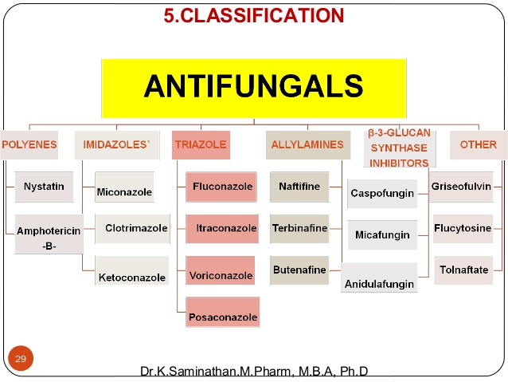

Slide 28
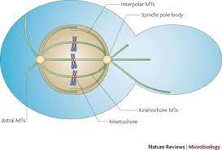
Anti fungal agent can be classified according to mechanism of action into: 1- Agent form pores in the cell membrane polyenes ( amphotericin B and Nystatin)
2. Agents disrupt ergosterol synthesis. a. Azole. Include Imidazole and triazole b. Allylamines. As terbinafine
3.A gents disrupts the mitotic spindle as Grisofulvin and caspofungin
4. Agents inhibiting DNA synthesis As Fluorocytosine

Slide 30
Antiviral drugs
Antiviral chemotherapy is still in its infancy.
Viruses are more difficult ‘targets’ than bacteria: they are most vulnerable during reproduction, but all use host cell organelles and enzymes to do this, so that antiviral compounds are often as toxic to host cells as to virus.

Slide 33
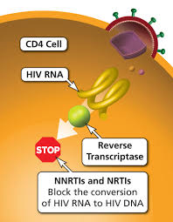
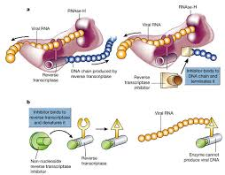

Slide 34
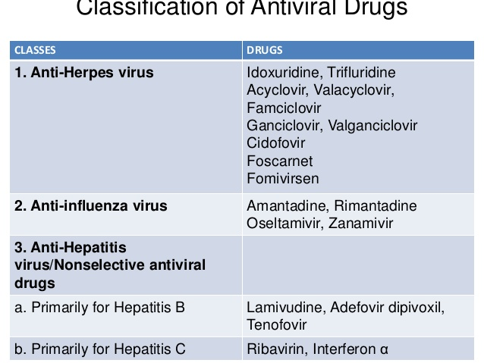
INFORMATION

Slide 35
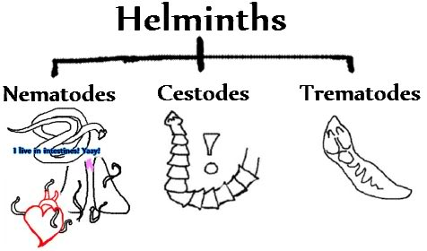
Antiprotozoan and Antihelminthic Drugs
Chloroquine and quinacrine stop DNA synthesis by intercalation between base pairs.
metronidazole(is an antibiotic that is used to treat a wide variety of infections. It works by stopping the growth of certain bacteria and parasites.)
Antihelminthic drugs include niclosamide ( is effective against cestodes that infect humans and many other animals.),
Mebendazole
praziquantel

Slide 36
Bacteriocins are proteinaceous toxins produced by bacteria to inhibit the growth of similar or closely related bacterial strain(s). They are structurally, functionally, and ecologically diverse. Applications of bacteriocins are being tested to assess their application as narrow-spectrum antibiotics
Bacteriocins were first discovered by A. Gratia in 1925.He was involved in the process of searching for ways to kill bacteria, which also resulted in the development of antibiotics and the discovery of bacteriophage, all within a span of a few years. He called his first discovery a colicine because it killed E. coli.

Slide 37
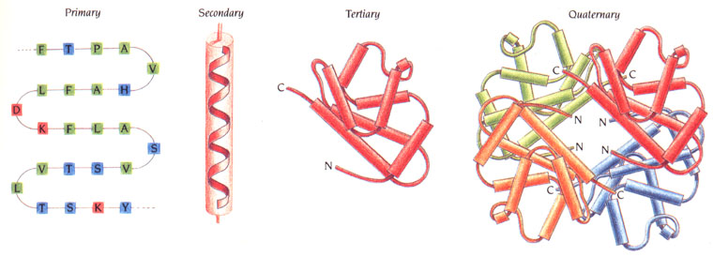
Methods of bacteriocin classification
Alternative methods of classification include:
-Method of killing (pore-forming, nuclease activity, peptidoglycan production inhibition, etc.),
-Genetics ( plasmids, chromosomal),
-Molecular weight and chemistry (large protein, peptide,
-Containing atypical amino acids such as lanthionine)

Slide 38
Bacteriocins are antimicrobial peptides produced by certain bacteria, that have little effect on closed organisms for competition at local position and prevention of produced bacteria from external harmful effects,might warrant serious consideration as alternatives to traditional antibiotics. antibiotics are substances produced by some bacteria and fungi that have wide effects against other microorganisms.
Difference between antibiotic and bacteriocin
1- Bacteriocins are produced on the surface of ribosomes in microbial cells, while antibiotics are primarily secondary metabolites of the cell;
(2) Bacteriocin producers are insusceptible to the bactericidal agents, unlike producers of antibiotics
(3) Bacteriocins can attach to the target cell wall anyplace on the surface, as no specific receptors on the target cell wall apparently exist.
(4) The mechanism of bacteriocin on target cells is diverse and is associated with the method of pore formation in the outer cell membrane

Slide 39
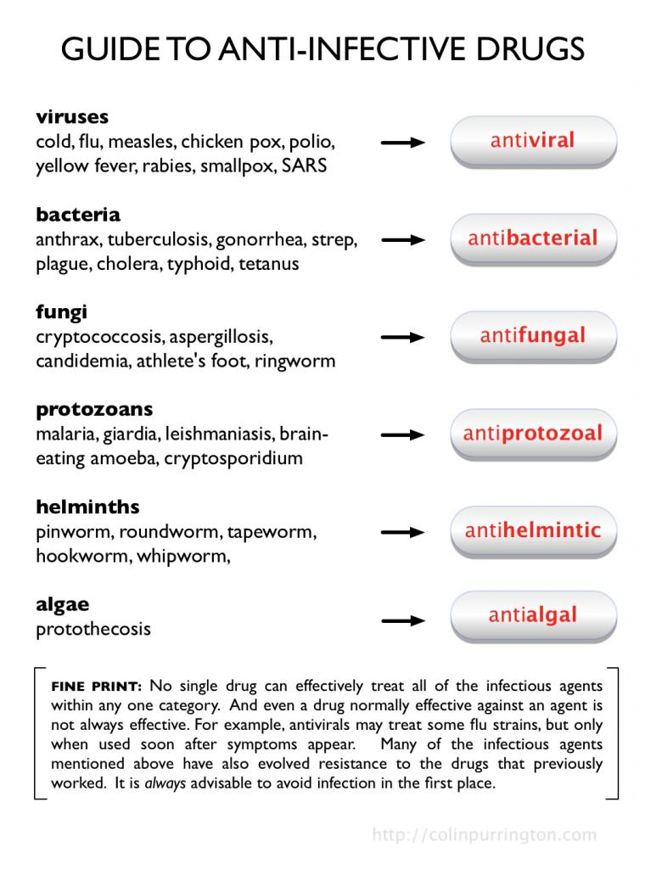

Slide 40
Question and Discussion

