Slide 1

STRESS MANAGEMENT
Academic Life and Skills
Chapter - 2
Prepared by
Waqar Ahmad

Slide 2


Slide 3

What is Stress?
Stress can be defined as our mental, physical, emotional, and behavioral reactions to any perceived demands or threats.
Notes:
We say we feel "burned out," stressed out, overwhelmed, angry, irritable, depressed, anxious, and on the verge of "losing it."

Slide 4

The “Fight or Flight” Response
When situations seem threatening to us, our bodies react quickly to supply protection by preparing to take action. This physiological reaction is known as the "fight or flight" response.
  The physiological response to a stressor is known as reactivity
  Physiological responses can accumulate and result in long-term wear on the body
Notes:
In the days of the cavemen, the fight or flight response was key to their survival. When faced with a threatening tiger, for instance, a caveman had two main choices. He could fight the tiger or he could run away. Either way, his body had to prepare quickly to respond. The caveman's heart began to race, his breathing rate increased, his pupils dilated, his muscles became tense, and his mind processed information rapidly. This natural response to danger helped the cavemen to protect himself and to survive.

Slide 5

What Makes Something Stressful?
Situations that have strong demands
Situations that are imminent
Life transitions
Timing (e.g., deviation from the “norm”)
Ambiguity
Desirability
Controllability

Slide 6
Not All Stress is Bad…
Distress is a continuous experience of feeling overwhelmed, oppressed, and behind in our responsibilities. It is the all encompassing sense of being imposed upon by difficulties with no light at the end of the tunnel.
  Examples of distress include financial difficulties, conflicts in relationships, excessive obligations, managing a chronic illness, or experiencing a trauma.
Eustress is the other form of stress that is positive and beneficial. We may feel challenged, but the sources of the stress are opportunities that are meaningful to us. Eustress helps provide us with energy and motivation to meet our responsibilities and achieve our goals.
  Examples of eustress include graduating from college, getting married, receiving a promotion, or changing jobs.

Slide 7

Stress Response: Example
A good example of a stressful situation for many people is taking a test. If you find testing to be stressful, you might notice certain physical, behavioral, mental, and emotional responses.
  Physical Response?
  Behavioral Response?
  Mental Response?
  Emotional Response?
Notes:
This may not be a life and death situation, but many of us perceive this situation as somewhat threatening.
Physically, your heart might race, your hands become clammy or sweaty, you shake, your breathing becomes rapid and shallow, your jaw tightens, and you might become light-headed.Behaviorally, you might stutter, look down, or avoid eye contact with the audience.Cognitively or mentally, your mind may go blank, or alternatively your thoughts might race wildly. You might have thoughts about making a mistake or looking ridiculous in front of your peers.Emotionally, you might feel very anxious or fearful.

Slide 8
What is Stressful to You?
Work | Roommate | Legal matters
Classes | Childcare | Mental health
Studying | Finances | Law violation
Relationship with partner | Appearance | Spiritual/Religious issues
Relationship with family | Physical Health | Major/Career decisions
Relationship with friends | Not “fitting in” | Attitudes/thoughts
Trauma | Getting married | Buying a house
Change in residence | Change to a new school | Change in amount of recreation
Change in amount of social activities | Change in eating habits | Death of friend/family member

Slide 9
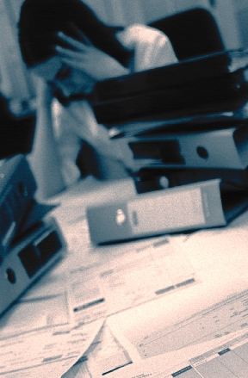
Why Do We "Stress Out"?
For two major reasons:
  We perceive a situation as dangerous, difficult, or painful.
  We don't believe we have the resources to cope.
Notes:
Our Perceptions = How Stressed We Feel
We often identify specific events, people, or situations that seem to make us feel stressed. It's as if these things automatically cause us feel stressed out. In reality, it's how we perceive an event, the meaning we give to it, that leads us to feel stressed or not stressed about it.
The interesting thing about stress is that it begins with our own perceptions of things!
Have you ever noticed that some people can feel quite stressed out about a particular event while others don't seem to be bothered by it at all? For instance, if three of your friends all get a poor grade on a test, you might notice some different reactions. One friend may seem mildly annoyed for an hour or so. Another friend doesn't seem to be bothered at all. The third friend, however, might become quite alarmed by this poor grade. She can't get it off her mind, she vows to study three times as hard next time, she can't concentrate on her other work, and she might even find it difficult to fall asleep that evening. She might become increasingly concerned about all the grades she'll make this semester, and wonder whether her GPA will suffer.
In a case such as this, a poor grade on a test means something different for each of your friends. The same situation has happened to all three, but each person feels more or less stressed about it because of what it means to him or her.

Slide 10

Stress Warning Signals
What are your "red flags," or warning signs, that stress is creeping into your life? If we keep pushing ourselves, eventually something inside of use will send "red flags," or warning signs that stress is becoming a problem.

Slide 11

Suggestions for Reducing Stress
1. Find a support system. Find someone to talk to about your feelings and experiences.
Notes:
Speak to friends, family, a teacher, a minister, or a counselor. Sometimes we just need to "vent" or get something "off our chest." Expressing our feelings can be relieving, we can feel supported by others, and it can help us work out our problems.

Slide 12
Suggestions for Reducing Stress
2. Change your attitude. Find other ways to think about stressful situations.
  "Life is 10% what happens to us, and 90% how we react to it."
Notes:
Talk to yourself positively. Remember, "I can handle it, " "this will be over soon," or "I have handled difficult things before, and I can do it again." Also, practice acceptance. We need to learn to accept things we cannot change without trying to exert more control over them.

Slide 13
Suggestions for Reducing Stress
3. Be realistic. Set practical goals for dealing with situations and solving problems.
  Develop realistic expectations of yourself and others.
Notes:
Setting our expectations or goals high may seem like a useful way to push ourselves and get things done, but we may also set ourselves up for disappointment and continued stress. Find the courage to recognize your limits

Slide 14
Suggestions for Reducing Stress
4. Get organized and take charge. Being unorganized or engaging in poor planning often leads to frustration or crisis situations, which most always leads to feeling stressed.
  Plan your time, make a schedule, establish your priorities.
Notes:
Do this regularly until it becomes a productive habit. Take responsibility for your life. Be proactive. Problem solve and look for solutions rather than worry.

Slide 15
Suggestions for Reducing Stress
5. Take breaks, give yourself "me time." Learn that taking time to yourself for rejuvenation and relaxation is just as important as giving time to other activities.
  At minimum, take short breaks during your busy day.
Notes:
You might purposely schedule time in your day planner just for yourself so that you can recharge for all the other things you need to do. Learn your "red flags" for stress, and be willing to take time to do something about it.

Slide 16

Suggestions for Reducing Stress
6. Take good care of yourself. Eat properly, get regular rest, keep a routine. Allow yourself to do something you enjoy each day.
  Paradoxically, the time we need to take care of ourselves the most, when we are stressed, is the time we do it the least.
Notes:
When we feel overwhelmed we tend to eat poorly, sleep less, stop exercising, and generally push ourselves harder. This can tax the immune system and cause us to become ill more easily. If we take good care of ourselves to begin with, we will be better prepared to manage stress and accomplish our tasks in the long run.

Slide 17
Suggestions for Reducing Stress
7. Learn to say "no." Learn to pick and choose which things you will say "yes" to and which things you will not.
  Protect yourself by not allowing yourself to take on every request or opportunity that comes your way.
Notes:
It is okay to decline a request for a favor. Saying "no" does not mean you are bad, self-centered, or uncaring. Learn skills of assertiveness so that you can feel more confident and have effective ways of saying "no."

Slide 18



Suggestions for Reducing Stress
8. Get regular exercise. Exercising regularly can help relieve some symptoms of depression and stress, and help us to maintain our health.
Notes:
Exercise can build confidence, self-esteem, and self-image.
It is also a great way to take time for yourself, blow off steam, and release physical tension.

Slide 19
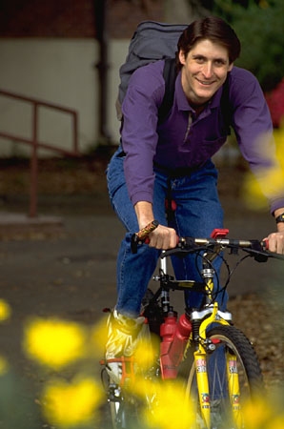


9. Get a hobby, do something different. For a balanced lifestyle, play is as important as work.
Notes:
Leisure activities and hobbies can be very enjoyable and inspiring, and they can offer an added sense of accomplishment to our lives. For ideas on new hobbies, browse through a bookstore or a crafts store, surf the internet, look up local organizations, see what classes or courses are available in your community or from a nearby college or university. Don't quickly dismiss new opportunities.

Slide 20

Suggestions for Reducing Stress
10. Slow down. Know your limits and cut down on the number of things you try to do each day, particularly if you do not have enough time for them or for yourself.
  Be realistic about what you can accomplish effectively each day.
  Monitor your pace. Rushing through things can lead to mistakes or poor performance. Take the time you need to do a good job.
    Poorly done tasks can lead to added stress.

Slide 21

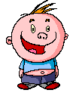
Suggestions for Reducing Stress
11. Laugh, use humor. Do something fun and enjoyable such as seeing a funny movie, laughing with friends, reading a humorous book, or going to a comedy show.

Slide 22

Suggestions for Reducing Stress
12. Learn to relax. Develop a regular relaxation routine.
  Try yoga, meditation, or some simple quiet time.
Notes:
Relaxation techniques are skills that need to be developed with patience and practice so that we can use them effectively during difficult times of stress later on.

Slide 23

Relaxation Exercises
Many different kinds, but 2 are:
  Deep Breathing
  Visualization: Visualization is a nice way of giving our minds and bodies a "mini vacation."
Notes:
When we feel stressed, it is common for our rate of breathing to increase. We also tend to breath in a shallow manner, more highly in our chest. A deep breathing exercise allows us to take fuller, slower breaths that reflect a true relaxed state
It involves using imagery to fully immerse ourselves in a pleasant scene, noticing the sights, sounds, smells, and tactile sensations.

Slide 24

Stress Management: Next Steps
Try to change the way you appraise a situation to make it less stressful
Remember stress is normal but watch out for symptoms of stress
Use coping skills/ways to reduce stress
Practice relaxation techniques
Contact advisor for counseling

Slide 25
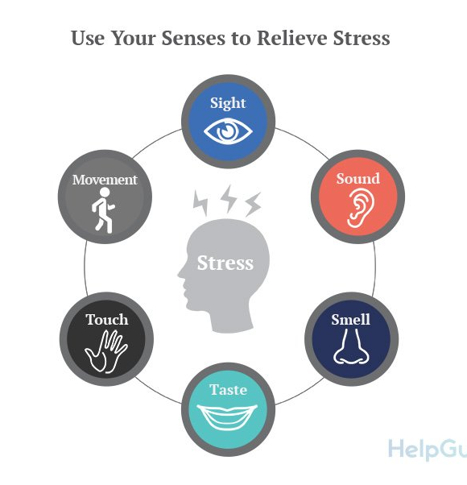
Quickest Solution
Involve your senses.
Everyone is unique so you need to find what works for you.
You may need a combination of techniques to be most effective.
Keep trying.

Slide 26

Stress Quiz
Try this one from The Canadian Mental Health Association.
https://cmha.ca/whats-your-stress-index

Slide 27

THANK YOU!

