Slide 1
Chapter 4
Email Etiquette
Prepared By Dr. Waqar Ahmad

Slide 2
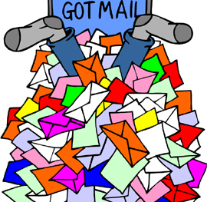
Email Etiquette

Slide 3
Netiquette
Netiquette = Network etiquette the proper way we communicate and interact with each other using email over the Internet

Slide 4
THANK GOODNESS FOR EMAIL!
Quicker Means of Communication
Cheaper
GO GREEN!
Easier

Slide 5
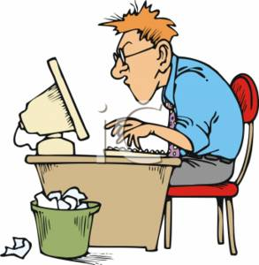
Maybe we were better off without it???
Today we avoid face to face communication
Depending on technology that is NOT perfect
Miscommunication
More impersonal
Almost Robotic
Notes:
How many of you would rather text a person, than call them on the phone?
Sending an email or a text is almost robotic and very impersonal. Even though you know you are sending it to someone..you really don’t have to face them instantly.
We are so dependant on technology today and yet we forget that these machines were man made…and may break down. Then what?
Because a lot of the communication process has to do with nonverbal communication (body language/facial expressions/tone of voice..etc) sometimes you detect a wrong message from the sender = MAY CAUSE PROBLEMS

Slide 6
Well...what can we do to improve communication?
Spell
Spell & Grammar Check
Distinguish
Distinguish between formal and informal styles when writing
Use
Use a Signature including contact info.
Be
Be kind & Respond Promptly
Be
Be concise with your subject lines
Address
Address to specific person
Be
Be specific about WHAT you want & HOW you want to attain in through your writing
Avoid
Avoid Attachments & keep email concise and within 1 screen shot
Avoid
Avoid slang & text writing
Notes:
Time is money and people are starting to get bombarded with emails (sometimes even 500 a day!)
Follow the tips above to maintain credibility and to get a quick response…don’t make yourself a bad email reputation
SUBJECT LINES ARE IMPORTANT!!!! (for organization/for quick reading and responses)
KEEP IT SHORT…the reader should not have to scroll down at all
Addressing it to a specific person closes the gap between you a bit and may allow for a quicker response
Check your email once a day and respond to someone within 48 hours MAX!!!

Slide 7
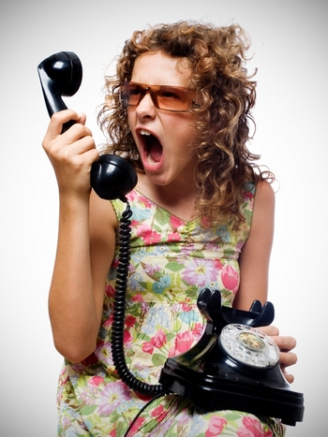
Avoiding Misunderstandings….
Remember that messages may be missed, ignored, lost, or forgotten
Sometimes MORE can be accomplished in one telephone call than 100 email messages
DO NOT TYPE IN ALL CAPITALS
Give credit to those deserving of it & ask for permission to quote them
Remember that you DO NOT have complete confidentiality and privacy (lawsuits/ work policy)
Notes:
If you work for a company…any emails written belong to the company…not you.
The company can view what you do on your computer screen from a different part of the building!
Be careful what you write in EMAIL!!!!

Slide 8
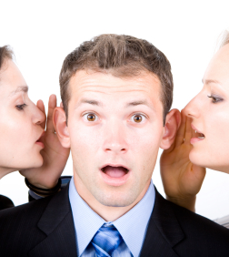
Some words to the wise… (cont.)
Always RE-READ before hitting send
Be aware of who is in the “TO” FIELD
Cc /Bcc & Reply/Reply All – CAREFUL!!!!!!
Do not use email to discuss confidential information & situations
Do not divulge your user name or password to others

Slide 9
Well what is “Bcc” & “Cc”?
Bcc:
Is short for Blind Carbon Copy
Carbon copied recipients are NOT visible to anyone but the sender
Use this when sending to a long list of recipients or to recipients that should not know each other
Should not be used as a spying device but only to protect the privacy of email addresses (ethical violation?)
Cc:
Is short for Carbon Copy
More than 1 addressees can be in this field (separate them with commas)
Carbon copied recipients ARE visible to all other recipients
Usually used when others are referenced in the email or for those you want included in the conversation

Slide 10
Example of CC vs. BCC
From: Jonathan Grove To: Ashley Miller Cc: Janet Costa, Nina Myers Bcc: Julie Ann Skala
--------------------------------------------------------------------------------------------------------------------
Dear Ashley,
Thank you for your support with the meeting. I will inform you of the results as soon as the files get posted.
Tomorrow’s agenda will be available first thing Monday morning. Please review the details with Janet and Nina.
Thank you,
Jonathan Grove
Assistant Manager
Summer Fun Company
23087 Meli Road
North Park, IL 62545
630-989-5224
Notes:
Who is this email copied to?
Do Janet and Nina know that Julie is also viewing this email?
Read this email. What is an example of an effective SUBJECT line for this email?

Slide 11
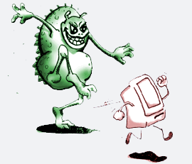
Some words to the wise…
Don’t forget to include your country as part of your address and your area code as part of your phone number (you never know how far your email will go)
Virus protection software is only a band-aid
Avoid listing your e-mail address in publicly available directories and avoid replying to spam

Slide 12
Send the RIGHT message…
(Click on Graphic →)
Avoid Abbreviations & Emoticons
Know your audience (language and style of writing depends on this)
Spelling/Grammar/Punctuation gives a bad impression
Separate FACTS from OPINIONS (focus only on facts)
Your most important statements should appear in the first paragraph
Don’t forget the GREETING and CLOSING
Notes:
CLICK ON THE GRAPHIC TO VIEW A QUICK VIDEO!!!!!

Slide 13
Email may NOT always be the best method of communication
When you reply to an email you MUST include the original email in your reply
Never insult or criticize via email. Work out differences face to face
Misinterpreted TONE
(Emails mask tone and body language)

Slide 14
Best Impressions = Lasting Impressions
Do NOT overuse: “URGENT” / “IMPORTANT” or “High Priority” option
Keep your language gender neutral
Do not forward chain letters
Don’t forward or send emails containing offensive, racist, or obscene remarks
DO NOT SEND VIRUSES!!!!!
Use bullets or numbers whenever possible
Notes:
-Using bullets and numbers/writing your email in a partially outlined format is easier to read than a chunk of information.

Slide 15
Be Responsive NOT Reactive
Avoid writing an email when you are upset or frustrated (it is best to sleep on it and respond the following day)
Emails are permanent and you never know where they go and who will view them
If you must send an email response ASAP, have someone re-read it to make sure your response is appropriate and “safe”
Avoid attaching unnecessary files
Be careful with your TONE
Remember you are judged by your writing skills
NO TEXT WRITING!!!!!
Notes:
-Text writing shows that you are careless, uneducated, and sloppy

Slide 16
Email Communication is Super Important !
Professionalism
Efficiency
Protection from Liability
Notes:
-The way you write an email can say a lot about you as a professional
-The way you write an email can help you get efficient responses to your concern
-Having an email saved and backed up can help your innocence to a sticky situation..or even to verify possible accusation

Slide 17
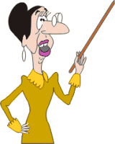
Passive vs. Active
Use the ACTIVE voice of a verb wherever possible.
EX) We will process your order today. (ACTIVE & sounds more personal)
vs.
EX) Your order will be processed today. (Passive)
Notes:
-Using ACTIVE voice helps sound determined, professional, and ready for action
-Using passive voice show the other person that you are not as serious about what you are writing and you allow wiggle room for not so punctual responses

Slide 18
Problems with Punctuation
E-mails without full stops or commas are difficult to read and can sometimes even change the meaning of the text
Small paragraphs separated by blank lines are much more readable than long run-on pieces
Careless writing skills demean your intelligence and integrity

Slide 19
Email Etiquette Unspoken Expectations…
Try to reply to an email within 24 hours
Establish an organized filing systems
Keep copies of important emails for reference
Use separate accounts for personal and business emails

Slide 20
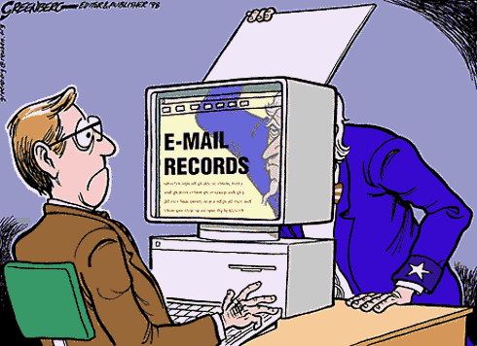
Email Etiquette Unspoken Expectations…
Don’t forget to say PLEASE and THANK YOU
Your email should not be longer than 1 screen (if you need to scroll down..it is way too long
Don’t broadcast email messages unnecessarily
Your SENT email cannot be UNSENT
DO NOT ASSUME PRIVACY.
(Click on Graphic →)
Notes:
CLICK ON GRAPHIC FOR A QUICK VIDEO!!!

Slide 21
Thank you

