Slide 1
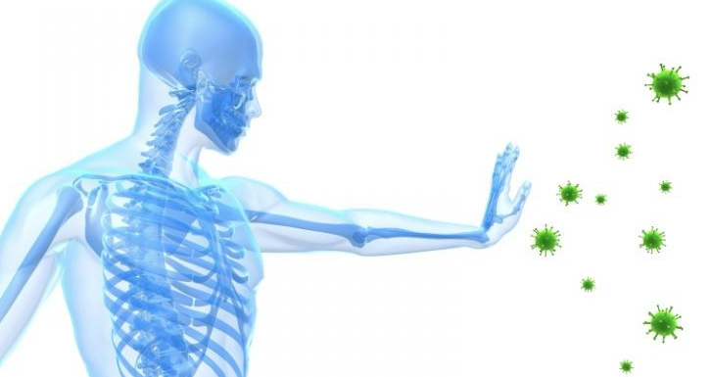

TIU - Faculty of Education
Biology Education Department
Antigen
Ms. Zhikal Omar Khudhur
Zhikal.omer@tiu.edu.iq
Immunology 8

Slide 2
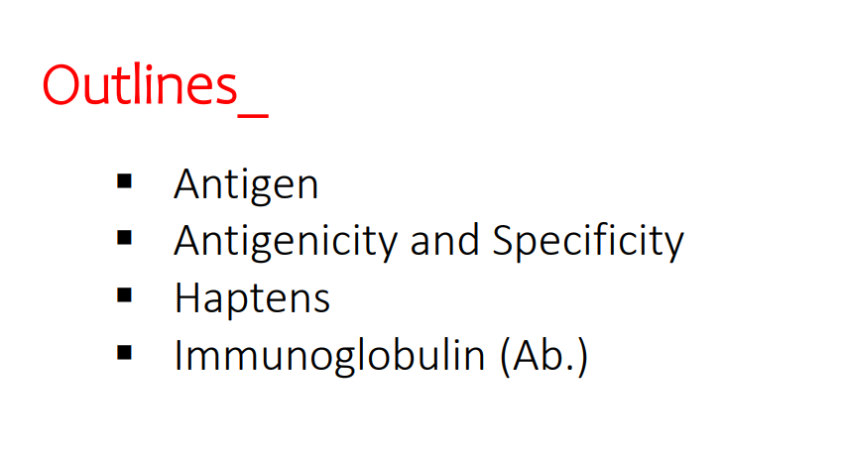

Slide 3
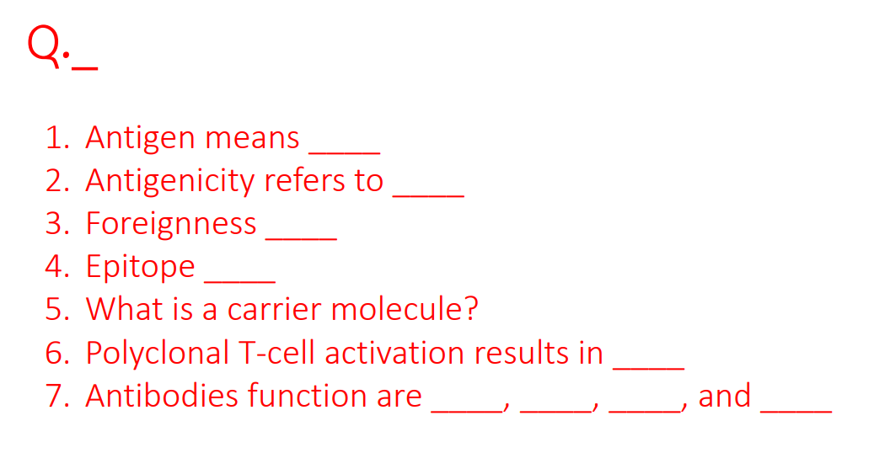

Slide 4
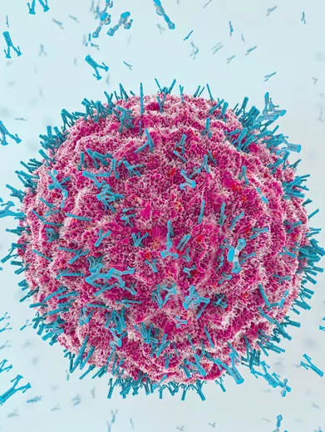
Antigens
Substances which have the ability to induce immune system when comes to contact, also can react with the products of the specific immune responses.

Slide 5
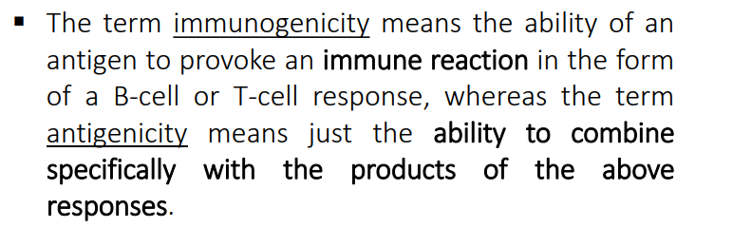
Immunogenicity and Antigenicity: The ability to induce an Ab and/or cell-mediated immune response or the ability to combine specifically with Ab and/or cell-surface receptors (Ig/TCR)

Slide 6
Factors affecting Immunogenicity
Contribution of the Immunogen
1. Foreignness - The immune system normally discriminates between self and non-self such that only foreign molecules are immunogenic. (non-self)
Notes:
- Generally, the greater the phylogenetic distance between two species, the greater the structural (and therefore the antigenic) disparity between them.
- Some macromolecules (e.g., collagen and cytochrome c) were highly conserved throughout evolution and therefore display very little immunogenicity across diverse species lines.
- Conversely, some self-components (e.g., corneal tissue and sperm) are effectively sequestered from the immune system, so that if these tissues are injected even into the animal from which they originated, they will function as immunogens.

Slide 7
2. Molecular size
• There is a correlation between the size of a macromolecule and its immunogenicity.
• The best immunogens tend to have a molecular mass >100,000 daltons (Da).
• Generally, substances with a molecular mass less than 5,000 – 10,000 Da are poor immunogens. (MW)
3. Chemical composition and complexity
• In general, the more complex the substance is chemically the more immunogenic it will be.
Synthetic homopolymers tend to lack immunogenicity regardless of their size.
Proteins are the most potent immunogens. All 4 levels of protein organization – primary, secondary, tertiary and quaternary – contribute to the structural complexity of a protein and hence affect its immunogenicity.
Notes:
•Proteins are the most potent immunogens. , while polysaccharides ranking second. Lipids and nucleic acids of an infectious agent generally do not serve as immunogens unless they are complexed with proteins or polysaccharides (for Ab (B-cell) responses)
• Only proteins and some lipids (glycolipids and phospholipids) serve as immunogens (for T-cell responses)

Slide 8
4. Physical form - In general particulate antigens are more immunogenic than soluble ones and denatured antigens more immunogenic than the native form.
5. Degradability - Antigens that are easily phagocytosed are generally more immunogenic. This is because for most antigens (T-dependant antigens, see below) the development of an immune response requires that the antigen be phagocytosed, processed and presented to helper T cells by an antigen presenting cell (APC).

Slide 9
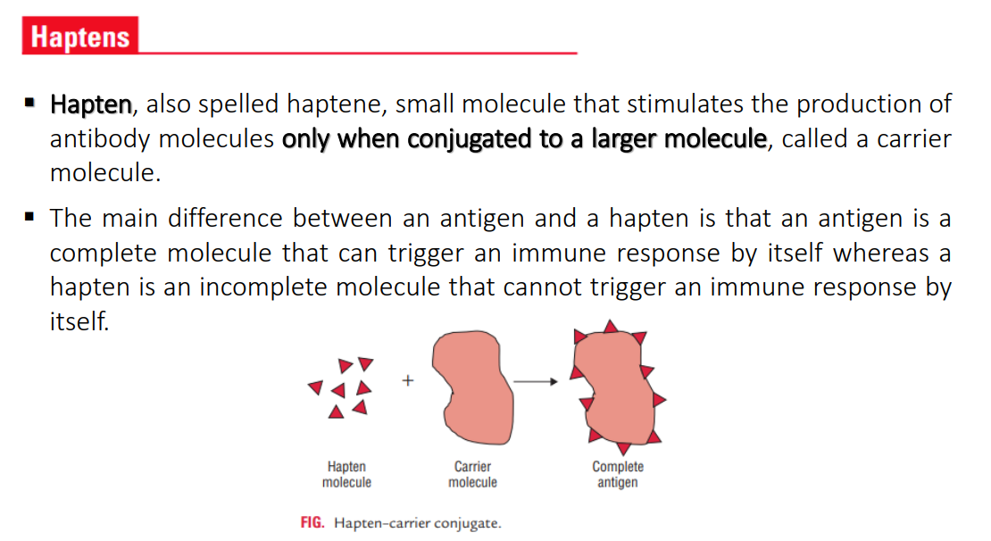
Adjuvants: Latin adjuvare, to help (Substances that, when mixed with an antigen and injected with it, enhance the immunogenicity of that antigen).

Slide 10
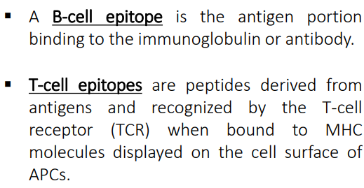
Epitope or Antigenic Determinant - That portion of an antigen that combines with the products of a specific immune response.

Slide 11
B. Contribution of the Biological System
1.Genetic Factors: Some substances are immunogenic in one species but not in another. Similarly, some substances are immunogenic in one individual but not in others (i.e. responders and non-responders). The species or individuals may lack or have altered genes that code for the receptors for antigen on B cells and T cells or they may not have the appropriate genes needed for the APC to present antigen to the helper T cells.
2. Age: Age can also influence immunogenicity. Usually the very young and the very old have a diminished ability to mount and immune response in response to an immunogen.

Slide 12
C. Method of Administration
1.Dose: The dose of administration of an immunogen can influence its immunogenicity. There is a dose of antigen above or below which the immune response will not be optimal.
2. Route: Generally the subcutaneous route is better than the intravenous or intragastric routes. The route of antigen administration can also alter the nature of the response.

Slide 13
Chemical nature of Ags
A. Proteins :
The vast majority of immunogens are proteins. These may be pure proteins or they may be glycoproteins or lipoproteins. In general, proteins are usually very good immunogens.
B. Polysaccharides :
Pure polysaccharides and lipopolysaccharides are good immunogens.
C. Nucleic Acids :
Nucleic acids are usually poorly immunogenic. However, they may become immunogenic when single stranded or when complexed with proteins.
D. Lipids :
In general lipids are non-immunogenic, although they may be haptens.

Slide 14
Superantigens (SAgs)
They are antigens which can activate multiple clones of T- lymphocytes
Like: Bacterial toxins: Staph. aureus toxic shock syndrome toxin (TSST) and enterotoxins; Strpt. pyogenes pyrogenic toxin A
They have the ability to bind both class II MHC molecules and TCR β chain; they are active at very low concentration causing release of large amounts of cytokines
The massive T-cell activation and release of large amounts of cytokines cause systemic toxicity
This method of stimulation is not specific to the pathogen
It does not lead to acquired immunity i.e no memory

Slide 15
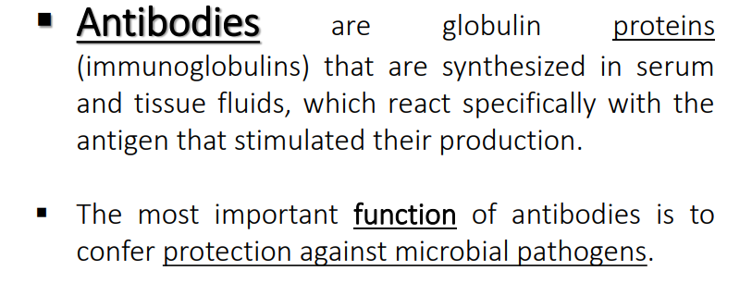
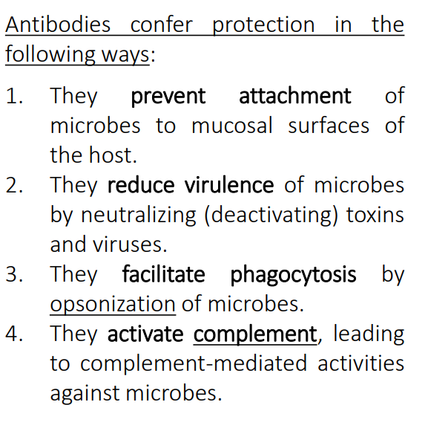
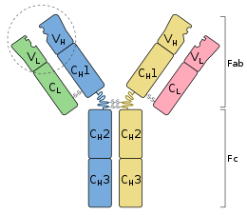

Slide 16
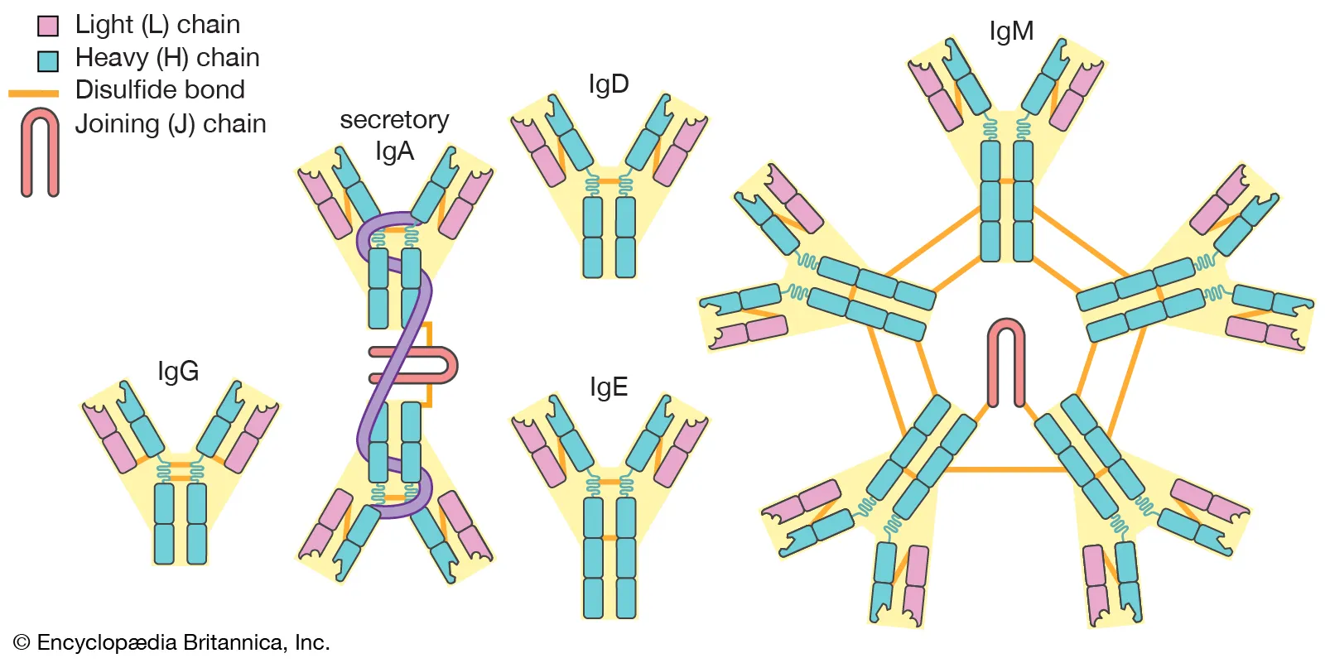

Slide 17
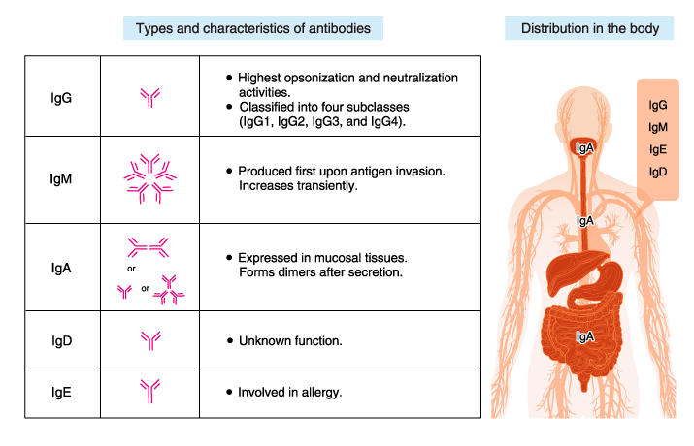

Slide 18
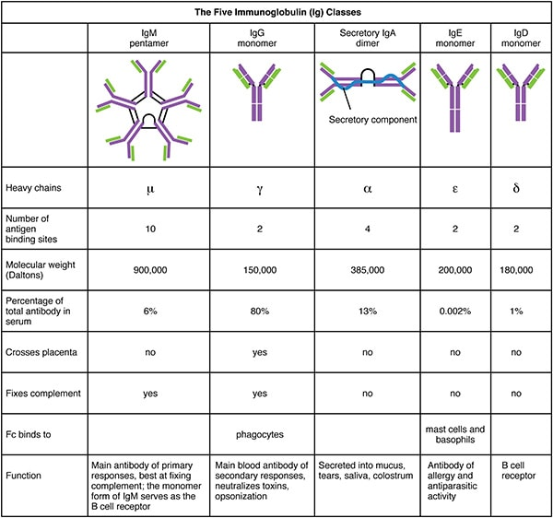

Slide 19
References
Abbas, A. K., Lichtman, A. H., & Pillai, S. (2014). Basic immunology: functions and disorders of the immune system. Elsevier Health Sciences.
Abbas, A. K., Lichtman, A. H., & Pillai, S. (2010). Cellular and Molecular Immunology. Updated 6th.

Slide 20
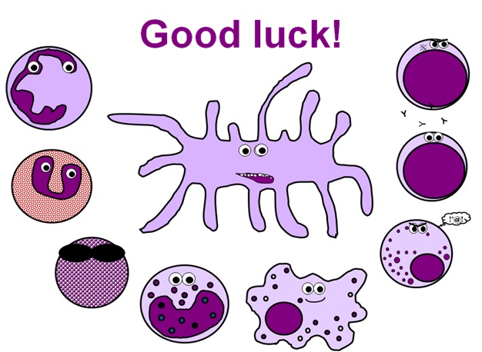
Thank you

