Slide 1
Lecture 1:
Numbers
Operators
Significant Figures
Scientific Notation
Factorial

Slide 2
Number Classification
$N = \{1,2,3,…\}$– natural numbers
$Z = \{0, ±1, ±2, ±3,…\}$– integers
$Q = \{a/b|a,b Є Z, b ≠0\}$– rational numbers
$\sqrt{2}$, π, $\sqrt{3}$, … - irrational Numbers
Real numbers - set of irrational numbers & rational numbers

Slide 3
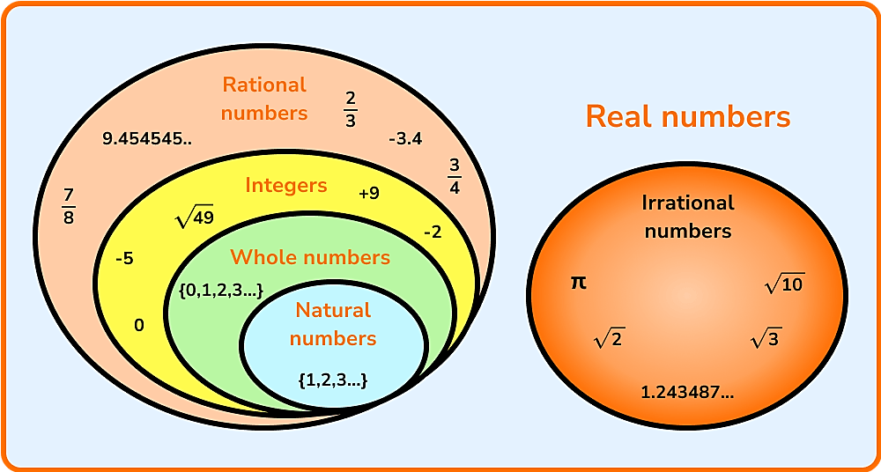

Slide 7
Operators used in programming

Slide 8
/ C++

Slide 9
Unary operator

Slide 10
Arithmetic operators
Let us use 9 as the value of its first operand:

Slide 11
Equality and Relational Operators

Slide 12
= and == operators
= is an Assignment Operator
== is an Equal To Operator

Slide 13
Logical Operators

Slide 14
Logical Operators cont.

Slide 15
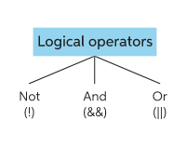
Logical Operator

Slide 16
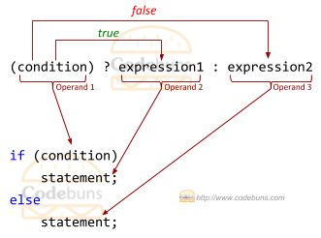
Ternary Operator
The syntax of ternary operator is :
The testCondition is a boolean expression that results in either true or false. If the condition is:
true - expression1 (before the colon) is executed
false - expression2 (after the colon) is executed
The ternary operator takes 3 operands (condition, expression1 and expression2). Hence, the name ternary operator.

Slide 17
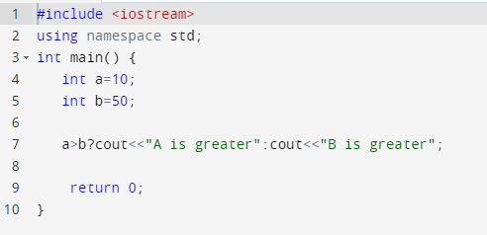

Slide 19
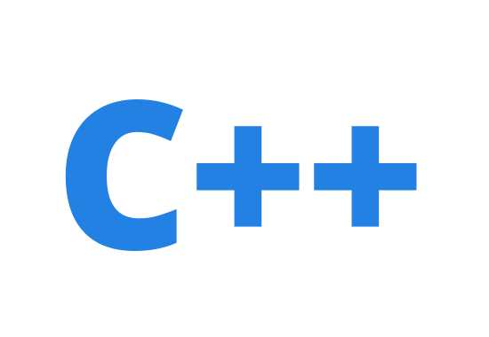
The sign of the result of a remainder operation is the same as the dividend's one.

Slide 21
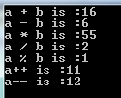
https://www.guru99.com/cpp-operators.html

Slide 22
Answer for the following questions: True or False
If $x=−2, y=5, z=0,$and $t=−4$, what is the value of each of the following expressions:
1. $x+y<z+1$
2. $x−2∗y+y<z∗2/3$
If the numerator is smaller than the denominator, then the remainder is equal to the numerator. 3 % 10 =3
3. $3∗y/4\%5<8 \&\& y> =4$
4. $t>5||z<\left(y+5\right)\&\&y<3$
5. $!\left(4+5∗y> =z−4\right)\&\&(z−2<7)$

Slide 27
Real line, GCD, LCM, significant figures, scientific notations and factorials

Slide 28
Number of Lines

Slide 29
Greatest Common Divisor and Least Common Multiple
Greatest Common Divisor (GCD) or Highest Common Factor (HCF) of two positive integers is the largest positive integer that divides both numbers without remainder. It is useful for reducing fractions to be in its lowest terms.
To find the common prime factors of 24 and 60:
24 = 2 × 2 × 2 × 3 60 = 2 × 2 × 3 × 5
The common prime factors are 2, 2 and 3. The greatest common divisor of 24 and 60 is the product of these common prime factors, i.e., 2 × 2 × 3 = 12.
Least Common Multiple (LCM) of two integers is the smallest integer that is a multiple of both numbers.
To find the prime factorization of each number and write it in index form:
24 = 2³ × 3 60 = 2² × 3 × 5
The least common multiple is the product of each prime factors with the greatest power. So, for the above example, the LCM is 2³ × 3 × 5 = 120.

Slide 30
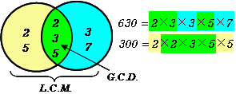
$$=30$$
$$=6300$$
$$3$$
$$21$$
$$1$$
$$105$$
$$1$$
$$24$$
$$6$$
$$78$$
$$5$$
$$70$$
$$9$$
$$84$$
7. $\left(15, 25, 30, 40\right)$
$$600$$

Slide 32
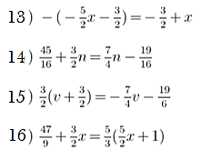
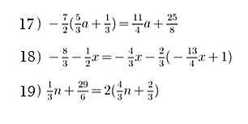
Practice

Slide 33
Answers to check

Slide 34
Significant figures are important to show the precision of your answer. This is important in science and engineering because no measuring device can make a measurement with 100% precision. Using Significant figures allows the scientist to know how precise the answer is, or how much uncertainty there is.
2002 has two significant zeroes, but 0.0103 has only 1 significant zero.

Slide 35
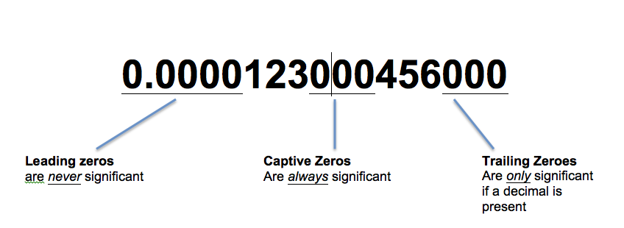
Significant Figures
The number of digits counted to the right from the leftmost positive digit is called the number of significant figures. For example,
26.103, 0.00304, 202.000 and 0.003040 are quoted to 5, 3, 6, 4 significant figures respectively.

Slide 37
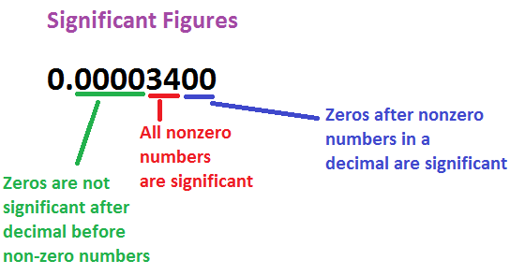
Sometimes, you'll be asked to round with significant figures. Significant figures have to do with the number of digits known with a degree of certainty. Keeping track of this number is important when gathering data from an experiment because it minimizes error. Here are the rules for significant figures:
1. All nonzero digits are significant.
2. All zeroes between nonzero digits are significant.
3. Trailing zeroes to the right of a decimal point are significant.
4. Leading zeroes to the left of the first non-zero number are not significant.
Here are some examples. Can you see which rule applies?
1.23 has _____________ figures
1001 has ____________ figures
2.03 has ____________ figures
0.033 has ____________ figures
0.20 has _______________ figures
3 significant
4 significant
3 significant
2 significant
2 only significant

Slide 38
1. Find the number of significant figure in each of the following: (a) 7.3
(b) 162.5 m
(c) 306 g
(d) 3.57 m
(e) 7.005 kg
(f) 0.045 km
(g) 0.00234 l
(h) 82.030 mg
2. Round off each of the following correct up to 3 significant figures: (a) 56.4517 g
(b) 5.20763 kg
(c) 33.311 km
(d) 50.001 cm
(e) 0.0012485 m
(f) 0.0013020 l

Slide 39
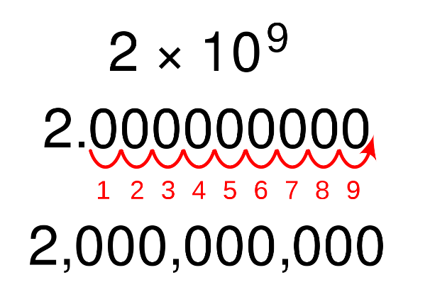
Scientific Notation
$193.034 = 1.93034 × {10}^{2}$
$0.003040 = 3.040 × {10}^{−3}$

Slide 41
Factorial
exclamation mark
$$0!=1$$
Notes:
Remember: 0! = 1

Slide 42
Notes:
Answer: (A,5) , (B,3) , (C,1) , (D,6) , (E,4) , (F,2)

Slide 43
More examples to solve:
Notes:
Answer: a) 30240 b) 586051200 c) 84 d) 495 e) 56 f) 8008 g) 20 h) 990

Slide 45
What makes a good life? Lessons from the longest study on happiness
Robert Waldinger
What keeps us healthy and happy as we go through life?
https://www.youtube.com/watch?v=8KkKuTCFvzI

