Slide 1
Revision Problems
Find the measure of the hypotenuse of a right-angled triangle whose sides measure square root of 2 and square root of 3.
Calculate the height that we can reach with a 3m ladder leaning against a wall if the bottom of the ladder is 70cm from the wall.

Slide 2
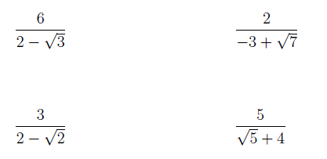
$2\left(4x−1\right)<38$
$−9−\frac{x}{2}≥\frac{x}{2}+1$
$1−\frac{3}{2}x≥x−4$
$4\left(x+1\right)<2x+3$

Slide 3
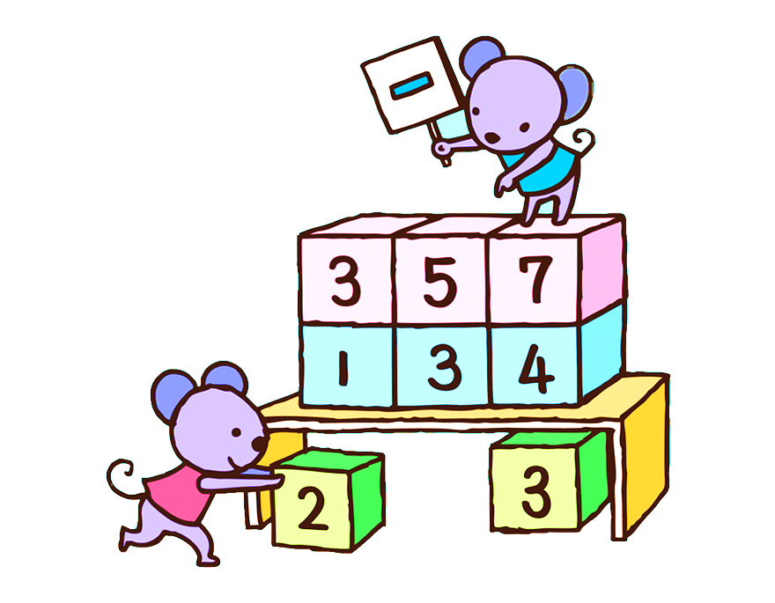
($2\sqrt{3}x+5) \left(x^{2}−9\right)\left(12x−10\right)\left(\frac{3}{4}x+\frac{11}{16}\right)=0$
$\left(\frac{7}{8}y−5\right)\left({3x}^{3}−81\right)\left(4x+13\right)\left(\sqrt{3}x−1\right)\left(12x+12\right)=0$
$\left(3x−\frac{2}{5}\right)\left(\sqrt{5}x−10\right)\left(x^{3}−64\right)=0$

Slide 4
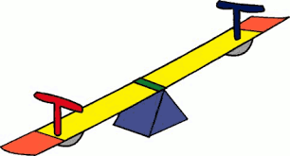
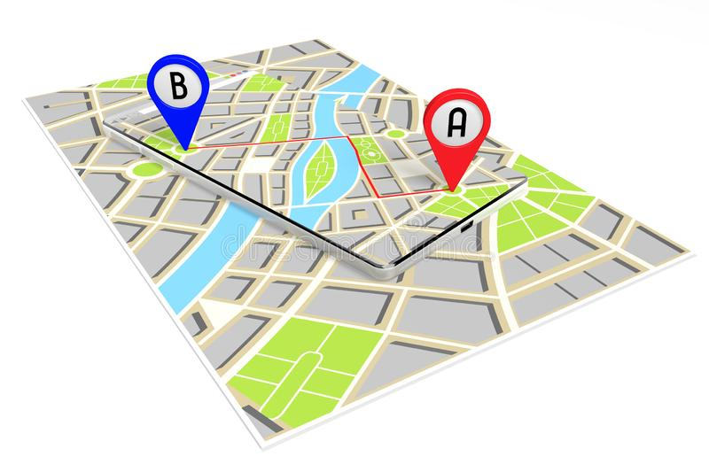
Lecture 3
Distance
Midpoint
Absolute Value: equation & inequality

Slide 5
The Cartesian Plane and Distance
$y$-axis
$xy$-plane – Cartesian plane
Plot points on a graph:
$x$-axis
$$O (0,0)$$ origin
$$P (2, 1)$$
$$Q (6, 4)$$
$$R (6, 1)$$

Slide 6
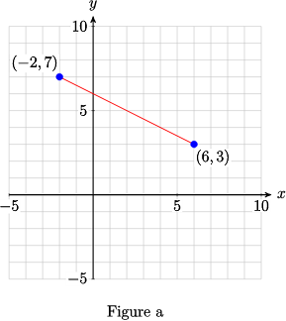
Distance
$$y$$
$$d=\sqrt{{{(x}_{2}−x_{1})}^{2}+{(y_{2}−y_{1})}^{2}}$$
Q ($x_{2}, y_{2}$)
d
P ($x_{1}, y_{1}$)
$$x$$

Slide 7
Midpoint
m ($\frac{x_{1}+x_{2}}{2},\frac{y_{1}+y_{2}}{2}$)
Find midpoint of a segment $PQ$, where $P (−2, 4)$and $Q (4, −2).$

Slide 8
P (1, 2)
Q (5, 6)
R (a, 2) – at this point occurs right-angle
Find a.
A (0, 2)
B (4, 5)
C (4, 2)
Find the length of PQ.
Find distance between two points (1, 3) and (3, 12).
Find distance between two points (2, 3) and (8, 27).
Find midpoint of the line segment between two points (1, 4) and (3, 10).

Slide 9
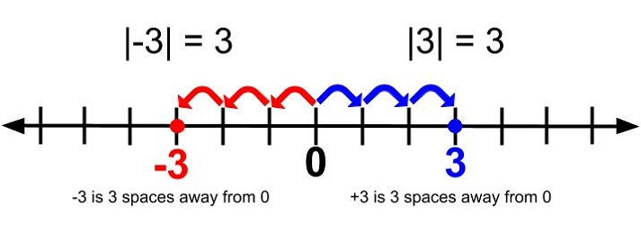
Distance and Absolute Value
Let $x ∈ ℝ$
Define the absolute value or magnitude of $x$ to be
$$x, if x ≥ 0$$
$|x|=$
$=$ distance between $x$ and $0$ on the real line.
$$x, if x < 0$$
$$−x = |x|$$
$$x = |x|$$
$$−x$$
$$0$$
$$x$$

Slide 10
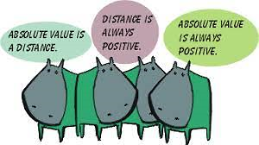

Slide 11
Absolute Value Equation

Slide 12
Absolute Value Inequality

Slide 13
Absolute Value on both sides
$$\left|2x+1\right|=|3x−5|$$
$$\left|number\right|=|number|$$
Check each case that is true:
$$\left|number\right|=|number|$$
$$\left|number\right|=|−number|$$
$$\left|−number\right|=|−number|$$
$$\left|−number\right|=|number|$$

Slide 14
Solve the equation.
Solve the inequality.

Slide 16
5 Roles, 5 Chairs, 5 Choices
A compass to being the best version of yourself
Successful living depends primarily on the way we manage our behaviours, moment-to-moment.
Our behaviours impact everything we do; the way we live, love, work, parent and lead. They create the atmosphere of our workplaces, the climate of our homes and the culture of our society at large.
In this talk Louise will present her transformative tool, The 5 Chairs, which invites us to become more aware of the choices we have to be the our very best selves in every moment.
Own Your Behaviours, Master Your Communication, Determine Your Success | Louise Evans
https://www.youtube.com/watch?v=4BZuWrdC-9Q

