Slide 1
| 6x + 4 | = 8x + 10
$\left|x−5\right|>7$
| 3x - 1 | + 5 = 3
$\left|2x+3\right|≤12$
| x - 2 | = 2x - 3
$2\left|x−6\right|≥24$
| 12 - 6x | = 42
$\left|4x−1\right|−11<20$
| 2b - 4 | = 2b - 4
$−3\left|x+2\right|≤−9$
| 2a + 1 | = a + 5
$\frac{|3x−3|}{−5}>−12$
$−3\left|x+5\right|+1=7\left|x+5\right|+8$
$8+\left|4v−7\right|≥17$
5 | c - 2 | = 30

Slide 2
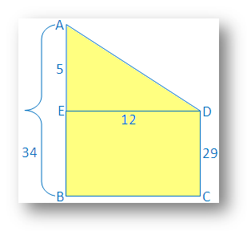
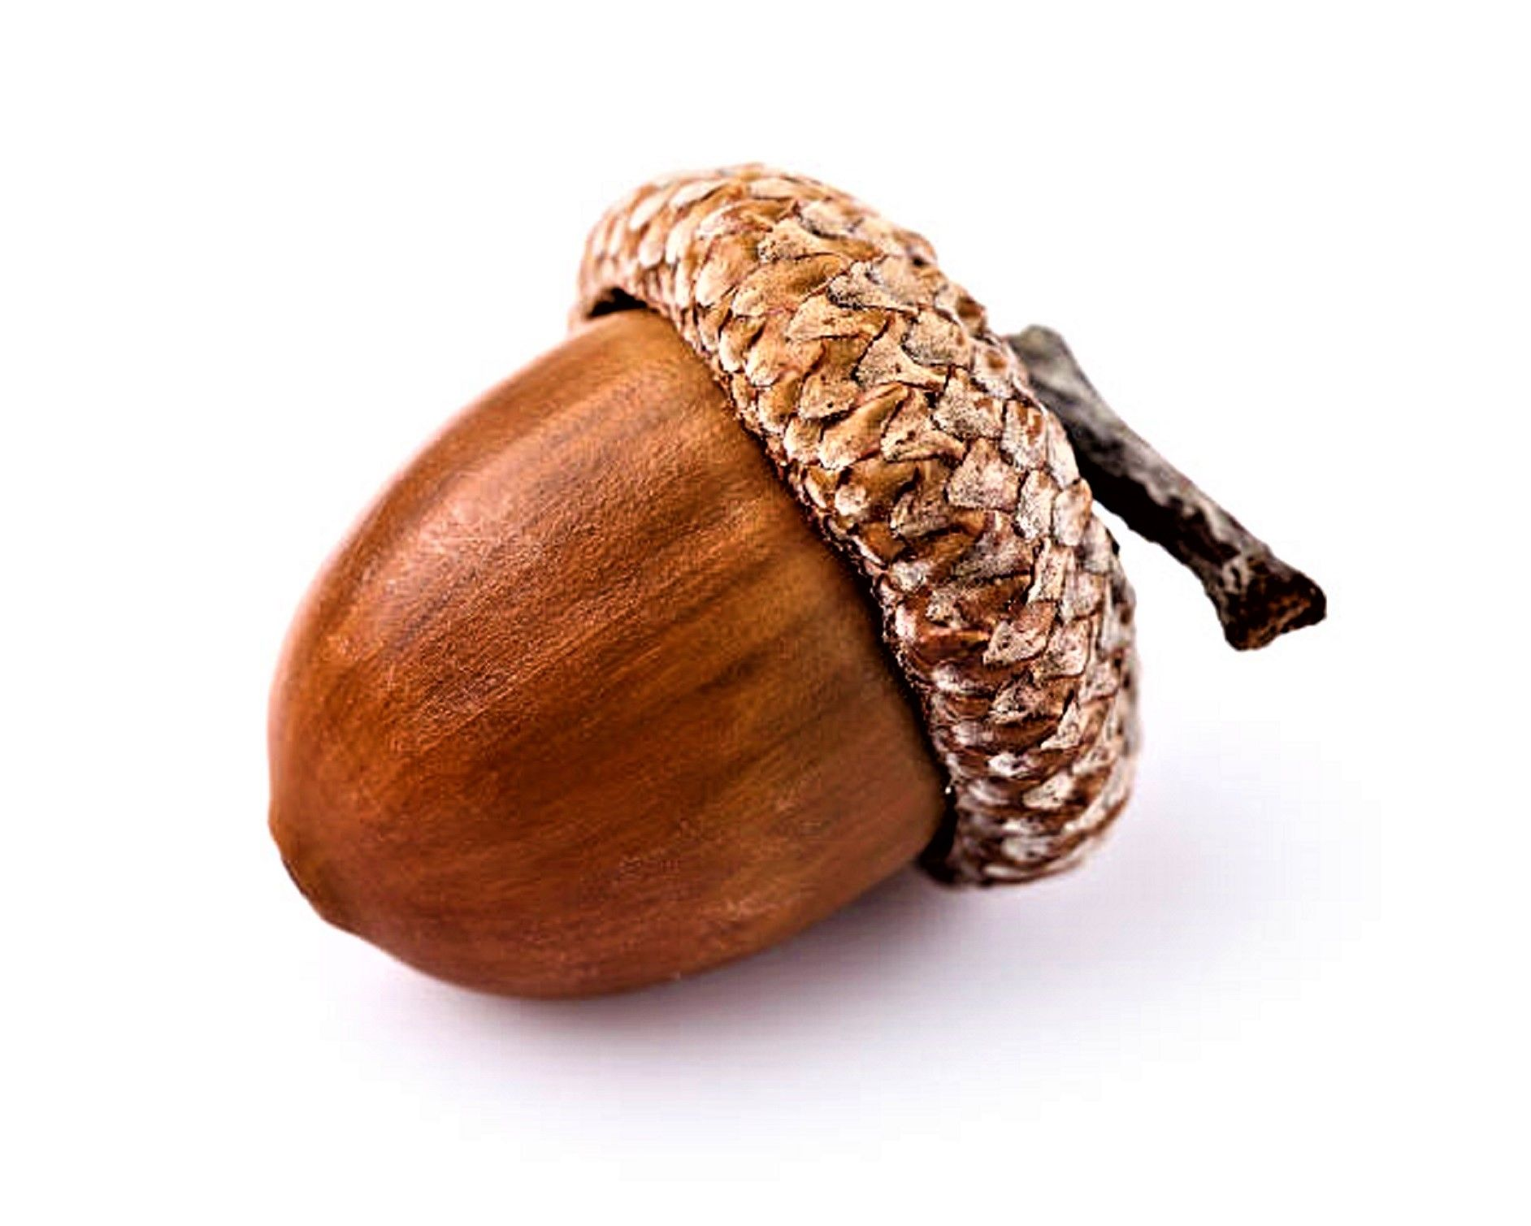
Factorization of zero: $(3\sqrt{4}y−4)(\frac{4}{5}y+12)$
Rationalize the denominator: $\frac{2}{\sqrt{5}−\sqrt{x}}$
The height of two building is 34 m and 29 m respectively. If the distance between the two building is 12 m, find the distance between their tops.
Find the perimeter of a rectangle whose length is 150 m and the diagonal is 170 m.
Ahmed has a 6 meter ladder that he wants to use to get his cat out of a tree. He puts the base of the ladder 2 meters away from the base of the tree. How high into the tree will the ladder reach?
A flying squirrel lives in a nest that is 16 feet high in a tree. To reach a fallen acorn that is 12 feet from the base of the tree, how far will the flying squirrel have to glide?
Negative six times a number decreased by 19 is no more than the seven times the number increased by 23. Find the number.

Slide 3
Lecture 4
Line equation
Slope
Circle
Systems of equations

Slide 4
Lines and Circles
General equation:
$ax+by=c$ $a, b, c −constants$
variables
A line is determined by two points.
Sketch the line.
$$y$$
$$x$$ | $$y$$
0 | 2
1 | $$\frac{4}{3}$$
$$2x+3y=6$$
$$3y=6−2x$$
$$x$$
$$y=−\frac{2}{3}x+2$$

Slide 5
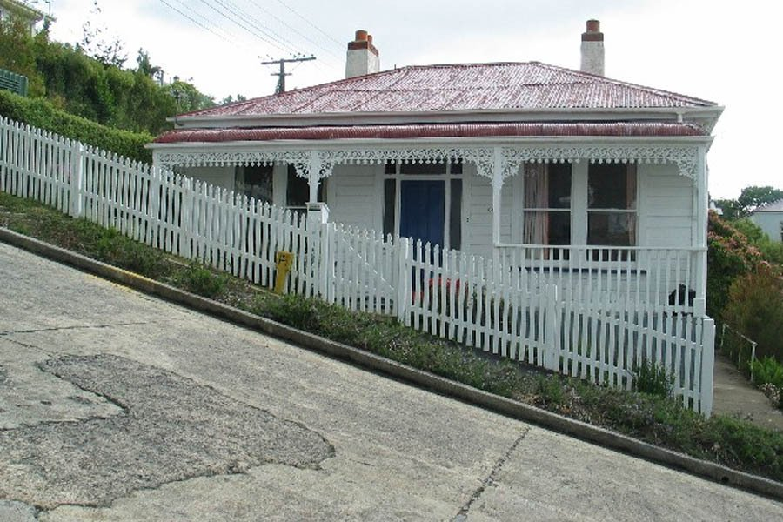
Slope
$$m=slope=\frac{vertical rise}{horizontal run}$$
Q$(x_{2},y_{2})$
$$y_{2}−y_{1}$$
$$m=\frac{y_{2}−y_{1}}{x_{2}−x_{1}}$$
$$P (x_{1},y_{1})$$
$$x_{2}−x_{1}$$

Slide 6
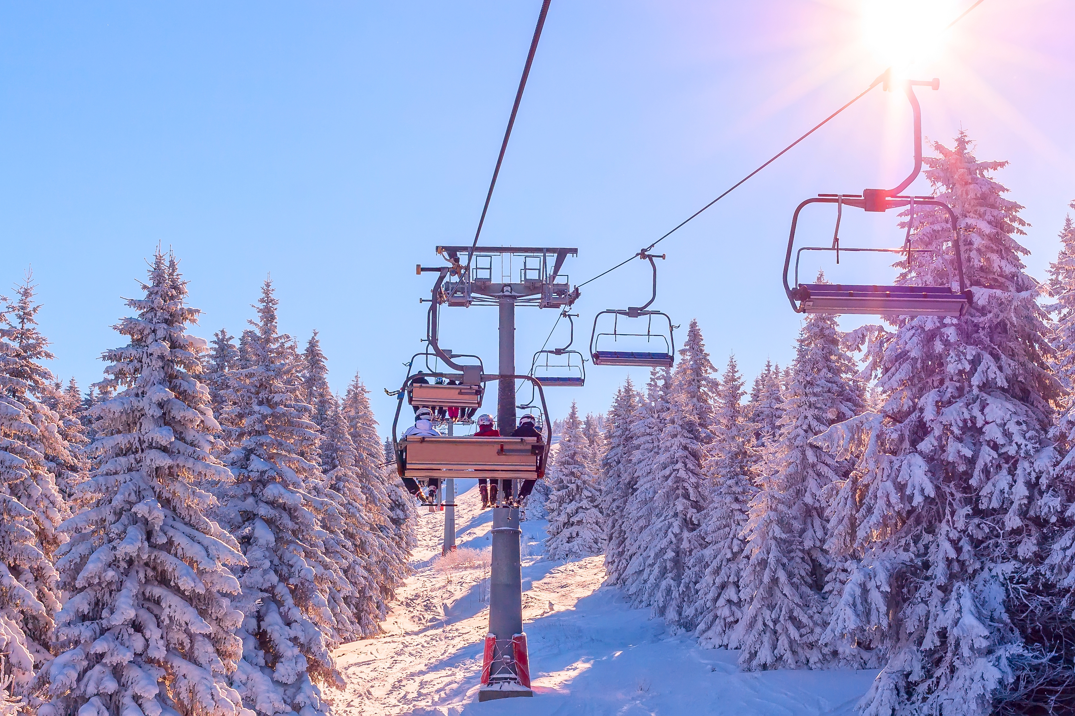
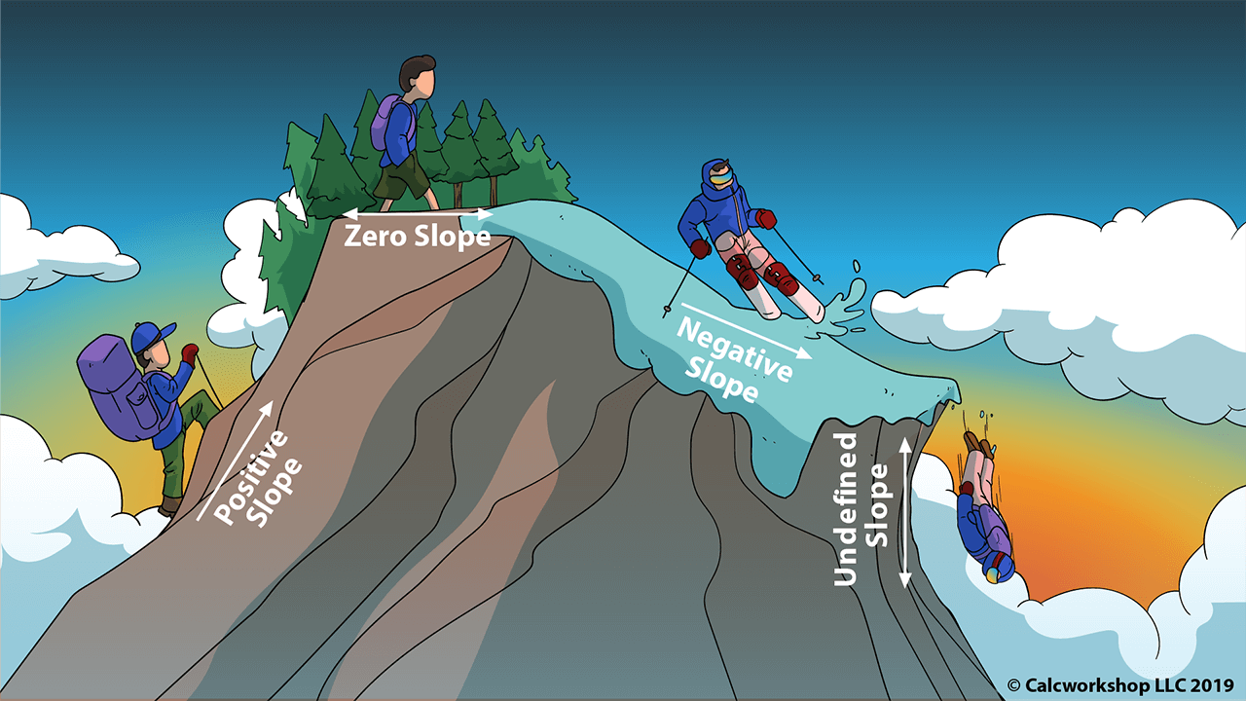
In mathematics, the slope or gradient of a line is a number that describes both the direction and the steepness of the line.
Slope tells you how steep a line is, or how much $y$ increases as $x$ increases. The slope is constant (the same) anywhere on the line.
Some real life examples of slope include:
in building roads one must figure out how steep the road will be.
skiers/snowboarders need to consider the slopes of hills in order to judge the dangers, speeds, etc.
when constructing wheelchair ramps, slope is a major consideration.

Slide 7
Find the slope of the line passing through P (2, 2) and Q (5, 6)
P($x_{1},y_{1}$) Q ($x_{2},y_{2}$)
$$slope=m=\frac{y_{2}−y_{1}}{x_{2}−x_{1}}=\frac{6−2}{5−2}=\frac{4}{3}$$
Find the slope where P (-1, 2) and Q (5, -4)

Slide 8
Slope
Positive
Negative
Zero
Infinite

Slide 9
How do we find the equation of a line?
$ax+by=c$
$by=−ax+c$
$y=\frac{−ax+c}{b}$, $b≠0$
$y=\left(−\frac{a}{b}\right)x+\frac{c}{b}$
$$y=mx+k$$

Slide 10
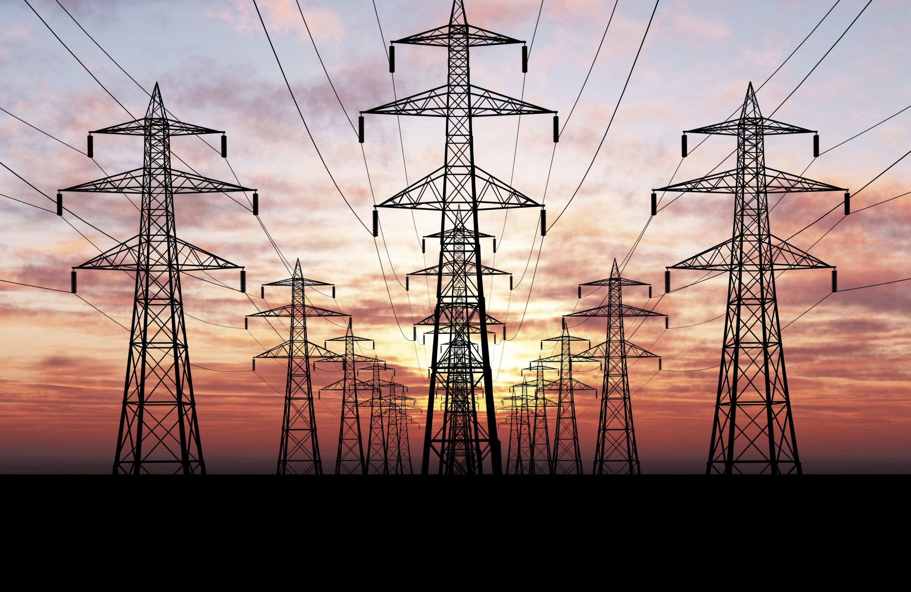
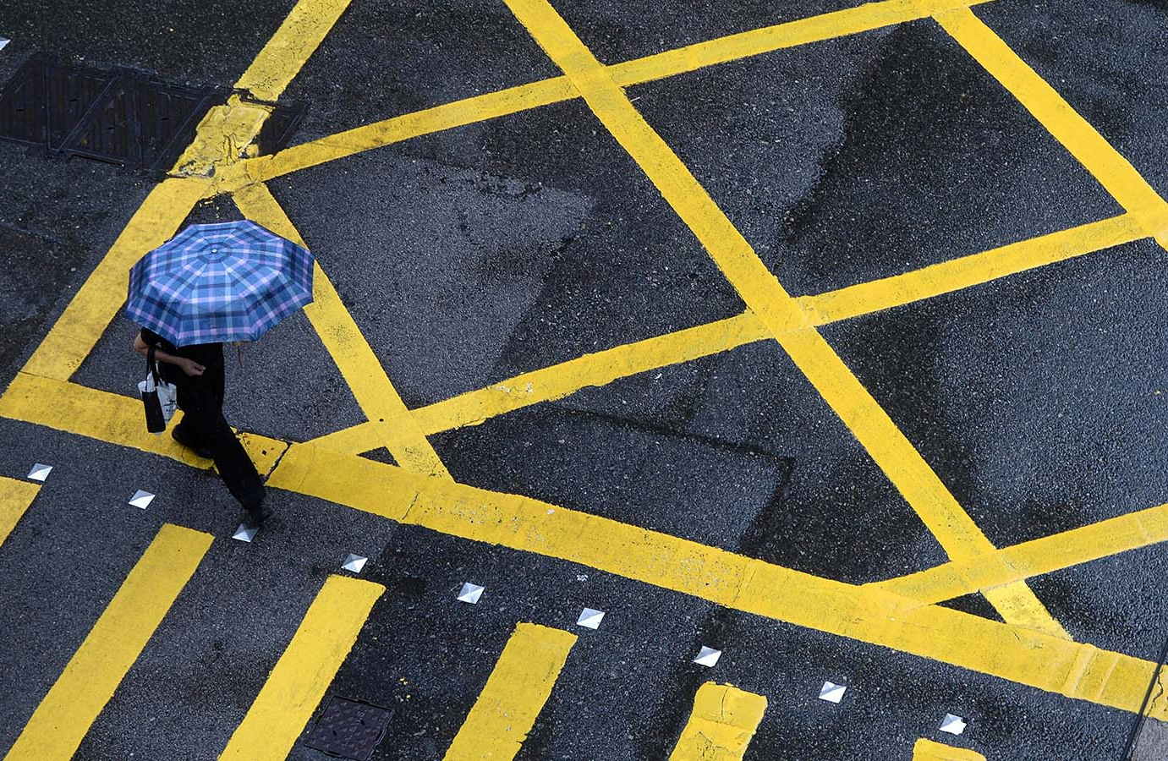
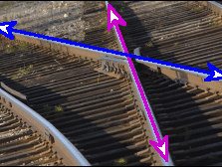
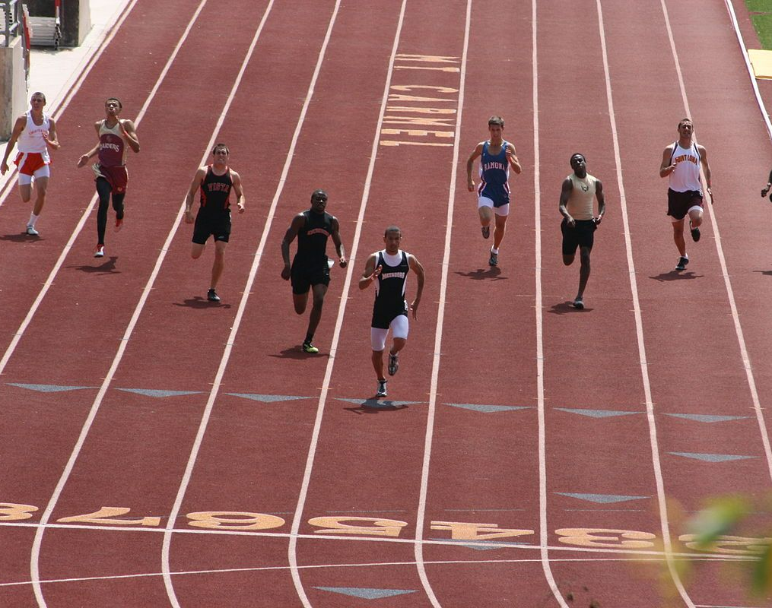
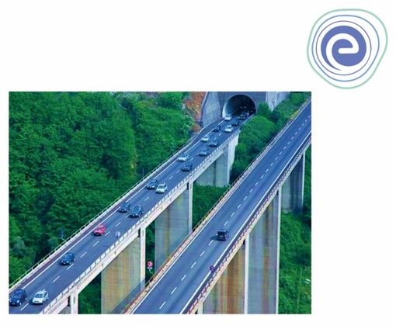

Slide 11
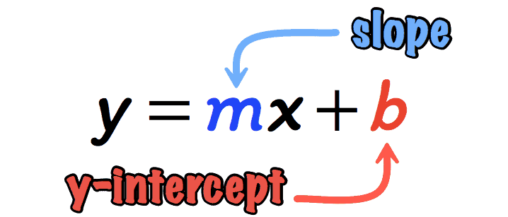
Find the equation of line L passing through P (2, 3) and Q (7, 13)
1) find a slope.
2) put coordinates of any of given points and find constant k.
1. $m=\frac{13−3}{7−2}=\frac{10}{5}=2 (slope)$
2. $y=mx+k$ – line equation
$y=2x+k m=2$
P(2,3): $3=2×2+k$
$3=4+k$
$k=3−4$
$k=−1$
$m=2, k=−1$
$y=2x−1$

Slide 12
P (2, 5) and Q (4, 9) – find a line equation.
A (2, 0) and B (8, 3) – find a line equation.
W (-2, 5) and Y (4, -9) – find slope.
What is the slope of a line that runs through points: (-2, 5) and (1, 7)? Write the line equation.
A line passes through the points (–3, 5) and (2, 3). What is the slope of this line and line equation?

Slide 13
Circle
r - radius
Q (x, y)
r
By Pythagoras:
$$r^{2}={(x−a)}^{2}+{(y−b)}^{2}$$
P (a, b)
Equation of the circle

Slide 14
Circle C centered at P (3, 4) with radius 5 units. Equation?
Crossing $x$ and $y$ axes:
$x = 0$, touches y-axis
$y = 0$, touches x-axis

Slide 15
Example
$$y⟺x$$
$$x, y = ?$$
$$Step 2. {(x−2)}^{2}+{(y+3)}^{2}=4$$
$${(x−2)}^{2}+{(−x−\frac{1}{2}+3)}^{2}=4$$
$${(x−2)}^{2}+(−x+\frac{5}{2})^{2}=4$$
${(x − 2)}^{2}+ {(y + 3)}^{2}= 4$ $2x + 2y = −1$
$$x^{2}−2×x×2+2^{2}+x^{2}−2×x×\frac{5}{2}+{(\frac{5}{2})}^{2}=4$$
$$Step 1. 2x+2y=−1$$
2$x^{2}−9x+\frac{25}{4}=0$
$$2y=−2x−1$$
$$y=−x−\frac{1}{2}$$
$$Step 3. Any method of solving quadratic equations:$$
$$x=\frac{9±\sqrt{81 −50}}{4}=\frac{9±\sqrt{31}}{4} (quadratic formula)$$
$$y_{1}=−\frac{9+\sqrt{31}}{4}−\frac{1}{2}=\frac{−11−\sqrt{31}}{4}$$
$$x_{1}=\frac{9+\sqrt{31}}{4}$$
$$y_{2}=−\frac{9−\sqrt{31}}{4}−\frac{1}{2}=\frac{−11+\sqrt{31}}{4}$$
$$x_{2}=\frac{9−\sqrt{31}}{4}$$

Slide 16
At what points given equations’ graphs intersect?
$x+y=1$
${(x−2)}^{2}+{(y+1)}^{2}=8$
$$x^{2}+y^{2}=9$$
$\left(x−1\right)+y=2$
At what points does the line with equation $y=2x+5$ intersect a circle with radius 2 and center (0, 5)?

Slide 17
Solve and show a solution set for each problem.
$A\left(5, −6\right) and B \left(−3, 1\right)$
$$find midpoint coordinates and distance$$
$$between given two points.$$
$\left|−6x+3\right|=27$
$2\left|3x−1\right|−1=7$
$2\left|3x−1\right|−1≤7$
$\left|−2x+7\right|+5≥14$

Slide 18
More problems

Slide 19
Solve for 3 lines below:
$(x+9)^{2}+(y+10)^{2}=100$
_____________
$y=x+1$
$x=1$
$y=−x+3$

Slide 20
$−4y−3x−2=0$ meets the circle $x^{2}+y^{2}+6x+4y=0$ in points A and B. Find the coordinates of A and B.
${(x−2)}^{2}+{(y+3)}^{2}=4$
$2x+2y=−1$

Slide 23
Notes:
https://www.businessinsider.com/guides/learning/best-free-online-courses-from-top-universities#stanford-university-machine-learning-3

