Slide 1
Ethical Values
Medical and Professional Ethics
Faculty of Applied Science
Medical Analyses Department
3rd GRADE
Dr. Sangar M. AHMED
E. mail: sangar.ahmed@tiu.edu.iq
@Dr.Sangarjaff
Spring Term
2022 -2023

Slide 2
Objectives
To define the main types of ‘Values’ .
Importance of |Human Values
To find out the difference between the types of values.

Slide 3
Definition
A value is defined as a principle that promotes well-being or prevents harm.”
Values are our guidelines for our success our paradigm about what is acceptable.” actions

Slide 4
Definition
Values are individual beliefs that motivate people to act one way or another. They serve as a guide for human behavior.
Generally, people are predisposed to adopt the values that they are raised with. People also tend to believe that those values are “right” because they are the values of their particular culture.

Slide 5
Ethical values
Ethical values provide the moral compass by which we live our lives and make decisions: 'doing the right thing' because it's the right thing to do

Slide 6
Ethics vs values
Ethics refers to the guidelines for conduct, that address questions of morality.
Value provides the principles and ideals upon which judgement is made of what is more important.

Slide 7
Ethics and values
Ethics and values are important in every aspect of life, when we have to make a choice between two things, wherein ethics determine what is right, values determine what is important.

Slide 8
Importance of Human Values
Provides understanding of the attitudes, motivation and behaviours
Influences our perception of the world around us
Represents interpretation of “right and wrong”
Provides a way to understand humans and organisation.

Slide 9
Personal Values are defined as:
“Emotional beliefs in principles regarded as particularly favorable or important for the individual.”
Our values associate emotions to our experiences and guide our choices, decisions and actions

Slide 10
Types of Values
1.Right conduct
2. Peace
3.Truth
4.Love
5.Nonviolence

Slide 11
Types of Values
Values related to RIGHT CONDUCT are:
SELF-HELP SKILLS:
Self-help skills are a subset of a larger repertoire of daily living skills, sometimes called activities of daily living (ADLs). Specifically, the term “self-help” usually refers to the following areas of independent behavior:

Slide 12
The term “self-help” usually refers to the following areas of independent behavior:
Eating/feeding and drinking: Skills may include holding and using utensils properly, drinking without spilling, eating a variety of foods, proper use of a napkin, table manners, and other mealtime routines.
Self care : This area includes skills such as brushing hair, shaving, and dressing (e.g., selecting clothing, putting clothes on and off without assistance, and managing fasteners).

Slide 13
The term “self-help” usually refers to the following areas of independent behavior:
Personal hygiene:
Skills include those such as bathing, brushing teeth, washing hair, and applying deodorant.
Skills related to toileting include managing clothing, cleaning oneself, as well as overall bowel and bladder management.

Slide 14
Values related to RIGHT CONDUCT are:
B. SOCIAL SKILLS:
Social skills are the skills we use to communicate and interact with each other, both verbally and non-verbally, through gestures, body language and our personal appearance.
Examples:
Good behavior, good manners, good relationships, helpfulness, No wastage, and good environment.

Slide 15
Values related to RIGHT CONDUCT are:
C. ETHICAL SKILLS: Personal ethics are ethical principles that a person uses when making decisions and behaving in both personal and professional settings. These ethics influence various aspects of a person's life and help individuals develop their work ethic, personal and professional goals, and values.
Code of conduct, courage, dependability, duty, efficiency, ingenuity, initiative, perseverance, punctuality, resourcefulness, respect for all, and responsibility

Slide 16
2. Value of PEACE :
Peace is about resolving conflict without violence. Respect for local culture and belief in the power of local capacities, ideas and solutions. Trust between people is a critical foundation for lasting peace.

Slide 17
Values related to PEACE are:
Attention, calmness, concentration, dignity, discipline, equality, faithfulness, focus, gratitude, happiness, harmony, humility, inner silence, patience, reflection, satisfaction, self-acceptance, self-confidence, self-control, self-discipline, self-esteem, self-respect, sense control, tolerance, and understanding

Slide 18
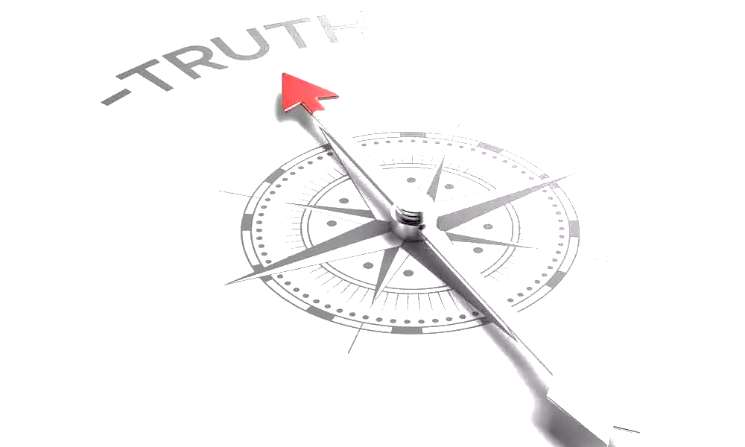
3. Value of TRUTH :
Truth was considered valuable because it enables us to see the world as it is without prejudice or bias, and moreover (according to some, most importantly) it enables us to act according to true moral dictums.

Slide 19
Values related to TRUTH are:
Accuracy, curiosity, discernment, fairness, fearlessness, honesty, integrity (unity of thought, word, and deed), intuition, justice, optimism, purity, quest for knowledge, reason, self-analysis, sincerity, sprit of enquiry, synthesis, trust, truthfulness, and determination.

Slide 20
4. Values related to LOVE are:
Acceptance, affection, care, compassion, consideration, dedication, devotion, empathy, forbearance, forgiveness, friendship, generosity, gentleness, humanness, kindness, patience, patriotism, sacrifice, selflessness, service, sharing, sympathy, tolerance and trust

Slide 21
5. Values related to NON-VIOLENCE :
Nonviolence is a value concept that is not only intended to shape individual attitudes and behavior but also group efforts organized to bring about, through peaceful means, a change in social conditions and practices that violate human rights.

Slide 22
5. Values related to NON-VIOLENCE are:
PSYCHOLOGICAL:
Benevolence, compassion, concern for others, consideration, forbearance, forgiveness, manners, happiness, loyalty, morality, and universal love

Slide 23
5. Values related to NON-VIOLENCE are:
B. SOCIAL: Appreciation of other cultures and religions, brotherhood, care of environment, citizenship, equality, harmlessness, national awareness, perseverance, respect for property, and social justice.

Slide 24
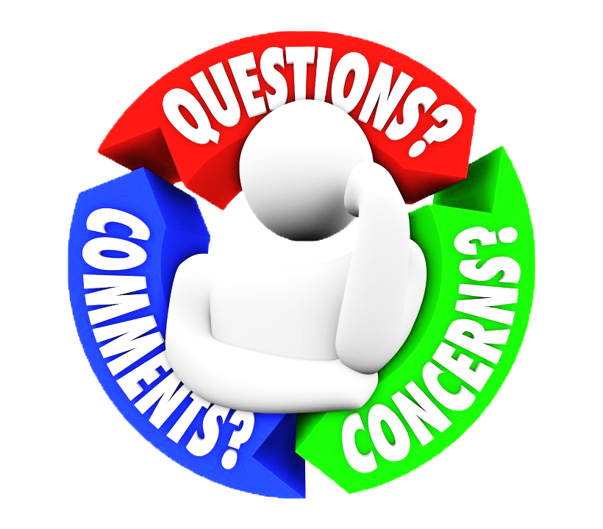

Slide 25
516 Ethics Essay Topics
https://studycorgi.com/ideas/ethics-essay-topics/

