Slide 1
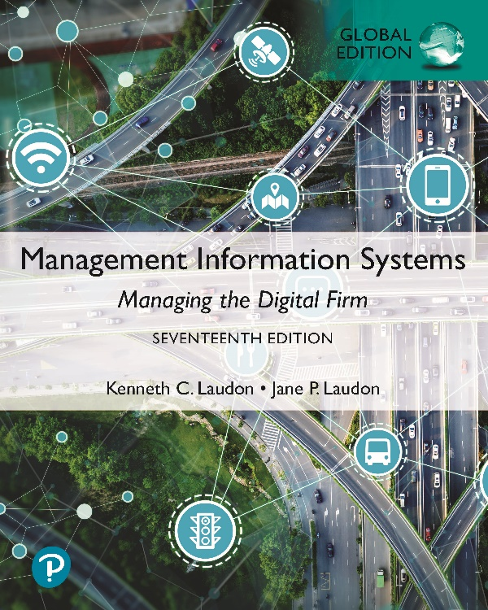
Management Information Systems: Managing the Digital Firm
Seventeenth Edition, Global Edition
Chapter 12
Enhancing Decision Making
Copyright © 2022, 2020, 2018 Pearson Education, Ltd. All Rights Reserved
Notes:
If this PowerPoint presentation contains mathematical equations, you may need to check that your computer has the following installed:
1) MathType Plugin
2) Math Player (free versions available)
3) NVDA Reader (free versions available)

Slide 2
Learning Objectives
12.1 What are the different types of decisions, and how does the decision-making process work?
12.2 How do information systems support the activities of managers and management decision making?
12.3 How do business intelligence and business analytics support decision making?
12.4 How do different decision-making constituencies in an organization use business intelligence?
12.5 How will M I S help my career?
Notes:
This chapter focuses on the information systems that support decision making in a firm and discusses the value of improved decision making in an organization. Ask the students to describe different types of decisions and whether some types of decisions are less valuable than others. What types of decisions, in a work framework, have students encountered in their own employment situations? Ask students to describe some of the decisions they made on their last job. How did they use information systems to help make those decisions?

Slide 3
Video Cases
Case 1: P S E G Leverages Big Data and Business Analytics Using G E’s PREDIX Platform
Case 2: FreshDirect Uses Business Intelligence to Manage Its Online Grocery
Case 3: Business Intelligence Helps the Cincinnati Zoo Work Smarter

Slide 4
Eastspring: Targeted Enterprise System Building
Problem
  End-of-life technology and legacy systems
  Business needs of regional business units
Solutions
  Systems offering a breadth of services
  Using outside vendors for products and systems
  Changing business processes
Illustrates benefits of implementing a new system solution while changing business processes

Slide 5
What Are the Different Types of Decisions, and How Does the Decision-Making Process Work? (1 of 2)
Business value of improved decision making
  Improving hundreds of thousands of “small” decisions adds up to large annual value for the business
Types of decisions
  Unstructured: Decision maker must provide judgment, evaluation, and insight to solve problem
  Structured: Repetitive and routine; involve definite procedure for handling so they do not have to be treated each time as new
  Semistructured: Only part of problem has clear-cut answer provided by accepted procedure
Notes:
This slide discusses the importance of improved decision making and describes the three types of decisions that are made in an organization. Table 12.1 in the text illustrates how a small decision made hundreds of times a year can be just as valuable as a single decision made once a year. For example, improving a decision to schedule production to fill orders, made 150 times a year, with a value of $10,000, can mean an annual value of $1.5 million. The different levels in an organization tend to make different types of decisions and require different types of support to make these decisions. Ask students to provide examples of each type of decision. Give students examples of decisions and ask what category the decision fall into and why.

Slide 6
What Are the Different Types of Decisions, and How Does the Decision-Making Process Work? (2 of 2)
Senior managers
  Make many unstructured decisions
Middle managers
  Make more structured decisions but these may include unstructured components
Operational managers and rank and file employees
  Make more structured decisions
Notes:
This slide describes the types of decisions being made at the different levels within an organization. Semistructured decisions contain a portion that is unstructured and a portion that is structured. Which portion of the example question for middle managers is structured and which is unstructured? What would make this question a fully structured question? Ask students to come up with additional examples of decisions at the executive, middle management, and operational levels of the organization, for companies they have worked for.

Slide 7
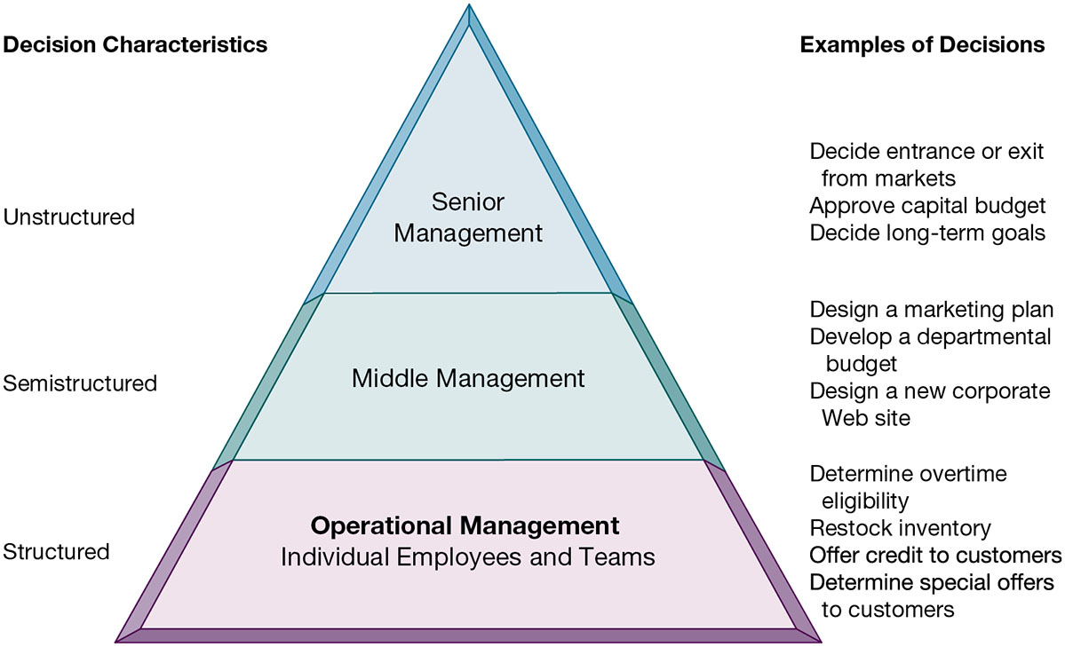
Figure 12.1 Information Requirements of Key Decision-Making Groups in a Firm
Notes:
Figure 12.1, Page 459.
Senior managers, middle managers, operational managers, and employees have different types of decisions and information requirements.
This figure provides an illustration of how the nature of decision making changes as you move up and down the corporate hierarchy. There are of course exceptions. Some senior managers like to take a hands-on approach to daily operations.
Alt Text
Long description: A pyramid diagram explains how different managers, operational management, and employees have different types of decisions and information requirements. The details from bottom-up are as follows:
Operational Management; Individual Employees and Teams: Decision characteristic is structured.
Examples of decisions:
Determine overtime eligibility
Restock inventory
Offer credit to customers
Determine special offers to customers.
Middle Management: Decision characteristic is semi structured.
Examples of decisions:
Design a marketing plan
Develop a departmental budget
Design a new corporate website.
Senior Management: Decision characteristic is unstructured.
Examples of decisions:
Decide entrance or exit from markets
Approve capital budget
Decide long-term goals.

Slide 8
The Decision-Making Process
Intelligence
  Discovering, identifying, and understanding the problems occurring in the organization
Design
  Identifying and exploring solutions to the problem
Choice
  Choosing among solution alternatives
Implementation
  Making chosen alternative work and continuing to monitor how well solution is working
Notes:
This slide describes the process of decision making as a series of four stages. It is important to note that if an implemented solution doesn’t work, the decider can return to an earlier stage in the process and repeat as needed. Give the students an example decision, such as “what college should I apply to” and ask them to describe the actions taken at each of the four stages.

Slide 9
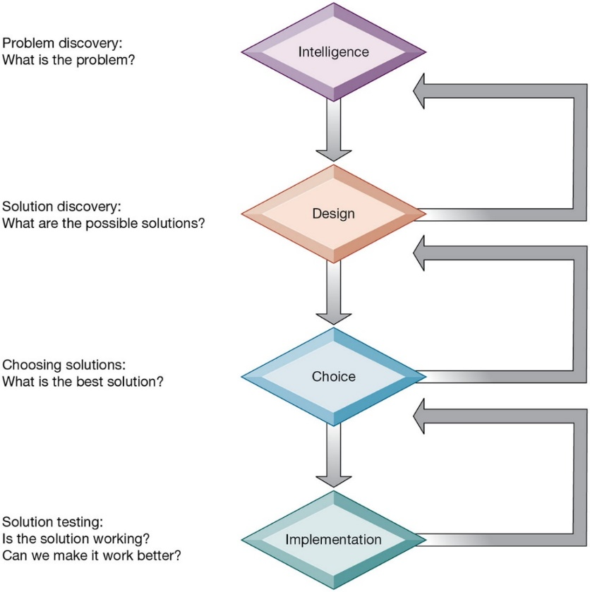
Figure 12.2 Stages in Decision Making
Notes:
Figure 12.2, Page 460.
The decision-making process is broken down into four stages.
This graphic illustrates the four stages of decision making introduced in the previous slide, emphasizing that steps can be repeated as needed, depending on the outcome at each stage. You can ask students to apply the framework to a decision they have made in the past.
Alt Text
Long description: A flowchart explains the various stages in decision making. The four stages in decision making are as below:
Intelligence. Text here reads, problem discovery: what is the problem?
Design. Text here reads, solution discovery: what are the possible solutions?
Choice. Text here reads, choosing solutions: what is the best solution?
Implementation. Text here reads, Solution testing: is the solution working? Can we make it work better?
After the last stage, the flowchart goes back to the first stage of intelligence.

Slide 10
Managerial Roles
Information systems can only assist in some of the roles played by managers
Classical model of management: five functions
  Planning, organizing, coordinating, deciding, and controlling
More contemporary behavioral models
  Actual behavior of managers appears to be less systematic, more informal, less reflective, more reactive, and less well organized than in classical model
Notes:
This slide discusses the idea that, although information systems can assist in making decisions by providing information and tools for analysis, they cannot always improve on decisions being made. Ask the students to provide examples of decisions that an information system might not be able to assist in. Is there any similarity among these example decisions, and what does this say about the types of decisions an information system can help with?
You can understand the complexity and breadth of some of the decisions being made within an organization by looking at the activities of its managers. Although the classical model of management sees five functional roles of managers, real-life observation of managers sees far more complexity in managerial activities. Ask the students to recall the five attributes listed in the book as differing greatly from the classical description. (1) Managers perform a great deal of work at an unrelenting pace; (2) managerial activities are fragmented, lasting for less than 9 minutes; (3) managers prefer current, specific, ad hoc information; (4) managers prefer oral forms of communication; and (5) managers give high priority to maintaining a complex web of contacts as an informal information system. Ask students to explain attributes 3, 4, and 5.

Slide 11
Mintzberg’s 10 Managerial Roles (1 of 2)
Interpersonal roles
  Figurehead
  Leader
  Liaison
Informational roles
  Nerve center
  Disseminator
  Spokesperson
Notes:
This slide expands on the behavioral model of managers and describes Mintzberg’s behavioral model of managers which defines 10 managerial roles that fall into three categories. Ask students to give examples of activities for each role. Which of these roles can be assisted by information systems and which cannot?

Slide 12
Mintzberg’s 10 Managerial Roles (2 of 2)
Decisional roles
  Entrepreneur
  Disturbance handler
  Resource allocator
  Negotiator
Notes:
This slide continues the discussion of Mintzberg’s classification of managerial roles.

Slide 13
Real-World Decision Making
Three main reasons why investments in I T do not always produce positive results
  Information quality
    High-quality decisions require high-quality information
  Management filters
    Managers have selective attention and have variety of biases that reject information that does not conform to prior conceptions
  Organizational inertia and politics
    Strong forces within organizations resist making decisions calling for major change
Notes:
Even in decision-making situations that can be helped by information systems, the information system may fail in helping to solve the problem or lead to a better decision. This slide describes the three main reasons why investments in information systems do not always produce positive results. What is meant by information quality? The text lists seven quality dimensions: accuracy, integrity, consistency, completeness, validity, timeliness, accessibility. Ask students to identify and/or describe these dimensions?
Ask students to provide an example of what a management “filter” might be. Have they ever witnessed someone in a managerial position be unable to recognize or handle a problem because of a “filter” they are using (but don’t even know it)?
Ask students why people within an organization would resist using an information system.

Slide 14
High-Velocity Automated Decision Making
Made possible through computer algorithms precisely defining steps for a highly structured decision
  Humans taken out of decision
For example: High-speed computer trading programs
  Trades executed in nanoseconds
Require safeguards to ensure proper operation and regulation
Notes:
This slide looks at the growth of systems for executing high-velocity decision making, such as financial trading programs. A second example is Google’s search engine. What types of problems lend themselves to this type of system? Ask students what other activities would benefit from humans being taken out of the decision-making process.

Slide 15
What is Business Intelligence?
Business intelligence
  Infrastructure for collecting, storing, analyzing data produced by business
  Databases, data warehouses, data marts, Hadoop, analytic platforms
Business analytics
  Tools and techniques for analyzing data
  O L A P, statistics, models, data mining
Business intelligence vendors
  Create business intelligence and analytics purchased by firms
Notes:
This slide introduces the concept of business intelligence and analytics. It is important to understand that business intelligence and business analytics are products defined by hardware and software vendors. This is also one of the fastest growing segments in the U.S. software environment. Ask students why this might be so.

Slide 16
The Business Intelligence Environment
Six elements in the business intelligence environment
  Data from the business environment
  Business intelligence infrastructure
  Business analytics toolset
  Managerial users and methods
  Delivery platform—M I S, D S S, E S S
  User interface
    Data visualization tools
Notes:
This slide looks at the six main elements at play in business intelligence. Ask students what is meant by managerial users and methods and why this is important. (Managers impose order on the analysis of data using a variety of managerial methods that define strategic business goals and specify how progress will be measured. Without management oversight, business analytics can produce a great deal of information that focus on the wrong matters and divert attention from the real issues.)

Slide 17
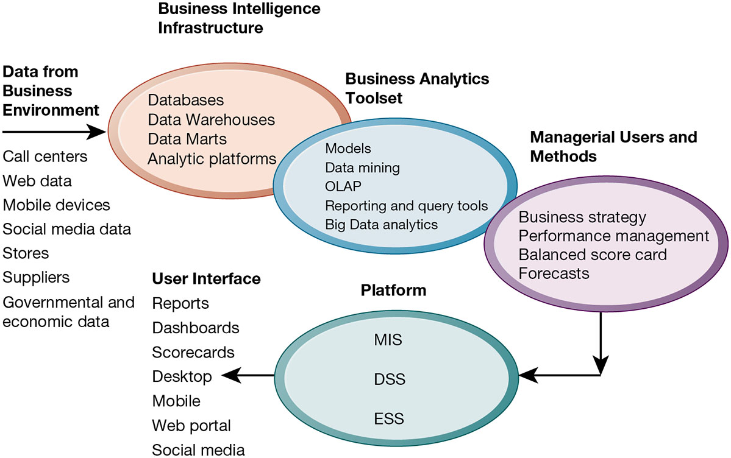
Figure 12.3 Business Intelligence and Analytics for Decision Support
Notes:
Figure 12.3, Page 465.
Business intelligence and analytics require a strong database foundation, a set of analytic tools, and an involved management team that can ask intelligent questions and analyze data.
This graphic is intended to illustrate in a single slide how all of the elements of a business intelligence environment work together. It provides an overview highlighting the kinds of hardware, software, and management capabilities that the major vendors offer and that firms develop over time.
Alt Text
Long description: An illustration explains how data from the business environment passes through various support systems and reaches the user. The details are as below:
Data from business environment reaches the business intelligence infrastructure. This infrastructure is connected to business analytics toolset, which is further connected to various platforms through managerial users and methods before reaching the user interface.
Data from business environment includes:
Call centers
Web data
Mobile devices
Social media data
Stores
Suppliers
Governmental and economic data.
Business intelligence infrastructure includes:
Databases
Data Warehouses
Data Marts
Analytic platforms.
Business analytics toolset includes:
Models
Data mining
OLAP
Reporting and query tools
Big Data analytics.
Managerial users and methods include:
Business strategy
Performance management
Balanced score card
Forecasts.
Platforms include:
MIS
DSS
ESS.
User interface includes:
Reports
Dashboards
Scorecards
Desktop
Mobile
Web portal
Social media.

Slide 18
Business Intelligence and Analytics Capabilities
Goal is to deliver accurate real-time information to decision makers
Main analytic functionalities of B I systems
  Production reports
  Parameterized reports
  Dashboards/scorecards
  Ad hoc query/search/report creation
  Drill down
  Forecasts, scenarios, models
Notes:
This slide looks at the main functionalities of business intelligence systems. Parameterized reports are reports that can be adjusted to reflect user-defined parameters. The text gives the example of viewing a report by region and time of day to see how sales vary by these parameters. Ask students what is meant by drill down and give an example (the ability to move from a high level view summary to a detailed view). For example, a summary view might present the total numbers of products by category sold worldwide. Drilling down, views might go to products sold at national, regional, and local levels, and down from product categories to single products and product versions.

Slide 19
Table 12.4 Examples of Business Intelligence Predefined Production Reports
Business Functional Area | Production Reports
Sales | Forecast sales; sales team performance; cross-selling; sales cycle times
Service/call center | Customer satisfaction; service cost; resolution rates; churn rates
Marketing | Campaign effectiveness; loyalty and attrition; market basket analysis
Procurement and support | Direct and indirect spending; off-contract purchases; supplier performance
Supply chain | Backlog; fulfillment status; order cycle time; bill of materials analysis
Financials | General ledger; accounts receivable and payable; cash flow; profitability
Human resources | Employee productivity; compensation; workforce demographics; retention
Notes:
Table 12.4, page 466

Slide 20
Predictive Analytics
Uses variety of data, techniques to predict future trends and behavior patterns
  Statistical analysis
  Data mining
  Historical data
  Assumptions
Incorporated into numerous B I applications for sales, marketing, finance, fraud detection, health care
  Credit scoring
  Predicting responses to direct marketing campaigns
Notes:
Predictive analytics software does not so much “predict” as it does estimate a probability that, based on historical data, a certain event will happen. This works quite well when there are very large data sets, the behavior is repetitive and consistent over time, and there are no changes in the environment. For instance, these techniques work well in machines with well defined parts that can be monitored. They do not work well in dynamic environments such as the stock market where the exogenous factor in the environment are constantly changing.

Slide 21
Big Data Analytics
Big data: Massive datasets collected from social media, online and in-store customer data, and so on
Help create real-time, personalized shopping experiences for major online retailers
Smart cities
  Public records
  Sensors, location data from smartphones
  Ability to evaluate effect of one service change on system
Notes:
Ask students if they have ideas about how the cities they live in, towns or villages, could use big data analytics to improve the lives of citizens.

Slide 22
Operational Intelligence and Analytics
Operational intelligence: Business activity monitoring
Collection and use of data generated by sensors
Internet of Things (IoT)
  Creating huge streams of data from web activities, sensors, and other monitoring devices
Software for operational intelligence and analytics enable companies to analyze their big data

Slide 23
Interactive Session: Organizations: Predictive Maintenance in the Oil and Gas Industry
Class discussion
  Why is predictive maintenance so important in the oil and gas industry? What problems does it solve?
  What is the role of the Internet of Things (IoT) and Big Data analytics in predictive maintenance?.
  How did BP and Royal Dutch Shell’s predictive maintenance applications change business operations and decision making?
  Give an example of how predictive maintenance systems could be used in another industry.

Slide 24
Location Analytics and Geographic Information Systems
Location analytics
  Ability to gain business insight from the location (geographic) component of data
    Mobile phones
    Sensors, scanning devices
    Map data
Geographic information systems (G I S)
  Ties location-related data to maps
  Example: For helping local governments calculate response times to disasters
Notes:
Many large corporations today are experiencing an explosion of customer information gathered from websites, social sites, blogs, and emails. Making sense out of this data is difficult. Graphical representation of data is one way to reduce the torrent of data into some simple messages that humans can understand in a glance.

Slide 25
Interactive Session: Management: GIS Helps Land O’Lakes Manage Assets Strategically
Class discussion
  Why is geographic location data so important to Land O’Lakes. What categories of geographic information does Land O’Lakes use?
  How did using GIS improve operations and decision making at Land O’Lakes?
  Give examples of three decisions at Land O’Lakes that were improved by using GIS.

Slide 26
Decisional Support for Operational and Middle Management
Charged with monitoring key aspects of business
Most decisions fairly structured
Middle managers typically use MIS
  Increasingly online; can be queried interactively
  Exception reports

Slide 27
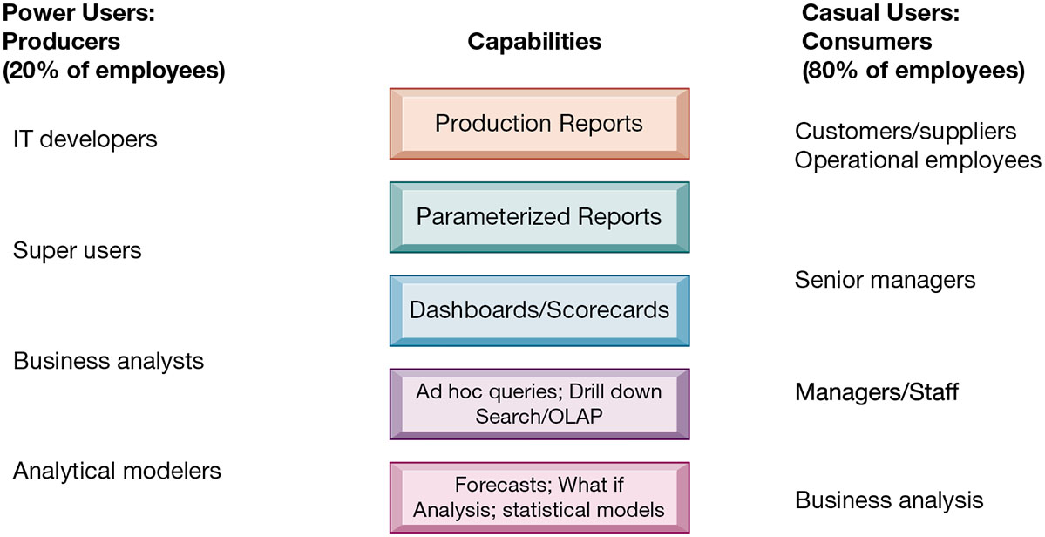
Figure 12.4 Business Intelligence Users
Notes:
Figure 12.4, Page 474.
Casual users are consumers of BI output, while intense power users are the producers of reports, new analyses, models, and forecasts.
This graphic looks at the different types of users and what they use BI applications for. On the left, power users (users who rely on BI most intensively) are broken into four main categories, with each category placed beside the types of reports it uses most. On the right, casual users are also broken into various categories and placed along the types of capabilities used most. For example, senior managers rely most on dashboards and scorecords. Ask students if they have ever used BI reports in a job setting.
Alt Text
Long description: A diagram explains the difference between power users and casual users based on capabilities. Power users are producers (20% of employees). Casual users are consumers (80% of employees). The users are defined based on the capabilities defined below:
Production reports: Power users, IT developers; Casual users, customers or suppliers and operational employees.
Parameterized reports: Power users, Super users; Casual users, customers or suppliers and operational employees.
Dashboards or scorecards: Power users, IT developers; Casual users, senior managers.
Ad hoc queries; Drill down search or OLAP: Power users, Business analysts; Casual users, managers or staff.
Forecasts; What if Analysis; statistical models: Power users, Analytical modelers; Casual users, business analysis.

Slide 28
Support for Semistructured Decisions
Decision-support systems
  Support for semistructured decisions
Use mathematical or analytical models
Allow varied types of analysis
  “What-if” analysis
  Sensitivity analysis
  Backward sensitivity analysis
  Multidimensional analysis / O L A P
    For example: pivot tables
Notes:
This slide looks at the decision support systems used for the semistructured decisions made by the business analysts and “super users” identified on the previous slide and outlines a variety of analysis methods that are utilized. Ask students to give examples of the different types of analysis. Remind students that DSS are business intelligence systems. The text cites the example of Progressive Insurance which uses business intelligence to identify the best customers for its products.

Slide 29
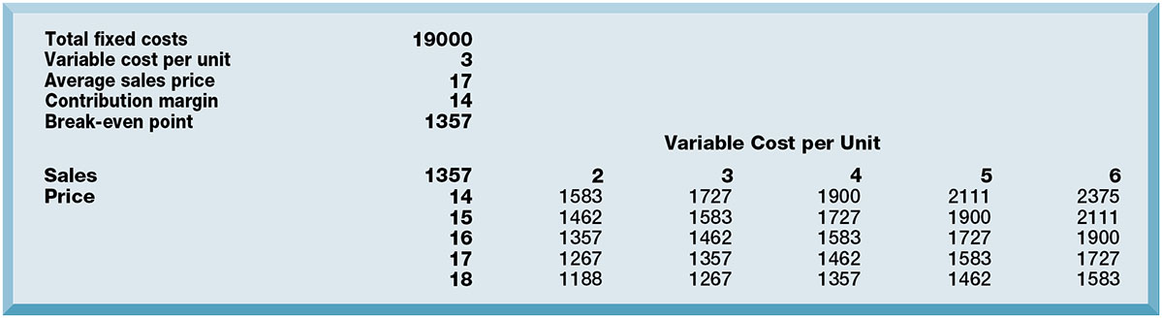
Figure 12.5 Sensitivity Analysis
Notes:
Figure 12.5, Page 475.
This table displays the results of a sensitivity analysis of the effect of changing the sales price of a necktie and the cost per unit on the product’s break-even point. It answers the question “What happens to the break-even point if the sales price and the cost to make each unit increase or decrease?”
This graphic illustrates the results of a sensitivity analysis of changing the sales price of a necktie—it answers the question “What happens to the break-even point if the sales price and the cost to make each unit increase or decrease?”
Alt Text
Long description: A text box displays the results of a sample sensitivity analysis. The details are as below:
Total fixed costs: 19000
Variable cost per unit: 3
Average sales price: 17
Contribution margin: 14
Break-even point: 1357.
Sales: 1357
Price 14: Variable cost per unit 2 is 1583; Variable cost per unit 3 is 1727; Variable cost per unit 4 is 1900; Variable cost per unit 5 is 2111; Variable cost per unit 6 is 2375.
Price 15: Variable cost per unit 2 is 1462; Variable cost per unit 3 is 1583; Variable cost per unit 4 is 1727; Variable cost per unit 5 is 1900; Variable cost per unit 6 is 2111.
Price 16: Variable cost per unit 2 is 1357; Variable cost per unit 3 is 1462; Variable cost per unit 4 is 1583; Variable cost per unit 5 is 1727; Variable cost per unit 6 is 1900.
Price 17: Variable cost per unit 2 is 1267; Variable cost per unit 3 is 1357; Variable cost per unit 4 is 1462; Variable cost per unit 5 is 1583; Variable cost per unit 6 is 1727.
Price 18: Variable cost per unit 2 is 1188; Variable cost per unit 3 is 1267; Variable cost per unit 4 is 1357; Variable cost per unit 5 is 1462; Variable cost per unit 6 is 1583.

Slide 30
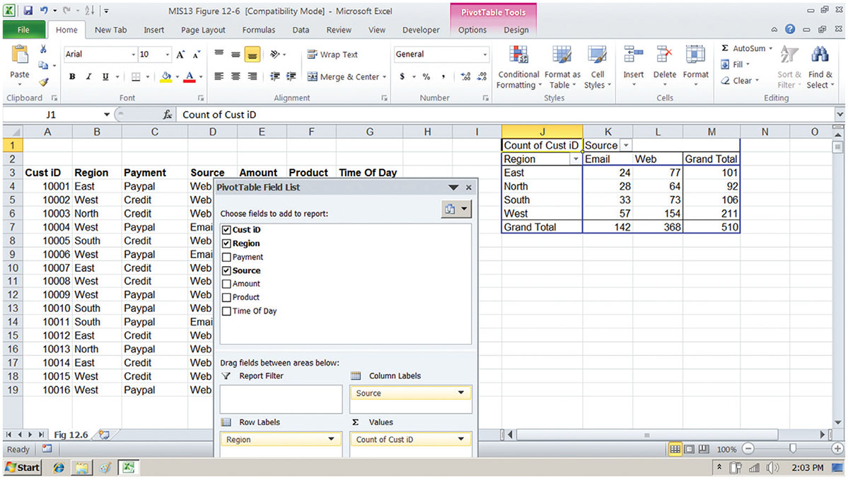
Figure 12.6 A Pivot Table That Examines Customer Regional Distribution and Advertising Source
Notes:
Figure 12.6, Page 475.
In this pivot table, we are able to examine where an online training company’s customers come from in terms of region and advertising source.
This graphic shows the same Microsoft Excel spreadsheet with a PivotTable with two dimensions—it shows where customers come from in terms of region and advertising source.
Alt Text
Long description: A screenshot of an Excel sheet shows a sample pivot table. The sample pivot table lists the details pertaining to the customer ID, region, payment, source, amount, product, and time of day in cells A to G in the excel sheet.
A dialog box superimposed on the sheet and the above-mentioned data displays the field list of the pivot table. The dialog box is labeled, pivot table field list and is divided into two panels.
In the top panel, a drop- down to choose from is provided in the dialog box. It reads: Choose fields to add to report.
Checkboxes for the following are given: Customer ID, region, payment, source, amount, product, and time of day. The fields of customer ID, region, and source are selected in the screenshot.
In the bottom panel a two-by-two matrix of areas is provided. It reads: Drag fields between areas below:
Report filter: Blank
Column labels: Source
Row labels: Region
Values: Count of customer ID.
A sample output table is provided in the excel sheet. The details are as below:
Region: East; Email: 24; Web:77; Grand total: 101
Region: North; Email: 28; Web:64; Grand total: 92
Region: South; Email: 33; Web:73; Grand total: 106
Region: West; Email: 57; Web:154; Grand total: 211
Grand total: Email: 142; Web:368; Grand total: 510.

Slide 31
Decision Support for Senior Management: Balanced Scorecard and Enterprise Performance Management Methods (1 of 2)
E S S: decision support for senior management
  Help executives focus on important performance information
Balanced scorecard method
  Measures outcomes on four dimensions
    Financial
    Business process
    Customer
    Learning and growth
  Key performance indicators (K P I s) measure each dimension
Notes:
This slide looks at the business intelligence used by senior management. These executive support systems utilize some type of methodology to determine which information affects the profitability and success of the firm and how this information can be measured. One popular methodology is the balanced scorecard method. Another popular method is discussed on a following slide. Ask students how the scorecard itself is determined (a scorecard is developed by consultants and senior managers).

Slide 32
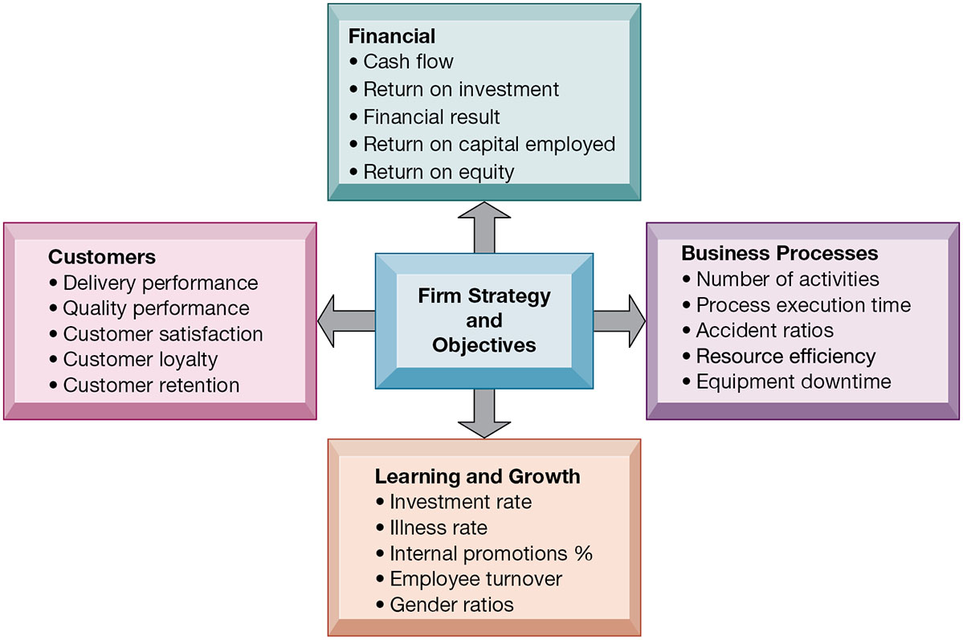
Figure 12.7 The Balanced Scorecard Framework
Notes:
Figure 12.7, Page 477.
In the balanced scorecard framework, the firm’s strategic objectives are operationalized along four dimensions: financial, business process, customer, and learning and growth. Each dimension is measured using several KPIs.
This graphic depicts the balanced scorecard methodology that many managers use to measure the performance of their business, and to understand how firm strategies are impacting the four dimensions of interest. For each of these dimensions, performance is operationalized by identifying key performance indicators for that dimension.
Alt Text
Long description: A framework explains the strategies and objectives of a sample firm. In the framework, the firm’s strategic objectives are illustrated along four dimensions: Financial, business process, customer, and learning and growth. The KPIs under each dimension are as below:
Financial:
Cash flow
Return on investment
Financial result
Return on capital employed
Return on equity.
Business process:
Number of activities
Process execution time
Accident ratios
Resource efficiency
Equipment downtime.
Customers:
Delivery performance
Quality performance
Customer satisfaction
Customer loyalty
Customer retention.
Learning and growth:
Investment rate
Illness rate
Internal promotions %
Employee turnover
Gender ratios.

Slide 33
Decision Support for Senior Management: Balanced Scorecard and Enterprise Performance Management Methods (2 of 2)
Business performance management (B P M)
  Translates firm’s strategies (e.g., differentiation, low-cost producer, scope of operation) into operational targets
  K P Is developed to measure progress toward targets
Data for E S S
  Internal data from enterprise applications
  External data such as financial market databases
  Drill-down capabilities
Notes:
This slide continues the discussion of business intelligence used by senior managers. Another methodology used by ESS, similar to the balanced scorecard method but with a stronger and more explicit emphasis on corporate strategy, is BPM. Ask students to describe what drill-down capabilities are—why is this important. It is important to note that information systems today allow for real-time management—information gathered on the factory floor is transmitted and summarized within hours and seconds for executive dashboards.

Slide 34
How Will MIS Help My Career?
The Company: Western Well Health
Position Description: Entry-level data analyst
Job Requirements
Interview Questions
Author Tips
Notes:
A good opportunity for a class discussion of the section on careers. Would any in the class be interested in a job like this? What do they think are the most important skills the employer is looking for? How would they answer the interviewer questions?

Slide 35

Copyright
This work is protected by United States copyright laws and is provided solely for the use of instructors in teaching their courses and assessing student learning. Dissemination or sale of any part of this work (including on the World Wide Web) will destroy the integrity of the work and is not permitted. The work and materials from it should never be made available to students except by instructors using the accompanying text in their classes. All recipients of this work are expected to abide by these restrictions and to honor the intended pedagogical purposes and the needs of other instructors who rely on these materials.

