Slide 1

Tishk International University
Dentistry Faculty
Dentistry Department
Paedodontic-Dent 363
NONVITAL PULP THERAPY TECHNIQUE of primary teeth
(COMPLETE PULPECTOMY)
Grade 3- spring Semester 2021-2022
Instructor: Dr. Bushra Rashid Noaman

Slide 2
Objectives
Definition of pulpectomy
Indications
Contraindications
Difficulties in treating root canals in primary teeth
Pulpectomy Procedure
Evaluation of success

Slide 3
Definition
Complete removal of all remaining pulp tissue and obturating the canals with absorbable material.

Slide 4
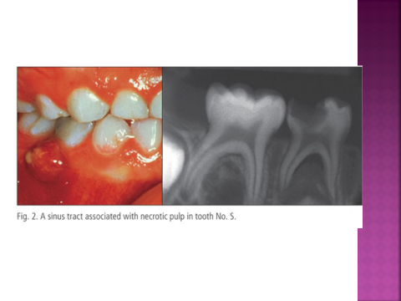
It is unwise to maintain untreated infected primary teeth in the mouth.
They may be opened for drainage and often remain asymptomatic for an indefinite period.
However, they are a source of infection and should be treated or removed.

Slide 5
Indications
1. Necrotic or chronically inflamed, strategically located tooth with accessible canals.
2. Essentially normal supporting bone, OR WITH MINIMAL BONE RESORPTION
3. Not more one third root resorption
4. Good patient compliance.
If the supporting bone is also compromised, the likelihood of successful endodontic therapy is lower.

Slide 6
Contraindications
1. Excessive bone resorption
2. Excessive root resorption
3. uncooperative child or parent
4. non-restorable tooth
5. acute systemic diseases, leukemia, valvular heart defects, acute glumerionephritis.

Slide 7
Cases needs to retain the infected second primary molar
1. If the second primary molar is lost before the eruption of the first permanent molar, the dentist is confronted with the difficult problem of preventing the first permanent molar from drifting mesially during its eruption.

Slide 8
Special effort should be made to treat and retain the second primary molar even if it has a necrotic pulp.
2. Similarly, longer than normal retention of a second primary molar may be desired when the succedaneous second premolar is congenitally missing

Slide 9
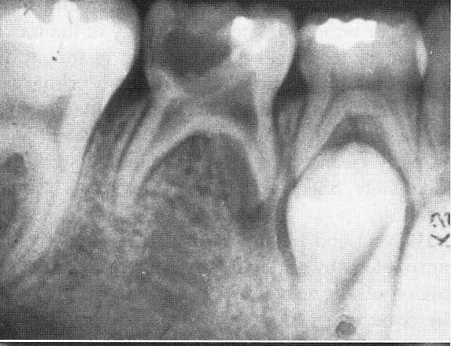
A, Necrotic tooth resulting from a carious exposure of the pulp of the second primary molar. Because the succedaneous second premolar was congenitally missing, a decision was made to attempt to save the tooth as a functional space maintainer through the growing years, if possible. Note the evidence of internal resorption at the floor of the pulp chamber

Slide 10
the succedaneous second premolar is congenitally missing

Slide 11
Difficulties in treating root canals in primary teeth
The morphology of the root canals in primary teeth makes endodontic treatment difficult and often impractical.
Mature first primary molar canals are often so small that they are inaccessible even to the smallest barbed broach.
If the canal cannot be properly cleansed of necrotic material, sterilized, and adequately filled, endodontic therapy is more likely to fail.

Slide 12
Properties of primary teeth root canals
It was apparent that initially only one root canal is present in each of the mandibular and maxillary molar roots.
The subsequent deposition of secondary dentin throughout the life of the teeth caused a change in the morphologic pattern of the root canal, producing variations and eventual alterations in the number and size of the canals.

Slide 13
The variations included lateral branching, apical ramifications, and partial fusion of the canals.
These findings explain the complications often encountered in root canal therapy

Slide 14
Procedure
1. The tooth should be isolated
2. the roof of the pulp chamber should be removed to gain access to the root canals as described previously in the pulpotomy technique.

Slide 15
3. The contents of the pulp chamber and all debris from the occlusal third of the canals should be removed, with care taken to avoid forcing any of the infected contents through the apical foramen.

Slide 16
4. A pellet moistened with camphorated mono-chlorophenol (CMCP) or a 1:5 concentration of Buckley’s formocresol, with excess moisture blotted Using cotton roll, should be placed in the pulp chamber.
5. Temporary filling

Slide 17
6. the remaining contents of the canals should be removed using the conventional technique
The maximum size is 35

Slide 18
7. The apex of each root should be penetrated slightly with the smallest file.

Slide 19
9. the canals prepared and filled

Slide 20
However, if the tooth has been painful and there is evidence of
moisture in the canals when the treatment pellet is removed,
the canals should again be mechanically cleansed and the treatment repeated.

Slide 21
Currently, pulpectomies in primary teeth are commonly completed in a single appointment
If the tooth has painful necrosis with purulence in the canals, however, completing the pulpectomy procedure over two or three visits should improve the likelihood of success

Slide 22
Successful single-appointment complete pulpectomy.
Note extrusion of zinc oxide–eugenol into furcal
area from distal root accessory canal, but adequate subsequent
healing.
A, Pretreatment.
B, Immediately after treatment.
C, 10 months after treatment.
A
B
C

Slide 23
Obturation materials
The primary teeth are subjected for physiologic root resorption
For that reason the obturation material in pulpectomy must be resorbable with the root of the tooth
Obturation materials is either
Calcium hydroxide
Or
Zinc-oxide euginol

Slide 24
Filling methods
(1) Pressure syringe.
(a) Using a paper point or file, coat the walls of the canals with a creamy mix of ZOE.
(b) Fill with creamy ZOE mix, starting 1 to 2 mm from the apex.

Slide 25
(2) Condensation.
(a) Coat the walls of the canals with creamy mix of ZOE.
(b) Continue mixing ZOE to a condensable
thickness, roll into points, and condense
with small endodontic or amalgam
pluggers.

Slide 26
Evaluation of success
successful pulpectomy is
free from clinical and radiographic symptoms.
a. Asymptomatic tooth.
b. No mobility or fistulas.
c. No furcation radiolucency.
d. No internal or external root resorption.

Slide 27
Instruction to the parents
The tooth should be checked after the treatment :
1. 1 month
2. 3 months
3. 1 year
4. on exfoliation time:
Because some of the pulpally treated teeth be ankylosed and may be need dentist to extract

Slide 28
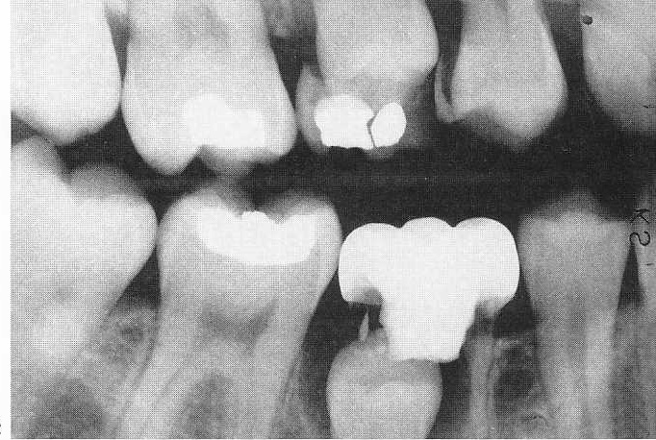
bite-wing radiograph of a patient 7 years after the pulpotomy reveal that the resorption of the pulpotomized molar is falling behind compared with its antimere.

Slide 29
Radiographic evaluation of primary tooth pulpectomies
should occur at least annually because the success rate of pulpectomy diminishes over time.

Slide 30
Root canal fillings materials for primary teeth
1.Although zinc oxide–eugenol paste is viewed as the traditional root canal filling material for primary teeth,
2. multiple studies suggest that KRI paste may be preferable. Excellent results have been observed in many cases.
The primary components of KRI paste are zinc oxide and iodoform. The main advantages of KRI paste compared with zinc oxide–eugenol paste are that KRI paste resorbs in synchrony with primary roots and is less irritating to surrounding tissues if a root is inadvertently overfilled

Slide 31
Another popular root canal filling material for primary teeth is
3. Vitapex a product that has successful use in infected primary teeth.
The primary components of Vitapex are calcium hydroxide and iodoform. Considerable laboratory and animal research has been reported.
Vitapex may be at least as effective as KRI paste,

Slide 32
Summary
Pulpectomy is Complete removal of all remaining pulp tissue.
Necrotic or chronically inflamed, strategically located tooth with accessible canals, Essentially normal supporting bone, OR WITH MINIMAL BONE RESORPTION , Not more one third root resorption and Good patient compliance. The pulpectomy is contraindicated in Excessive bone resorption, Excessive root resorption, uncooperative child or paren, non-restorable tooth and acute systemic diseases, leukemia, valvular heart defects, acute glumerionephritis.
The materials used in obturation of the root canal are either calcium hydroxide or zinc-oxide eugenol because they are resorbable materials.
Pulpectomy treated tooth needs follow-up. Evaluation of success are Asymptomatic tooth, No mobility or fistulas, No furcation radiolucency and No internal or external root resorption.

