Slide 1
Linear Programming
Dr. Sultana

Slide 2
Introduction
Optimization is the way of life. We all have finite resources and time and we want to make the most of them. From using your time productively to solving supply chain problems for your company – every thing uses optimization.

Slide 3
It is also a very interesting topic – it starts with simple problems, but can get very complex. For example, sharing a chocolate between siblings is a simple optimization problem. We don’t think in mathematical term while solving it. On the other hand devising inventory and warehousing strategy for an e-Retailer can be very complex.

Slide 4
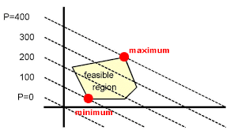
Linear programming (LP) is one of the simplest ways to perform optimization. It helps you solve some very complex optimization problems by making a few simplifying assumptions. As an analyst you are bound to come across applications and problems to be solved by Linear Programming.

Slide 5
What is Linear Programming?
Linear programming is a simple technique where we depict complex relationships through linear functions and then find the optimum points. The important word in previous sentence is depict. The real relationships might be much more complex – but we can simplify them to linear relationships.

Slide 6
Applications of linear programming are every where around you. You use linear programming at personal and professional fronts. You are using linear programming when you are driving from home to work and want to take the shortest route. Or when you have a project delivery you make strategies to make your team work efficiently for on time delivery.

Slide 7
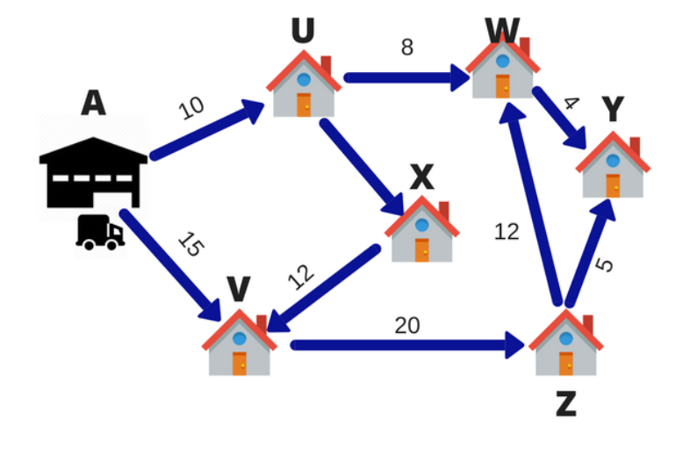
Example
Let’s say a FedEx delivery man has 6 packages to deliver in a day. The warehouse is located at point A. The 6 delivery destinations are given by U, V, W, X, Y and Z. The numbers on the lines indicate the distance between the cities. To save on fuel and time the delivery person wants to take the shortest route.

Slide 8
So, the delivery person will calculate different routes for going to all the 6 destinations and then come up with the shortest route. This technique of choosing the shortest route is called linear programming.
In this case, the objective of the delivery person is to deliver the parcel on time at all 6 destinations. The process of choosing the best route is called Operation Research.
Operation research is an approach to decision-making, which involves a set of methods to operate a system. In the above example, our system was the Delivery model.
Linear programming is used for obtaining the most optimal solution for a problem with given constraints. In linear programming, we formulate our real life problem into a mathematical model. It involves an objective function, linear inequalities with subject to constraints.

Slide 9
Let’s manufacture some chocolates
Consider a chocolate manufacturing company which produces only two types of chocolate – A and B. Both the chocolates require Milk and Choco only. To manufacture each unit of A and B, following quantities are required:
Each unit of A requires 1 unit of Milk and 3 units of Choco
Each unit of B requires 1 unit of Milk and 2 units of Choco
The company kitchen has a total of 5 units of Milk and 12 units of Choco. On each sale, the company makes a profit of
$ 6 per unit A sold.
$ 5 per unit B sold.
Now, the company wishes to maximize its profit. How many units of A and B should it produce respectively?

Slide 10
Solution
The first thing to do is to represent the problem in a tabular form for better understanding.
Let the total number of units produced of A be = X
Let the total number of units produced of B be = Y
Now, the total profit is represented by Z
The total profit the company makes is given by the total number of units of A and B produced multiplied by its per unit profit Rs 6 and Rs 5 respectively.
Profit: Max Z = 6X+5Y
which means we have to maximize Z.
 | Milk | Choco | Profit per unit
A | 1 | 3 | Rs 6
B | 1 | 2 | Rs 5
Total | 5 | 12

Slide 11
Solution….
The company will try to produce as many units of A and B to maximize the profit. But the resources Milk and Choco are available in limited amount.
As per the above table, each unit of A and B requires 1 unit of Milk. The total amount of Milk available is 5 units. To represent this mathematically,
X+Y ≤ 5
Also, each unit of A and B requires 3 units & 2 units of Choco respectively. The total amount of Choco available is 12 units. To represent this mathematically,
3X+2Y ≤ 12
Also, the values for units of A can only be integers.
So we have two more constraints, X ≥ 0 & Y ≥ 0
For the company to make maximum profit, the above inequalities have to be satisfied.
This is called formulating a real-world problem into a mathematical model.

Slide 12
Common terminologies used in Linear Programming
Decision Variables: The decision variables are the variables which will decide my output. They represent my ultimate solution. To solve any problem, we first need to identify the decision variables. For the above example, the total number of units for A and B denoted by X & Y respectively are my decision variables.
Objective Function: It is defined as the objective of making decisions. In the above example, the company wishes to increase the total profit represented by Z. So, profit is my objective function.
Constraints: The constraints are the restrictions or limitations on the decision variables. They usually limit the value of the decision variables. In the above example, the limit on the availability of resources Milk and Choco are my constraints.
Non-negativity restriction: For all linear programs, the decision variables should always take non-negative values. Which means the values for decision variables should be greater than or equal to 0.

Slide 13
Process to formulate a Linear Programming problem
Let us look at the steps of defining a Linear Programming problem generically:
Identify the decision variables
Write the objective function
Mention the constraints
Explicitly state the non-negativity restriction
For a problem to be a linear programming problem, the decision variables, objective function and constraints all have to be linear functions.
If the all the three conditions are satisfied, it is called a Linear Programming Problem.

Slide 14
Solve Linear Programs by Graphical Method
A linear program can be solved by multiple methods. In this section, we are going to look at the Graphical method for solving a linear program. This method is used to solve a two variable linear program. If you have only two decision variables, you should use the graphical method to find the optimal solution.
A graphical method involves formulating a set of linear inequalities subject to the constraints. Then the inequalities are plotted on a X-Y plane. Once we have plotted all the inequalities on a graph the intersecting region gives us a feasible region. The feasible region explains what all values our model can take. And it also gives us the optimal solution.
Let’s understand this with the help of an example.

Slide 15
Lets try this….
A store has requested a manufacturer to produce pants and sports jackets.
For materials, the manufacturer has 750 m² of cotton textile and 1,000 m² of polyester. Every pair of pants (1 unit) needs 1 m² of cotton and 2 m² of polyester. Every jacket needs 1.5 m² of cotton and 1 m² of polyester.
The price of the pants is fixed at $50 and the jacket, $40.
What is the number of pants and jackets that the manufacturer must give to the stores so that these items obtain a maximum sale?

Slide 16
Solution
Choose the unknowns.
x = number of pants
y = number of jackets
Write the objective function.
f(x,y)= 50x + 40y
Write the constraints as a system of inequalities.
To write the constraints, use a table:
x + 1.5y =< 750 -> 2x + 3y =< 1500 ( Multiply by 2)
2x + y =< 1000
As the number of pants and jackets are natural numbers, there are two more constraints:
X >= O
Y >= O
 | pants | jackets | available
cotton | 1 | 1.5 | 750
polyester | 2 | 1 | 1,000
x + 1.5y ≤ 750 2x+3y ≤ 1500
To write the constraints, use a table:

Slide 17
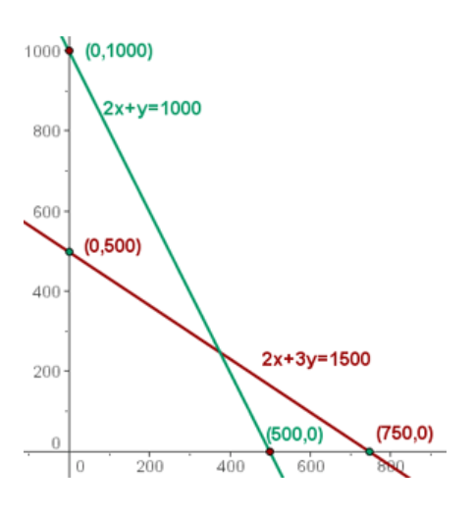
Find the set of feasible solutions that graphically represent the constraints.
Represent the constraints graphically.
As x ≥ 0 and y ≥ 0, work in the first quadrant.
Represent the straight lines from their points of intersection with the axes.
Solve the in-equation graphically
2x +3y ≤ 1500, and take a point on the plane, for example (0,0).
2 * 0 + 3 * 0 =< 1500
Since 0 ≤ 1,500 then the point (0,0) is in the half plane where the inequality is satisfied.
Similarly, solve 2x + y ≤ 1,000.
2 * 0 + 0 =< 1000

Slide 18
Find the set of feasible solutions that graphically represent the constraints.
Represent the constraints graphically.
As x ≥ 0 and y ≥ 0, work in the first quadrant.
Represent the straight lines from their points of intersection with the axes.
Solve the in-equation graphically
2x +3y ≤ 1500, and take a point on the plane, for example (0,0).
Let x = 0;
So 2*0 + 3y = 1500
0+3y= 1500
3y=1500
Y= 1500/3= 500 Hence it is proved that when
X=0 Y=500 (0,500)

Slide 19
Find the set of feasible solutions that graphically represent the constraints.
Represent the constraints graphically.
As x ≥ 0 and y ≥ 0, work in the first quadrant.
Represent the straight lines from their points of intersection with the axes.
Solve the first -equation graphically
2x +3y ≤ 1500, and take a point on the plane, for example (0,0).
Let say now y = 0; ( 2x + 3 Y = 1500)
So 2x + 3 * 0 = 1500
2x=1500
x= 1500/2= 750
Hence it is proved that when y = 0 x= 750
(750,0)

Slide 20
Find the set of feasible solutions that graphically represent the constraints.
Represent the constraints graphically.
As x ≥ 0 and y ≥ 0, work in the first quadrant.
Represent the straight lines from their points of intersection with the axes.
Solve the first equation graphically
Now let us solve the second equation:
2x + y ≤ 1,000. Let us say now x= 0
2*0 +y=1000
0+y=1000
Y=1000
So it is proved that when x= 0 ; y= 1000

Slide 21
Find the set of feasible solutions that graphically represent the constraints.
Represent the constraints graphically.
As x ≥ 0 and y ≥ 0, work in the first quadrant.
Represent the straight lines from their points of intersection with the axes.
Solve the in-equation graphically
Now let us solve the second equation:
2x + y ≤ 1,000. Let us say now y= 0
2x +o =1000
2x +0 =1000
2x=1000
X=500
So it is proved that when y= 0 ; x= 500 (500,0)

Slide 22
Equation:
2x+y = 1000
Y= 1000- 2x
2x+ 3y = 1500
Substituting the value of y in the equation
We get 2x + 3( 1000-2x) = 1500
2x+3000-6x=1500
-4x= 1500-3000
-4x=-1500
4x=1500
X= 1500/4 = 375 ------- 1 so x= 375
2 * 375 +y = 1000
750 + y = 1000
Y = 1000-750 = 250
So y = 250….. So y = 250

Slide 23
The area of intersection of the solutions of the inequalities would be the solution to the system of inequalities, which is the set of feasible solutions.
Calculate the coordinates of the vertices from the compound of feasible solutions.
The optimal solution, if unique, is in a vertex. These are the solutions to the systems:
2x + 3y = 1,500 x = 0 (0, 500)
2x + y = 1,000 y = 0 (500, 0)
2x + 3y =1,500
2x + y = 1,000 (375, 250)

Slide 24
Calculate the value of the objective function at each of the vertices to determine which of them has the maximum or minimum values. It must be taken into account the possible non-existence of a solution if the compound is not bounded.
In the objective function, place each of the vertices that were determined in the previous step.
f(x, y) = 50x + 40y
f(0, 500) = 50·0 + 40·500 = $20,000
f(500, 0) = 50·500 + 40·0 = $25,000
f(375, 250) = 50·375 + 40·250 = $28,750 Maximum
The optimum solution is to make 375 pants and 250 jackets to obtain a benefit of $28,750.
The solution is not always unique, so we can also find other solutions.

Slide 25
The solution is not always unique, so we can also find other solutions.

