Slide 1
Faculty of Pharmacy
Tishk Internationl University
Dietary Protein
10th lecture; Nutritional Biochemistry
Mohammed Rasul
Assistant Lecturer |MSc. Biomedical Science
Mohammed.rasul@tiu.edu.iq
Notes:
Example of reducing and non reducing sugar
https://www.biologyonline.com/dictionary/reducing-sugar
The loss of electrons during a reaction of a molecule is called oxidation while the gain of single or multiple electrons is called reduction.
The oxidation and reduction reactions (also called redox reactions) are the chemical reactions in which the oxidation number of the chemical species that are taking part in the reaction changes.
The redox processes are the wide range of reactions that include the majority of the chemical and biological processes taking part around us.
Rusting and dissolution of the metals, browning of the fruits, fire reactions, respiration and the process of photosynthesis are all oxidation-reduction processes.
Oxygen atom Transfer:
C+ 2H₂O → CO₂ + 2H₂
Hydrogen atom Transfer:
N₂H₄+ O₂ → N₂+ 2H₂O
Electron Transfer:
Zn + Cu⁺² → Zn⁺² + Cu

Slide 2
Learning Outcomes:
The chemistry of proteins
Nitrogen balance in the body
Dietary protein recommendation
Which kind of protein do we need in our diet?
What happens to dietary protein in our GI tract
How convincing is the scientific evidence linking dietary protein to a certain outcome

Slide 3
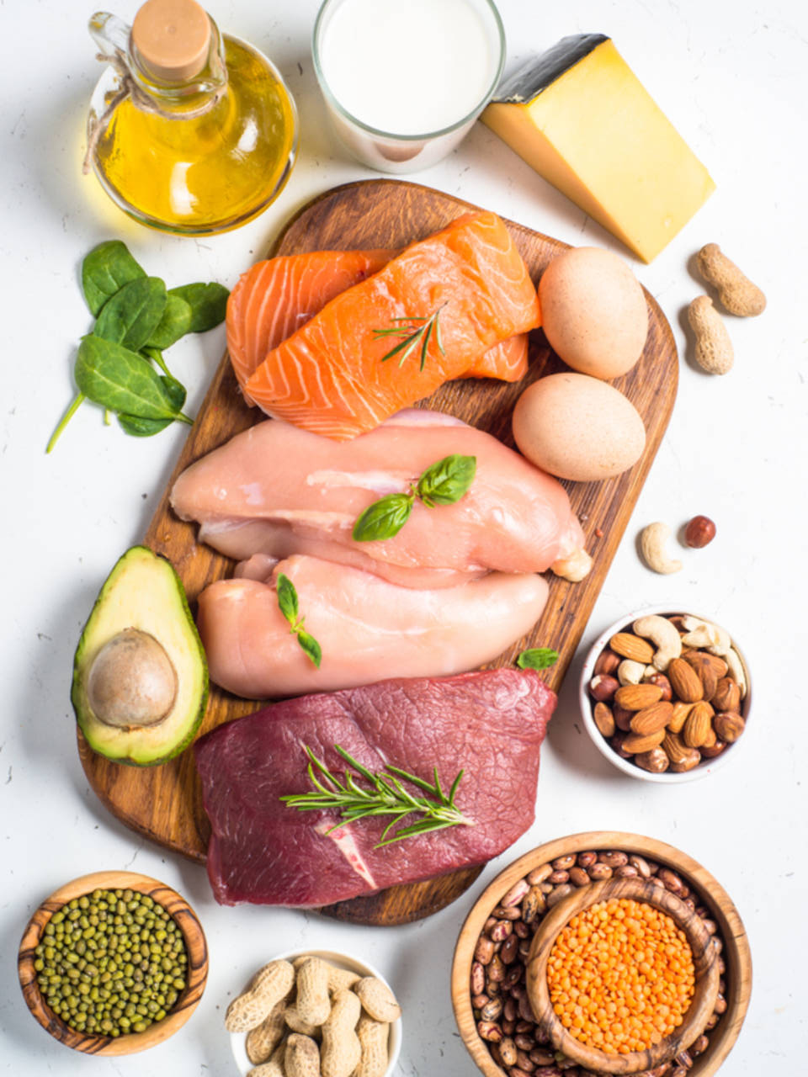
Chemistry of Protein:
Protein is the composite term for hundreds of thousands of different individual proteins present in our diet.
Proteins are composed of chains of different amino acids.
There are 20 different amino acids, giving rise to an almost infinite number of combinations of amino acids and thus proteins.
The size of a protein can vary from a few to more than a thousand amino acids.
Every food contains many different types of proteins in different quantities.

Slide 4
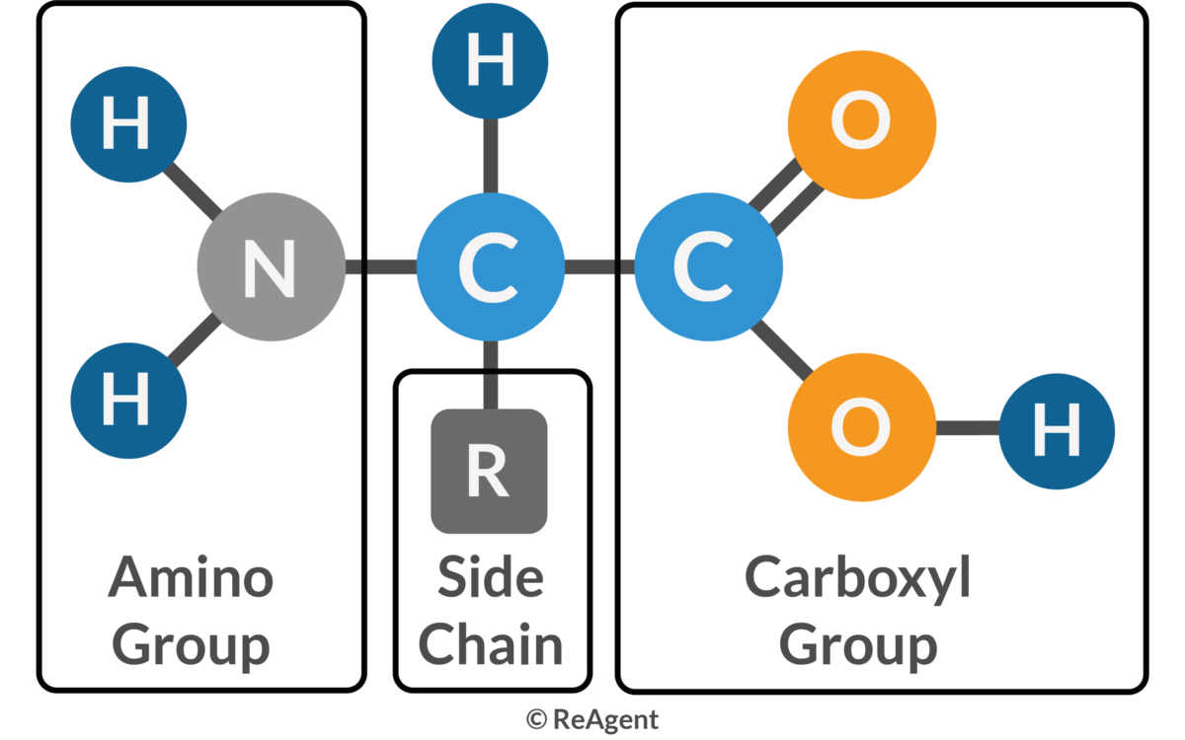
Amino Acids:
All amino acids have the same basic structure consisting of an acid (carboxyl) group and an amino group.
Amino acids differ in the chemical structure of the side chain (designated in the picture above with R).
In the simplest amino acid, glycine, R is a hydrogen atom.
Other amino acids have more complicated side chains, including some with an aromatic ring.
The chemical structure of the side chain determines whether an amino acid is more hydrophilic (“water-loving”) or hydrophobic (“fat loving”).

Slide 5
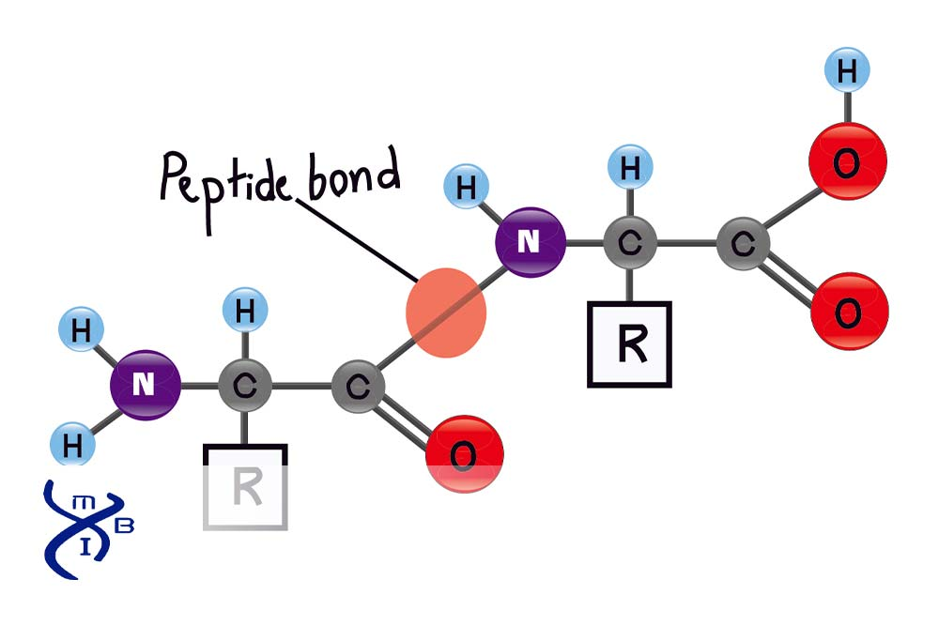
Peptide Bond
The amino group of one amino acid can link with the carboxyl group of another amino acid to form a stable (covalent) bond.
These linkages are also called peptide bonds.
Two amino acids linked together form a so-called dipeptide.
When many amino acids are linked together it is called a protein or polypeptide.

Slide 6
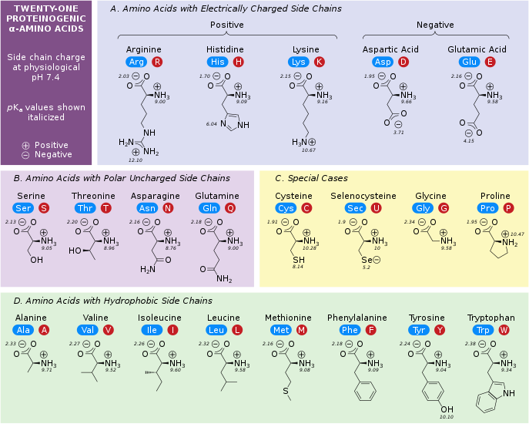

Slide 7
Essential AA!
As explained above, there are 20 different amino acids.
Nine of these 20 amino acids must be provided in the diet because the body cannot make these amino acids. They are therefore called essential amino acids.
The remaining 11 amino acids can be made from the 9 essential amino acids.
Any dietary protein provides a mixture of the 20 amino acids in different proportions.

Slide 8
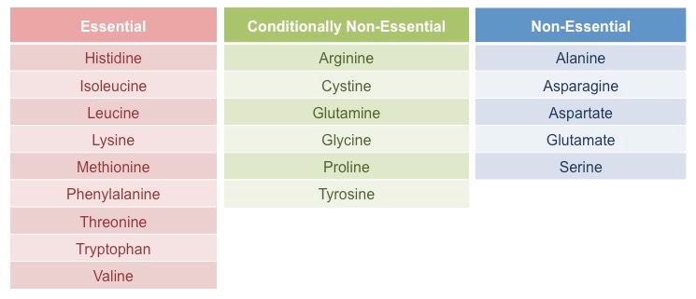

Slide 10
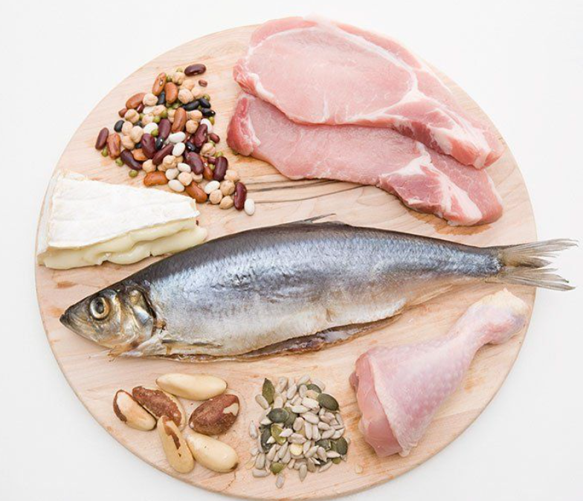
Protein content of selected foods
The protein content of real foods never exceeds 25-30%.
The protein content of protein powders used by bodybuilders can reach 90%, but before consumption the protein powder must be diluted with milk, water, or fruit juice, effectively lowering the actual protein content to below 20%.
Excellent protein sources are meat, fish, eggs, and dairy products.
Vegans avoid all products of animal origin and therefore have a relatively low protein intake as compared with omnivores.

Slide 11
Adult vegans can easily meet their protein requirements by incorporating soy, nuts, beans, and grains into their diet.
Raising young children on a vegan diet is not impossible but should be discouraged unless the parents have a solid understanding of the nutritional needs of young children.

Slide 12
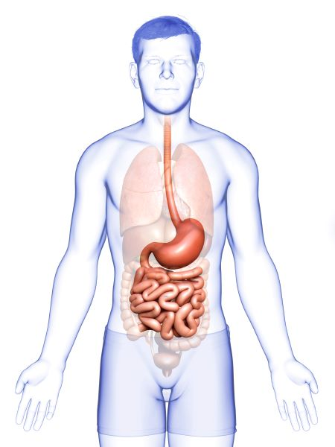
Protein digestion

Slide 13
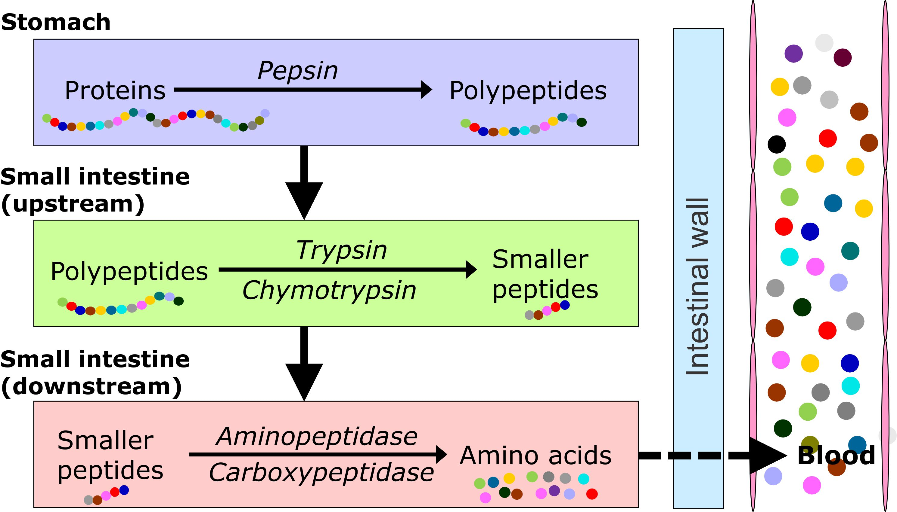

Slide 14
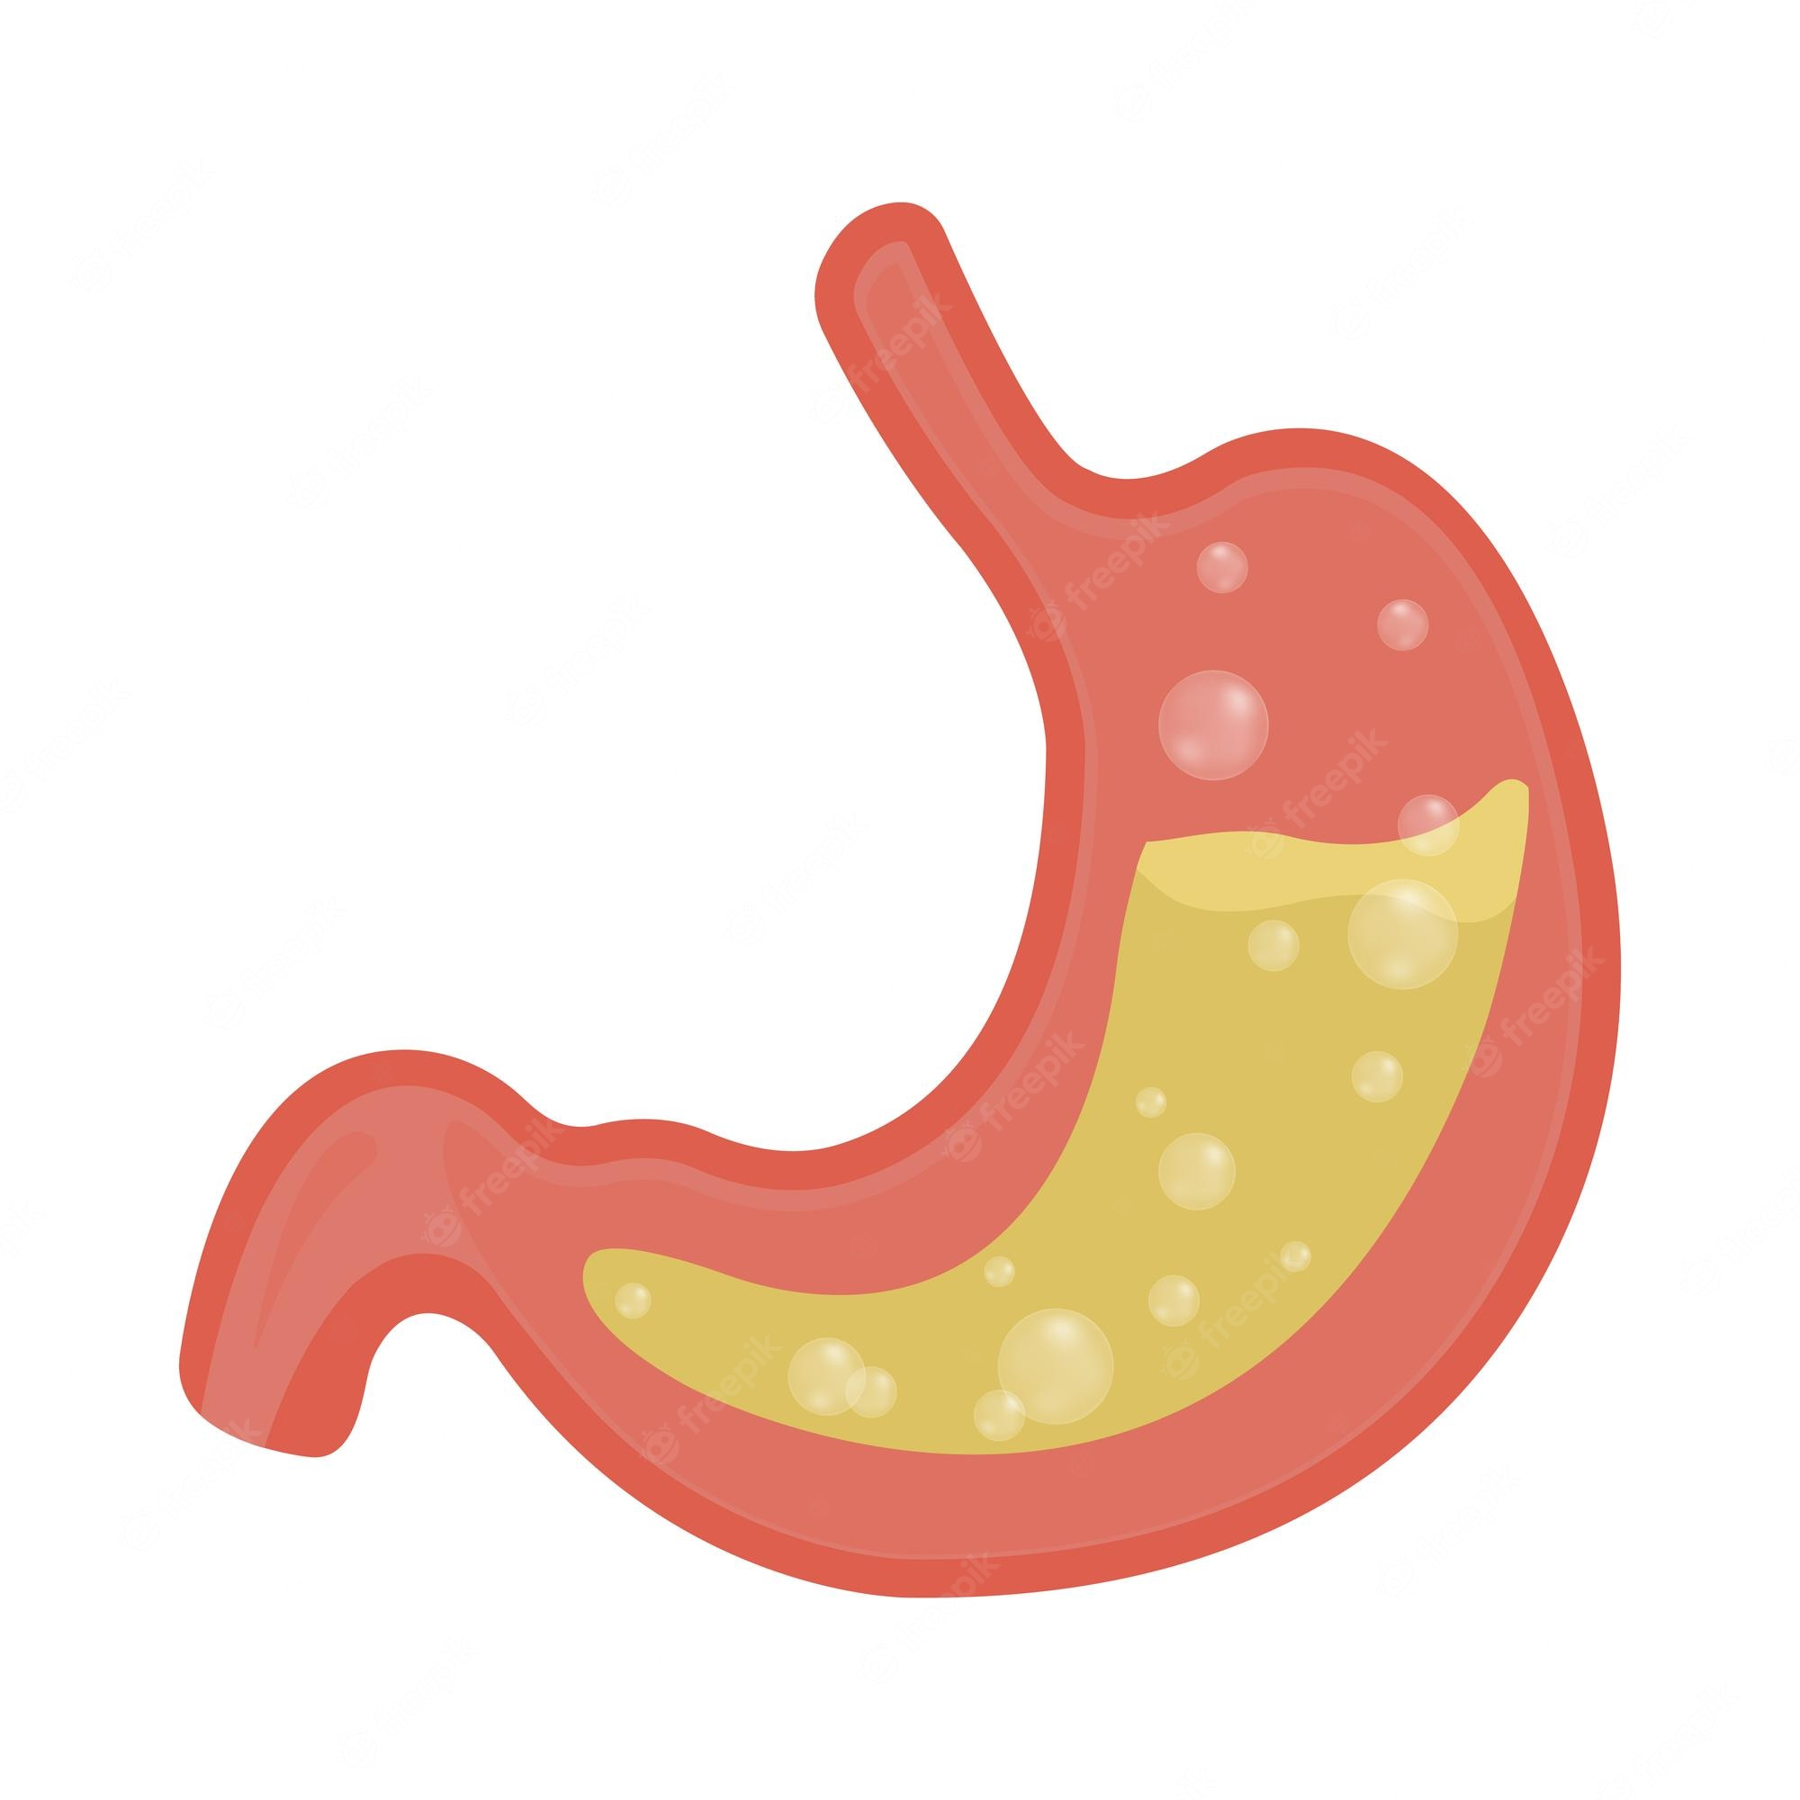
Protein digestion in Stomach
Protein digestion starts in the stomach.
The acid environment of the stomach causes proteins to unfold, allowing the enzyme pepsin easier access to the dietary proteins and thus facilitating their digestion.
Pepsin is produced by the Chief cells lining the stomach.
It is secreted as an inactive pro-enzyme called pepsinogen.
Pepsinogen is activated by the acid environment resulting in its self-cleavage to form pepsin.
Pepsin cleaves peptide bonds between specific amino acids, generating polypeptides.

Slide 15
Protein digestion in Small Intestine
Protein digestion continues in the small intestine via two major proteolytic enzymes produced by the pancreas named trypsin and chymo-trypsin.
trypsin and chymotrypsin are produced as inactive pro-enzymes and become activated once they reach the intestine.
Trypsin and chymotrypsin cleave the polypeptides arriving from the stomach at specific positions in the polypeptide chain to release smaller peptides.
In the small intestine, enzymes produced by the intestinal cells (aminopeptidases and carboxypeptidases) remove single amino acids from both ends of the peptide to finally yield single amino acids.

Slide 16
Protein Absorption

Slide 17
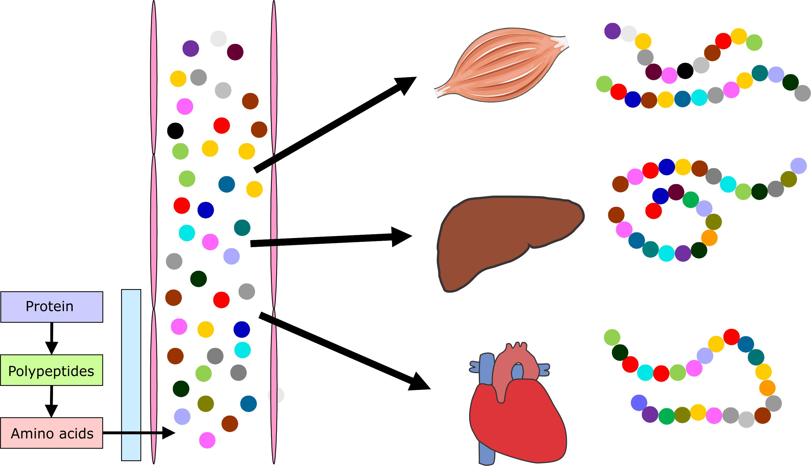

Slide 18
Protien Absorption
The amino acids are absorbed into the portal circulation and are taken to the liver.
The liver will use some of the amino acids to synthesize proteins such as albumin.
Every day, the liver makes about 10 g of albumin.

Slide 19
Protein Distribution
Most of the amino acids will travel to other organs and tissues where they will serve as 1. fuel and as 2. building blocks for the synthesis of body proteins.
Every day, the body synthesizes about 250 g of protein.
It is estimated that the human body contains more than 100,000 different proteins.
Some of these proteins are present in the body in minute quantities, sometimes only in a single cell type, whereas other proteins are very abundant in numerous tissues.

Slide 20
Protein functions
Functions of protein in the body
Proteins serve multiple functions in cells and tissues.
The function of a protein is determined by the amino acid sequence and the folding of the polypeptide chain into a specialized three-dimensional structure.
The persistent faulty incorporation of one incorrect amino acid in the polypeptide chain can severely disrupt the function of a protein and is at the basis of many genetic diseases.

Slide 21
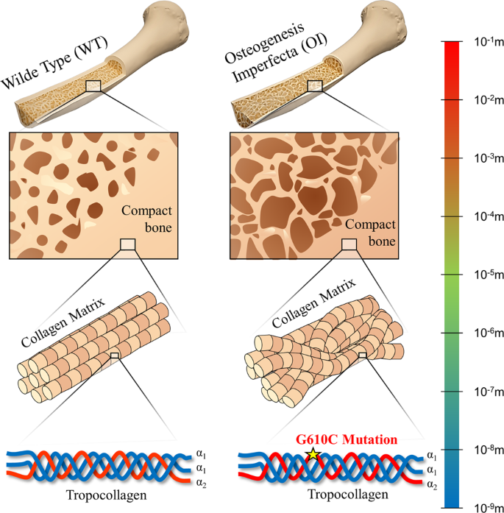
1. Building material
many proteins have an important structural role inside and outside cells.
The main structural protein and most abundant protein in the body is collagen.
Skin, tendons, cartilage, bone, and connective tissue contain a lot of collagen.
Collagen acts like a scaffold that gives strength and structure to cells and tissues.
Defects in collagen synthesis lead to a severe disease called osteogenesis imperfecta, which is characterized by very brittle bones that fracture easily.

Slide 22
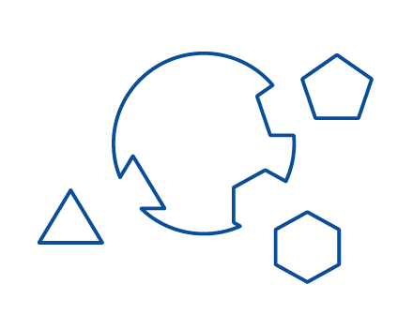
2. Enzymes:
Enzymes: enzymes are proteins that speed up a biochemical reaction.
In biochemical terms, they function as catalysts, which means that they lower the activation energy barrier that needs to be overcome for a reaction to proceed.
Every cell has thousands of different enzymes that are responsible for many different reactions, including those that are required to break down fatty acids and glucose to generate energy.

Slide 23
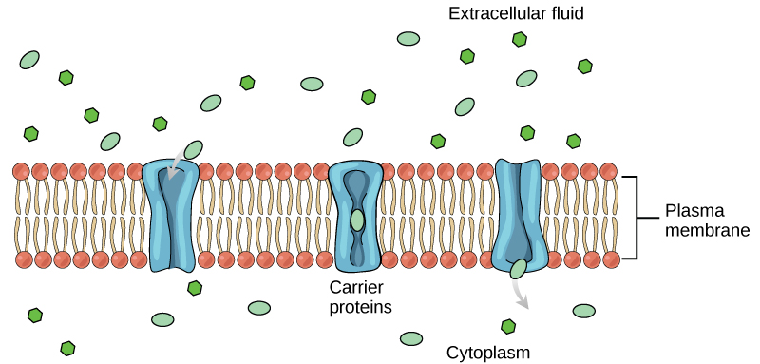
3. Transporters
Transporters: transporters assist with the import or export of different molecules across the cell membrane.

Slide 24
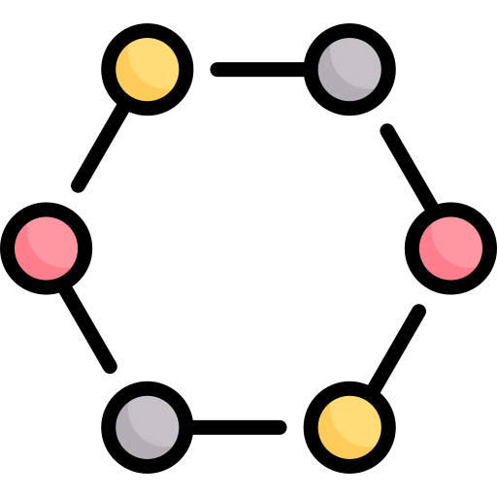
4. Hormones
hormones are messengers that circulate in the blood.
They are released from a particular tissue into the bloodstream to signal to distant tissues.
For example, insulin is released by the pancreas and travels to muscle and fat tissue to promote glucose uptake and fat storage.
Insulin consists of 51 amino acids, whereas glucagon consists of 29 amino acids.

Slide 25
5. Antibodies
antibodies circulate in the body and are involved in immune defense against pathogens such as bacteria and viruses.
They are also referred to as immunoglobulins and are secreted by plasma cells.

Slide 26
6. Regulation of fluid balance:
proteins play an important role in making sure that water in the body is appropriately distributed across the bloodstream (intravascular compartment), the space between cells (intercellular compartment), and inside cells (intracellular compartment).

Slide 27
Protein turnover and nitrogen balance

Slide 28
Definition:
protein turnover: (the constant synthesis and breakdown of body proteins)
nitrogen balance (also called protein balance: the balance between protein input and protein output).

Slide 29
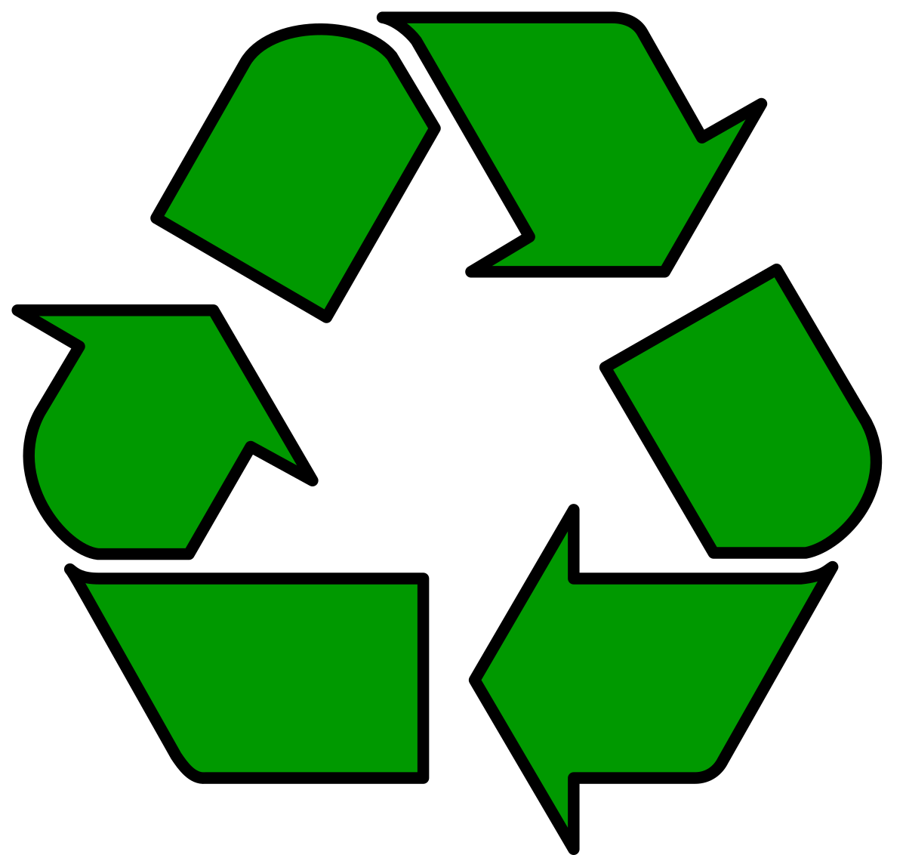
Protein turnover
The amino acids in the bloodstream are taken up into tissues and used to synthesize body proteins.
This process is called protein synthesis.
Every day, the body synthesizes about 250 grams of protein.
In a healthy adult who is neither gaining nor losing weight, the amount of body protein being synthesized is balanced by the amount of body protein being broken down (protein degradation).
The amino acids released by protein breakdown end up in the bloodstream and can be re-used for protein synthesis.
The continuous synthesis and breakdown of body proteins are referred to as protein turnover.
The rate of synthesis and breakdown of proteins determine the rate of protein turnover.

Slide 30
Protein Turnover depends on functions
Every one of the more than 100,000 proteins in the body has a different turnover rate.
Some proteins are degraded within minutes after they are newly synthesized.
Other proteins are stable for months.
Whether a protein has a slow or fast turnover rate depends on its function.
Structural proteins (example: collagen) usually have a slow turnover rate, meaning that they are very stable, whereas many enzymes involved in energy metabolism have a fast turnover rate.
This is because they need to be able to quickly adjust to changes in energy requirements in tissues.

Slide 31
Nitrogen balance
Uptake of amino acids via the diet does not normally result in a net gain in protein/amino acids in the body because it is balanced by the degradation of amino acids.
Amino acids are degraded in the liver. In the liver, the amino (nitrogen-containing) portions of the amino acids are removed and converted into urea.
The urea leaves the body in the urine.
The remaining carbon-containing part of the amino acids is used for energy production.
The balance between amino acid input via the diet and amino acid output via conversion to urea and loss via the urine is called protein balance.
Protein balance is more commonly called nitrogen balance.

Slide 32
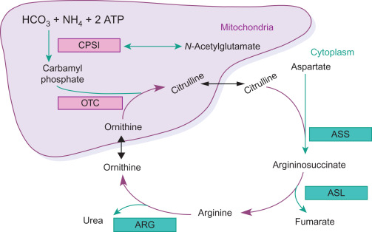
Urea Cycle

Slide 33
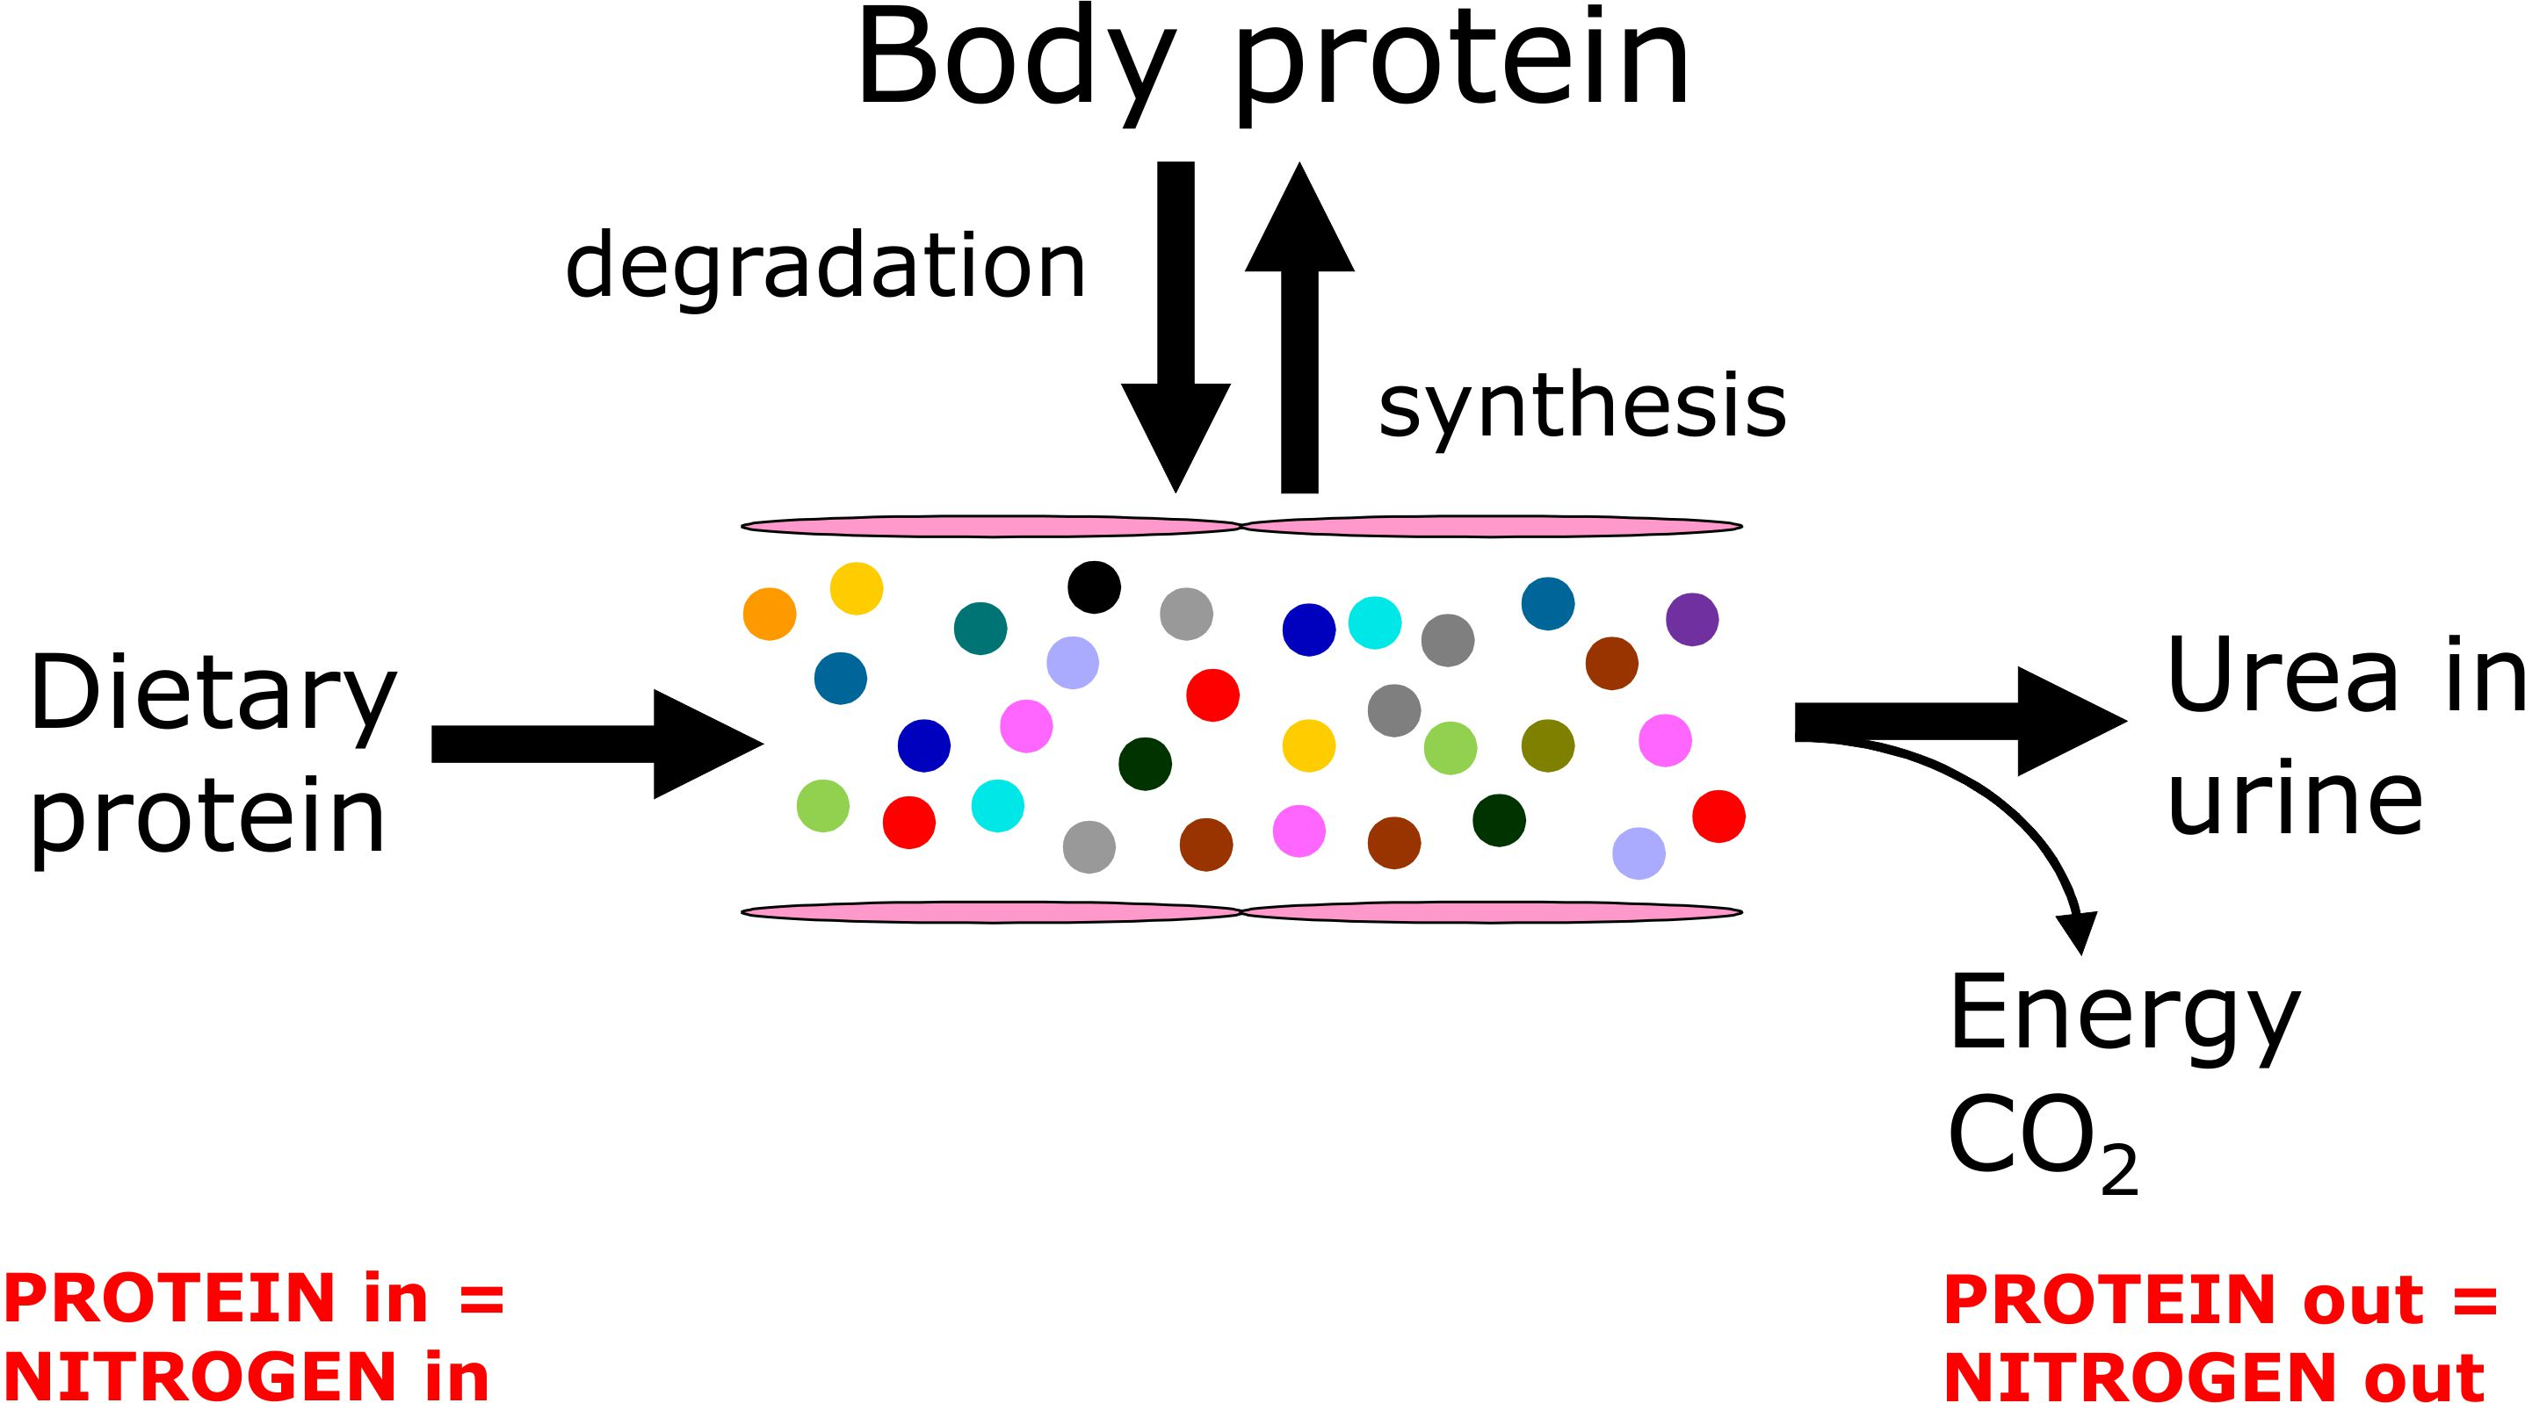

Slide 34
The nitrogen balance describes the difference between nitrogen intake (via diet) and nitrogen excretion (via urine and a small portion via stools).
It reflects the protein balance: the difference between amino acid intake via the diet and loss of amino acids as urea in the urine.
That is because almost all of the nitrogen in our diet is part of dietary protein.
Fats and carbohydrates do not contain any nitrogen.
Adults are normally in nitrogen balance, which means that the total content of protein and amino acids in the body does not change.

Slide 35
positive nitrogen balance
People are in a state of positive nitrogen balance when protein intake exceeds protein excretion.
A positive nitrogen balance results in a net gain of protein in the body.
Children and pregnant women, as well as patients recovering from a severe illness or trauma, are in a state of positive nitrogen balance.

Slide 36
negative nitrogen balance
People are in a state of negative nitrogen balance when protein excretion exceeds protein intake.
A negative nitrogen balance results in a net loss of protein from the body.
A negative nitrogen balance is never normal.
People that suffered heavy trauma or burns or have another type of illness (e.g. cancer, infectious disease) are in a state of negative nitrogen balance.
A negative nitrogen balance can also be due to low protein intake.

Slide 37
Breakdown of amino acids generates energy in the form of ATP.
Dietary protein thus provides considerable energy, which amounts to approximately 10-15% of the total energy intake.
When amino acids are broken down, the amino (nitrogen-containing) portion of the molecule is converted into urea.
The carbon part of the amino acid is further broken down into carbon dioxide and water.

Slide 38
It is important to realize that in most people, an increase in protein intake in itself does not automatically lead to a positive nitrogen balance.
This is because the increased intake of amino acids via the diet is normally compensated by increased degradation of amino acids, preventing any net gains in amino acids and protein in the body.

Slide 39
Protein quality
The quality of dietary protein is determined by two variables:
1) the digestibility (the proportion of dietary protein that is actually absorbed in the body)
2) the amino acid composition

Slide 40
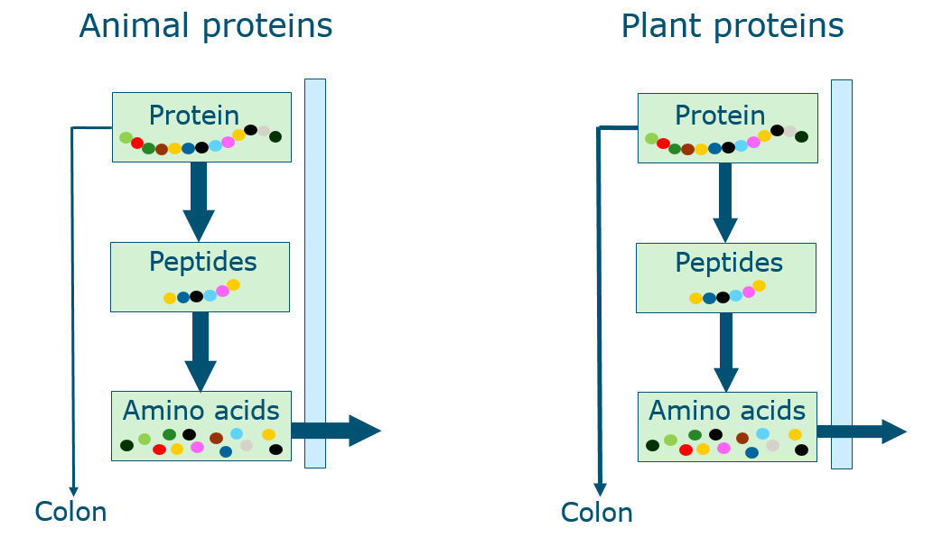

Slide 41
Protein digestibility
Protein digestibility describes the degree to which a dietary protein can be fully digested and absorbed into the body.
Dietary proteins differ substantially in their digestibility.
In general, proteins of animal origin have a higher digestibility than plant proteins.
The reason why plant proteins generally have a lower digestibility is because of:
1) Natural structural barriers to the digestion of macronutrients, ie, the food matrix
2) Structural organization of protein (networks, fibers, gels, emulsions)
3) Presence of compounds limiting the digestion (anti-nutritional factors)
The digestibility of plant proteins can be improved by various food processing techniques such as cooking, fermentation, and extrusion.

Slide 42
Limiting amino acid
The higher the similarity in amino acid composition between a dietary protein and the average body protein, the higher the quality of the dietary protein.
This is because protein synthesis in the body requires that all amino acids are present simultaneously in adequate quantities and proper proportions.
A deficit in any one essential amino acid would limit protein synthesis.
The limiting amino acid is the amino acid that is least abundant in a dietary protein source in comparison with the average human body protein. For instance, proteins in the human body contain plenty of lysine.
In contrast, wheat protein contains little lysine. If we would only eat wheat protein, the conversion of wheat protein into body protein would be limited by the availability of lysine.
In general, the amino acid composition of plant proteins is less similar to human body protein as compared with animal proteins.

Slide 43
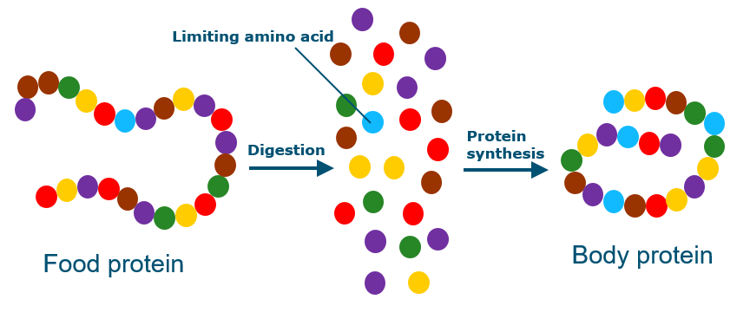

Slide 44
Protein complementation
Due to the lower digestibility and more unfavorable amino acid composition, the quality of plant proteins is generally lower than that of animal proteins.
A mixture of plant proteins has a more favorable amino acid composition than the individual plant proteins would have alone.
That is because the amino acid composition of the mixture of plant proteins more closely resembles human body protein. For example, most grains are low in lysine, whereas beans are low in methionine. By eating beans and grains together, the strengths of one make up for the deficiencies of the other, creating a complete protein.
Combining proteins to achieve a higher protein quality is called protein complementation.

Slide 45
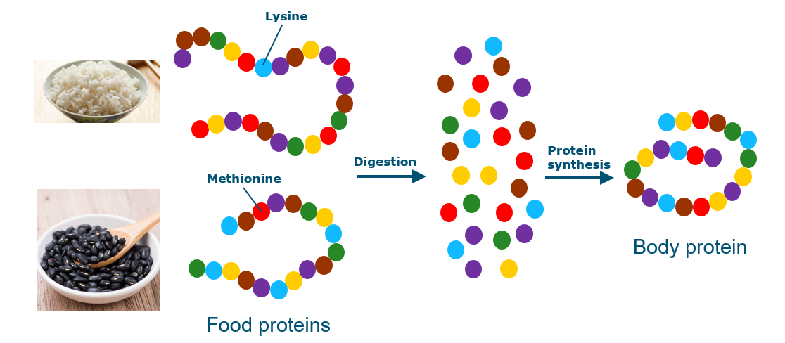

Slide 46
Recommended protein intake
The recommended daily allowance (RDA) for dietary protein in most countries is 0.8 grams per kg of body weight per day.
That amounts to 56 grams for a 70 kg adult.
Isolated protein deficiency is extremely rare in adults but may be observed in infants and children in developing countries.
Most people eat substantially more protein than the RDA, ranging from 10-25% of the total energy intake.
Protein intakes above 20% of total energy intake can only be achieved by very high consumption of meats, eggs, and/or dairy products.

Slide 47
Athletes
There is a lot of discussion about whether athletes and especially strength athletes, including bodybuilders, would benefit from a higher protein intake.
The panel responsible for formulating the dietary recommendation in the US has taken the position that healthy adults undertaking resistance or endurance exercise do not require additional dietary protein.
In contrast, the American Dietetic Association, Dietitians of Canada, and the American College of Sports Medicine recommend protein intakes for endurance and strength-trained athletes from 1.2 to 1.7 grams per kg of body weight per day.
These organizations have also stated that: "These recommended protein intakes can generally be met through diet alone, without the use of protein or amino acid supplements."
They also state that "the optimum timing for protein ingestion to promote the most favorable recovery and adaptation is after exercise".
They recommend that athletes should consume protein as soon as possible after exercise.

Slide 48
Dietary protein and muscle size and function
For many years, bodybuilders and other strength athletes have been consuming a diet high in protein.
Indeed, since the sport first emerged in the late 1800’s, high-protein foods such as eggs, fish, and meat have formed the basis of most bodybuilder’s diets.
In the last decade, the scientific evidence to support such practices has grown substantially.
It is now well accepted that a high protein diet can stimulate muscle mass in individuals that engage in resistance-type exercise.
Studies have shown that the most optimal moments to ingest protein are shortly after exercise and just before going to bed.
The consumption of protein before going to bed helps to mitigate the catabolic state and accompanying muscle breakdown that inevitably develops during the sleeping period.

Slide 49
Any Questions?

