Slide 1
Faculty of Pharmacy
Tishk Internationl University
Introduction To Nutritional Biochemistry (Why We Eat?)
1st lecture; Nutritional Biochemistry
Mohammed Rasul
Assistant Lecturer |MSc. Biomedical Science
Mohammed.rasul@tiu.edu.iq
Notes:
Example of reducing and non reducing sugar
https://www.biologyonline.com/dictionary/reducing-sugar
The loss of electrons during a reaction of a molecule is called oxidation while the gain of single or multiple electrons is called reduction.
The oxidation and reduction reactions (also called redox reactions) are the chemical reactions in which the oxidation number of the chemical species that are taking part in the reaction changes.
The redox processes are the wide range of reactions that include the majority of the chemical and biological processes taking part around us.
Rusting and dissolution of the metals, browning of the fruits, fire reactions, respiration and the process of photosynthesis are all oxidation-reduction processes.
Oxygen atom Transfer:
C+ 2H₂O → CO₂ + 2H₂
Hydrogen atom Transfer:
N₂H₄+ O₂ → N₂+ 2H₂O
Electron Transfer:
Zn + Cu⁺² → Zn⁺² + Cu

Slide 2
Learning outcome (Syllabus)
Explaining the role of nutrition in medicine
Macronutrition(structure, digestion, absorption and metabolism)
Micronutrition (vitamins and minerals)
Malnutrition and malabsorption
Obesity and associated disorder
Role of diet in human health and diseases
Diet and Cancer

Slide 3
If you have question
Quiz
Lecturer note
Exam
Types of question
Question bank
Scintific question
Mohammed.rasul@tiu.edu.iq
Representative

Slide 4
Grad
Mid-term 25%
Attendance 5%
Quiz 10% (1 quiz/2 weeks)
Project 10%
Presentation 10%

Slide 5
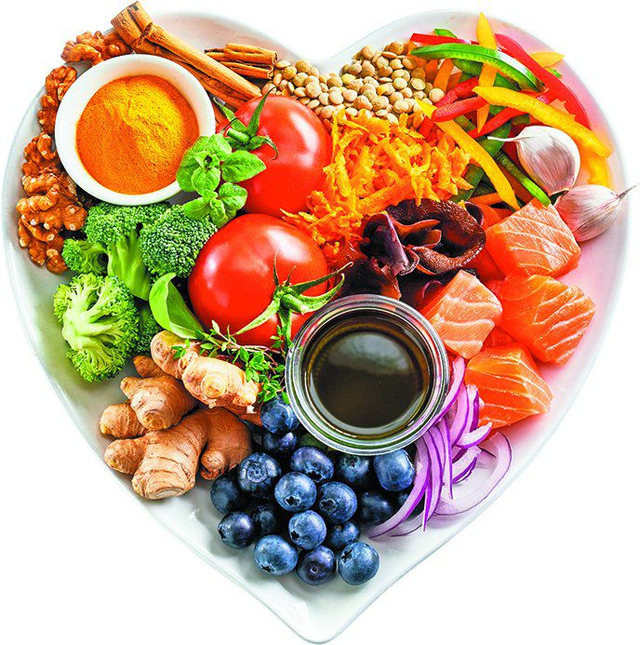
Nutrition
Nutrition: is defined as the science that deals with food and the nutrients, their action, interaction and balance in relation to health and disease, and the process by which the organism ingests, digests, absorbs, transports, utilizes and excretes food substances.

Slide 6
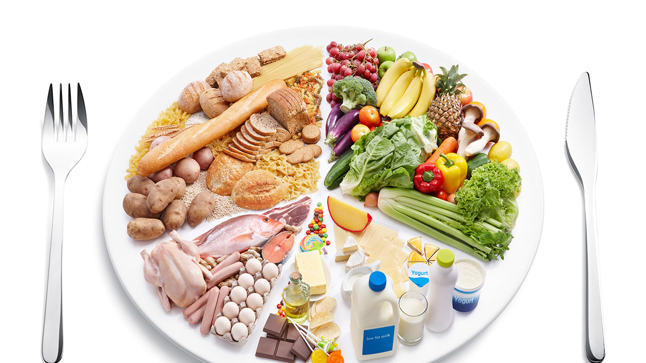
Diet
Diet: refers to what a person habitually eats and drinks.
The controlled or restricted consumption of food or drink for a particular purpose, e.g. to manage body weight.

Slide 7
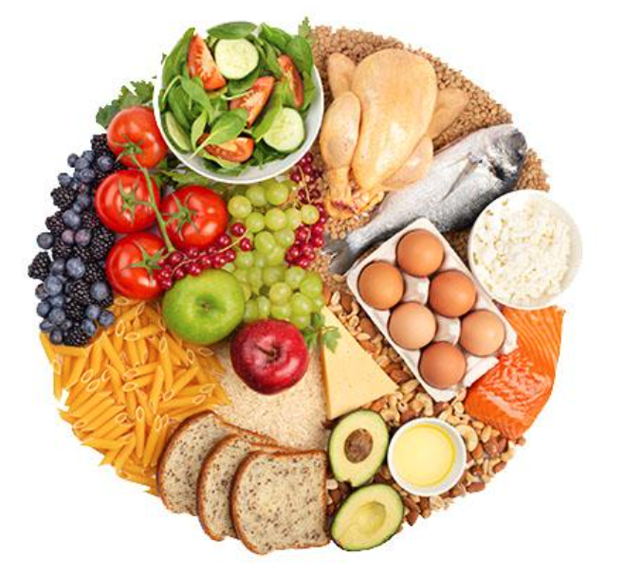
Food
Food: is any edible substance which when taken in the body (ingested) provides it with the necessary nutrients .
- Main five food groups are:
1- Starchy carbohydrate: bread, pasta, rice, oat, potato.
2- fruit and vegetables.
3-high protein foods: meat, fish, chicken, egg, cheese and legumes.
4- food rich in fat or oil.
5- Diary products and alternatives.

Slide 8
Nutrients:
Nutrients: Are chemical compounds in food that are used by the body to function properly and maintain health.
They provide body with energy, contribute to body structure and regulate chemical processes.

Slide 9
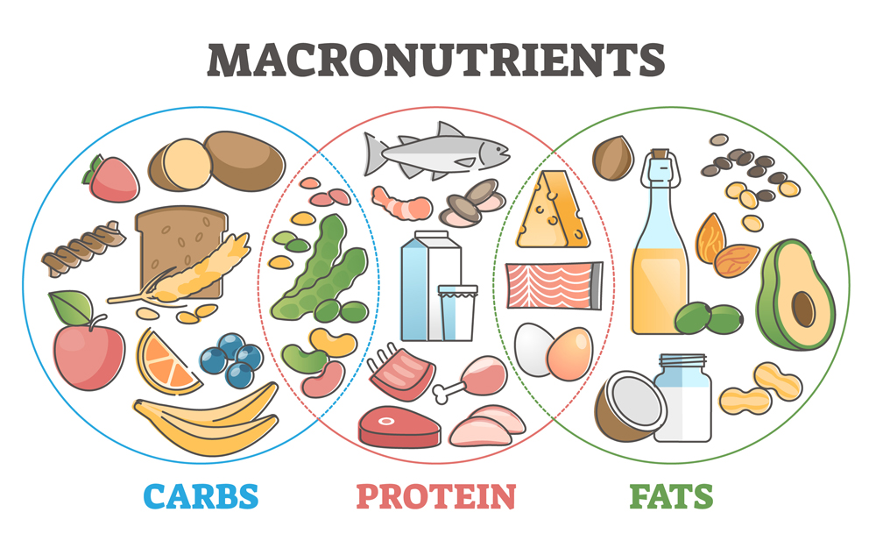
Macronutrients
Refer to nutrients that are required in large (gm) amounts.
Three classes of macronutrients are carbohydrates, proteins and lipids.
They are main sources of energy and provide essential nutrients as amino acids and essential fats.

Slide 10
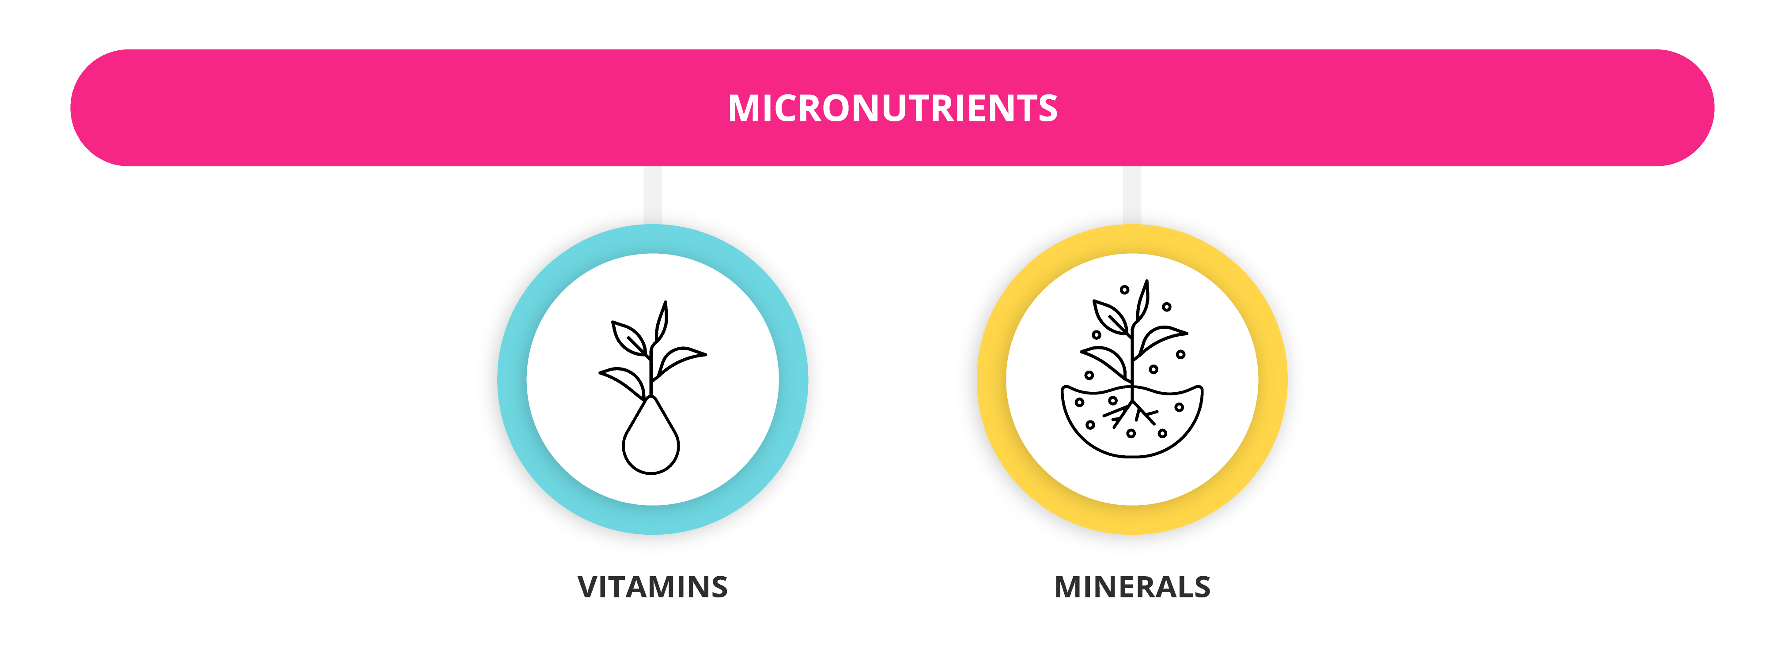
Micronutrients
Are one of the main type of nutrients that are required in small amount.
Essential for carrying out bodily functions.
They are not regarded as dietary energy sources.
Micronutrients include vitamins and minerals.

Slide 11
Energy
It represents the capacity of a system to perform work.
Food energy is chemical energy that released from macronutrients ( carbohydrates, proteins and lipids).
The unit of energy in nutrition is calorie.

Slide 12
Calorie
A calorie is a unit that measures energy.
1 calorie is the amount of energy it takes to raise the temperature of 1 gram of water by 1 degree Celsius.
When it comes to calories and health, we're talking about the amount of energy that our bodies can use from the foods and drinks we consume.
As a guide, an average man needs around 2,500kcal (10,500kJ) a day to maintain a healthy body weight.
For an average woman, that figure is around 2,000kcal (8,400kJ) a day.
1000 calories = 1 kilocalorie(Kcal)
1 calorie = 4.18 joule.
1 Kcal = 4.18 KJ.
1 gm carbohydrate = 4 kcal.
1 gm Protein = 4 kcal.
1 gm fat = 9 kcal.
The joule is the unit of energy in the International System of Units.
It is equal to the amount of work done when a force of 1 newton displaces a mass through a distance of 1 metre in the direction of the force applied

Slide 13
Any Questions?

