Slide 1
Faculty of Pharmacy
Tishk Internationl University
Dietary Reference Intakes
2nd lecture; Nutritional Biochemistry
Mohammed Rasul
Assistant Lecturer |MSc. Biomedical Science
Mohammed.rasul@tiu.edu.iq
Notes:
Example of reducing and non reducing sugar
https://www.biologyonline.com/dictionary/reducing-sugar
The loss of electrons during a reaction of a molecule is called oxidation while the gain of single or multiple electrons is called reduction.
The oxidation and reduction reactions (also called redox reactions) are the chemical reactions in which the oxidation number of the chemical species that are taking part in the reaction changes.
The redox processes are the wide range of reactions that include the majority of the chemical and biological processes taking part around us.
Rusting and dissolution of the metals, browning of the fruits, fire reactions, respiration and the process of photosynthesis are all oxidation-reduction processes.
Oxygen atom Transfer:
C+ 2H₂O → CO₂ + 2H₂
Hydrogen atom Transfer:
N₂H₄+ O₂ → N₂+ 2H₂O
Electron Transfer:
Zn + Cu⁺² → Zn⁺² + Cu

Slide 2
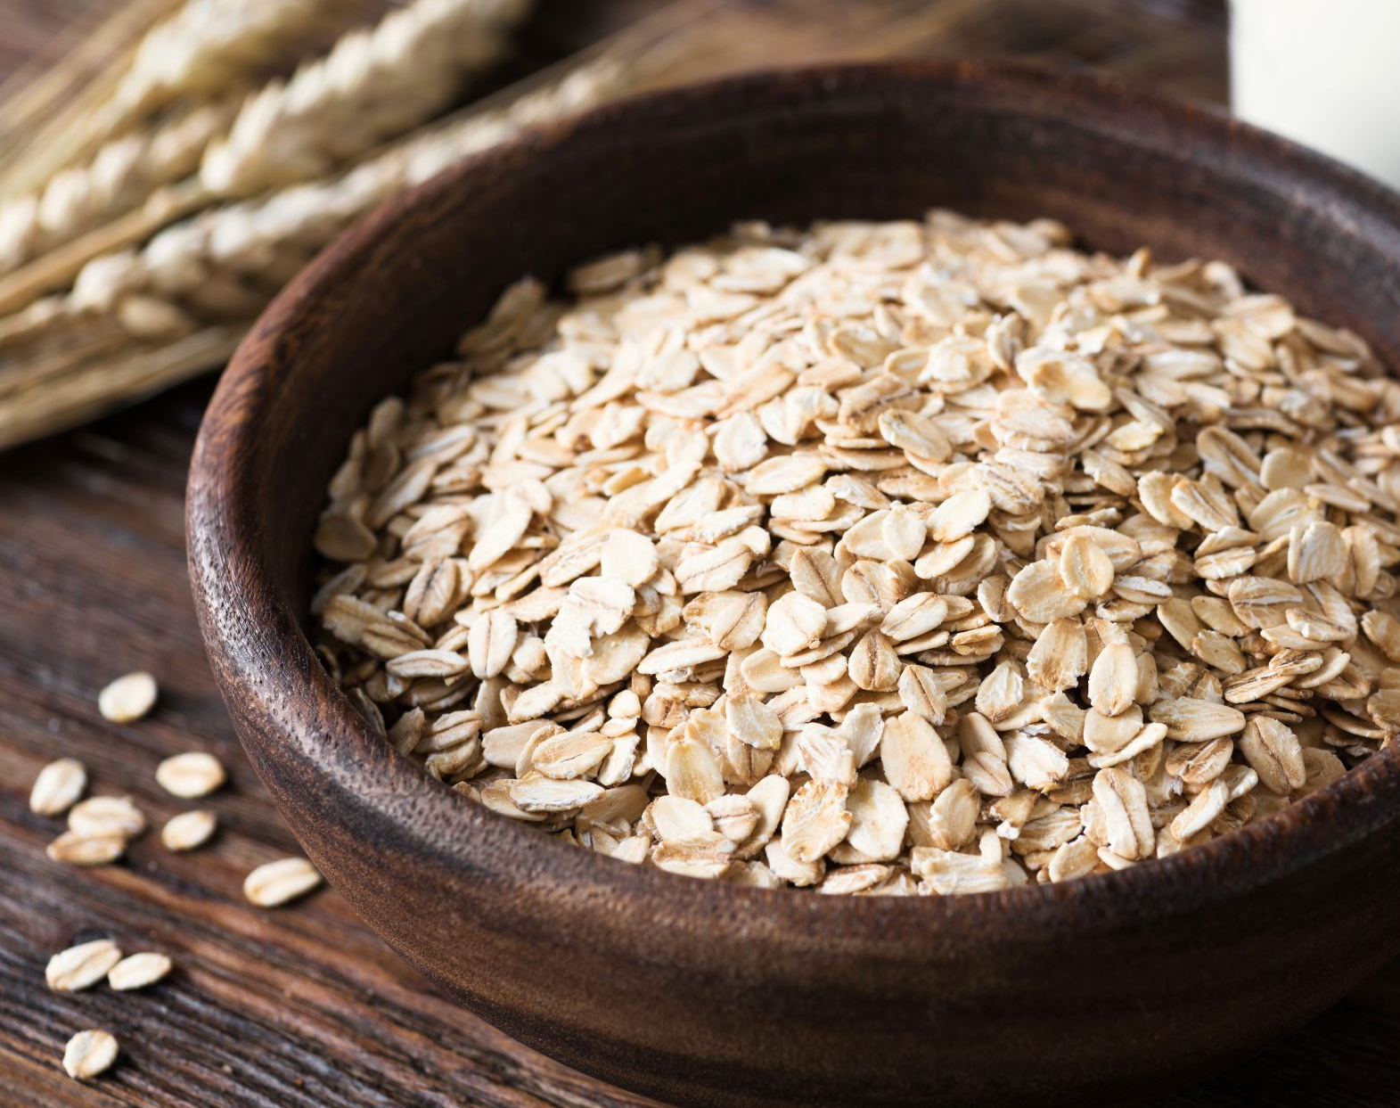
Nutrients are the constituents of food necessary to sustain the normal functions of the body.

Slide 3
Outline:
DIETARY REFERENCE INTAKES

Slide 4
DIETARY REFERENCE INTAKES

Slide 5
DIETARY REFERENCE INTAKES
Committees of U.S. and Canadian experts organized by the Food and Nutrition Board of the Institute of Medicine of the National Academy of Sciences have compiled Dietary Reference Intakes (DRI), which are estimates of the amounts of nutrients required to prevent deficiencies and maintain optimal health and growth.
Dietary reference intakes (DRIs) are a set of scientifically developed reference values for nutrients.
DRI values provide the scientific basis for:
nutrition professionals
governments,
non-governmental organizations to carry out activities such as: Developing nutrition labels.

Slide 6
The DRI expands on the Recommended Dietary Allowances (RDA), which have been published with periodic revisions since 1941.
Unlike the RDA, the DRI establishes upper limits on the consumption of some nutrients and incorporates the role of nutrients in lifelong health, going beyond deficiency diseases.
Both the DRI and the RDA refer to long-term average daily nutrient intakes, because it is not necessary to consume the full RDA every day.

Slide 7
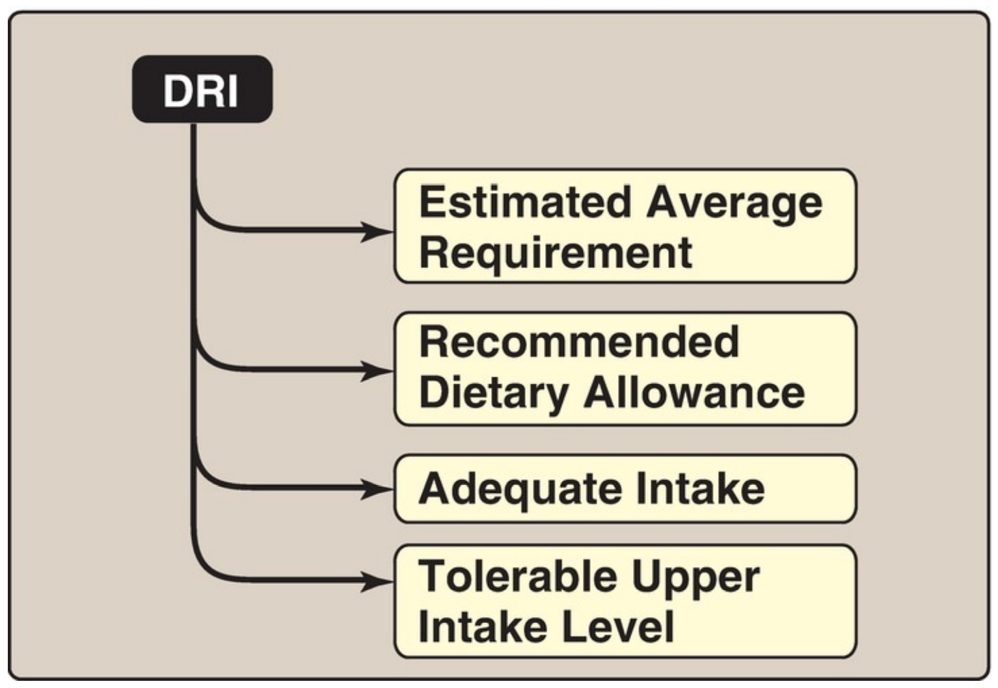
The DRI consists of four dietary reference standards for the intake of nutrients designated for:
1. specific life stage (age) groups
2. physiologic states,
3. gender

Slide 8
Estimated average requirement:
The average daily nutrient intake level estimated to meet the requirement of one half of the healthy individuals in a particular life stage and gender group is the Estimated Average Requirement (EAR).
Average amount sufficient for half of the individuals.
It is useful in estimating the actual requirements in groups and individuals.

Slide 9
Recommended Dietary Allowance:
The RDA is the average daily nutrient intake level that is sufficient to meet the requirements of nearly all (97%– 98%) individuals in a particular life stage and gender group.
The RDA is not the minimal requirement for healthy individuals, but it is intentionally set to provide a margin of safety for most individuals.
The EAR serves as the foundation for setting the RDA.
Most of the meals based on RDA to provide nutrition to almost all the healthy individuals.
For most of the nutrition's, RDA is available.

Slide 10
Adequate Intake:
An Adequate Intake (AI) is set instead of an RDA if sufficient scientific evidence is not available to calculate an EAR or RDA.
The AI is based on estimates (approximation) of nutrient intake by a group (or groups) of apparently healthy people.

Slide 11
Tolerable upper intake level (TUL)
The highest level of nutrients that nearly that all healthy individuals in a particular group can reach without adverse effect.
As intake increases above the UL, the potential risk of adverse effects may increase.
Point where nutrient is likely to be toxic.
The UL is useful because of the increased availability of fortified foods and the increased use of dietary supplements. For some nutrients, there may be insufficient data on which to develop a UL.
TUL can be used to protect us from overconsumption.

Slide 12
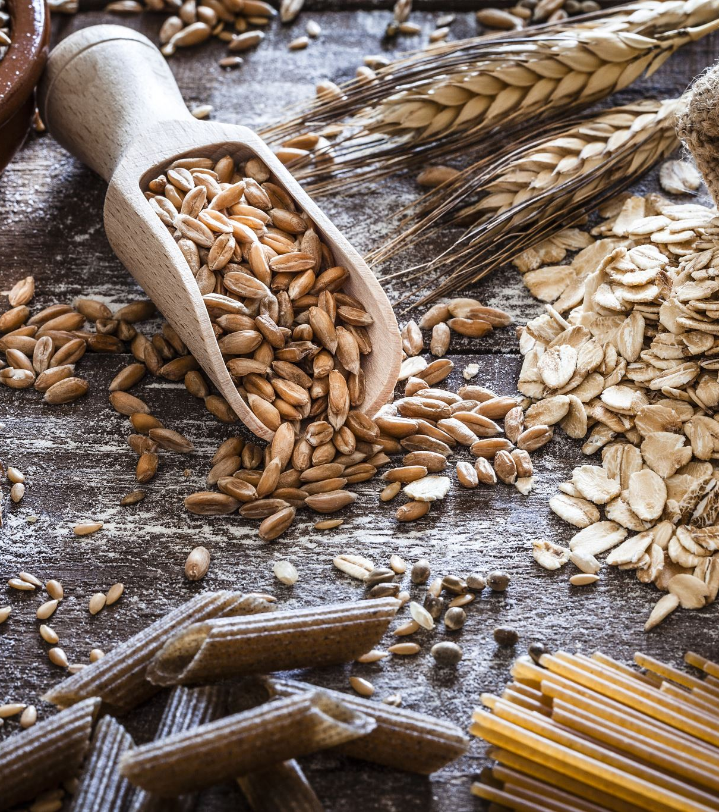
Using the Dietary Reference Intakes

Slide 13
In Summery:
Most nutrients have a set of DRI.
Usually a nutrient has an EAR and a corresponding RDA.
Most are set by age and gender and may be influenced by special factors, such as pregnancy and lactation in women.
When the data are not sufficient to estimate an EAR (or an RDA), an AI is designated.
Intakes below the EAR need to be improved because the probability of adequacy is ≤50%.
Intakes between the EAR and RDA likely need to be improved because the probability of adequacy is <98%, and intakes at or above the RDA can be considered adequate.
Intakes between the UL and the RDA can be considered to have no risk for adverse effects.

Slide 14
Comparison of the components of the Dietary Reference Intakes.
EAR = estimated average requirement; RDA = recommended dietary allowance; AI = adequate intake; UL = tolerable upper intake level.

Slide 15
ENERGY REQUIREMENT IN HUMANS

Slide 16
The Estimated Energy Requirement (EER)
The average dietary energy intake predicted to maintain an energy balance (that is, the calories consumed are equal to the energy expended)
Differences in the1. genetics, 2. body composition, 3. metabolism, and 4. behavior of individuals make it difficult to accurately predict a person’s caloric requirements.
However, some simple approximations can provide useful estimates.
sedentary adults require ~30 kcal/kg/day to maintain body weight
moderately active adults require 35 kcal/kg/day
very active adults require 40 kcal/kg/day.
Notes:
Amount of calories needed for all daily functions.
Including energy requires for vital and physical acitivites.

Slide 17
A. Energy content of food
The energy content of food is calculated from the heat released by the total combustion of food in a calorimeter.
It is expressed in kilocalories (kcal, or Cal).
Amount of Calori per micronutrition
CHO 4 kcal/g
Protein 4 kcal/g
Fat 9 kcal/g
Notes:
[Note: The joule (J) is a unit of energy widely used in countries other than the United States. One cal = 4.2 J; 1 kcal (1 Cal, 1 food calorie) = 4.2 kJ. For uniformity, many scientists are promoting the use of joules rather than calories in the United States. However, kcal still predominates and is used throughout this text.]

Slide 18
Practical

Slide 19
We have a patient that requires to take 2150kcal/day! He wants to take it according to the ”AMDR, acceptable macronutrients distribution range”
How much protein should he take per day?
How much carbohydrate should he take per day?
How much fat should he take per day?

Slide 20
”AMDR, acceptable macronutrients distribution range”
CHO 45 % to 65 %
Protein 10 % to 35 %
Lipid 20 % to 30 %

Slide 21
B. Use of food energy in the body
The energy generated by metabolism of the macronutrients is used for three energy-requiring processes that occur in the body:
resting metabolic rate (RMR)
physical activity
The thermic effect of food.
The number of kcal expended by these processes in a 24-hour period is the total energy expenditure (TEE).

Slide 22
Estimated total energy expenditure in a healthy 20-year-old woman, 5 ft, 4 in (165 cm) tall, weighing 110 lb (50 kg), and engaged in light activity.

Slide 23
1. Resting metabolic rate:
RMR is the energy expended by an individual in a resting, postabsorptive state.
It represents the energy required to carry out the normal body functions, such as respiration, blood flow, and ion transport.
RMR can be determined by measuring oxygen (O2) consumed or carbon dioxide (CO2) produced (indirect calorimetry).
[Note: The ratio of CO2 to O2 is the respiratory quotient (RQ). It reflects the substrate being oxidized for energy (Fig. 27.6).] RMR also can be estimated using equations that include sex and age (RMR reflects lean muscle mass, which is highest in men and the young) as well as height and weight.
A commonly used rough estimate is 1 kcal/kg/hour for men and 0.9 kcal/kg/hour for women. [Note: A basal metabolic rate (BMR) can be determined if more stringent environmental conditions are used, but it is not routinely done. RMR is ~10% higher than the BMR.]
In an adult, the 24-hour RMR, known as the resting energy expenditure (REE), is ~1,800 kcal for men (70 kg) and 1,300 kcal for women (50 kg). From 60%–75% of the TEE in sedentary individuals is attributable to the REE (Fig. 27.7).
[Note: Hospitalized individuals are commonly hypercatabolic, and the RMR is multiplied by an injury factor that ranges from 1.0 (mild infection) to 2.0 (severe burns) in calculating their TEE.]

Slide 24
The respiratory quotient (RQ). [Note: For protein, the nitrogen is removed and excreted, and the α-keto acids are oxidized.]

Slide 25
2. Physical activity:
Muscular activity provides the greatest variation in the TEE.
The amount of energy consumed depends on the duration and intensity of the exercise.
This energy cost is expressed as a multiple of the RMR (range is 1.1 to >8.0) that is referred to as the physical activity ratio (PAR) or the metabolic equivalent of the task (MET).
In general, a lightly active person requires ~30%–50% more calories than the RMR (see Fig. 27.7), whereas a highly active individual may require ≥100% calories above the RMR.

Slide 26
3. Thermic effect of food:
The production of heat by the body increases as much as 30% above the resting level during the digestion and absorption of food.
This is called the thermic effect of food, or diet-induced thermogenesis.
The thermic response to food intake may amount to 5%– 10% of the TEE.

Slide 28
Any Questions?

