Slide 1
Faculty of Pharmacy
Tishk Internationl University
Energy Requirment in Human
3rd lecture; Nutritional Biochemistry
Mohammed Rasul
Assistant Lecturer |MSc. Biomedical Science
Mohammed.rasul@tiu.edu.iq
Notes:
Example of reducing and non reducing sugar
https://www.biologyonline.com/dictionary/reducing-sugar
The loss of electrons during a reaction of a molecule is called oxidation while the gain of single or multiple electrons is called reduction.
The oxidation and reduction reactions (also called redox reactions) are the chemical reactions in which the oxidation number of the chemical species that are taking part in the reaction changes.
The redox processes are the wide range of reactions that include the majority of the chemical and biological processes taking part around us.
Rusting and dissolution of the metals, browning of the fruits, fire reactions, respiration and the process of photosynthesis are all oxidation-reduction processes.
Oxygen atom Transfer:
C+ 2H₂O → CO₂ + 2H₂
Hydrogen atom Transfer:
N₂H₄+ O₂ → N₂+ 2H₂O
Electron Transfer:
Zn + Cu⁺² → Zn⁺² + Cu

Slide 2
Oulines:
Estimated Energy Requirment
acceptable macronutrients distribution range
Use of food energy in the body
total energy expenditure (TEE).

Slide 3
ENERGY REQUIREMENT IN HUMANS

Slide 4
The Estimated Energy Requirement (EER)
The average dietary energy intake predicted to maintain an energy balance (that is, the calories consumed are equal to the energy expended)
Differences in the1. genetics, 2. body composition, 3. metabolism, and 4. behavior of individuals make it difficult to accurately predict a person’s caloric requirements.
However, some simple approximations can provide useful estimates.
sedentary adults require ~30 kcal/kg/day to maintain body weight
moderately active adults require 35 kcal/kg/day
very active adults require 40 kcal/kg/day.
Notes:
Amount of calories needed for all daily functions.
Including energy requires for vital and physical acitivites.

Slide 5
A. Energy content of food
The energy content of food is calculated from the heat released by the total combustion of food in a calorimeter.
It is expressed in kilocalories (kcal, or Cal).
Amount of Calori per micronutrition
CHO 4 kcal/g
Protein 4 kcal/g
Fat 9 kcal/g
Notes:
[Note: The joule (J) is a unit of energy widely used in countries other than the United States. One cal = 4.2 J; 1 kcal (1 Cal, 1 food calorie) = 4.2 kJ. For uniformity, many scientists are promoting the use of joules rather than calories in the United States. However, kcal still predominates and is used throughout this text.]

Slide 6
”AMDR, acceptable macronutrients distribution range”
CHO 45 % to 65 %
Protein 10 % to 35 %
Lipid 20 % to 30 %

Slide 7
Practical

Slide 8
Example!
One of the 3rd grade student ask you to tell her the approximate amount of macronutrient that she has to consume it per day!
What would be your answer if you know her weight is 89kg and height is 160 cm!

Slide 9
B. Use of food energy in the body
The energy generated by metabolism of the macronutrients is used for three energy-requiring processes that occur in the body:
resting metabolic rate (RMR)
physical activity
The thermic effect of food.
The number of kcal expended by these processes in a 24-hour period is the total energy expenditure (TEE).

Slide 10
Estimated total energy expenditure in a healthy 20-year-old woman, 5 ft, 4 in (165 cm) tall, weighing 110 lb (50 kg), and engaged in light activity.

Slide 11
1. Resting metabolic rate:
RMR is the energy expended by an individual in a resting, postabsorptive state.
It represents the energy required to carry out the normal body functions:
Respiration
blood flow
ion transport.
basic neurological functions
RMR can be determined by measuring oxygen (O2) consumed or carbon dioxide (CO2) produced.
REE allows the nutritionist to understand how much they need to feed their patients.
Notes:
The method for measuring inspired oxygen and expired carbon dioxide is to calculate the resting energy expenditure (REE) and respiratory quotient (RQ). REE allows the nutritionist to understand how much they need to feed their patients.

Slide 13
Practice:
Find your resting metabolis rate?

Slide 15
Respiratory Quotient
The respiratory quotient, also known as the respiratory ratio (RQ), is defined as the volume of carbon dioxide released over the volume of oxygen absorbed during respiration.
It is a dimensionless number used in a calculation for basal metabolic rate when estimated from carbon dioxide production to oxygen absorption.
Notes:
Respiration is the process by which the respiratory substrate is broken down to release energy. The two main operating factors of cell respiration are aerobic and anaerobic respiration, where aerobic respiration requires the presence of oxygen and anaerobic respiration does not. The most common respiratory substrate is glucose, which has a 6-carbon compound. The substrate is metabolized through glycolysis, the TCA cycle, electron transport chain, and oxidative phosphorylation. Through these cycles, cells are able to produce and store ATP, and carbon dioxide is produced as a by-product. It is important to understand the levels of carbon dioxide produced from different substrates because toxic levels can be destructive to the body. Healthcare professionals can recommend that a patient alter his or her diet, particularly for those with pulmonary and liver conditions, to increase the release of CO2 and avoid respiratory fatigue and utilize it as a prognostic factor, respectively
Glucose and fat
In the presence of macronutrients, oxygen is required for the breakdown of carbohydrates, fat, and protein. Carbohydrates (C6H12O6 + 6O2) have a 6 carbon chain and metabolize via glycolysis to form 2 pyruvate substrates, releasing CO2 as a by-product when converting to acetyl CoA. CO2 is also a by-product in the Krebs cycle when 2 carbon acetyl CoA reacts with a 4 carbon citrate, making a total of 3 CO2 in each metabolizing cascade. If the starting molecule is a fatty acid, which contains 12, 18, 20, or 22 carbon molecules, it goes through the process of B - oxidation to form acetyl Co-A which does not generate carbon dioxide. Therefore, when using fat over carbohydrates as a form of fuel, less CO2 is generated for every oxygen consumed.

Slide 16
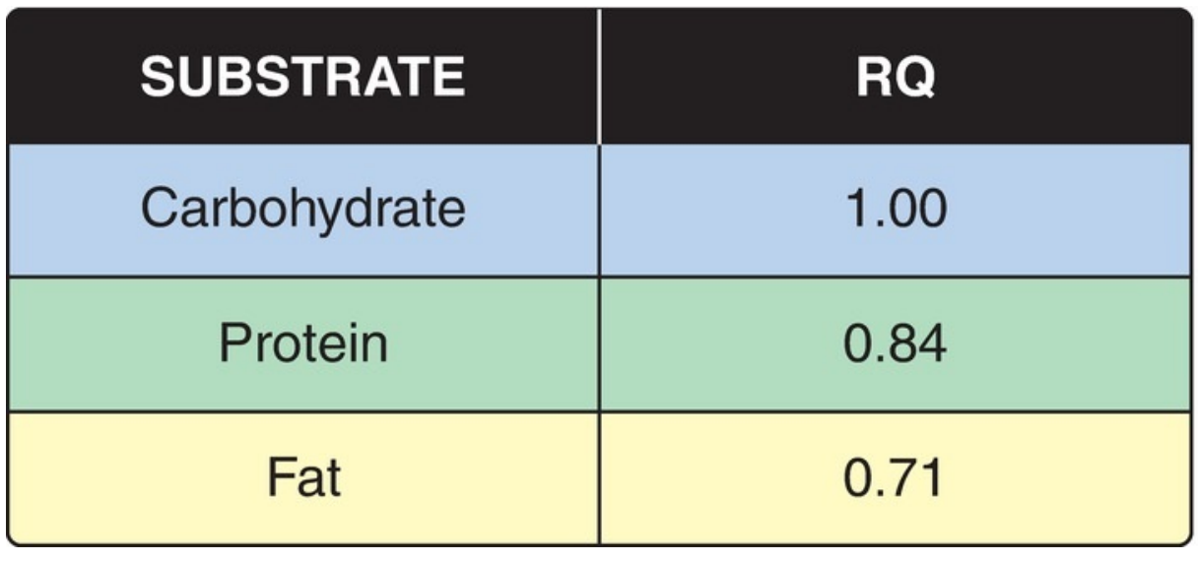
Respiratory Ratio
RQ = Vol CO2 released/Vol O2 absorbed
It is calculated for a particular substrate i.e., carbohydrates, organic acid, fat, and protein.
-Carbohydrates are oxidized through aerobic respiration resulting in an equal ratio of CO2 release and oxygen consumption.
-If a mixture of the substrates is consumed, then the RQ ratio collectively is 0.8

Slide 17
HOMEWORK!
Note: Hospitalized individuals are commonly hypercatabolic, and the RMR is multiplied by an injury factor that ranges from 1.0 (mild infection) to 2.0 (severe burns) in calculating their TEE(total energy expenditure ). Why? Homework?

Slide 18
2. Physical activity:
Muscular activity provides the greatest variation in the TEE.
The amount of energy consumed depends on the duration and intensity of the exercise.
In general, a lightly active person requires ~30%–50% more calories than the RMR. Whereas a highly active individual may require ≥100% calories above the RMR.

Slide 19
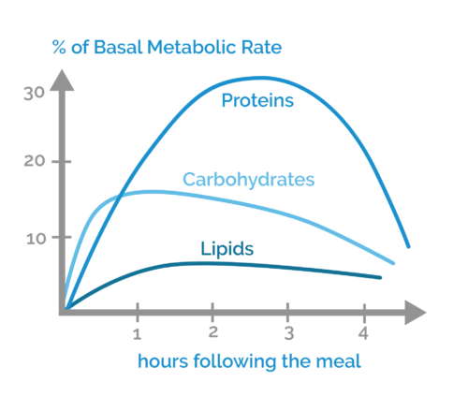
3. Thermic effect of food:
The thermic effect of food is amount of energy burnt as a result of digesting either protein, carbs, fat or a combination of all three.
The production of heat by the body increases as much as 30% above the resting level during the digestion and absorption of food.
The thermic response to food intake may amount to 5%– 10% of the TEE.

Slide 20
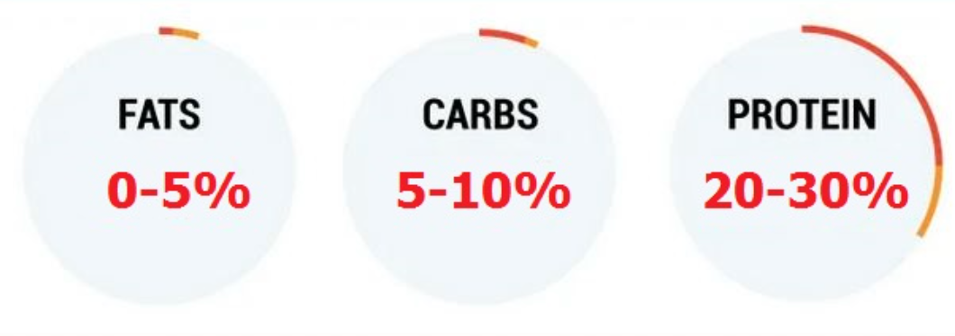

Slide 22
Project
10% of your total mark, deadline April 1st, 2023
Using treatment during the fasting, ramadan?
Role of nutriton! Medical advice!
CVD
Diabetes
Kidney stone
Cancer
Depresion
Pregnancy
Skin disorders
Irritable Bowel Syndrome
Preparing the bord
Joining the Festival

Slide 23
Any Questions?

