Slide 1
Faculty of Pharmacy
Tishk Internationl University
Energy Homeostasis
4th lecture; Nutritional Biochemistry
Mohammed Rasul
Assistant Lecturer |MSc. Biomedical Science
Mohammed.rasul@tiu.edu.iq
Notes:
Example of reducing and non reducing sugar
https://www.biologyonline.com/dictionary/reducing-sugar
The loss of electrons during a reaction of a molecule is called oxidation while the gain of single or multiple electrons is called reduction.
The oxidation and reduction reactions (also called redox reactions) are the chemical reactions in which the oxidation number of the chemical species that are taking part in the reaction changes.
The redox processes are the wide range of reactions that include the majority of the chemical and biological processes taking part around us.
Rusting and dissolution of the metals, browning of the fruits, fire reactions, respiration and the process of photosynthesis are all oxidation-reduction processes.
Oxygen atom Transfer:
C+ 2H₂O → CO₂ + 2H₂
Hydrogen atom Transfer:
N₂H₄+ O₂ → N₂+ 2H₂O
Electron Transfer:
Zn + Cu⁺² → Zn⁺² + Cu

Slide 2
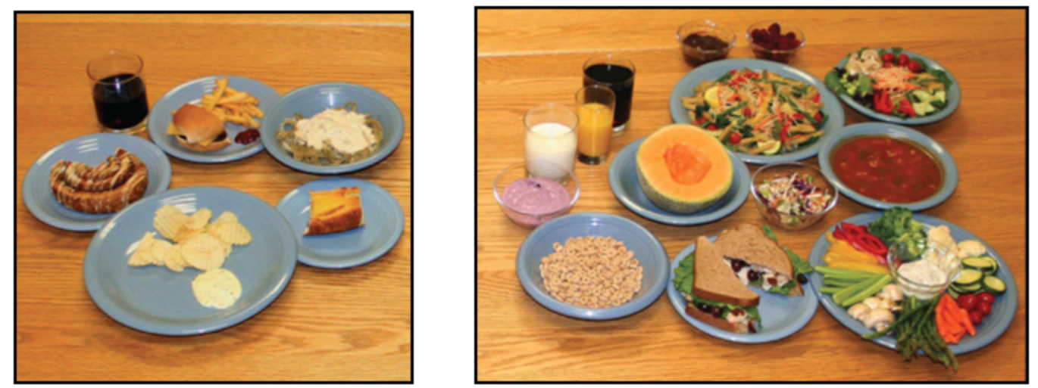
What did you learn by now?

Slide 3
Learning outcomes:
understand the basis for weight gain and loss
explain the concept of energy balance
understand the basic mechanisms involved in the regulation of food intake
understand the caloric value of foods as expressed on a food package to understand how the energetic value of nutrients is calculated
estimate the rate of energy expenditure for various activities
know to the importance of maintenance (basal metabolic rate) in determining energy expenditure
explain why weight loss and gain automatically level off

Slide 4
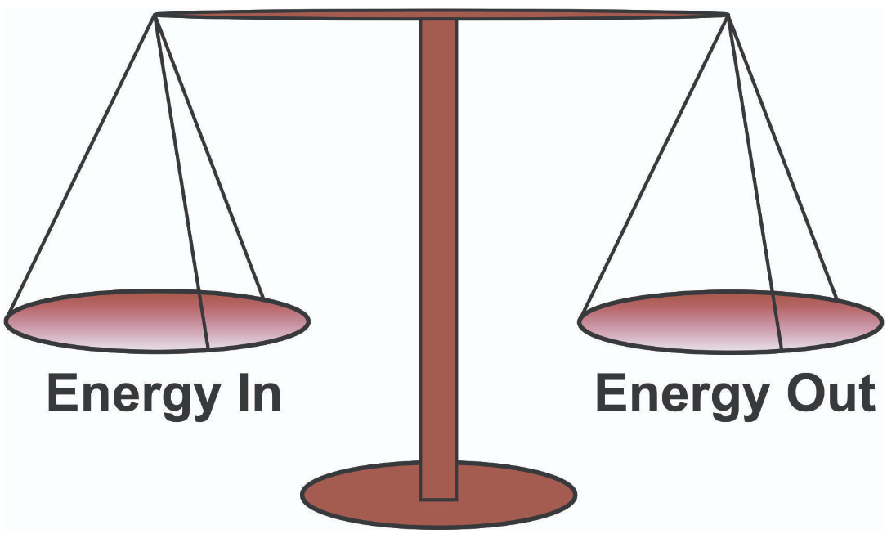
Energy Balance:
Energy balance is a very important topic that forms the basic for our understanding of weight gain and obesity.
Energy balance is the balance between energy coming in (energy intake) and energy going out (mainly energy expenditure).
When energy coming in exceeds the energy going out (people consume more calories than they burn), people gain weight.
When energy going out exceeds energy coming in, people lose weight.

Slide 5
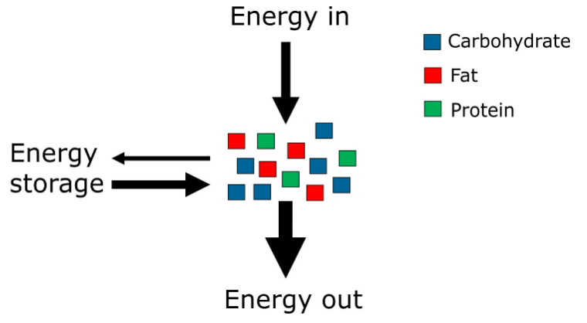
Energy Balance…
When energy coming in exceeds energy going out, a person is considered to be in a state of positive energy balance. The excess energy is stored in the body, mainly as body fat.
When energy going out exceeds energy coming in, energy is lost from the body, resulting in a decrease in fat stores.

Slide 6
Energy Balance
The three macronutrients carbohydrate, fat, and protein, contain energy and thus contribute to energy intake.
The energy that is consumed and not immediately used as fuel can be stored in the body, mainly in the form of body fat.
The stored energy can be utilized when there is a need for it.
If energy coming in equals energy going out, the size of the energy storage does not change and a person is considered to be in energy balance.

Slide 7
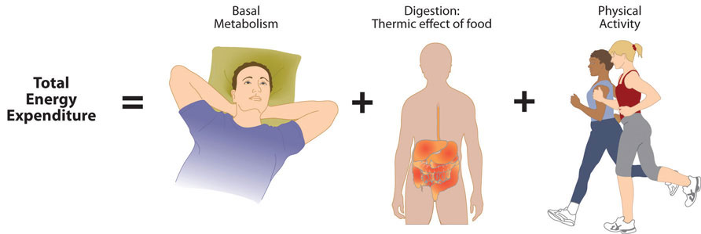
Energy Loss:
Energy balance is often considered as the balance between total energy intake and energy expenditure.
Strictly, this is not correct.

Slide 8
Energy Loss…
The reason is that energy expenditure is not the only way by which the body loses energy. Some energy is lost in the stools and urine.
What is important to realize, however, is that the loss of energy in stools and urine are already taken into account when calculating the energy content of foods and accordingly also when calculating our energy intake.
This is further explained when we discuss the energy value of nutrients.

Slide 9
Regulation of food intake

Slide 10
Food intake- Terminology
Hunger is defined as the uncomfortable sensation caused by a lack of food that makes people look for food.
Appetite is the integrated response to the sight, smell, thought, or taste of food that triggers eating.
Sometimes appetite is driven by hunger, but often it is due to cravings, habits, the availability of food, boredom, or other social and emotional factors.
Hunger is a very dominant sensation that impairs a person’s ability to focus on other tasks.

Slide 11
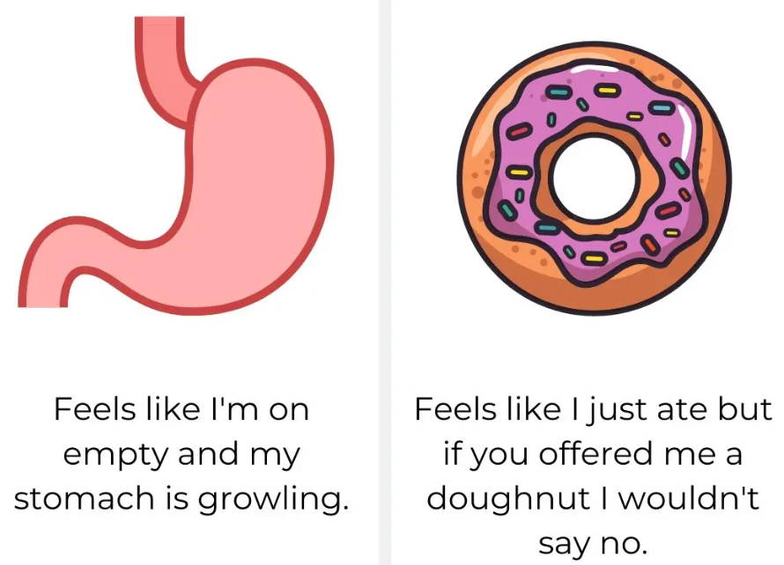
People can have an appetite without being hungry. Otherwise, nobody would order anything from the dessert menu!
You can also have no appetite for food even though you are hungry, which may happen in a stressful situation or during an illness.

Slide 12
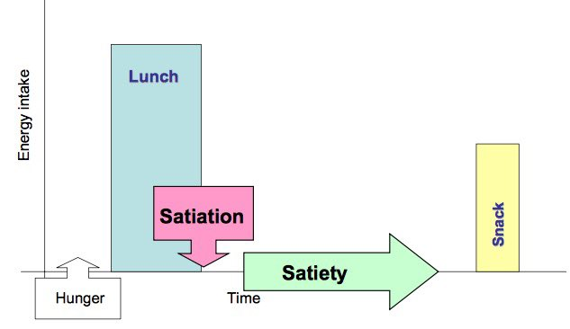
Satiation and satiety
Satiation is often defined as the feeling of satisfaction and fullness that occurs during a meal and that makes you stop eating. Satiation determines how much food is consumed during a meal.
It is your immediate reaction to the ingestion of food: the drive that causes you to stop eating. Satiety is defined as the feeling of satisfaction that occurs after a meal and prevents you from eating until the next meal.
Satiety determines how much time passes between meals. Please note that the distinction between satiation and satiety is not necessarily maintained in normal (colloquial) language and the two terms are often used interchangeably.

Slide 13
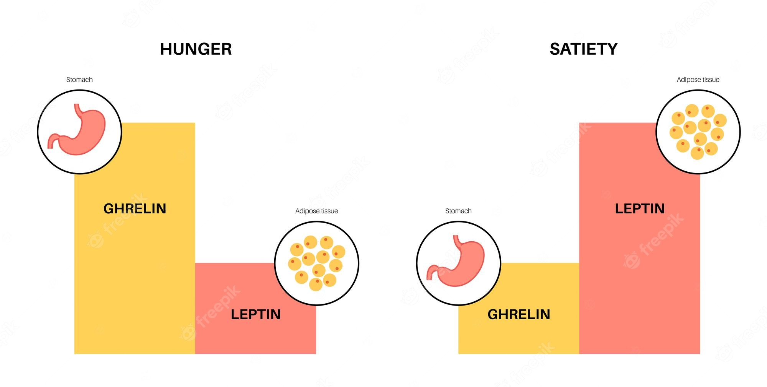

Slide 14
Take a careful look at the two meals below. Which meal is more satiating?
The correct answer is the meal on the right. The meal on the right has much more volume, water, and fiber. It will probably take nearly an hour to finish this meal, whereas one could finish the left meal in 15 minutes or less.
Because meals such as the one shown on the left are not very satiating, they tend to promote overeating. The brain doesn’t receive the sensory input that tells it to stop eating.

Slide 15
Foods that promote satiation are generally:
very bulky
have a high water
High fiber content
carry strong sensory attributes.
Vegetables are an excellent example. It is important to realize that the satiating properties of food are not just determined by its nutrient (and water) content.

Slide 16
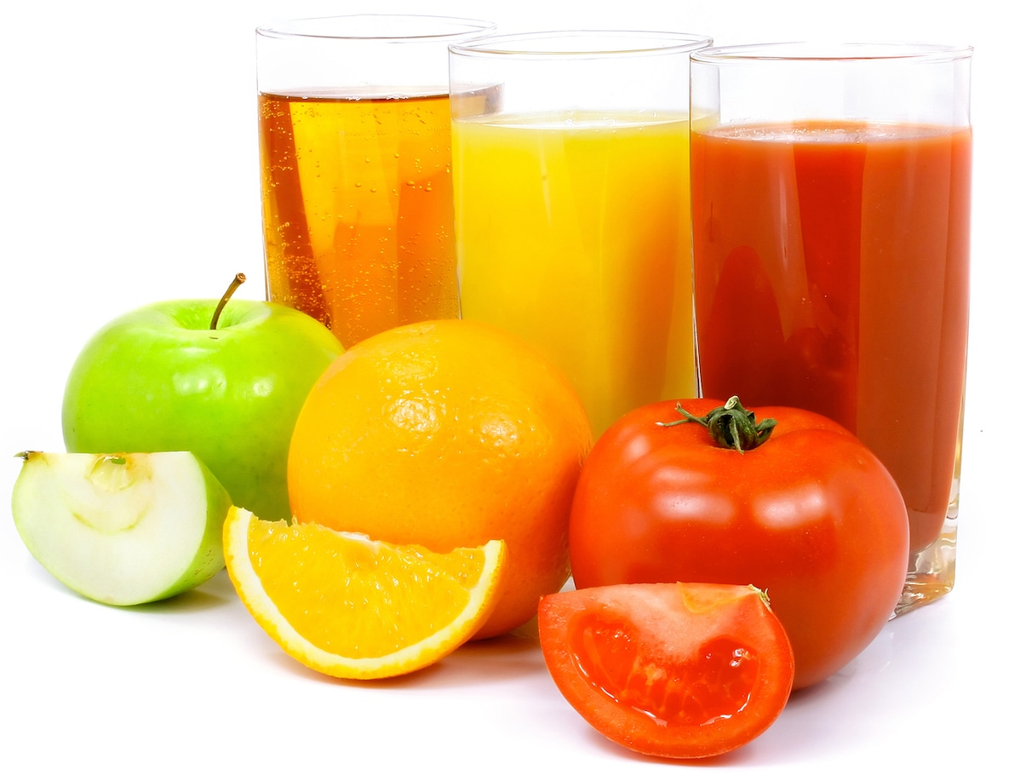
The texture is also very important. For example, eating an apple is more satiating than drinking apple juice, even if that apple juice was prepared in a blender using the entire apple.
Because calories that are ingested quickly are not properly sensed, consuming energy-containing beverages, which are ingested very quickly, does not make people eat less of other foods thereafter.

Slide 17
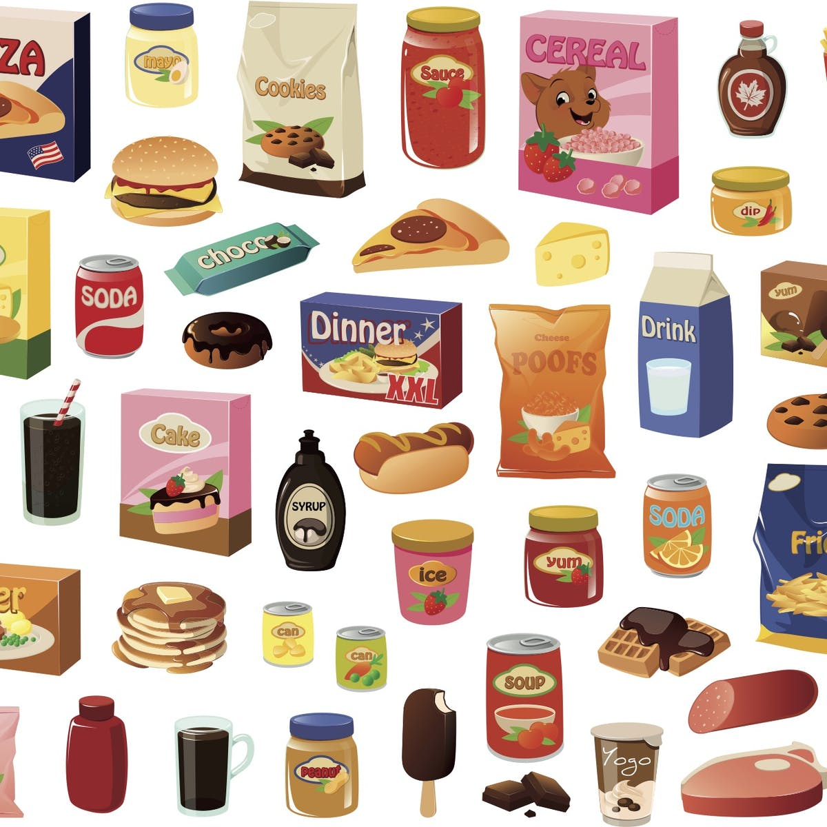
PROCESSED FOODS
There is growing evidence that people have a much higher tendency to overeat if they ingest calories quickly. In line with this notion, processed foods probably lead to overeating because they can be consumed quickly, not necessarily because of the macronutrient content.
Recently, Dr. Kevin Hall from the NIH in the USA performed a study in which he had people consume ultra-processed versus unprocessed diets for 14 days. The ultra-processed diet caused increased energy intake and weight gain despite having similar caloric, sugar, fat, sodium, fiber, and macronutrient content as the unprocessed diet. An important finding was that the rate of energy intake was significantly greater during the ultra-processed diet than the unprocessed diet.

Slide 18
PROCESSED FOODS…
The RATE OF ENERGY INTAKE is expressed as calories per minute and differs considerably between foods.
Studies performed at our department at Wageningen University have found that drinking whole chocolate milk leads to the highest rate of caloric intake, exceeding 400 Kcal per minute! Prolonging the exposure time to foods in the mouth causes people to consume less energy in total and may offer opportunities to food technologists to reduce the obesogenic properties of foods.

Slide 19
Any Questions?

