Slide 1
Faculty of Pharmacy
Tishk Internationl University
Charbohydrate and Health
6th lecture; Nutritional Biochemistry
Mohammed Rasul
Assistant Lecturer |MSc. Biomedical Science
Mohammed.rasul@tiu.edu.iq
Notes:
Example of reducing and non reducing sugar
https://www.biologyonline.com/dictionary/reducing-sugar
The loss of electrons during a reaction of a molecule is called oxidation while the gain of single or multiple electrons is called reduction.
The oxidation and reduction reactions (also called redox reactions) are the chemical reactions in which the oxidation number of the chemical species that are taking part in the reaction changes.
The redox processes are the wide range of reactions that include the majority of the chemical and biological processes taking part around us.
Rusting and dissolution of the metals, browning of the fruits, fire reactions, respiration and the process of photosynthesis are all oxidation-reduction processes.
Oxygen atom Transfer:
C+ 2H₂O → CO₂ + 2H₂
Hydrogen atom Transfer:
N₂H₄+ O₂ → N₂+ 2H₂O
Electron Transfer:
Zn + Cu⁺² → Zn⁺² + Cu

Slide 2
Learning Outcomes:
Monosacharide
Disacharides
Starch
Fiber
Sweetenrs

Slide 3
Chemistry of Charbohydrate (sugar)
All of them availbale in our diet, except Galactose, which is available only as Lactose.
Disaccharides undergo hydrolysis to be breaked down to the mononsacardide and absorbed by the body

Slide 4
Types of Sugar in our Diet:

Slide 5
Inverted Sugar
Invert Sugar (Inverted Sugar) is an equal mixture of glucose and fructose.
What is the difference between sugar and invert sugar?
Invert sugar is an edible mixture of glucose and fructose, which are both simple sugars.
Invert sugar indeed is “sweeter than sugar” – in fact, it's 125% sweeter than ordinary white table sugar. That's one of the reasons bakers love it: it packs a stronger punch with less product.

Slide 6
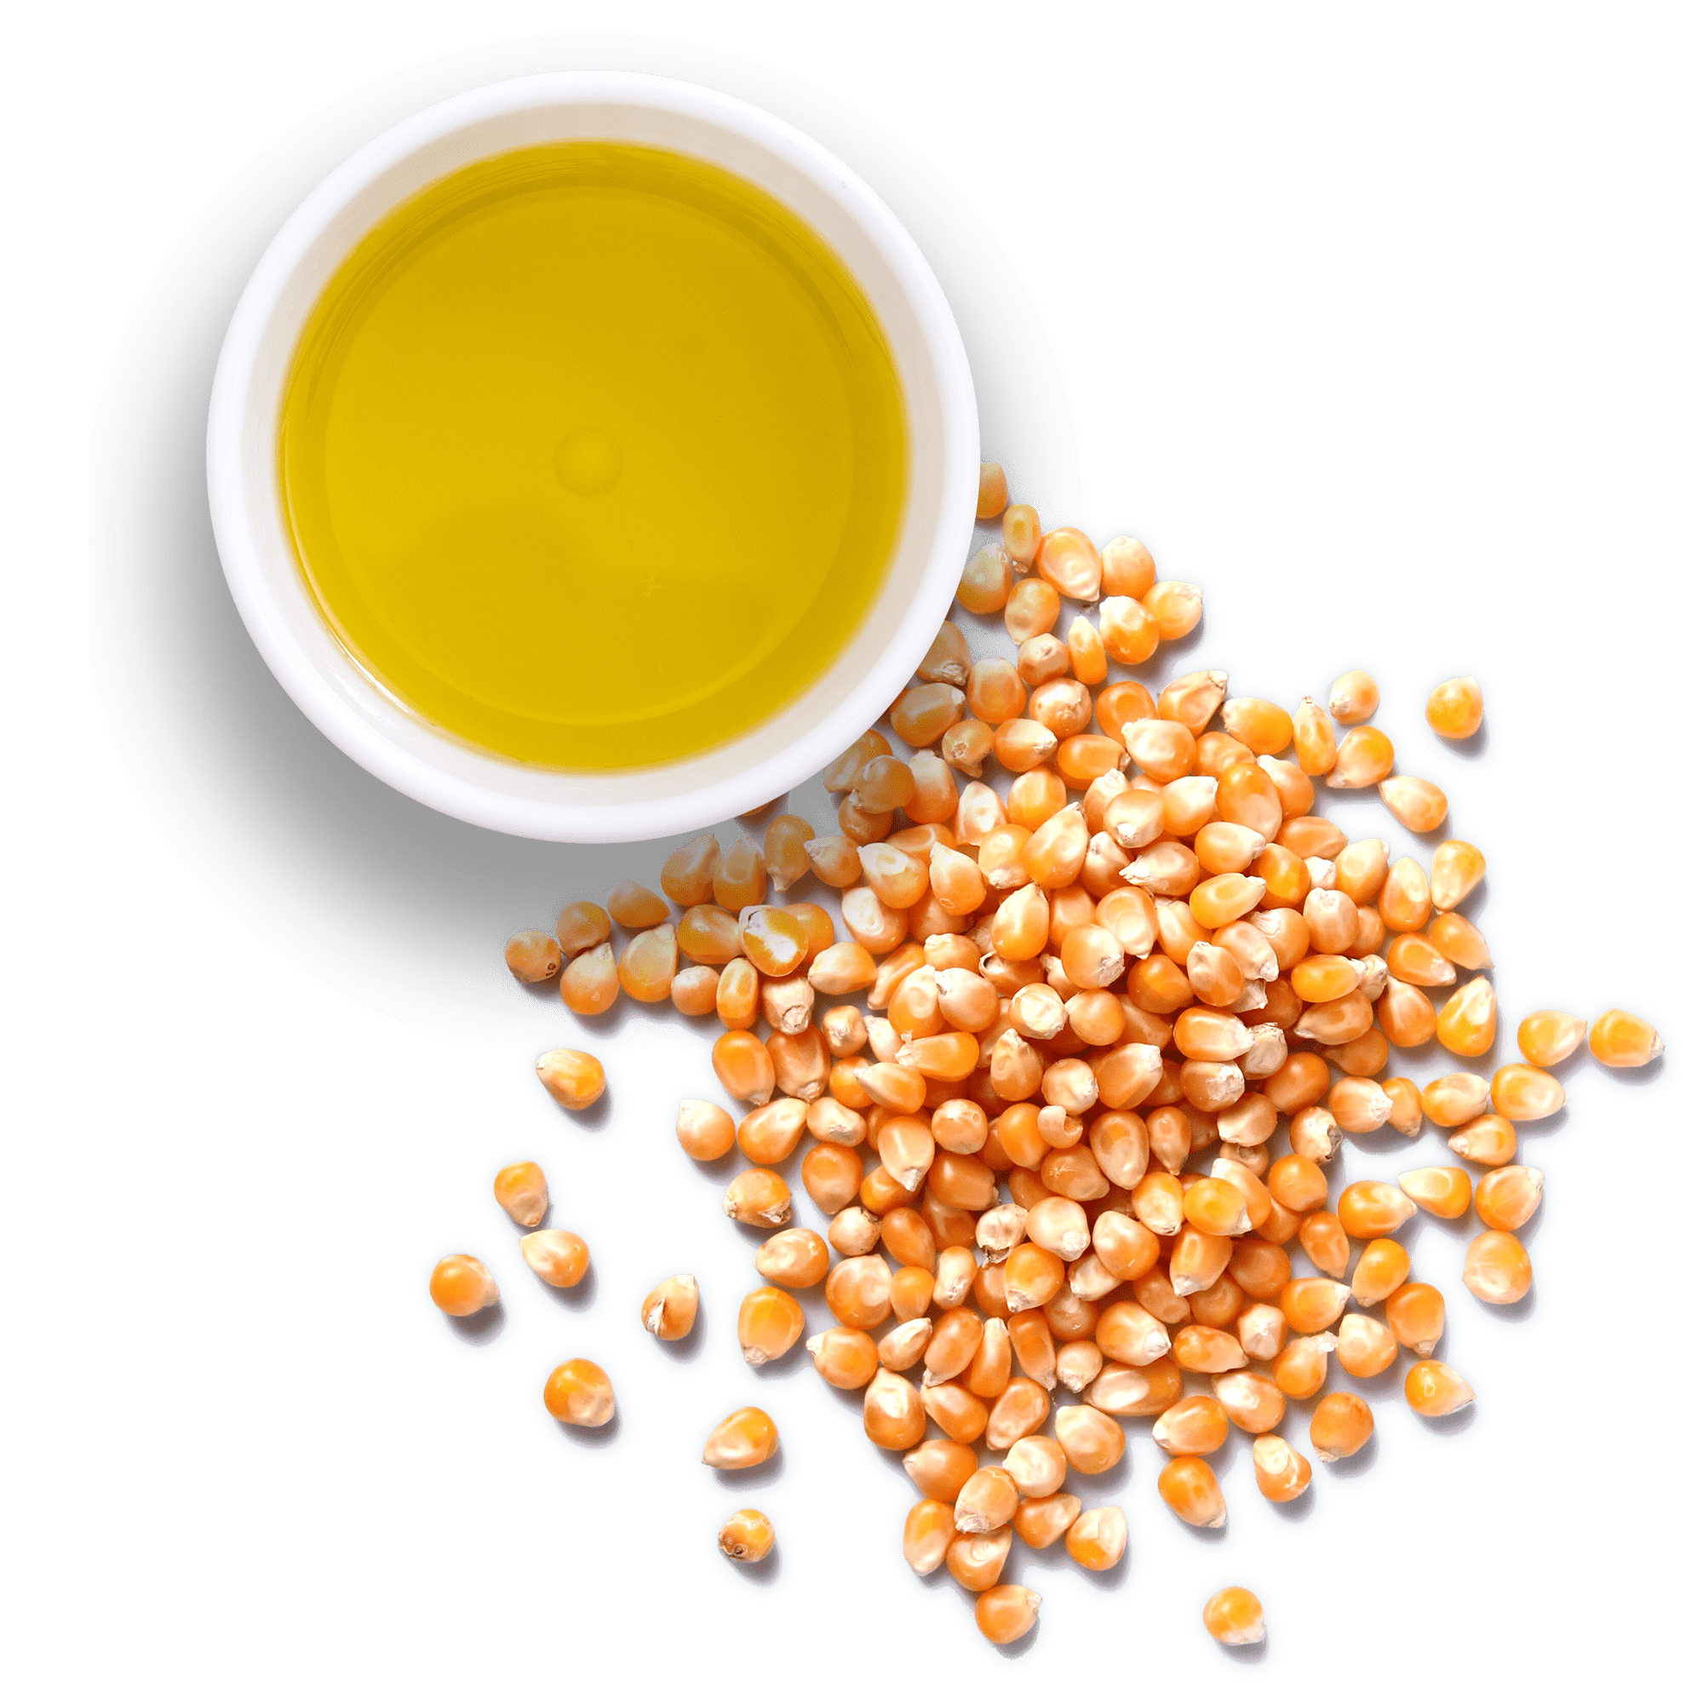
high-fructose corn syrup
High-fructose corn syrup (HFCS) is an artificial sugar made from corn syrup.
Many experts believe that added sugar and HFCS are key factors in today's obesity epidemic.
HFCS and added sugar are also linked to many other serious health issues, including diabetes and heart disease.
The most common forms of HFCS contain either 42 percent or 55 percent fructose, as described in the Code of Federal Regulations (21 CFR 184.1866), and these are referred to in the industry as HFCS 42 and HFCS 55.

Slide 7
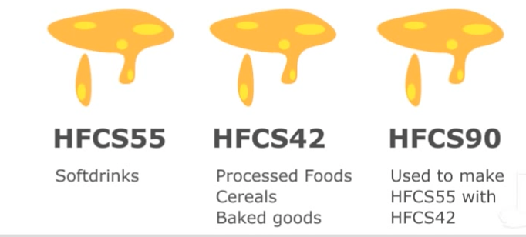
Types of HFCS

Slide 8
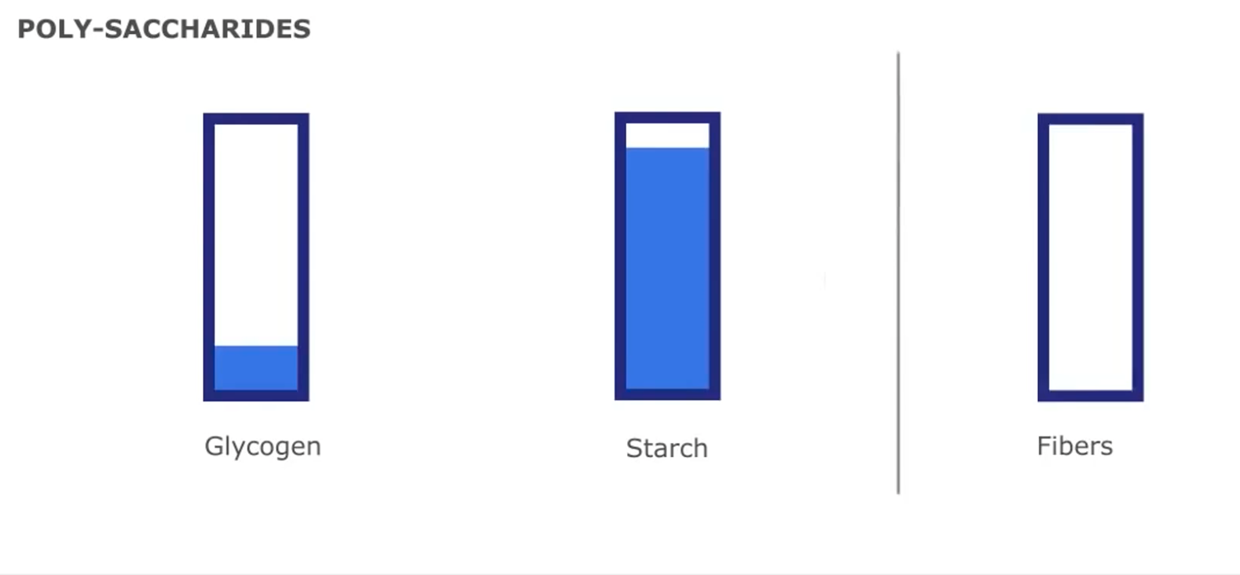
Complex CHO

Slide 9
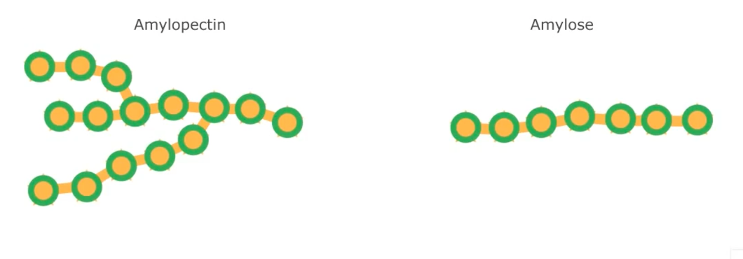
Starch
Starch consists of glucose molecules.
It can occur in two forms: amylose and amylopectin.
Amylose is a linear or straight-line polymer that scientists describe as linear or solid.
Amylopectin forms a branched chain and is crystalline.
After Digestion, starch is entirely glucose.

Slide 10
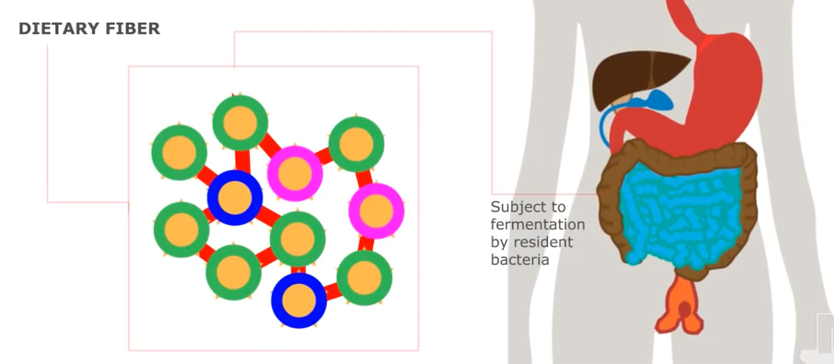
Dietary Fiber
A dietary fiber describes a chemically diverse group of non-digestible carbohydrates.
Dietary fibers are dietary carbohydrates that are not subject to digestion by endogenous enzymes, but may be digested by bacteria in the colon.

Slide 11
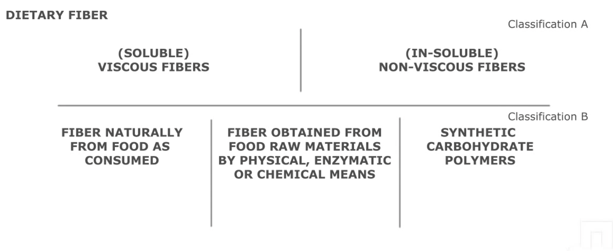
Dietary Fiber Classification:

Slide 12
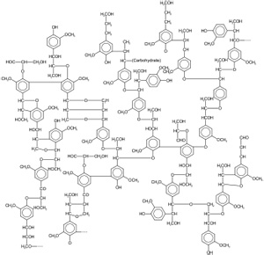
Chemistry of dietary fiber
Fiber is classified into soluble (or viscous) fiber and insoluble (or non-viscous) fiber based on its physicochemical properties.
Soluble fiber Soluble fiber is a chemically diverse group that includes the following:
Pectin
Hemicellulose
Fructans

Slide 13
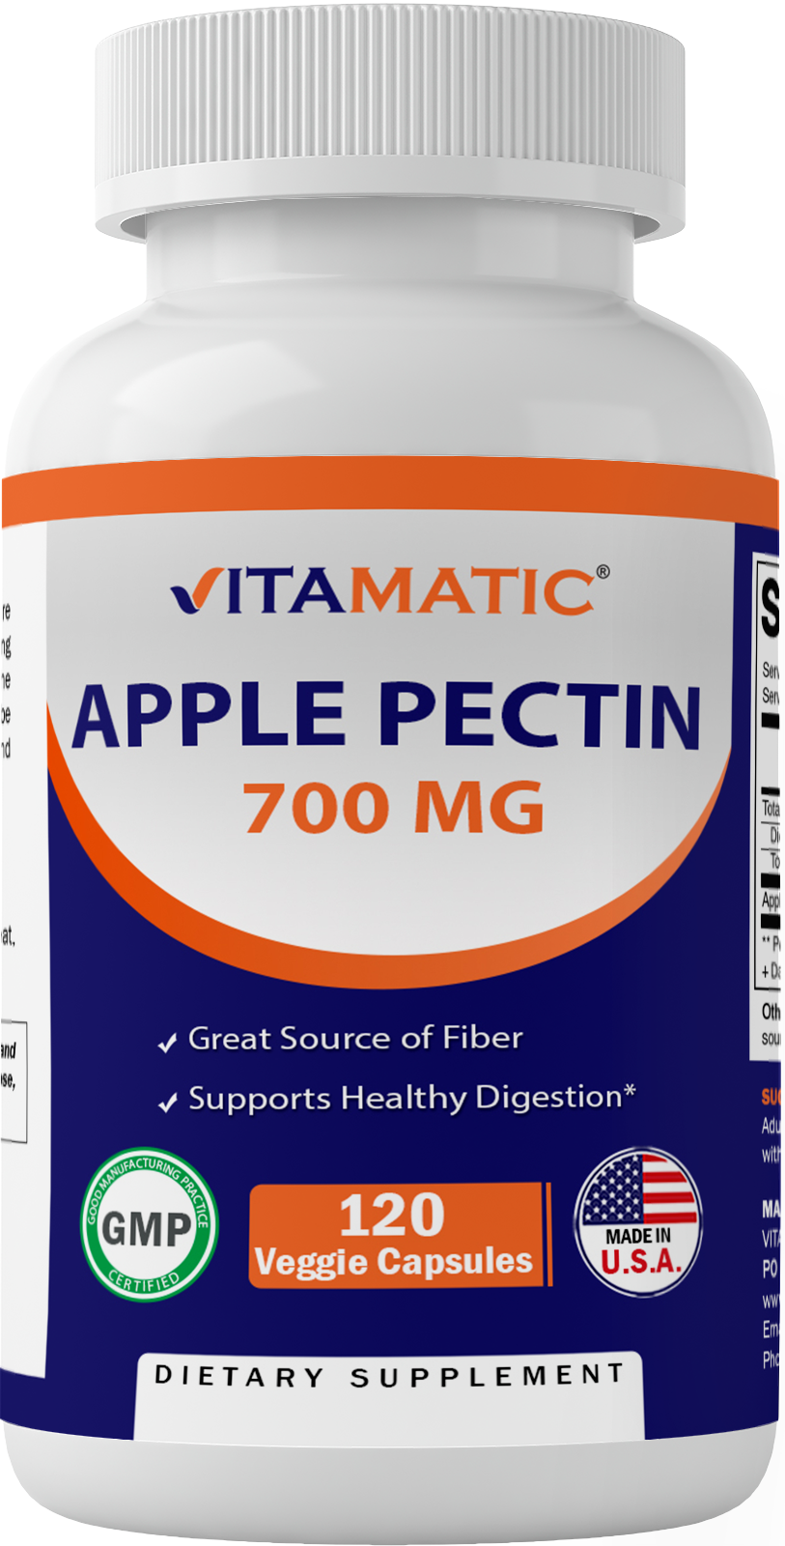
Pectin

Slide 14
Pectin
Pectin is part of the cell wall of plants.
Its key feature is the abundant presence of galacturonic acid.
Pectin is often added during food manufacturing to impart gelation, texture, and protein stability.
It is used in food products such as jams and jellies because of its ability to form stable gels.

Slide 15
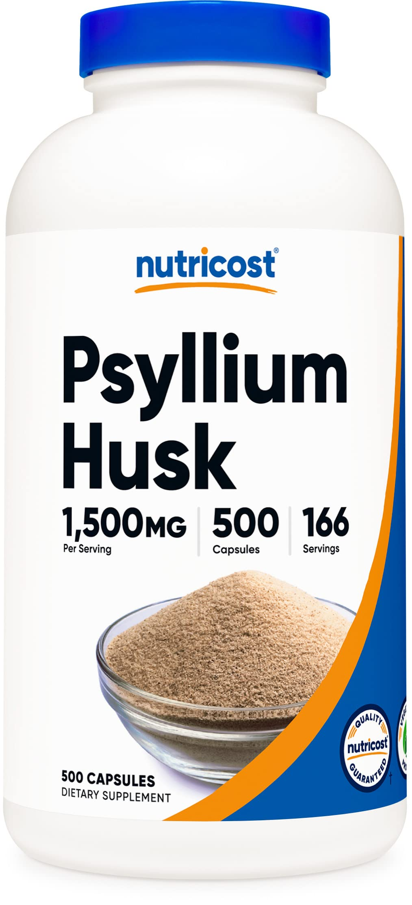
Hemicellulose
Hemicellulose describes a diverse set of polysaccharides composed of different monosaccharides.
Hemicelluloses are part of the cell walls of plants.
An example of a fiber that is part of the hemicelluloses is psyllium/si’lee’um/, which is one of the most widely used fiber supplements in the world.

Slide 16
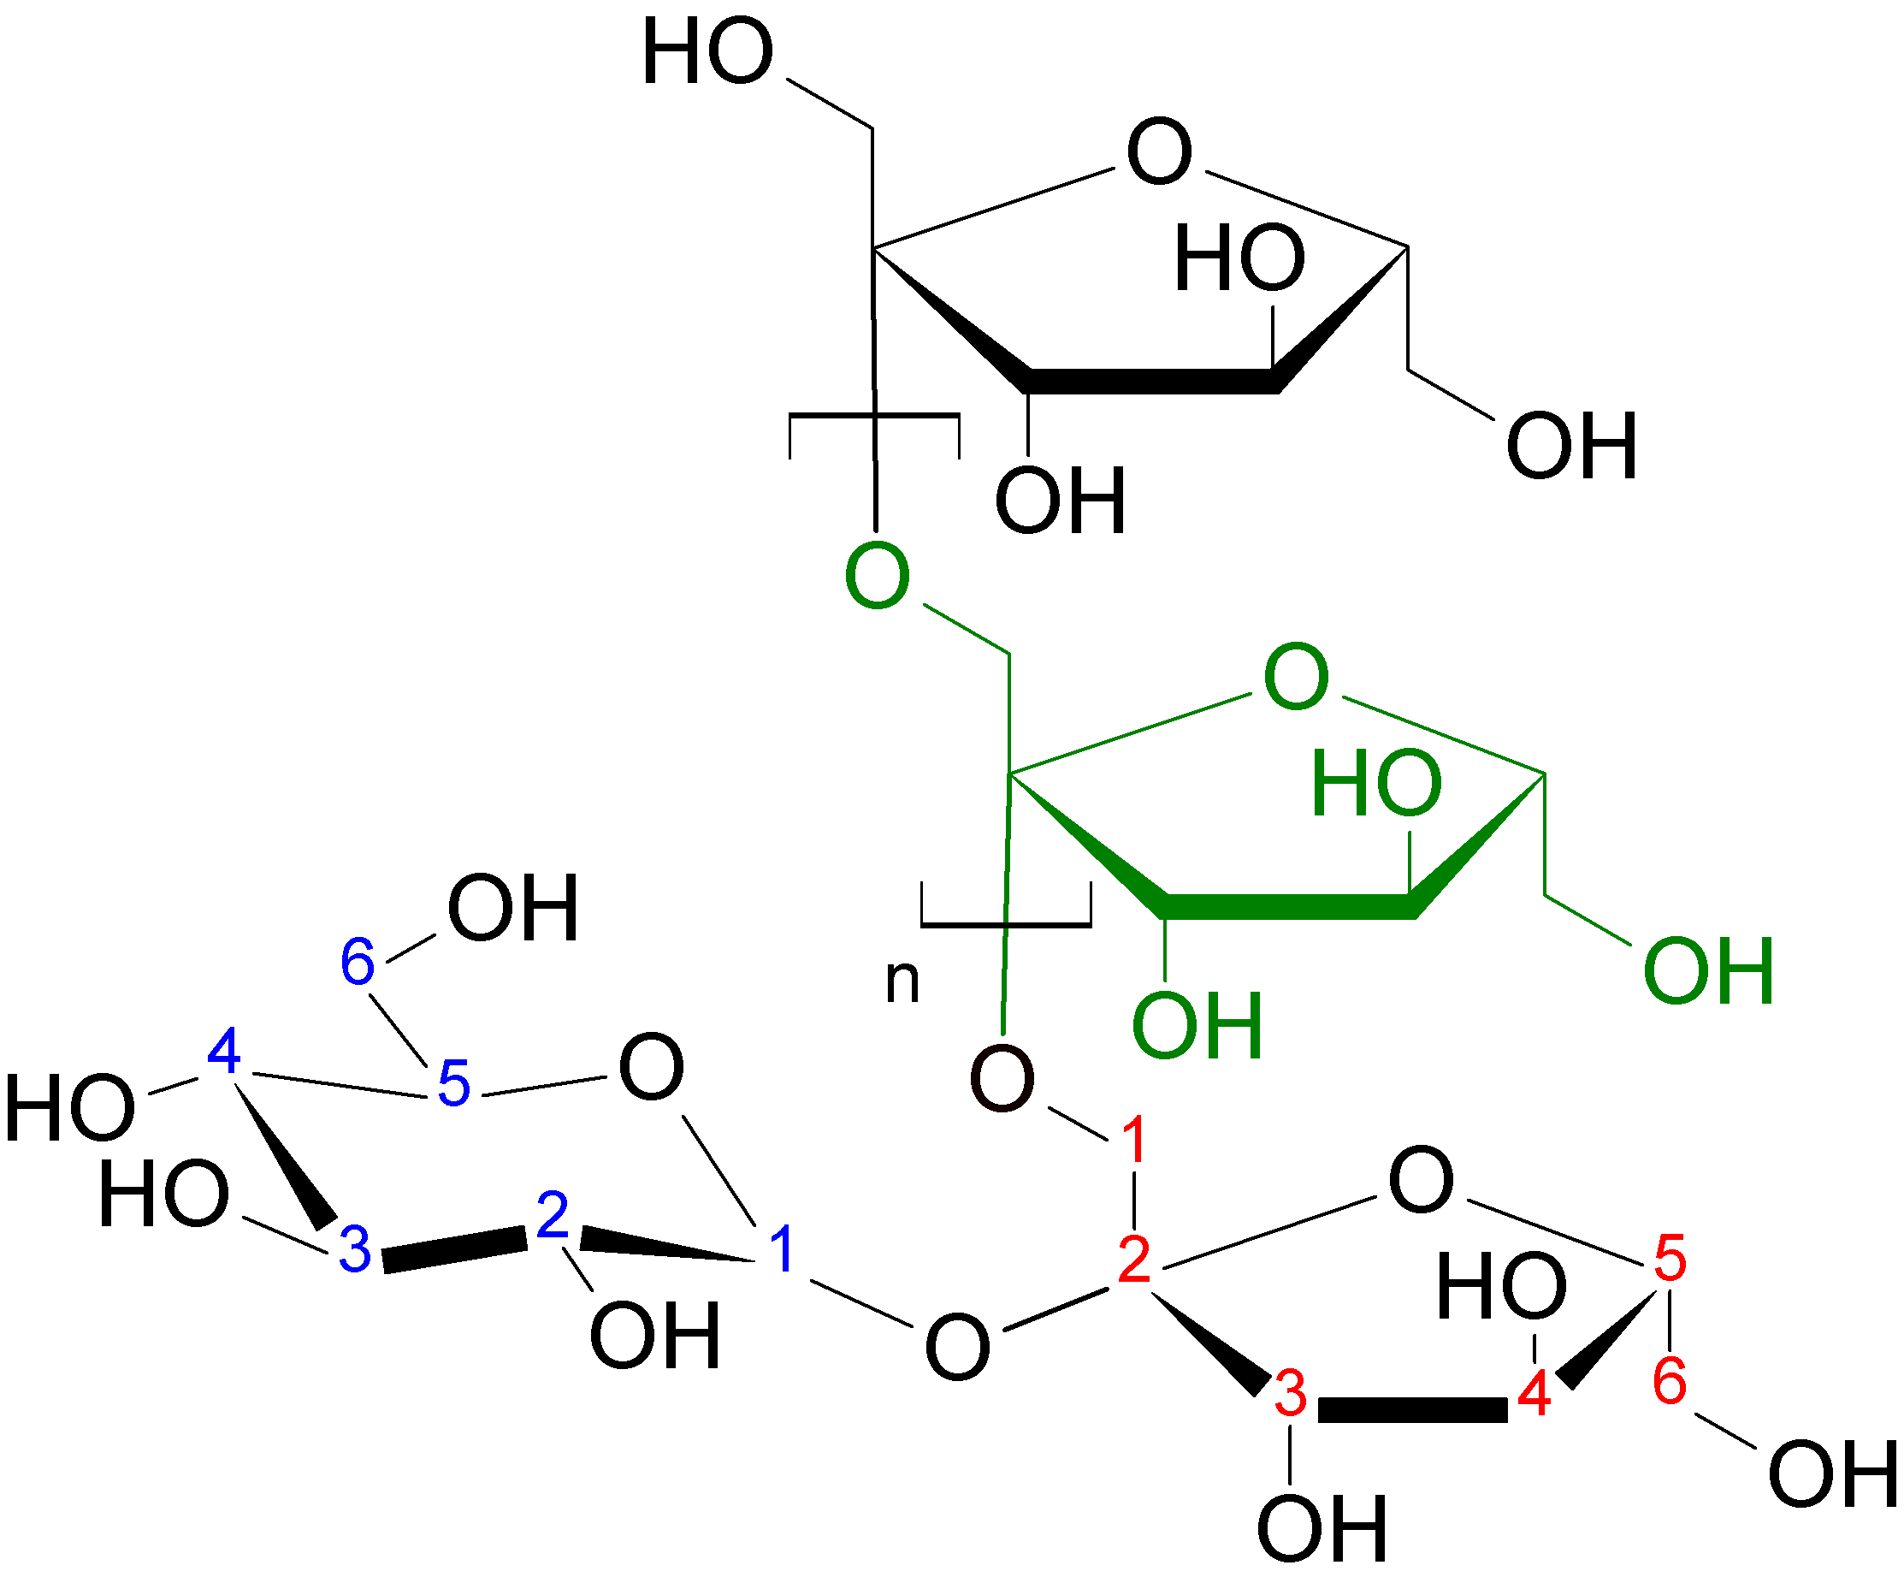
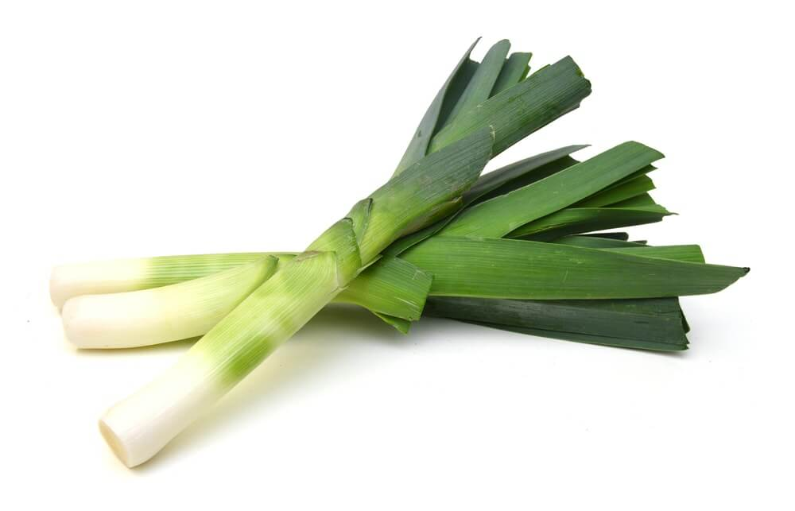
Fructans
Fructans are polymers of fructose.
The best-known representative of the fructans are the highly fermentable inulins.
Inulin is naturally present in various foods, such as leek, onions, and banana.
In addition, inulin is added to foods as a functional pre-biotic food ingredient to confer a health benefit.

Slide 17
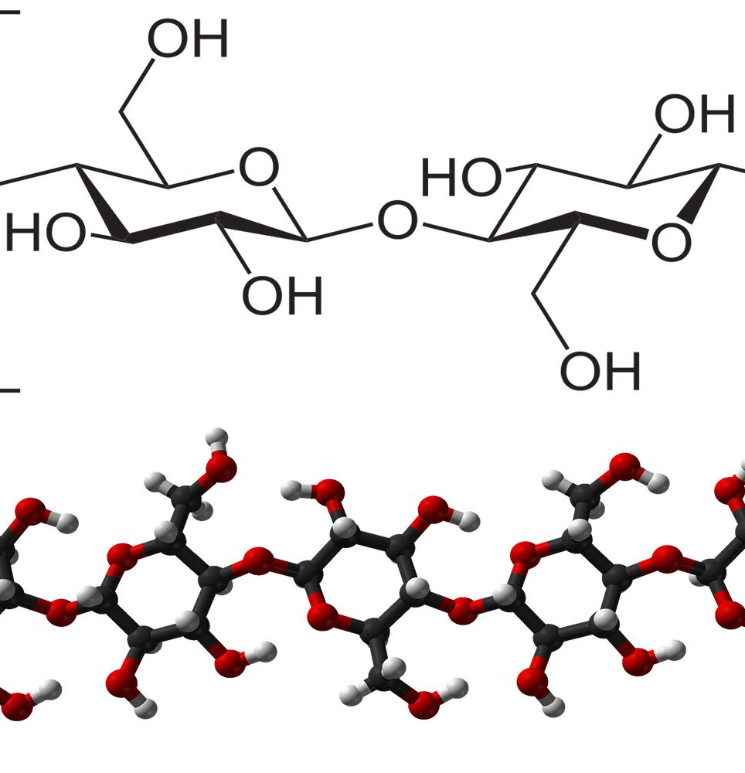
Insoluble fiber
Insoluble fiber includes the following:
Cellulose is a linear chain of glucose, similar to amylose, except that the glucose units are linked in such a way that our digestive enzymes cannot break them.
As a result, cellulose leaves the human body completely undigested.
Ruminants such as cows have special bacteria in their stomach that produce cellulase, allowing them to break down cellulose and thus utilize cellulose for fuel.

Slide 18
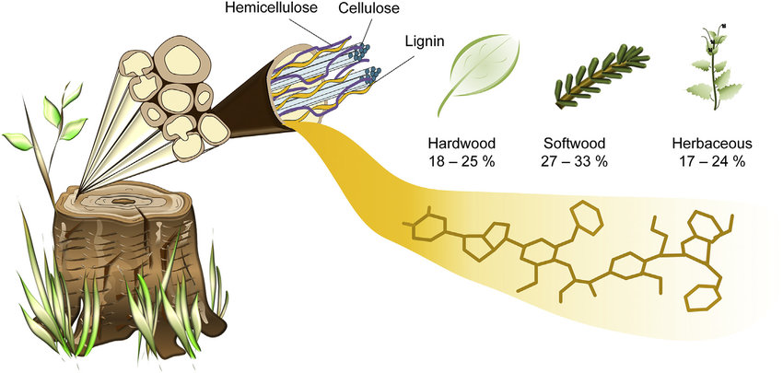

Slide 19
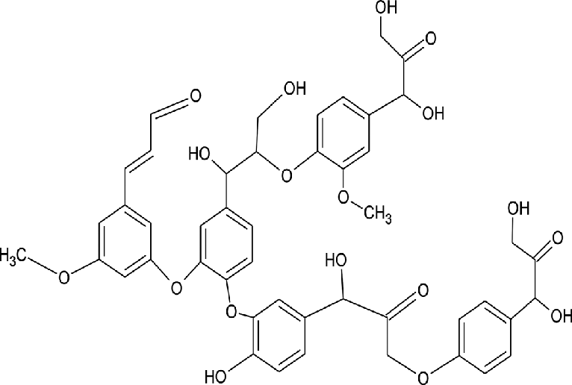
Lignins
Lignins are a special type of fiber because unlike other dietary fibers, lignins do not belong to carbohydrates.
They are complex polymers of aromatic alcohols.
It is the second most abundant natural polymer in the world, next to cellulose.
Lignin is abundant in cell walls of some specific cells.
lignins has a strong antioxidant capacity.

Slide 20
Hemi-cellulose
Hemicellulose describes a diverse set of polysaccharides composed of different monosaccharides.
Certain fibers within this class are soluble in water, whereas others are insoluble.

Slide 21
Health Benefit of Fiber
Fiber can help lower cholesterol level
better regulate blood sugar levels
prevent intestinal cancer
Promotes regular bowel movements
Keeps you feeling fuller for longer
Helps lower high blood pressure

Slide 22
How much fiber recommended per day?
The National Academy of Medicine recommends getting following amount of fiber per day:
Women 50 years of age and younger: 25 grams
Women 51 years of age and older: 21 grams
Men 50 years of age and younger: 38 grams
Men 51 years of age and older: 30 grams

Slide 23
Any Questions?

