Slide 1
Faculty of Pharmacy
Tishk Internationl University
Charbohydrate in Our Diet
7th lecture; Nutritional Biochemistry
Mohammed Rasul
Assistant Lecturer |MSc. Biomedical Science
Mohammed.rasul@tiu.edu.iq
Notes:
Example of reducing and non reducing sugar
https://www.biologyonline.com/dictionary/reducing-sugar
The loss of electrons during a reaction of a molecule is called oxidation while the gain of single or multiple electrons is called reduction.
The oxidation and reduction reactions (also called redox reactions) are the chemical reactions in which the oxidation number of the chemical species that are taking part in the reaction changes.
The redox processes are the wide range of reactions that include the majority of the chemical and biological processes taking part around us.
Rusting and dissolution of the metals, browning of the fruits, fire reactions, respiration and the process of photosynthesis are all oxidation-reduction processes.
Oxygen atom Transfer:
C+ 2H₂O → CO₂ + 2H₂
Hydrogen atom Transfer:
N₂H₄+ O₂ → N₂+ 2H₂O
Electron Transfer:
Zn + Cu⁺² → Zn⁺² + Cu

Slide 2
Carbohydrates in our diet
The predominant sources of carbohydrates in most people’s diets are starchy foods such as wheat, corn, rice, cassava, and potatoes.
In addition, people generally ingest a lot of carbohydrates in the form of sugars, encompassing the mono- and disaccharides.
These sugars are either present naturally (as in fruits, honey, and milk) or are added during food processing.
Crystalline table sugar is 100% carbohydrate in the form of sucrose.
Meat contains only very small amounts of carbohydrates, as do eggs, fish, and most cheeses.
Nuts contain low amounts of carbohydrates, depending on the type of nuts.

Slide 4
There is a Relation between Hyperglycemia and Hyperlipidemia! How?
Sugar
Glycolysis
Glucose F1,6 P DHAP + G6P pyruvate
Glycerol synthesis
Acetyl CoA
F.A synthesis
Triglyceride
Glycerol ₊ 3 Fatty Acid

Slide 5
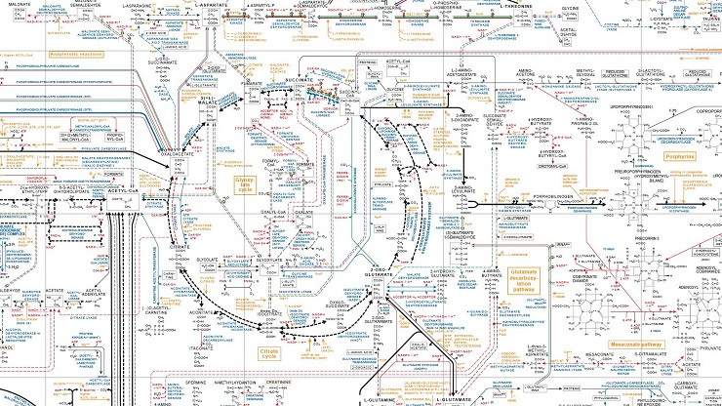

Slide 6
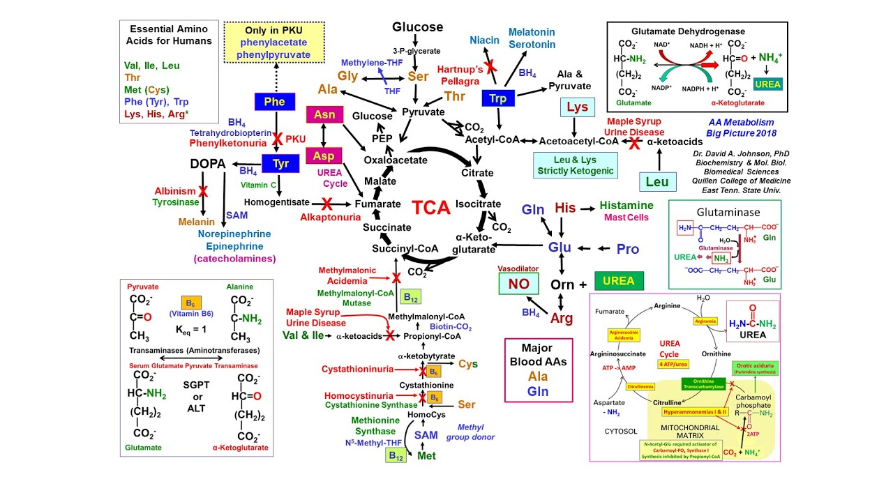

Slide 7
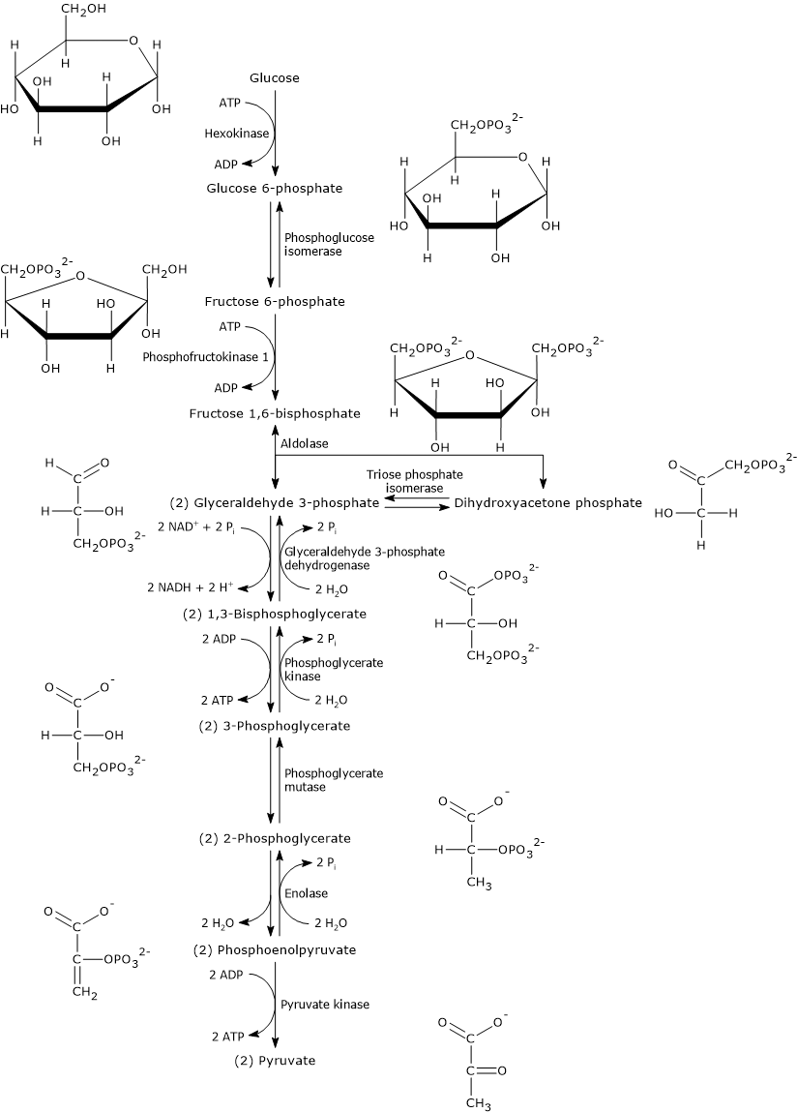

Slide 9
Sources of dietary fiber
Plant foods in their natural form usually contain substantial amounts of fiber.
Most high fiber foods contain a mixture of dietary fibers, although the main type of fiber present can differ considerably between various foods.
Processing of food often leads to loss of fiber.
White rice contains much less fiber than brown rice.
Orange juice contains less fiber than an actual orange.
White bread contains less fiber than whole wheat bread.

Slide 10
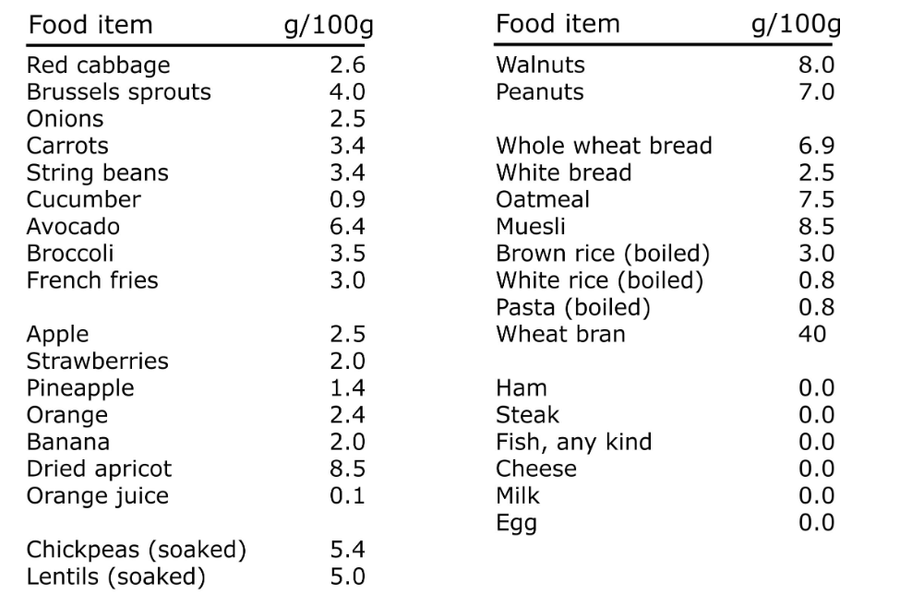

Slide 11
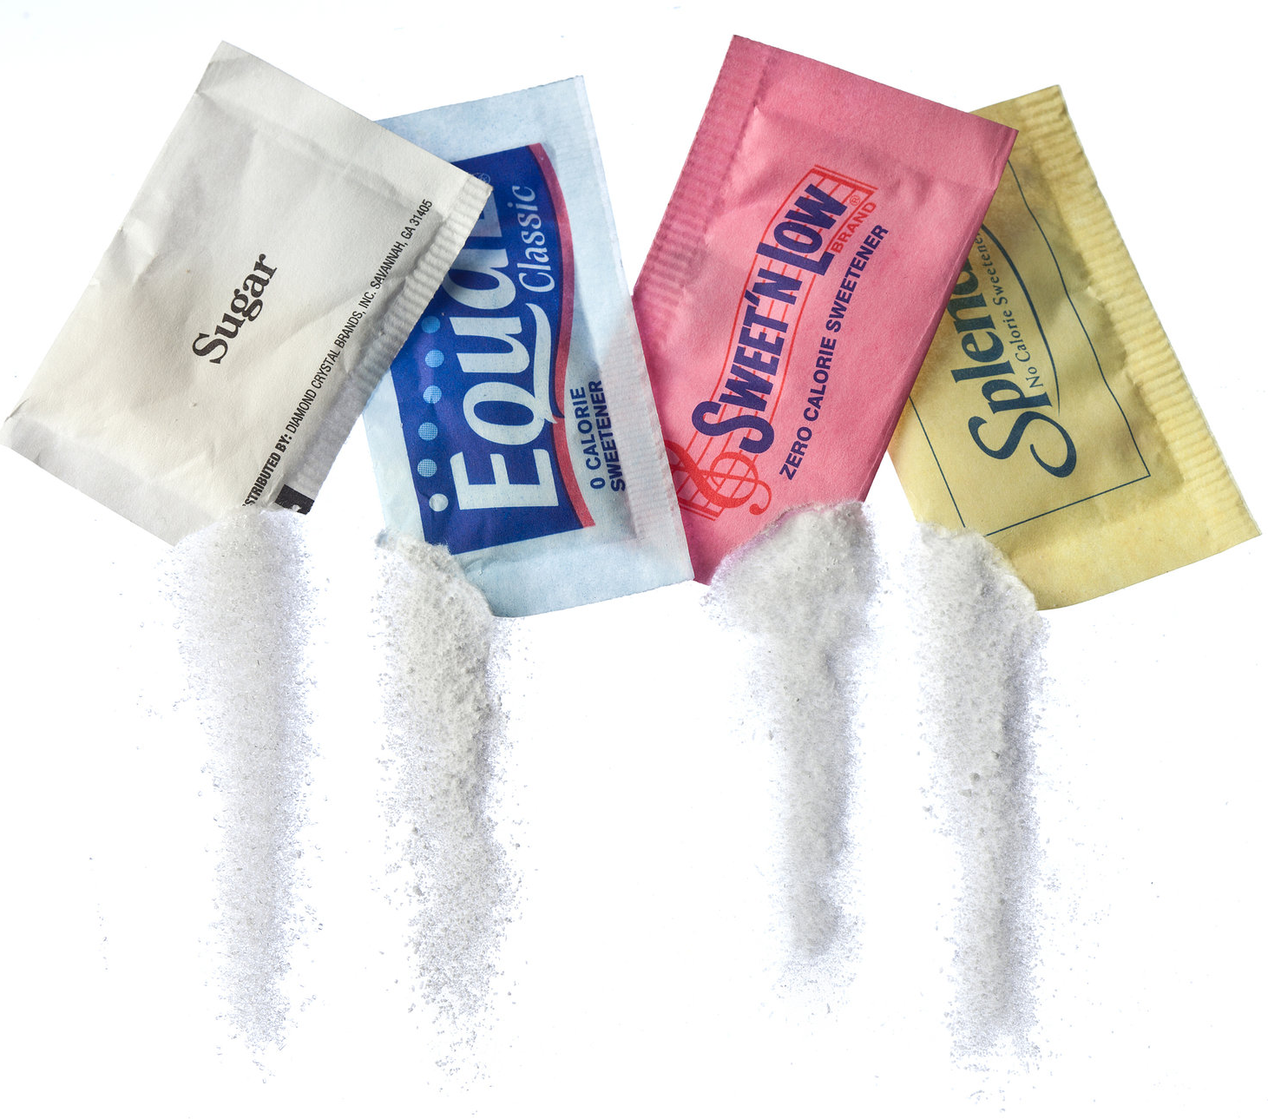
sweeteners
Lower or no calorie sweeteners are substances used instead of sugar to sweeten foods and drinks.
They're found in products such as drinks, desserts and ready meals, cakes, chewing gum and toothpaste.
Sweeteners approved for use in the UK include:
acesulfame K (E950)
aspartame (E951)
erythritol (E968)
saccharin (E954)
sorbitol (E420)
steviol glycosides (E960)
sucralose (E955)
xylitol (E967)

Slide 12
How sweetener provide a sweet taste without added calories?
Artificial sweetener molecules are similar enough to sugar molecules to fit on the sweetness receptor.
However, they are generally too different from sugar for your body to break them down into calories.

Slide 13
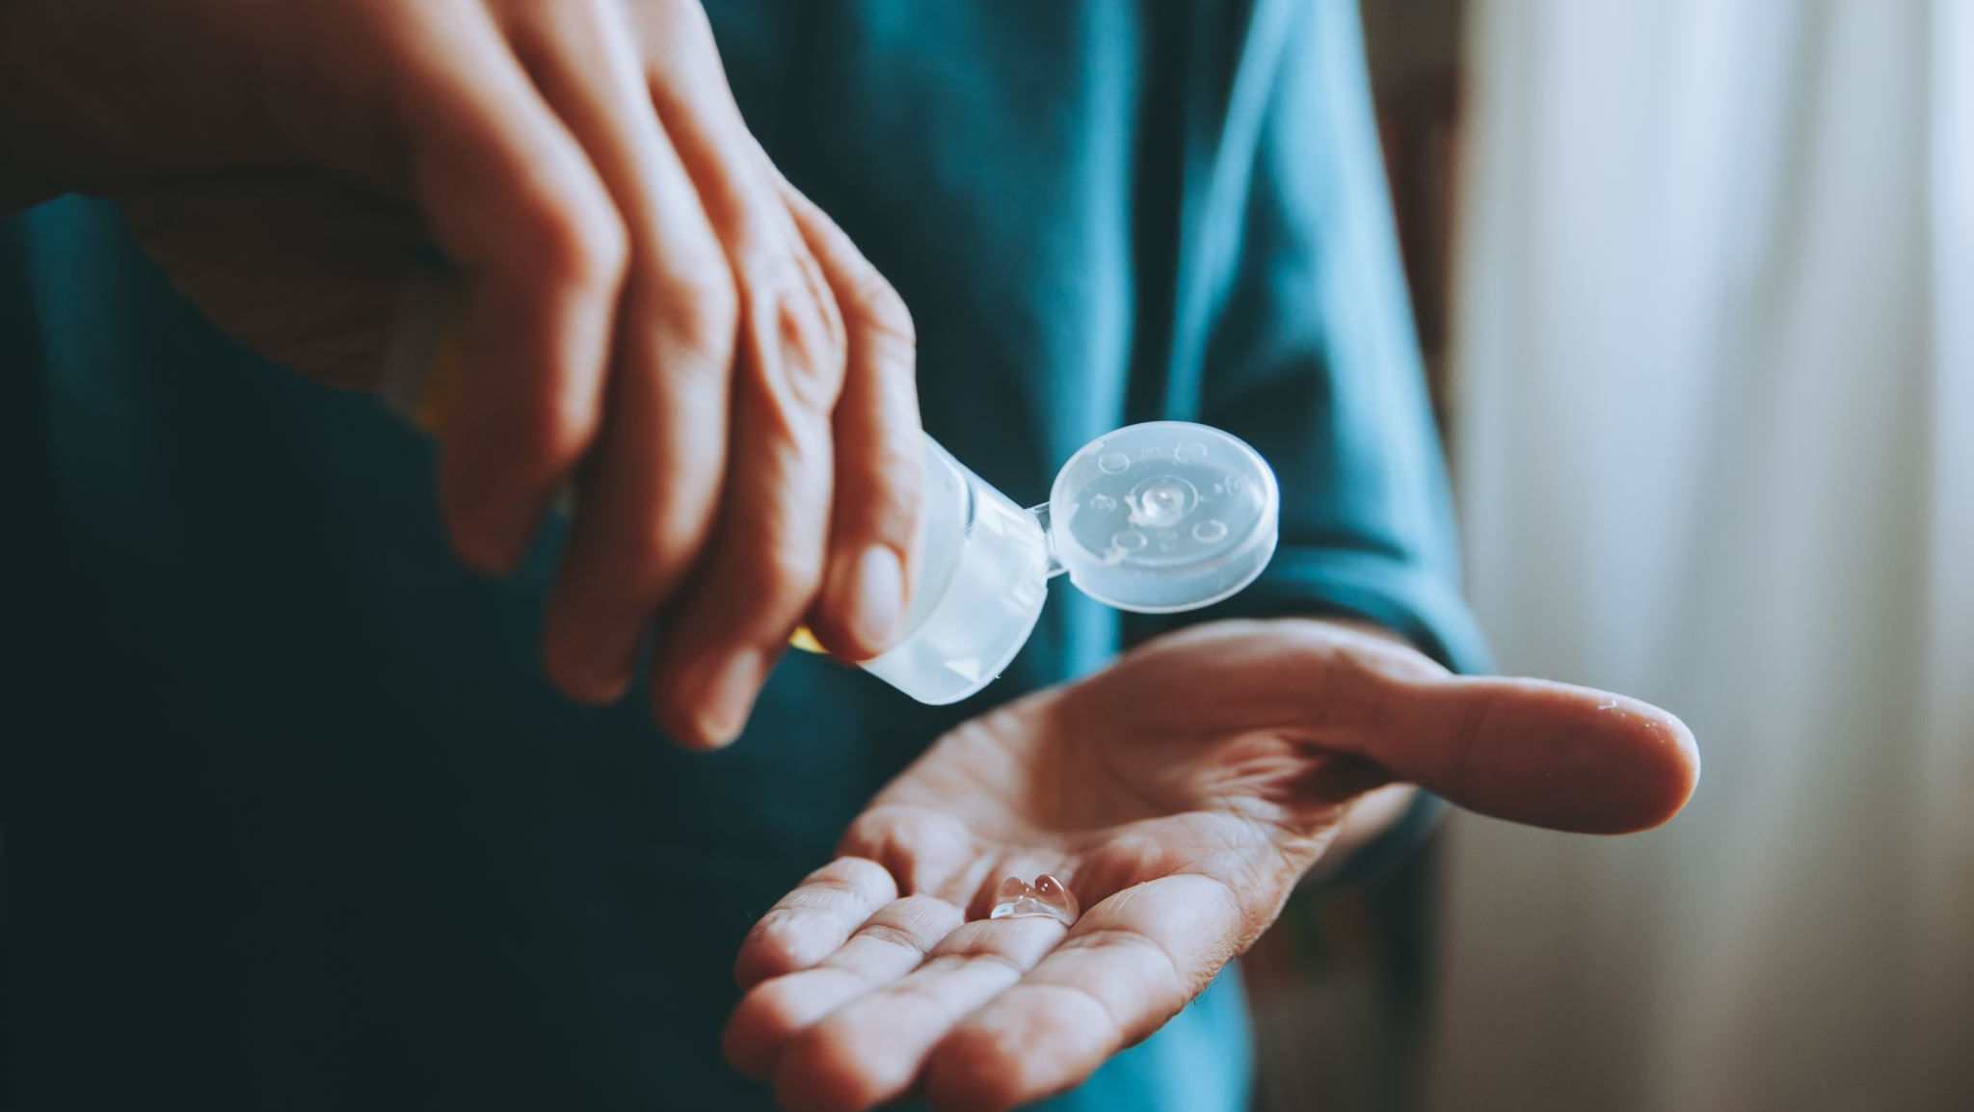
Impact of Artificial Sweetener on the Human Health?

Slide 14
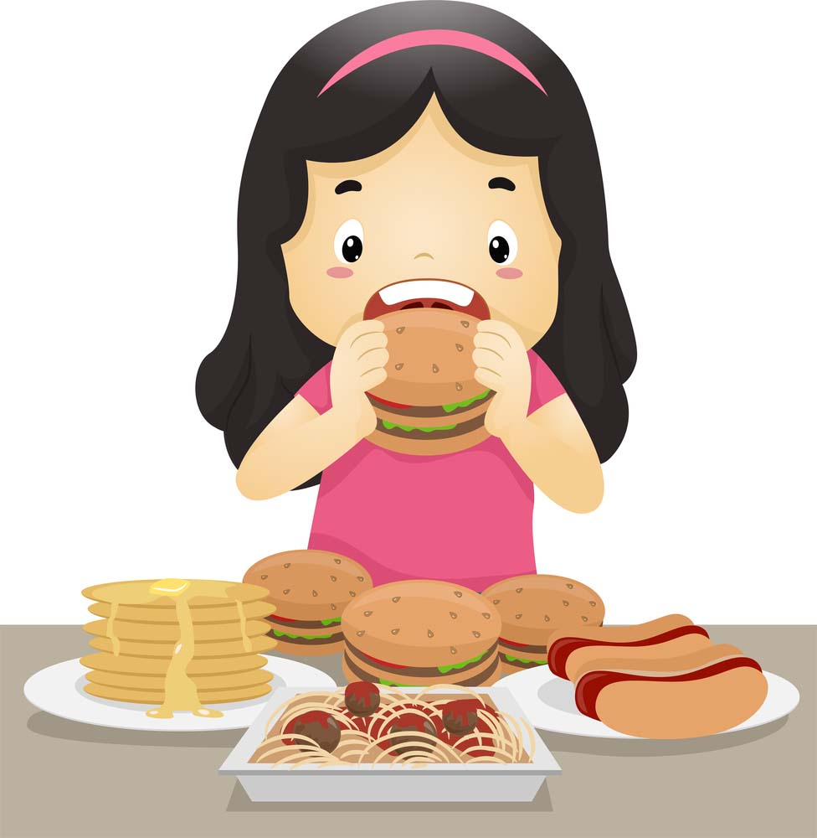
Effects on appetite
Some people believe that artificial sweeteners might increase appetite and promote weight gain .
The idea is that artificial sweeteners may be unable to activate the food reward pathway needed to make you feel satisfied after you eat.
Given that they taste sweet but lack the calories found in other sweet-tasting foods, they’re thought to confuse the brain into still feeling hungry .

Slide 15
Effects on weight
Consuming artificial sweeteners does not appear to cause weight gain — at least not in the short term. In fact, replacing sugar with artificial sweeteners may be helpful in reducing body weight — though only slightly at best.
Meta-analyses showed no effect of aspartame consumption on body weight compared to sugar or water in individuals with either obesity or T2DM

Slide 16
gut health
In one study, the artificial sweetener disrupted gut bacteria balance in four out of seven healthy participants.
The four “responders” also showed poorer blood sugar control after as few as 5 days after consuming the artificial sweetener.
What’s more, when gut bacteria from these people were transferred into mice, the animals also developed poor blood sugar control.
Your gut bacteria play an important role in your health, and poor gut health is linked to numerous problems such as:
weight gain
poor blood sugar control
metabolic syndrome
a weakened immune system
disrupted sleep

Slide 17
Tooth Decay
Lower calorie and no calorie sweeteners will not necessarily make a food or drink healthy but can be helpful in reducing your sugar intake.
High sugar intakes increase the risk of tooth decay. Therefore, the use of no calorie sweeteners in food and drink, as long as the product does not contain any sugars, can help reduce the risk of tooth decay.
However, carbonated drinks are associated with dental erosion due to their acid content, regardless of whether they contain sugar, lower calorie sweeteners or no calorie sweeteners.

Slide 18
Cancer
Cancer Research UK staited that there is not investigated links between using sweeteners and developing the risk of cancer.

Slide 19
aspartame
The sweetener aspartame is not suitable for people with phenylketonuria (PKU), a rare inherited condition.
This is because aspartame contains phenylalanine, which people with PKU cannot metabolize it.
If a product contains aspartame, the ingredients list will include aspartame or its E number E951. There will also be a separate warning on the product label that it contains a source of phenylalanine.
People with PKU should check food labels for this warning.

Slide 20
Any Questions?

