Slide 1
Faculty of Pharmacy
Tishk Internationl University
Dietary Lipid
8th lecture; Nutritional Biochemistry
Mohammed Rasul
Assistant Lecturer |MSc. Biomedical Science
Mohammed.rasul@tiu.edu.iq
Notes:
Example of reducing and non reducing sugar
https://www.biologyonline.com/dictionary/reducing-sugar
The loss of electrons during a reaction of a molecule is called oxidation while the gain of single or multiple electrons is called reduction.
The oxidation and reduction reactions (also called redox reactions) are the chemical reactions in which the oxidation number of the chemical species that are taking part in the reaction changes.
The redox processes are the wide range of reactions that include the majority of the chemical and biological processes taking part around us.
Rusting and dissolution of the metals, browning of the fruits, fire reactions, respiration and the process of photosynthesis are all oxidation-reduction processes.
Oxygen atom Transfer:
C+ 2H₂O → CO₂ + 2H₂
Hydrogen atom Transfer:
N₂H₄+ O₂ → N₂+ 2H₂O
Electron Transfer:
Zn + Cu⁺² → Zn⁺² + Cu

Slide 2
Learning Outcomes:
Chemistry of Dietary Fat
Lipid content and composition of food
Lipid digestion and absorption
Types of Lipase enzyme
Fat Absorption

Slide 3
AMDR: accepatable Macronutrient Distrinution Ranges

Slide 4
Dietery Lipids
95%

Slide 5
Triglycrides
Triglycerides consist of three fatty acids linked via a glycerol molecule.
The three fatty acids in the triglyceride molecule are usually not the same fatty acids.
Triglycerides are fats (if solid at room temperature) and oils (if liquid at room temperature).
Vegetable oils such as sunflower oil or olive oil entirely consist of triglycerides (100%).

Slide 6
Free Fatty Acids:
Fatty acid is a chain of hydrogenated carbon atoms connected to a carboxyl (COOH) group.
The fatty acids that are part of the triglyceride molecule differ in 3 major properties:
1) the chain length, ranging from 3 to 24 carbons or more. Most of the fatty acids in our diet have 16 or 18 carbon atoms.
2) The degree of unsaturation. Unsaturated fatty acids have at least one double bond. Mono-unsaturated fatty acids have one double bond, poly-unsaturated fatty acids have at least two double bonds.
3) The point of saturation, which describes where the double bonds are located in the fatty acid molecule.

Slide 7
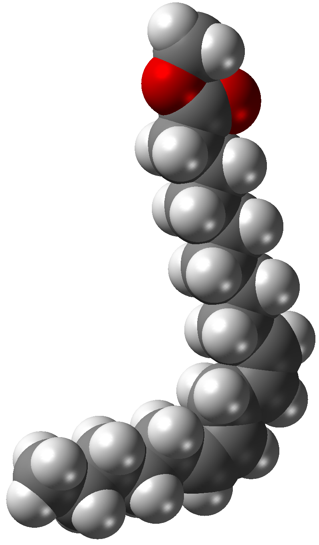
Physical propertiy of FFA.
Lower faty acid chain, lower the melting point of fat.
TG contains unsaturated faty acids, liquid in room tempereature.
TG contains saturated faty acids, solid in room temperatures.
Solid Fat
More stable
Less prone to oxidation
Negativly affect the property of the fat or oil.

Slide 8
Hydrogenation:
Hydrogenation: make the fat more stable and less prone to spoilage.
Hyrdogenated fat increase the concentration of LDL, and decrease the consentration of HDL in blood.
It is a sossiated with the increase the risk of coronary heart disease.

Slide 9
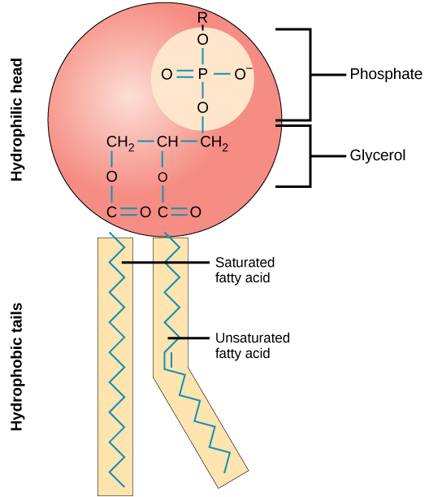
Phospholipids
Phospholipids are major components of all cell membranes and are therefore present in small quantities in almost all plant and animal foods.
They are also added during food manufacturing as an emulsifier. Emulsifiers help to mix oil and water to create a stable emulsion. It thus prevents the oil and water from separating into two layers.
Phospholipids line up tail-to-tail in the cell membrane to form a so-called bilayer. This phospholipid bilayer functions as a barrier for the entry of numerous molecules into the cell.

Slide 10
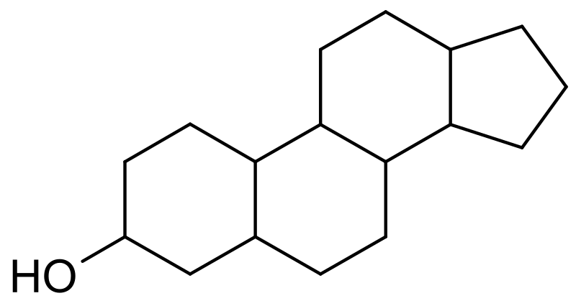
sterols
another lipid component of the diet is sterols.
The main sterol present in animal foods is cholesterol.
Plant foods do not contain cholesterol. Instead, they contain plant sterols, which resemble cholesterol.

Slide 11
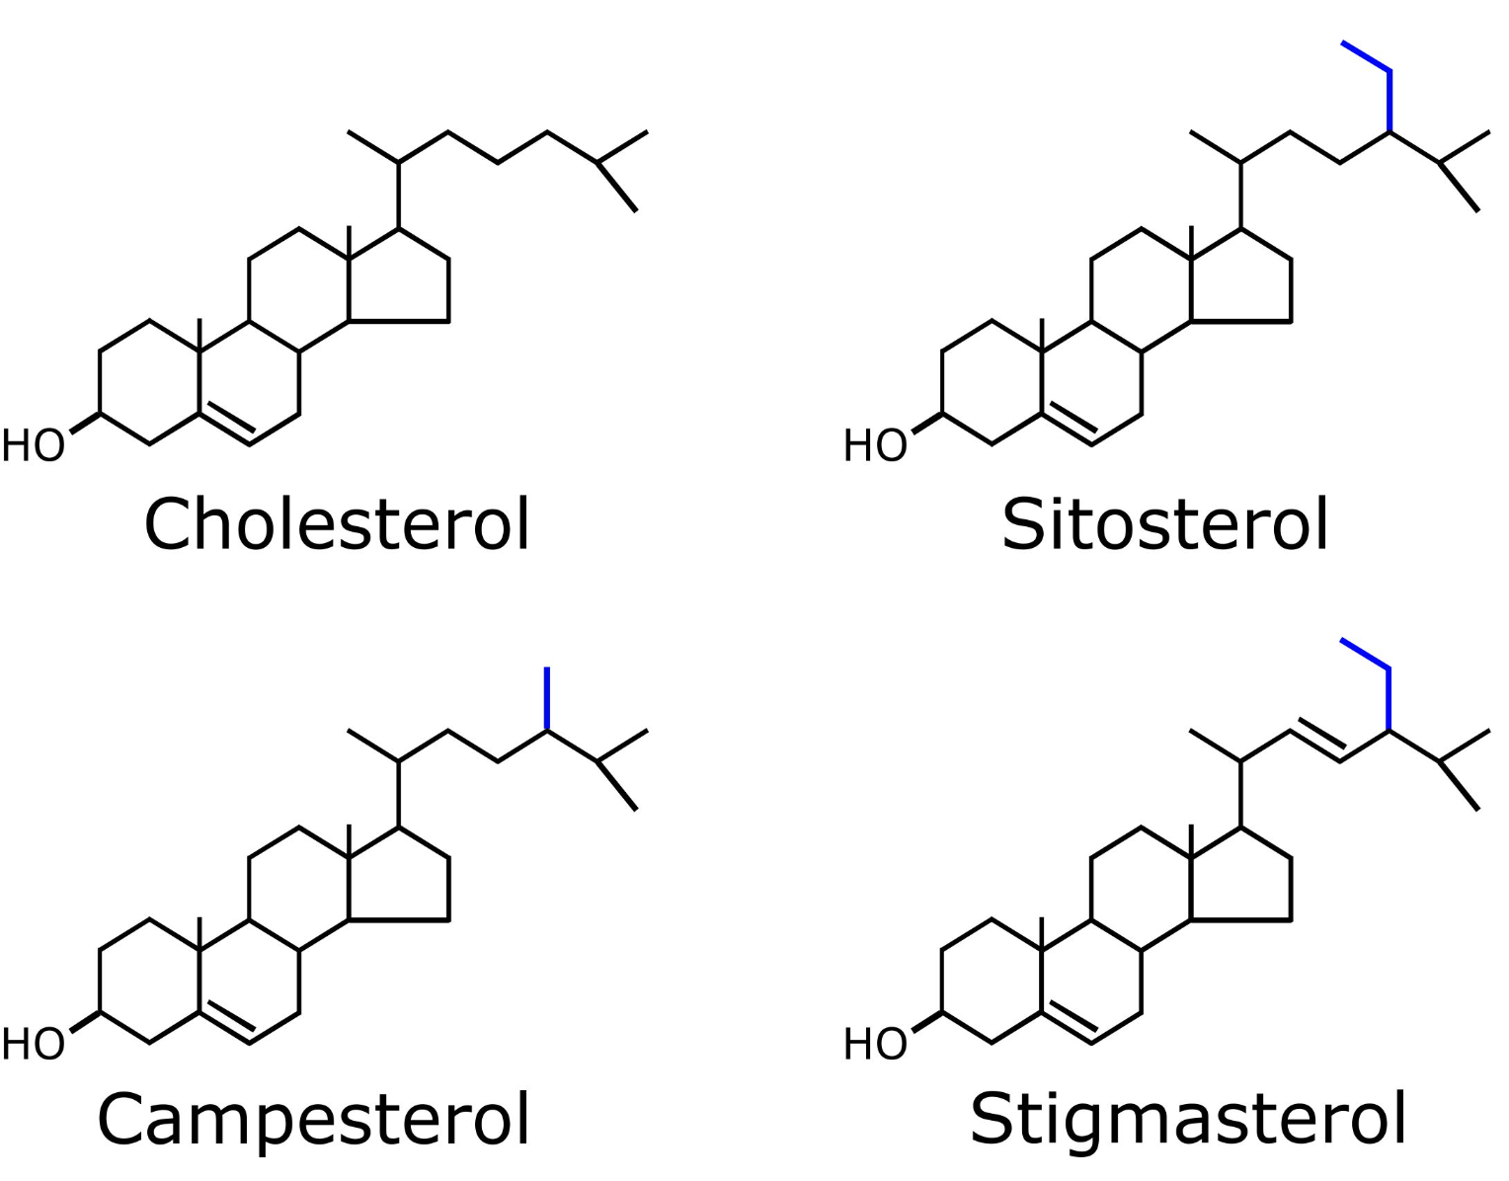
Plant sterols
Plant sterols are cholesterol look-a-likes.
They differ from cholesterol at one branch point.
Only minute amounts of plant sterols are absorbed. Most of the ingested plant sterols leave the body via the stools.
They are incorporated into functional foods for their ability to reduce the absorption of dietary cholesterol, leading to the lowering of blood cholesterol levels.
The maximal reduction in blood cholesterol that can be achieved by ingesting plant sterols is about 10%.

Slide 12
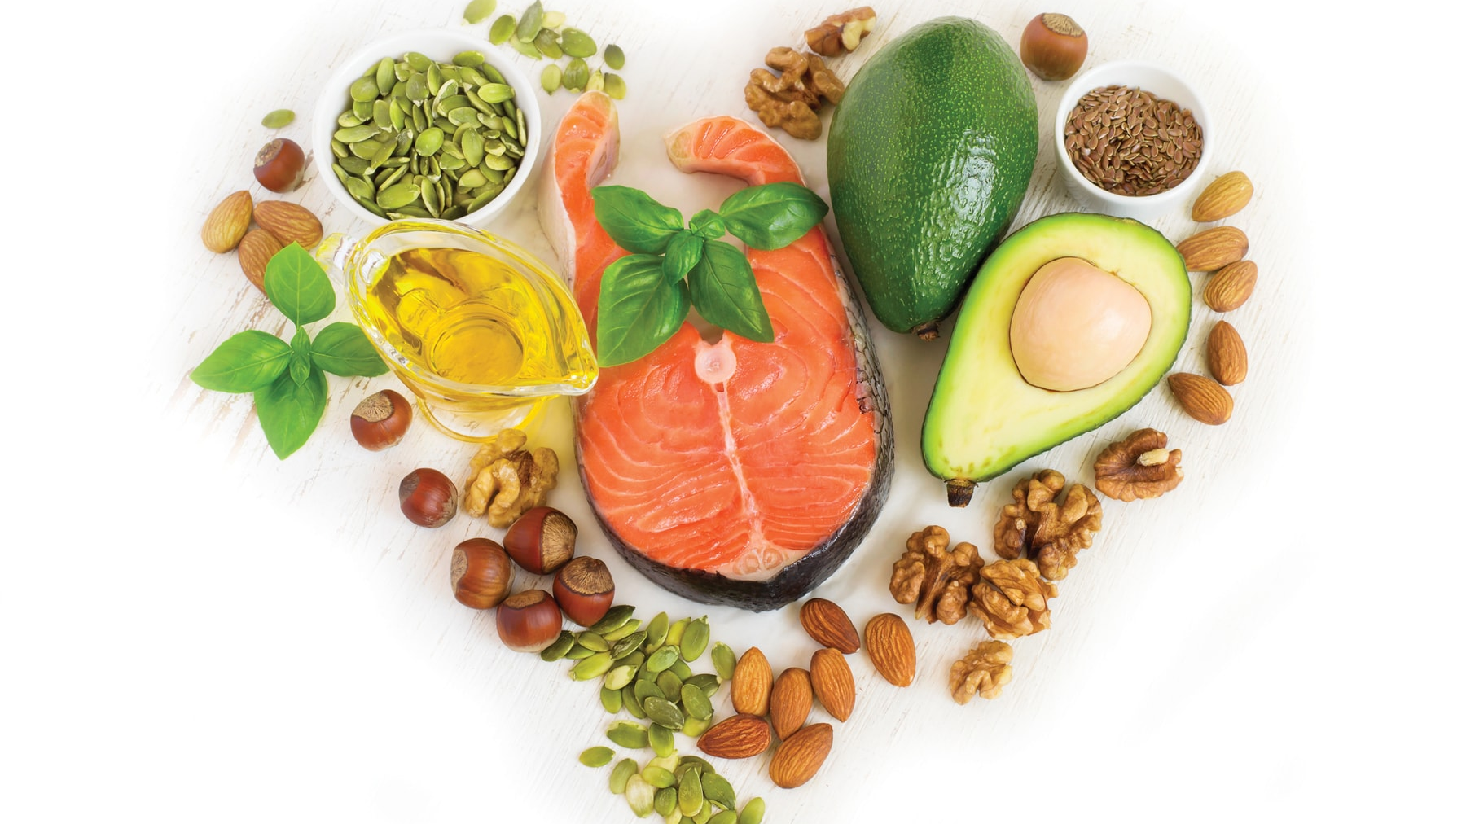
Lipid content and composition of foods

Slide 13
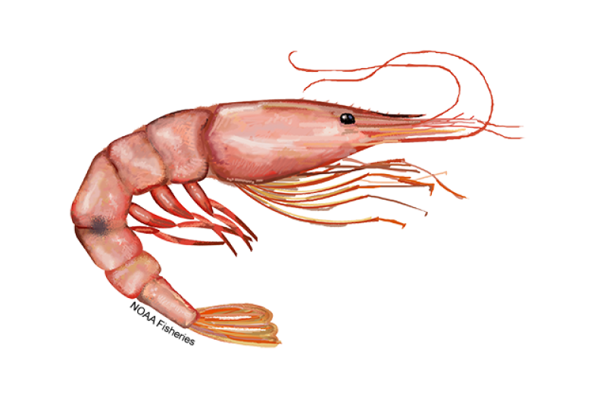
Lipid content of foods
Many foods contain substantial amounts of fat.
Cooking oils such as sunflower, peanut, and olive oil are 100% fat in the form of triglyceride.
Butter is about 80% fat.
Fruits and vegetables generally contain little to no fat.
Cholesterol is only found in foods of animal origin.
The highest cholesterol content is found in shrimp and egg yolk.

Slide 14
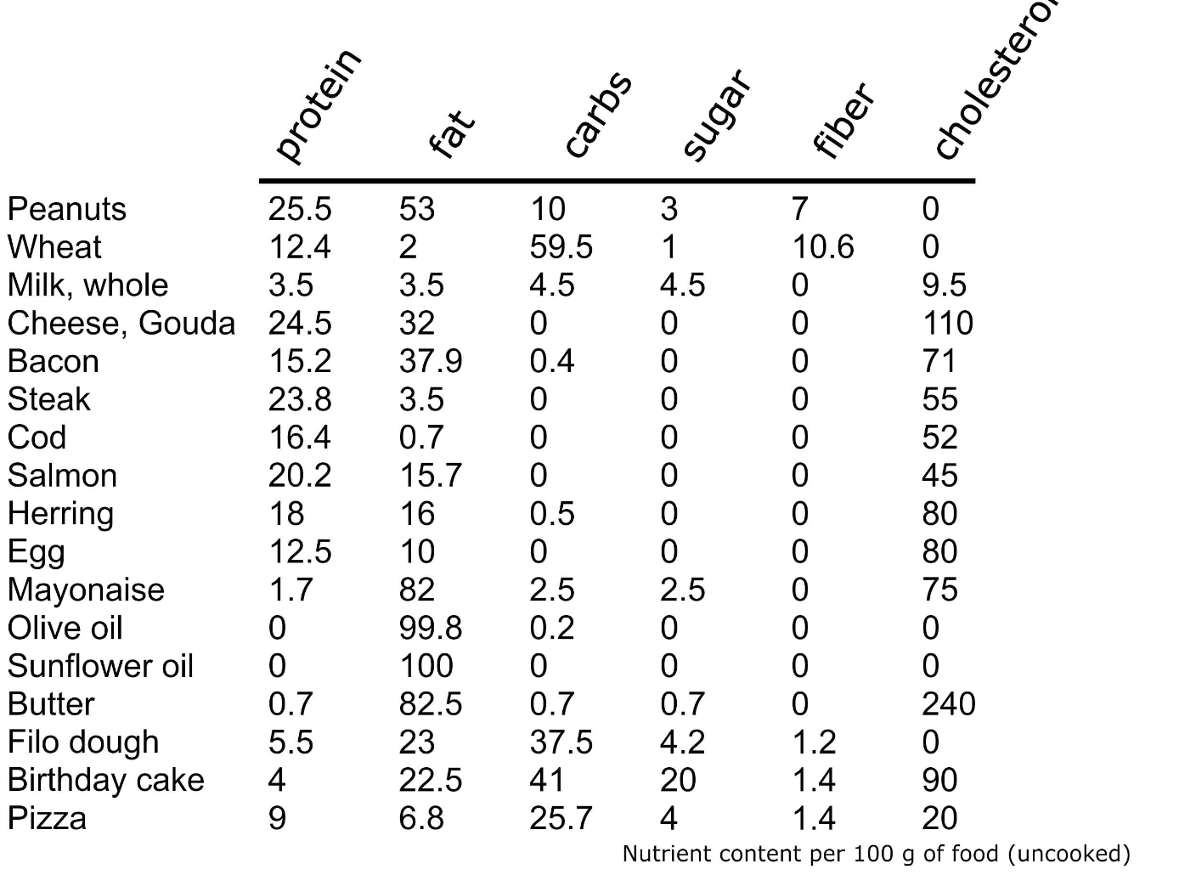
The table below gives an overview of the macronutrient composition of common foods that contribute substantially to our fat intake, including their total fat content (in grams per 100 grams of product) and cholesterol content (in milligrams per 100 grams of product).

Slide 15
Fatty Acid composition
The fatty acid composition of a particular oil varies depending on the variety of the crop, growing conditions, etc.
Lard and butter are rich in saturated fatty acids, whereas vegetable oils contain mostly unsaturated fatty acids, the exception being coconut oil.
Fish oil provides large quantities of fatty acids of chain length 20 to 22.
Typical fatty acids present in fish oil are eicosapentaenoic acid (C20:5) and docosahexaenoic acid (C22:6).

Slide 16
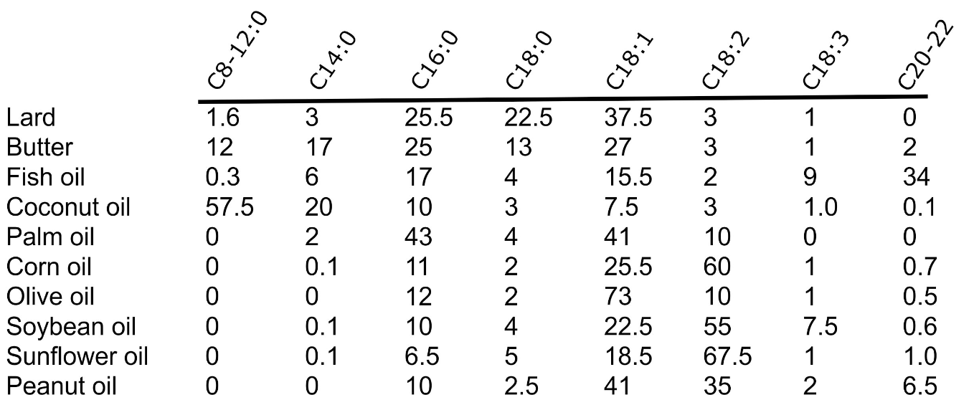
The values provided in the table below give a reasonable estimation of the fatty acid composition of the major fats and oils used in food manufacturing and food preparation.

Slide 17
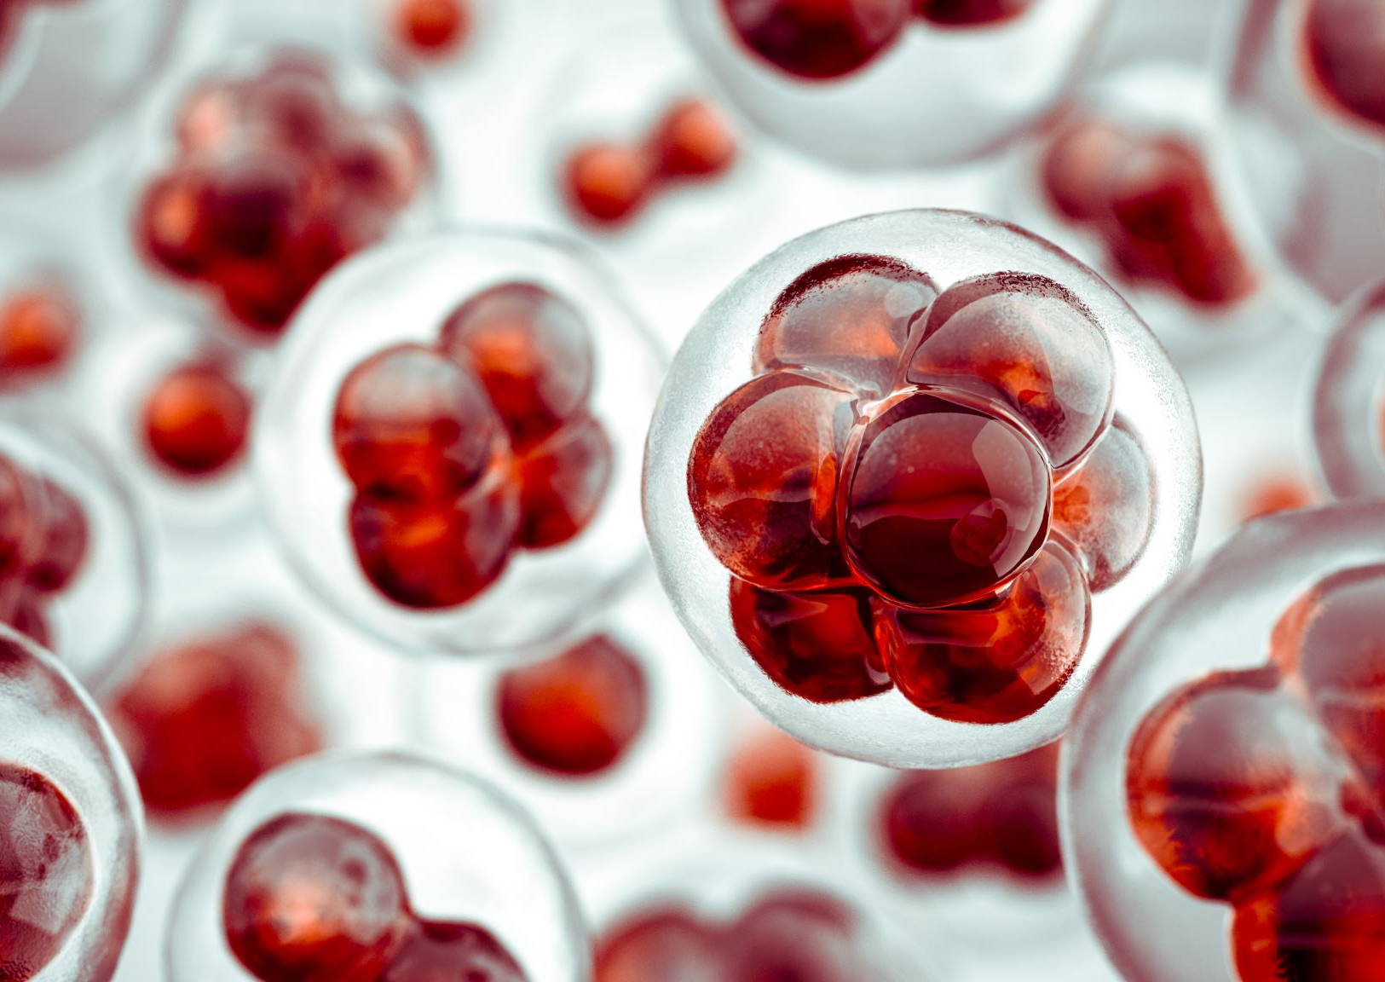
Lipid digestion and absorption

Slide 19
Types of Lipase
Most of the digestion of dietary fat takes place in the small intestine through the action of a lipase produced by the pancreas called pancreatic lipase.
The remainder is accounted for by lipase in the stomach called gastric lipase.
The salivary glands also produce a lipase called lingual lipase, which happens to be the same lipase as gastric lipase.
Lingual lipase has been suggested to be involved in oral fat detection.

Slide 20
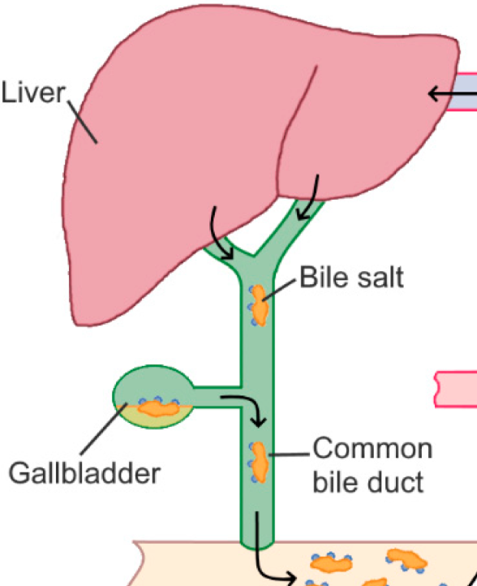
Bile Acids
Bile acids play an important role in fat digestion by functioning as emulsifiers.
They dis-perse the dietary fat into smaller fat droplets, helping the pancreatic lipase gain easier access to the fat.
Bile acids are produced in the liver from cholesterol and are stored together with cholesterol and phospholipids in the gall bladder.
The entry of fat into the small intestine causes the secretion of the intestinal hormone cholecystokinin, which triggers the contraction of the gall bladder and the release of its content in the duodenum.
The main bile acid is called cholic acid. It is attached to the amino acids glycine to form glycol-cholate

Slide 21
Fat Absorption:

Slide 22
Fat Absorpotion:
The action of pancreatic lipase causes the triglyceride molecules to fall apart into two fatty acids and one mono-glyceride (one fatty acid attached to glycerol).
The fatty acids and mono-glycerides are taken up by the enterocyte. Within the enterocyte, they are reconverted into triglycerides via a process called re-esterification.
The triglycerides are packaged into specialized particles called chylomicrons.
The chylomicrons are released into the lymphatic circulation and ultimately reach the blood circulation via transport through the thoracic duct.
Thus, in contrast to absorbed amino acids and glucose, which are taken up into the portal vein, absorbed fats do not first travel to the liver.

Slide 23
Any Questions?

