Slide 1
Faculty of Pharmacy
Tishk Internationl University
Lipid Metabolism and its role in Disease
9th lecture; Nutritional Biochemistry
Mohammed Rasul
Assistant Lecturer |MSc. Biomedical Science
Mohammed.rasul@tiu.edu.iq
Notes:
Example of reducing and non reducing sugar
https://www.biologyonline.com/dictionary/reducing-sugar
The loss of electrons during a reaction of a molecule is called oxidation while the gain of single or multiple electrons is called reduction.
The oxidation and reduction reactions (also called redox reactions) are the chemical reactions in which the oxidation number of the chemical species that are taking part in the reaction changes.
The redox processes are the wide range of reactions that include the majority of the chemical and biological processes taking part around us.
Rusting and dissolution of the metals, browning of the fruits, fire reactions, respiration and the process of photosynthesis are all oxidation-reduction processes.
Oxygen atom Transfer:
C+ 2H₂O → CO₂ + 2H₂
Hydrogen atom Transfer:
N₂H₄+ O₂ → N₂+ 2H₂O
Electron Transfer:
Zn + Cu⁺² → Zn⁺² + Cu

Slide 2
Learning Outcomes:
Metabolism of Lipids
Fat distrbution in the body
Risk of high LDL level in the blood
Using FFA as a fuel
storgae of FFA
Diffirences between Brown and White Fat

Slide 3
The picture above depicts the fate of exogenous lipids (=dietary lipids) and endogenous lipids (produced in the liver).

Slide 4
Fat distribution in body
Dietary triglycerides and cholesterol are incorporated into chylomicrons, which reach the bloodstream after passage through the lymphatic circulation.
Shortly after entering the bloodstream, the triglycerides in chylomicrons are for a large part broken down by lipoprotein lipase in the capillaries of muscle and fat tissue.
The resulting fatty acids are taken up by the underlying muscle and fat cells to be used as fuel or to be stored as extra energy.

Slide 5
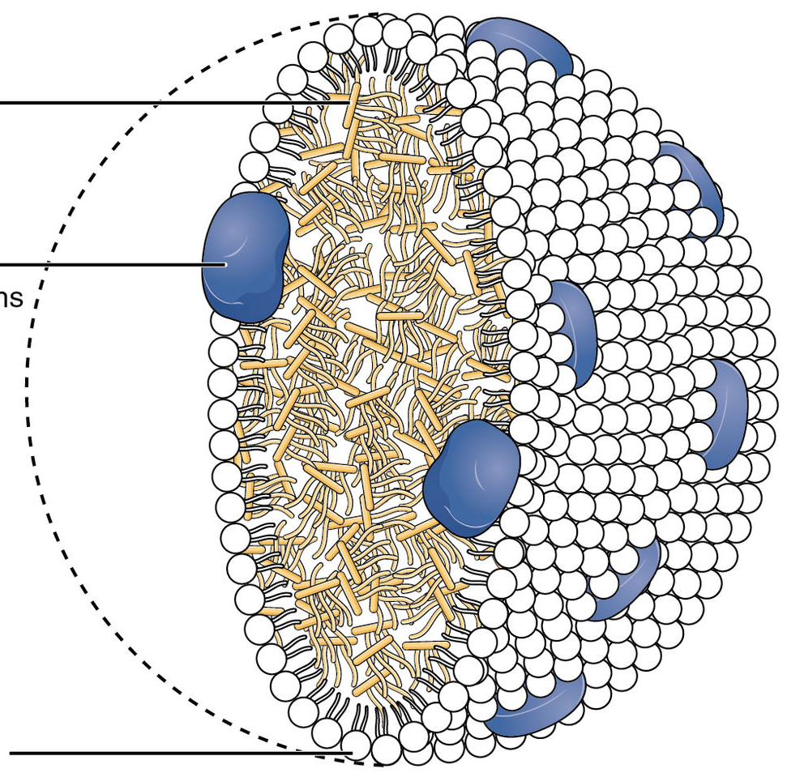
The leftover chylomicron particle, which is referred to as a chylomicron remnant, still contains dietary cholesterol.
Chylomicron remnants are subsequently taken up by the liver, where the dietary cholesterol mixes with the cholesterol produced in the liver.
End of the Cholestrol in the body:
Part of the cholesterol in the liver is converted into bile acids and secreted into the bile as such.
Part of the cholesterol is directly secreted into the bile.
And part of the cholesterol is incorporated into very-low-density lipoproteins, together with triglycerides produced in the liver.

Slide 6
The very low-density lipoproteins are secreted by the liver and undergo a similar fate as chylomicrons, meaning that they are processed by lipoprotein lipase in the capillaries of muscle and fat.
The particle that is formed after removal of most of the triglycerides is called intermediate-density lipoprotein, which after further processing is converted into low-density lipoproteins (LDL).
LDL consists mostly of cholesterol, complemented with phospholipids, proteins, and small amounts of triglycerides.

Slide 7
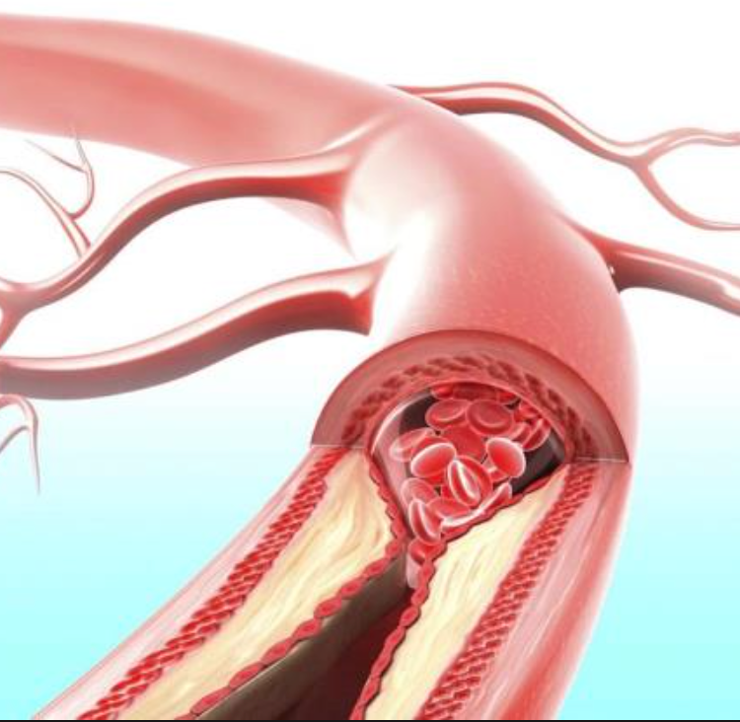
Risk of high LDL in Blood stream
In contrast to chylomicrons and VLDL, LDL is removed very slowly from the circulation.
LDL is removed mainly in the liver via the LDL receptor.
Defects in the LDL receptor lead to impaired removal of LDL from the blood, leading to elevated LDL cholesterol levels in the blood.
Elevated LDL contributes to the formation of atherosclerotic plaques via its uptake by macrophages in the wall of arteries, as further explained in the section on atherosclerosis.

Slide 8
Use of fatty acids as fuel

Slide 9
From triglycerides to fatty acids
Depending on whether you are in the fasted state or you just consumed a heavy meal, most of the triglycerides in the blood are contained in either VLDL or chylomicron particles.
The enzyme lipoprotein lipase is bound to the wall of capillaries in the heart, skeletal muscle, and fat tissue, and breaks down the triglycerides within VLDL and chylomicrons into fatty acids.
The fatty acids subsequently enter the tissues to be used as fuel (muscle, heart) or to be stored as triglycerides (fat tissue).
The activity of lipoprotein lipase in fat tissue is stimulated by insulin and goes up after a meal to ensure efficient storage of consumed fat.

Slide 10
genetic defect in the lipoprotein lipase enzyme
Some people have a genetic defect in the lipoprotein lipase enzyme
As a result, they cannot remove the triglycerides from the blood very well and end up with very high triglyceride levels in the blood.
Other people carry changes in other genes that lead to a more active lipoprotein lipase enzyme and, as a consequence, low triglyceride levels in the blood.

Slide 11
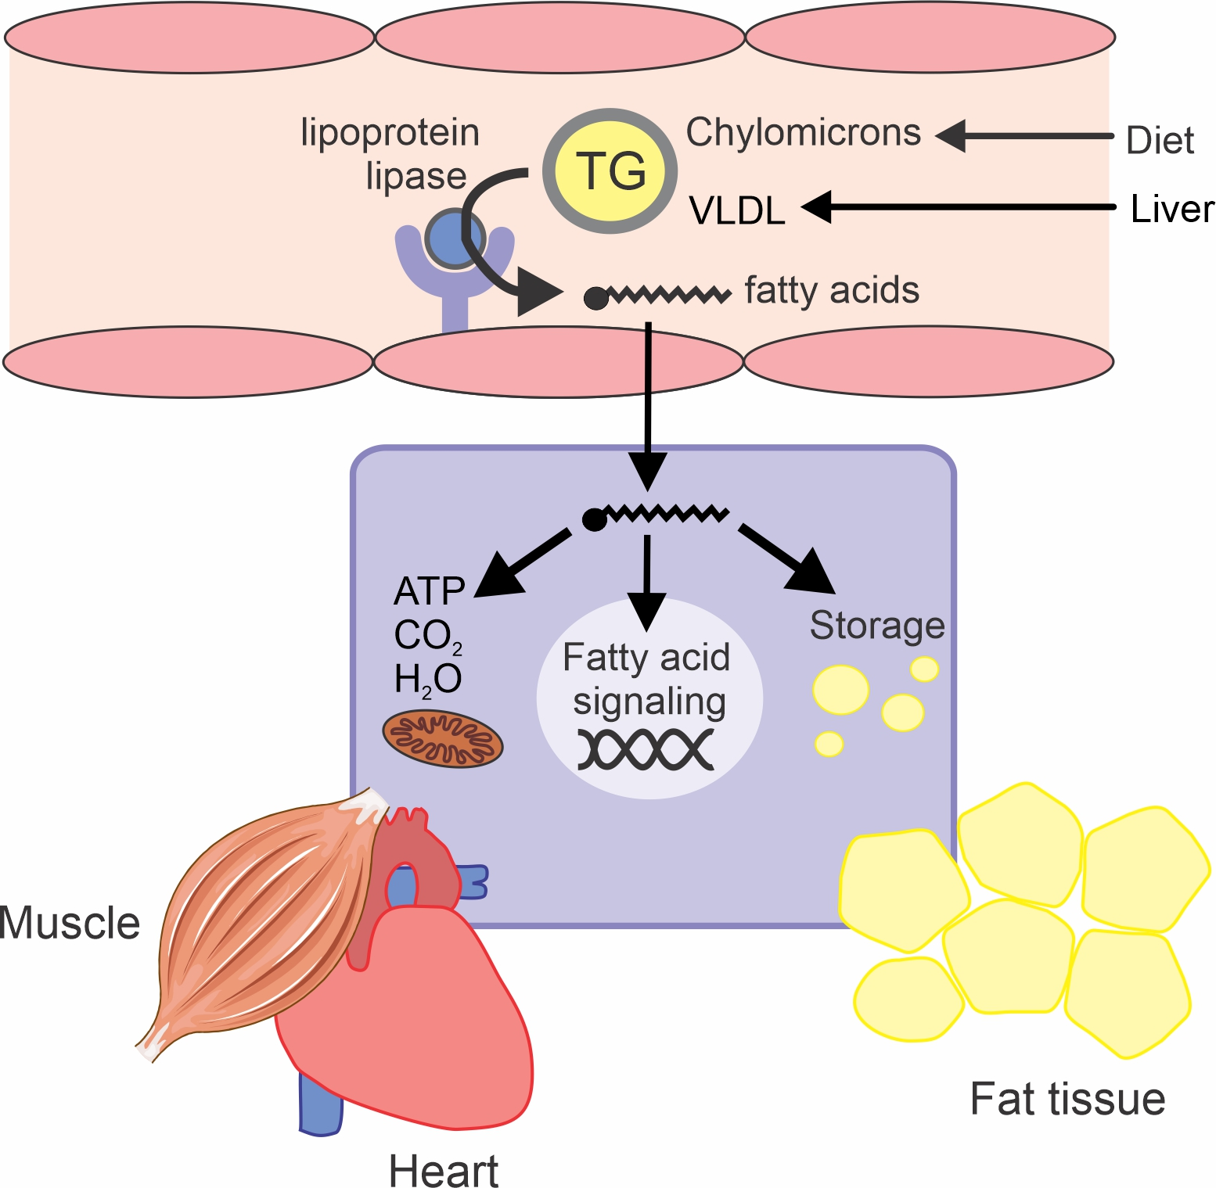
From Free Faty Acid to Energy

Slide 12
From fatty acid to energy
Once taken up into cells, most of the fatty acids are burned to yield energy in the form of ATP.
The breakdown of fatty acids to generate ATP resembles the breakdown of glucose to ATP.
In the first step, the fatty acid is progressively shortened to yield Acetyl-CoA.
This step is called beta-oxidation.
Acetyl-CoA is further oxidized in the second step via the tricarboxylic acid (TCA) or citric acid cycle.
The energy liberated during beta-oxidation and the TCA cycle is temporarily stored in NADH (or FADH2).
NADH donates its energy to a set of proteins that together comprise the electron transport chain, ultimately converting the energy into ATP.

Slide 13
Other Unique function of FFA.
In addition to serving as fuel, fatty acids are also important signaling molecules that regulate a variety of different processes in the cell.
For instance, fatty acids are able to turn on genes by binding to special receptors called PPARs.

Slide 14
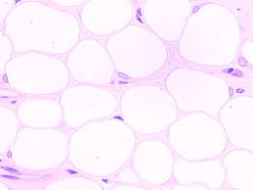
Storage of fatty acids
The fatty acids taken up into cells that are not needed to produce energy are stored as triglycerides in so-called lipid droplets.
Fat cells consist of one large lipid droplet.
The main role of fat cells in the body is to store energy after a meal and release the energy when the body needs it.
Muscle cells and many other cell types can store a limited amount of energy, usually in many tiny lipid droplets.
Excess fat storage in most cell types can disrupt the normal functioning of cells.

Slide 15
Cholesterol balance
Cholesterol has a number of functions in the body.
First, cholesterol is needed to make bile acids, which in turn are required for the efficient digestion of dietary fats.
cholesterol is used to make several (steroid) hormones such as the male and female sex hormones.
cholesterol is a component of cell membranes. It is important to realize that cholesterol is not a nutrient because our own cells can make cholesterol.
Only approximately one-third of the cholesterol in our bodies comes from our diet. The rest is made in the body. For this reason, we can subsist on a diet that is completely devoid of cholesterol.

Slide 16
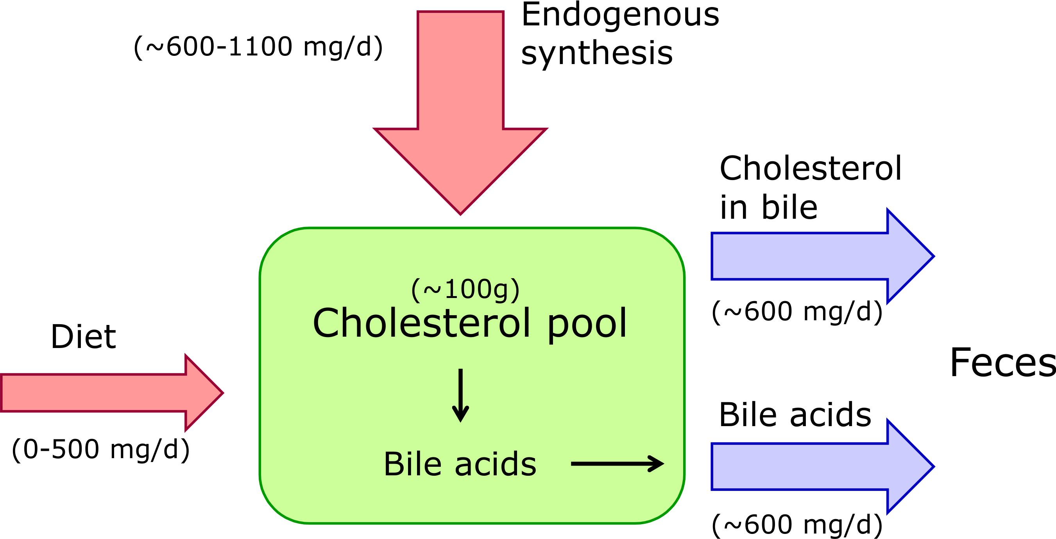

Slide 17
Fat Tissue

Slide 18
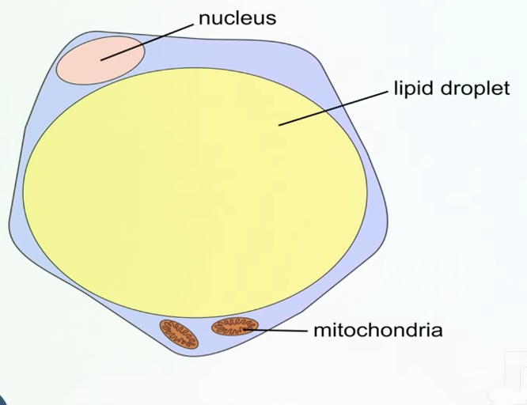
Role of Adipose tissue
Heat insulation
Energy balance
Endocrine function
Adipocytes are now generally accepted to be a complex cell type involved in generating a number of signals which include cytokines, hormones and growth factors that not only affect the neighboring cells but also impact target tissues involved in energy metabolism and influencing physiologic and pathologic processes.

Slide 20
Brown Vs White Fat
Brown fat breaks down blood sugar (glucose) and fat molecules to create heat and help maintain body temperature.
Cold temperatures activate brown fat, which leads to various metabolic changes in the body.
Most of our fat, however, is white fat, which stores extra energy.
Too much white fat builds up in obesity

Slide 21
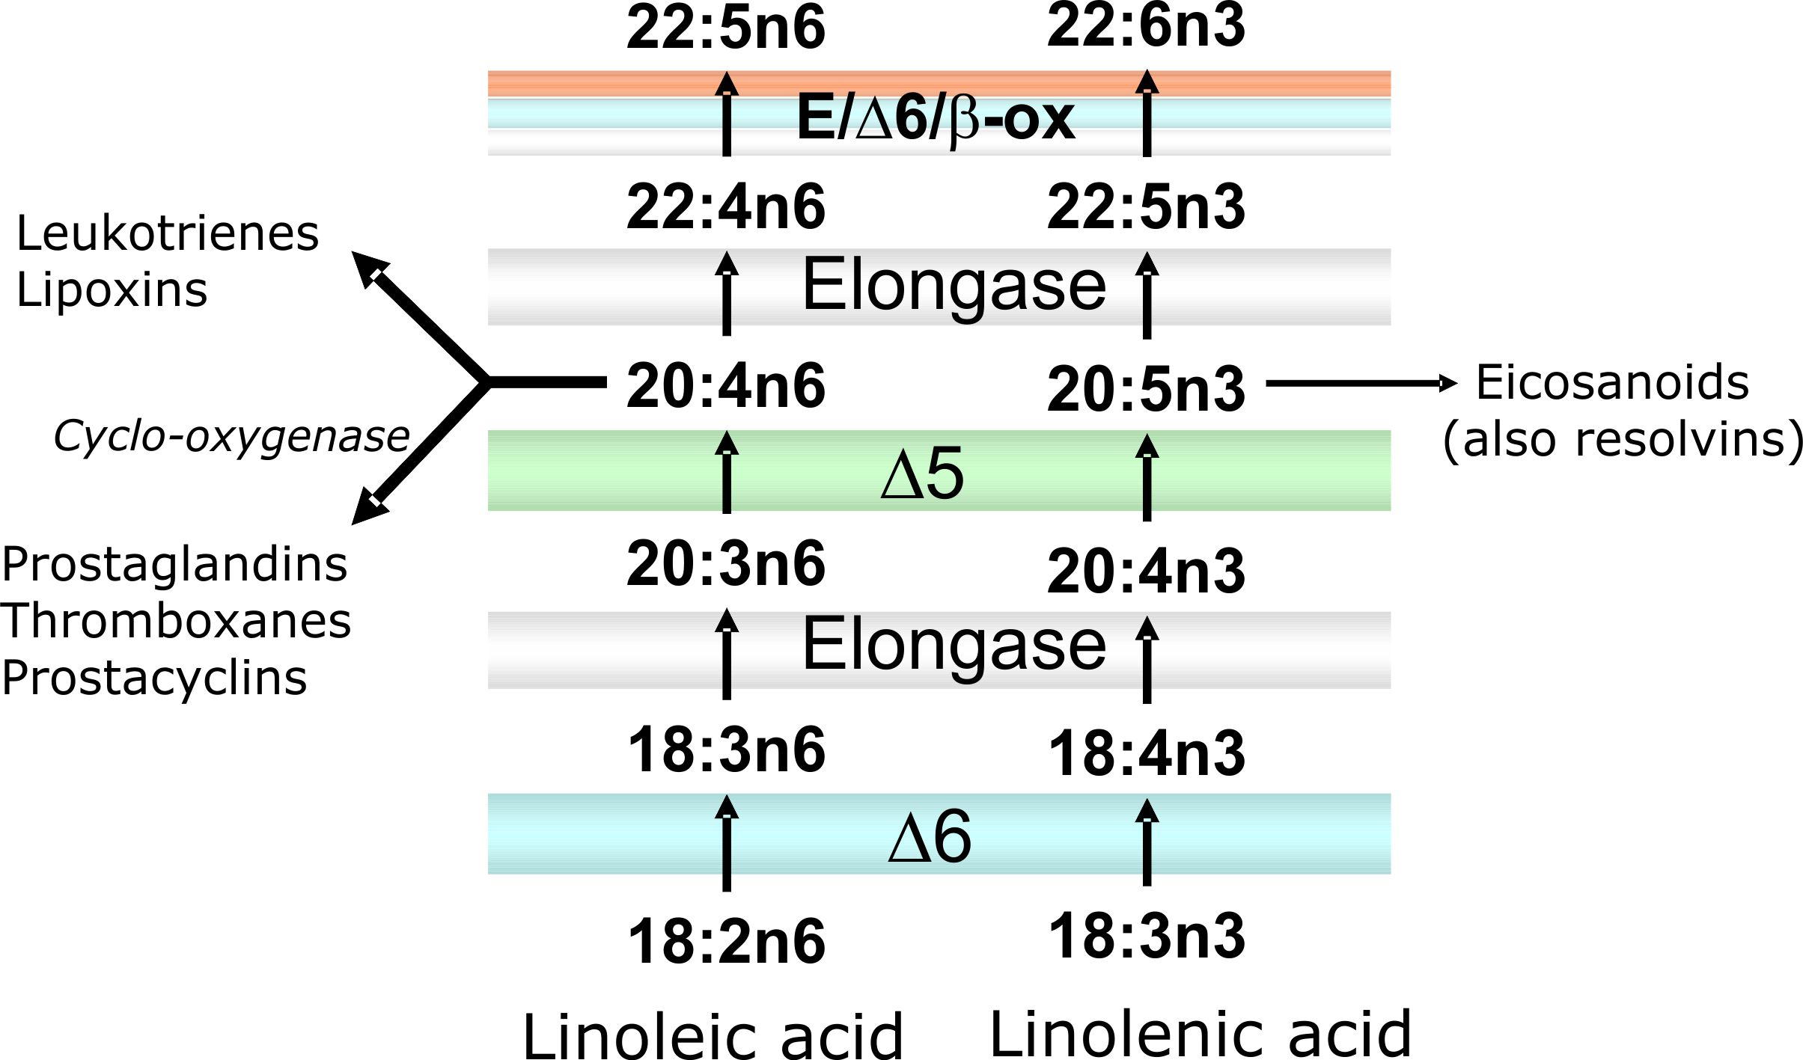
Essential fatty acids

Slide 22
Linoleic acid and linolenic acid
Certain fatty acids need to be provided in the diet.
Early studies in animals have shown that the diet lack of essential fatty acids leads to poor growth and ultimately death.
Essential fatty acids can be divided into two groups: the n-6 fatty acid family and the n-3 fatty acid family.
The main n-6 fatty acid in our diet is linoleic acid.
Linoleic Acid is a polyunsaturated essential fatty acid found mostly in plant oils.

Slide 23
linolenic acid, n-3
The main n-3 fatty acid in our diet is linolenic acid.
Linolenic acid is essential because it is used to make certain eicosanoids as well as the fatty acids eicosapentanoic acid (EPA) and docosahexanoic acid (DHA).
DHA is incorporated into phospholipids in the brain and retina.
EPA and DHA can also be obtained directly from the diet.
EPA and DHA are not present in plant foods and are highly enriched in fatty fish. For this reason, EPA and DHA are often referred to as fish oil fatty acids.

Slide 24
The reason why n-3 and n-6 fatty acids are essential and n-9 fatty acids are not is that mammals lack the ability to insert double bonds beyond carbon 10 counting from the carboxyl end.
Hence, unlike plants, we cannot insert double bonds at the Δ12 and Δ15 positions, and these double bonds need to be present in (some of) the fatty acids we ingest through the diet.
Mammals are able to insert double bonds at the Δ9, Δ6, and Δ5 position, which together with the ability to add carbons at the carboxyl end.
However, we are unable to make n-3 and n-6 fatty acids or convert n-6 fatty acids into n-3 fatty acids.

Slide 26
Any Questions?

