Slide 1
Tishk International University
FACULTY OF PHARMACY
Department of Pharmacognosy
AROMAtherapy
Grade 4- Spring semester 2
Dr. Omji Porwal

Slide 2
A r o m a t h e r a p y
Introduction
History
Modes of Application
Clinical Aromatherapy
Examples of Essential Oils for Aromatherapy
Safety Concerns
Practical Safety Concerns
Carrier Oils

Slide 3
Introduction
“Aroma”
“Therapy”
“Fragrant smell or Scent”
“Treatment”
“The use of essential oils in holistic healing to improve health and emotional well- being and in restoring balance to the body is known as aromatherapy.”
Used to alter one’s:
Mood
Cognitive
Psychological well-being

Slide 4
History
Tittle aromatherapy was first coined by French Chemist Rene-Maurice Gattefosse in 1928, when he accidentally used lavender oil for his burned Hand
French Army Surgeon, Jean Volnet pioneered the use of aromatherapy. He applied it cure the wounds of soldiers during World War II
The use of aroma oil is known to be as old as 6000 years
In 4500 B.C., Egyptians used cedar wood oil to preserve the dead bodies
Hippocrates recommended regular aromatherapy bath for health improvement
Romans utilized essential oils for pleasure and to cure pain

Slide 5
Modes of Application
Inhalation Topical Application
Inhalation
Simplest and effective method
Inhaled through lungs via nose
Beneficial for respiratory problems, sinus congestion, flu, cough, colds, catarrh and sore throat
May be done through:

Slide 6
Facial Steam

Slide 7
Atomizers

Slide 8
Vaporizers (Aroma Burner)

Slide 9
Nebulizers

Slide 10
Direct Inhalation

Slide 11
Modes of Application
Topical Application
Essential oils are applied over the skin
Due to lipophilic nature, they penetrate through the skin surface
Absorbed into lymph and then circulatory system
May be done through:
Bath
Foot Bath
Compresses
Massage

Slide 12
Clinical Aromatherapy
VIA SKIN
Due to lipophilic nature of essential oils, they easily penetrate the skin surface and absorbed into blood via lymph
Essential oil Skin (Superficial Layer) Sub-Cutaneous Layer Sub-Cutaneous Layer Lymph Lymph Vessels
Lymph Vessels Vein Systemic Circulation

Slide 13
Clinical Aromatherapy
VIA NOSE
Aroma
Nose Cilia Receptors in Cilia
Olfactory lobe Limbic system
Impulse
Impulse
Generate response
Limbic system controls mood, emotions, memory or learning capabilities
The action impulse generated by aroma acts on limbic system and limbic system in response alter the mood, emotion or learning capabilities.

Slide 14
Examples of Essential Oils for Aromatherapy
Lavender Oil --- It is used to treat burns and it has a sedative effect thus also used for relaxation
Cedar Wood Oil --- It is used as antiseptic and anti-bacterial to prevent infection
Aphrodisiac Oil --- It is used to induce romantic feelings
Chamomile Oil --- It is used as anti-inflammatory
Lemon Oil --- It is used as anti-depressant

Slide 15
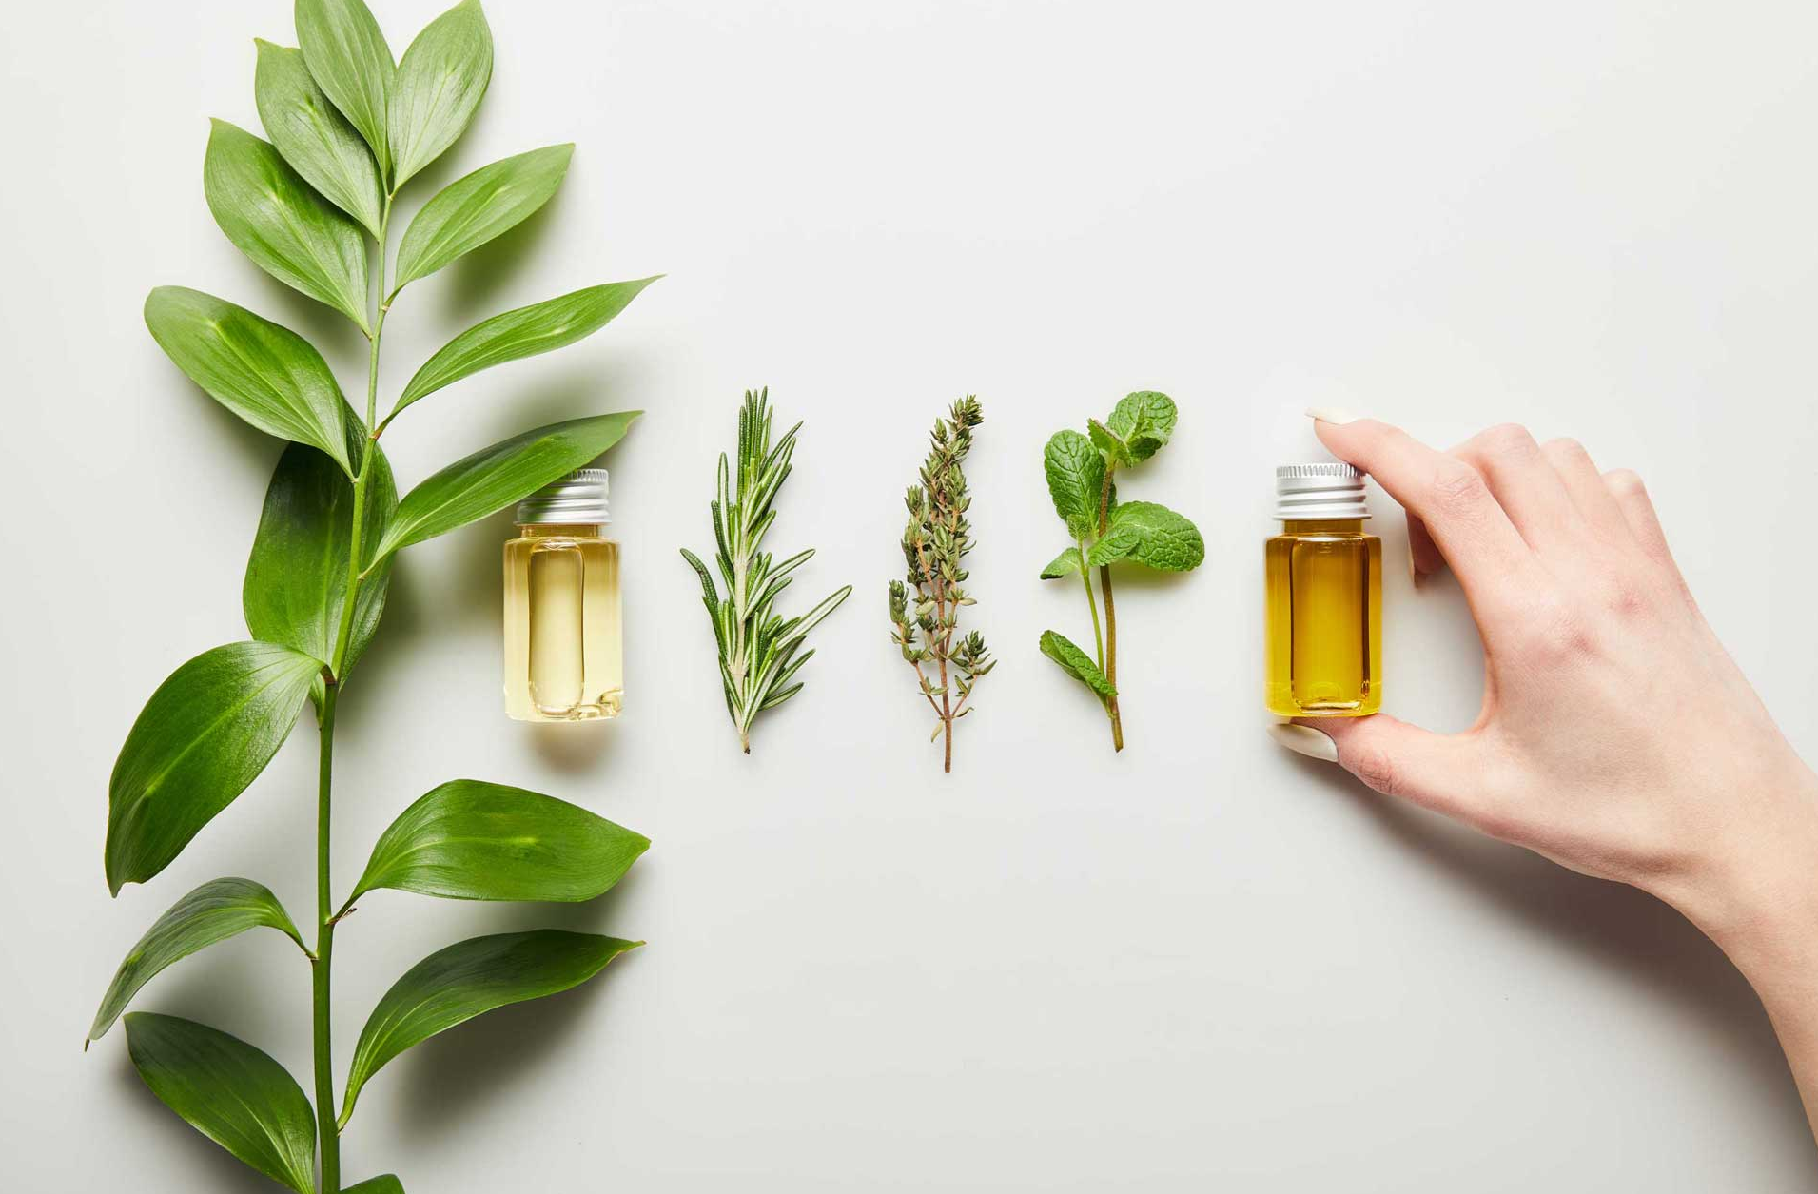

Slide 16
Examples of Essential Oils for Aromatherapy
Eucalyptus Oil --- It is used to relieve pain
Spearmint Oil --- It is used to relieve headache
Wintergreen Oil --- It is used to relieve backache
Peppermint Oil --- It is used to treat stomach upset
Rosemary Oil --- It is used to boost mental activity and stimulate hair growth

Slide 17
Safety Concerns
They should never be used directly because some oils may irritate sensitive skin or cause photosensitivity
They should be blended in adequate proportion with the carrier oils
They should be stored in a cool place in darkened bottles to avoid photo-oxidation of components
Take out a patch test before applying
Must not be taken orally as they irritate mucous membrane
Due to concentrated and potency of pure essential oils, dilution in a carrier oils is recommended

Slide 18
Practical Safety Concerns
While taking bath, take 7-8 drops of essential oil in 30ml of carrier oil and add water and mix it well before use.
While massage, add 15-22 drops of essential oils to a 30ml of carrier oil for a full body massage.
Always massage in an upward motion and toward the heart for the best effect
While taking facial steams, add 2-3 drops of oil into a bowl of boiled water.
Drape a towel over your head and lean over the bowl to inhale the steam while keeping eyes shut.
Breathe through mouth for throat problems and through nose for sinus congestion

Slide 19
Carrier Oils
oThese are vegetable oils or base oils
oUsed to retain properties of the aroma oil
oThey do not mask its aroma
o For Example, soya oil and wheat germ oil

Slide 20
THANKS

