Slide 1
Tishk International University
FACULTY OF PHARMACY
Department of Pharmacognosy
A R O M A t h e r a p y
Oil to know and use them-3
Grade 4- Spring semester
Prof. Dr. Omji Porwal

Slide 2
LEMON

Slide 3
Citrus limonum SCENT: CITRUS
In India, lemons are called “golden apples.”
Lemon essential oil is one of the most useful botanicals available to the aromatherapist.
It is used for flavoring everything from pickles (popular in Asia) to candy to soda and prized for its versatility as an ingredient in cosmetics, medicinals, and non-toxic cleaning products.
The fruit has an exotic heritage—born in India, given an Arabic name, and brought to Europe by the Crusaders.

Slide 4
PROPERTIES Antibacterial, Antiseptic, Astringent, Detoxification, Febrifuge, Styptic, Tonic
POTENTIAL USES Bacterial infection, Bee stings, Bleeding, Bronchitis, Digestive upset, Fever, Headaches, Insect bites, Mouth ulcers, Muscle aches, Oily,skin, Skin discoloration, Sore throat, Stain removal, Warts
BLENDS WITH Citrus: orange, mandarin, grapefruit Earthy: oakmoss Floral: chamomile Herbal: fennel Medicinal: eucalyptus, tea tree Oriental: frankincense Woody: benzoin, juniper, sandalwood
CAN BE SUBSTITUTED WITH Grapefruit Lime
PRECAUTIONS Phototoxic if used at more than a 2 percent dilution (2 drops per teaspoon of carrier oil).

Slide 5
NUTMEG

Slide 6
Long used as a spice and flavoring, nutmeg is used in perfumery to fix citrus scents.
It was originally used by Arab physicians (who introduced it to the Venetians), to treat digestive disorders, kidney ailments, and bad breath.
Both Indians and Arabs used the spice as an aphrodisiac.
Elizabethans used it to ward off the plague.
Nutmeg is frequently used for unisex and masculine scents like Guerlain’s Vetiver Sport and Dior’s Fahrenheit.

Slide 7
PROPERTIES Analgesic, Anti-inflammatory, Antiseptic, Aphrodisiac, Digestive tonic, Relaxant, Sedative, Stimulant
POTENTIAL USES Arthritis, Diarrhea, Digestive issues, Gas, Nausea, Pain, Shampoo, Sexual problems, Vomiting
BLENDS WELL WITH Citrus: orange, grapefruit, bergamot Earthy: oakmoss Floral: geranium, lavender Spicy: coriander
CAN BE SUBSTITUTED WITH Cinnamon Cloves
PRECAUTIONS Avoid use while pregnant.

Slide 8
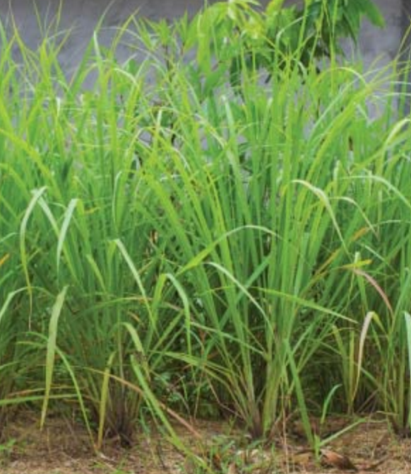
PALMAROSA

Slide 9
Palmarosa essential oil is extracted from a flowering grass harvested before it flowers.
It was used by ancient Indian doctors to treat nerve pain, rheumatism, and infectious diseases.
It is valued as a perfume ingredient because of the “rosy note” in its aroma.
Alternate names for palmarosa include Turkish rose, Indian rose, and rose geranium.
Perfumes with palmarosa notes include Ciara by Revlon and Jasmin 17 by Le Labo.

Slide 10
PROPERTIES Antibacterial, Anti-inflammatory, Antiseptic, Antiviral, Appetite stimulant, Febrifuge, Insect repellant, Stimulates cell growth
POTENTIAL USES Abrasions, Aches and pains, Acne, Aging skin, Bacterial infection, Dermatitis, Eczema, Gastroenteritis, Psoriasis, Rosacea, Scarring, Skin irritation
BLENDS WELL WITH Citrus: orange, bergamot Oriental: patchouli Floral: ylang ylang Herbal: rosemary Woody: amyris, cedarwood, sandalwood
CAN BE SUBSTITUTED WITH Geranium Rose
PRECAUTIONS May interact with certain medications. Talk to your doctor or pharmacist about potential interactions.

Slide 11
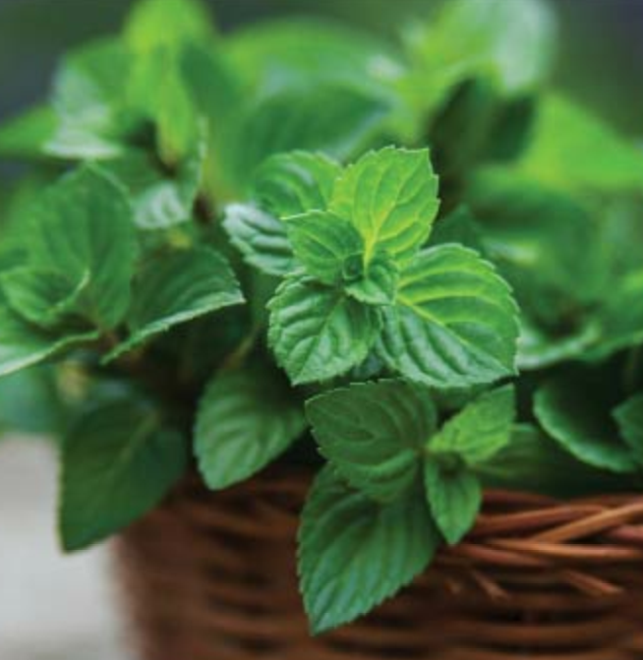
PEPPERMINT

Slide 12
PEPPERMINT Mentha piperita SCENT: MINTY
The plant we know as peppermint is a natural hybrid, a cross between spearmint and water mint, a plant that grows in damp places across Europe, Asia, and northwest Africa.
The ancient Romans planted peppermint between the stepping stones leading to their houses so that guests would be welcomed by the scent as they approached.
Peppermint is used to flavor both food and medicine and as a fragrance in cosmetics.
Drunk as a tea, it aids digestion.

Slide 13
PROPERTIES Analgesic, Antibacterial, Antiseptic, Decongestant, Febrifuge, Insecticide, Sedative, Vermifuge
POTENTIAL USES Acne, Anxiety, Colds/flu, Congestion, Dermatitis, Digestive upset, Fever, Gas, Indigestion, Insect repellant, Itching, Motion sickness, Muscle aches, Nausea, Pest repellant, Ringworm, Vomiting, Scabies
BLENDS WELL WITH Citrus: orange, lemon, grape fruilt Floral: geranium Medicinal: eucalyptus, tea tree, niaouli Spicy: black pepper Woody: benzoin
CAN BE SUBSTITUTED WITH Spearmint
PRECAUTIONS Avoid use while breastfeeding, as it can reduce the milk supply in some women. Do not use with children under 6 years old. Avoid use near mucous membranes.

Slide 14
PINE Pinnus sylvestris

Slide 15
Pine is an evergreen tree that can grow up to 115 feet high.
The scent of pine oil is ubiquitous in cleaning products to the point that it is virtually synonymous with “clean.”
According to Bryan Millerand Dr. Light Miller, authors of the authoritative Ayurveda & Aromatherapy, “the world’s largest production of any essential oil is pine.”
It is also used in perfumery in fragrances as diverse as Fille en Aiguilles by Serge Lutens and Black Forest by Black Phoenix Alchemy Lab.

Slide 16
PROPERTIES Analgesic, Antibacterial, Antidepressant, Antiseptic, Decongestant
POTENTIAL USES Arthritis, Bronchitis, Cleaning products, Colds/flu, Congestion, Cough, Depression, Fatigue, Gout, Muscle aches, Scabies, Urinary tract infection
BLENDS WELL WITH Citrus: bergamot, grapefruit, lemon, orange Floral: lavender Minty: peppermint Medicinal: eucalyptus, tea tree Oriental: frankincense Woody: cedarwood
CAN BE SUBSTITUTED WITH Cypress Juniper
PRECAUTIONS None specific

Slide 17
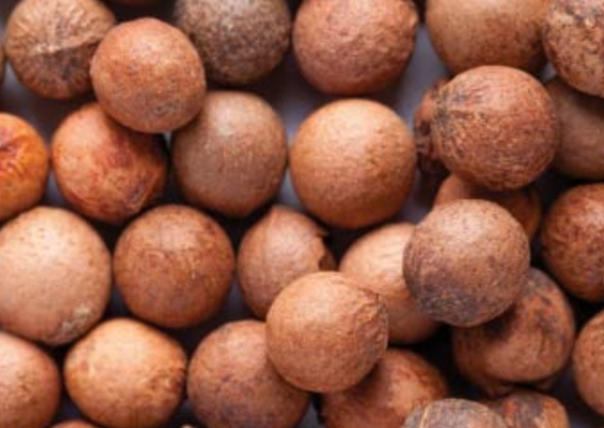
SANDALWOOD

Slide 18
SANDALWOOD Santalum album SCENT: WOODY NOTE
Sandalwood is slightly more expensive than other woody essential oils, but its scent is highly prized.
It has a woody, masculine scent found in incense, men’s cologne, and women’s fragrances.
While traditional sandalwood comes from India, recently Australia has surpassed India as the leading provider of sandalwood throughout the world.

Slide 19
PROPERTIES Anti-inflammatory, Antiseptic, Decongestant, Expectorant, Tonic
POTENTIAL USES Acne, Dry skin, Colds/flu, Cough, Sinusitis, Urinary tract infection
BLENDS WELL WITH Floral: petitgrain, rose, jasmine, ylang ylang Woody: pine, benzoin
CAN BE SUBSTITUTED WITH Cedarwood Vetiver
PRECAUTIONS None specific.

Slide 20
Thanks

