Slide 1
Tishk International University
FACULTY OF PHARMACY
Department of Pharmacognosy
Cosmetic A R O M A t h e r a p y
face care and hair care
Grade 4- Spring semester
Prof. Dr. Omji Porwal

Slide 2
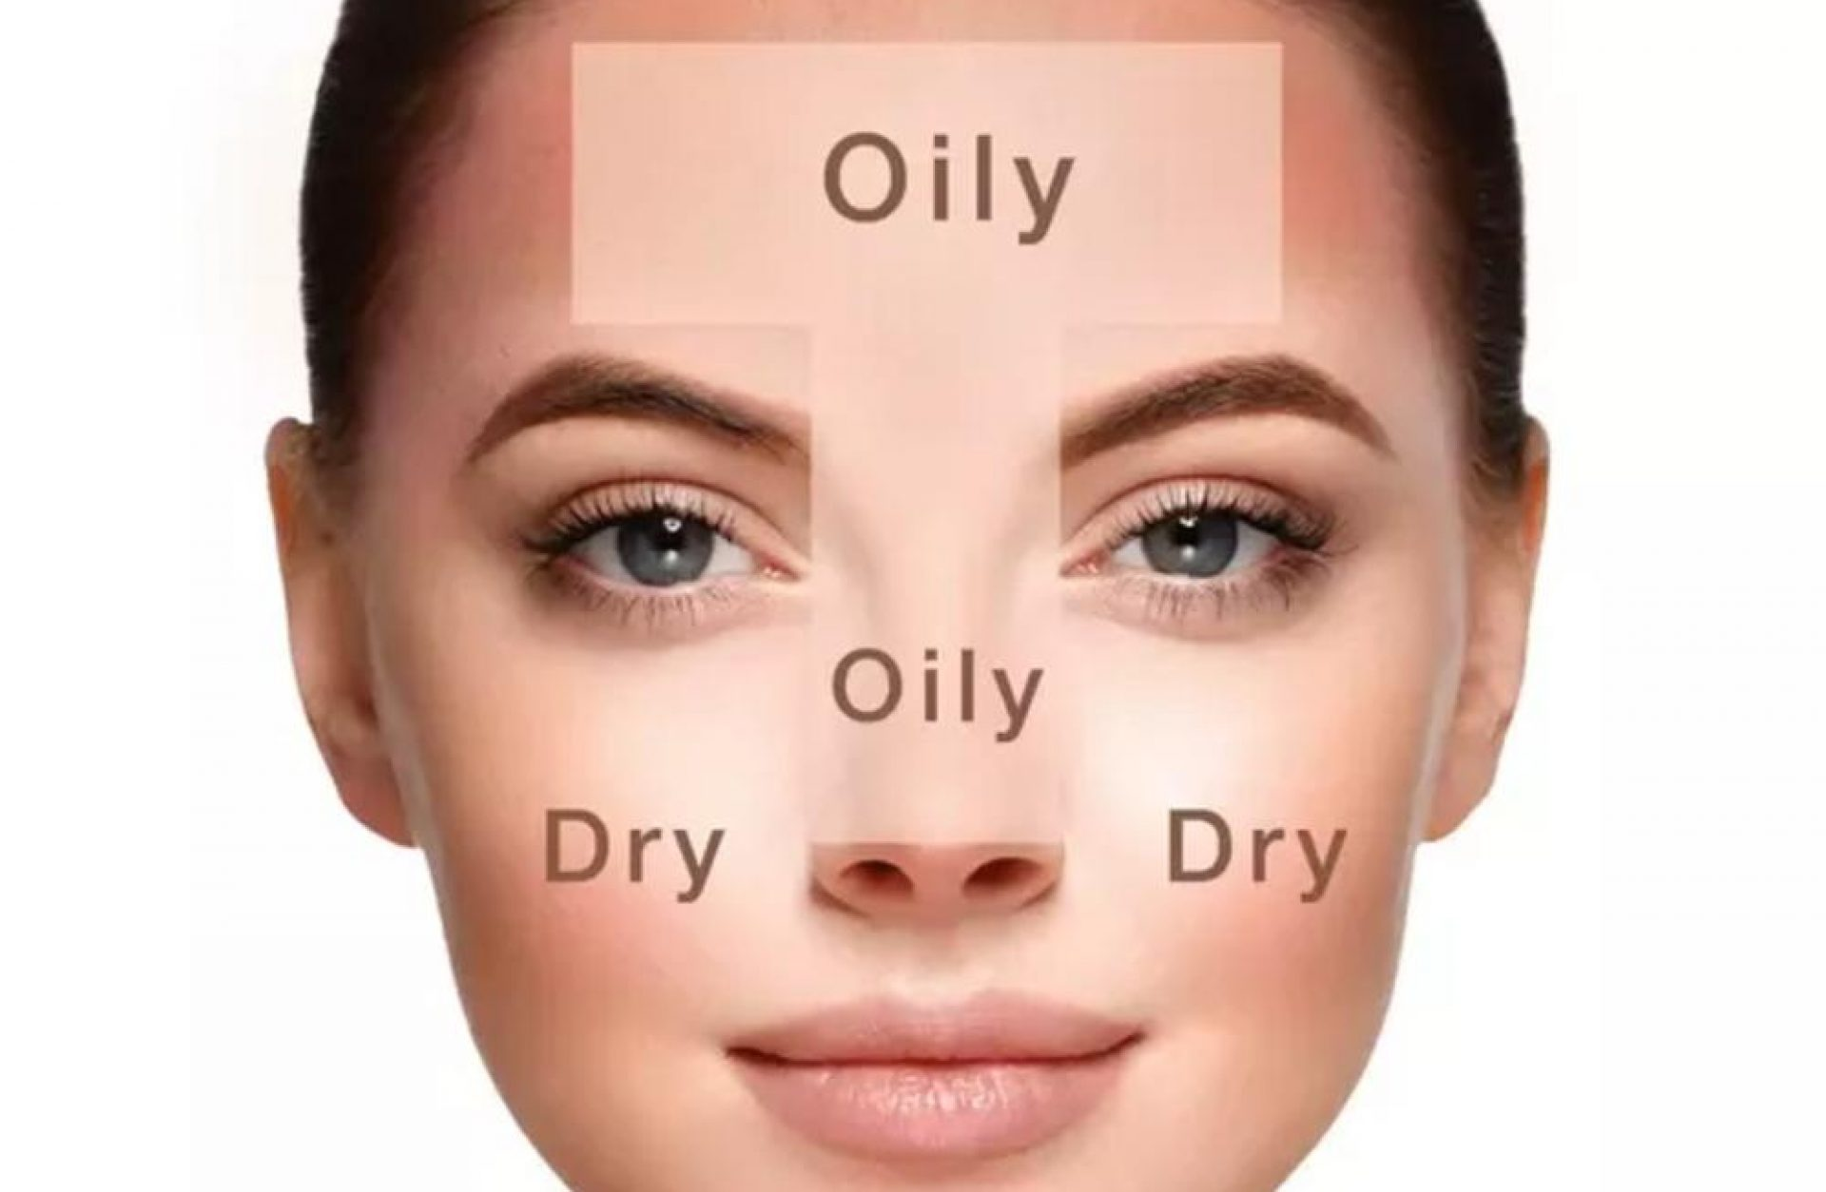

Slide 3
FACE CARE: OILY SKIN
GREEN TEA TONER
SCENT: HERBAL
MAKES: 1 CUP
The green tea lends a strong herbal note to this toner.
The tea and vinegar serve as astringents to close pores and fight oil, while the thyme essential oil has disinfectant and antiseptic properties to clean and tone skin, and the disinfectant and antiseptic properties of the thyme complement the scent.

Slide 4
¾ cup brewed green tea,
cooled ¼ cup apple cider vinegar
15 drops thyme essential oil
1. In a medium bowl, combine the tea and vinegar.
2. Add the essential oil and stir to mix well.
3. Transfer the mixture to an 8-ounce spray bottle.

Slide 5
SIMPLE SWAP
You can replace the thyme oil with rosemary oil for the same effects but a different scent.

Slide 6
HAIR CARE: BRITTLE HAIR

Slide 7
HAIR CARE: BRITTLE HAIR
HOT OIL TREATMENT FOR BRITTLE HAIR
SCENT: HERBAL
MAKES: 1 TREATMENT
Simply put, hot oil treatments restore moisture to hair.
There are many factors that contribute to brittle or dry hair, from environmental toxins to hair coloring.
Here the essential oil blends with coconut oil, which both moisturizes and prevents the loss of protein to strengthen hair.
The rosemary essential oil complements the coconut oil by stimulating the growth the of new hair.

Slide 8
4 tablespoons extra-virgin coconut oil 1 drop rosemary essential oil
1. Microwave the oil in a small glass bowl until it is warm.
Time will vary depending on microwave strength.
Start with 10 seconds and work up.
2. Stir in the essential oil.

Slide 9
APPLICATION
Massage the oil through the hair and down to the scalp.
Cover the head with a shower cap (you can buy disposable ones at a beauty supply store) or a towel.
Leave on for at least half an hour, but preferably overnight.
(Cover your pillow with a towel so you don’t ruin the pillowcase.) Rinse out with warm water and then shampoo as usual.
STORAGE
This is a single-use treatment, and no storage is required

Slide 10
HAIR CARE: DANDRUFF

Slide 11
HAIR CARE: DANDRUFF
ROSEMARY AND CEDARWOOD DANDRUFF SHAMPOO
SCENT: WOODY/HERBAL MAKES: 1 CUP
Rosemary and cedarwood essential oils blend well together scent-wise, and they both have astringent and exfoliating properties that fight dandruff.
Because liquid castile soap can be drying by itself, the addition of coconut oil helps to moisturize, leaving your hair shiny and manageable.

Slide 12
½ cup unscented liquid castile
soap ¼ cup vegetable glycerin
¼ cup fractionated coconut oil
12 drops rosemary essential oil
12 drops cedarwood essential oil In an 8-ounce bottle,
combine all the ingredients and shake well to mix.

Slide 13
NOTE Vegetable glycerin is readily available at drug stores like CVS and big-box stores like WalMart.
It costs less than $5 for 8 ounces.
APPLICATION: Shampoo hair with 1 to 2 tablespoons of the soap daily, massaging it into your scalp with your fingertips.
STORAGE: Store in a tightly sealed bottle in your shower for up to 3 months.

Slide 14
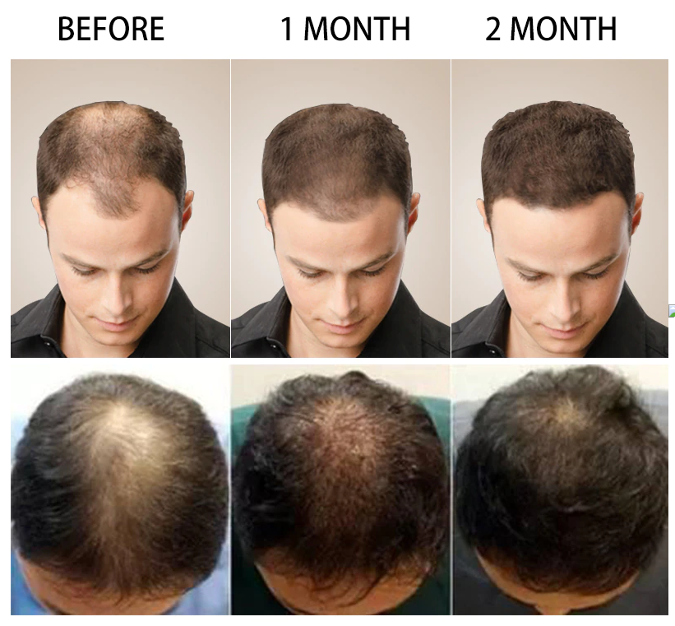
HAIR CARE: HAIR LOSS

Slide 15
HAIR CARE: HAIR LOSS
SCALP-STIMULATING CONDITIONER
SCENT: FLORAL/HERBAL
MAKES: 1 TREATMENT
A number of things can cause hair loss.
While this treatment most likely won’t reverse hair loss and cause new hair to grow once it’s gone, it may be able to stimulate your scalp and keep you from losing more hair.
This conditioner also has a heady, delicious, and addictive fragrance from the ylang ylang and thyme essential oils, both which may help combat hair loss.

Slide 16
½ cup extra-virgin coconut oil,
melted 5 drops ylang ylang essential oil
5 drops thyme essential oil In a small metal or glass bowl,
combine all the ingredients
and
mix with a metal spoon or rod.

Slide 17
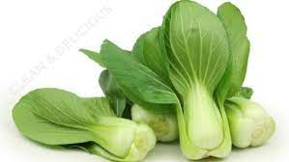
A CLOSER LOOK Poor diet can cause thinning hair.
Foods that aid in preventing hair loss include walnuts, spinach, halibut, carrots, bok choy , eggs, and Greek yogurt.
APPLICATION: Use once per week. Massage onto scalp and comb through hair.
Leave on the scalp for 15 minutes before washing and conditioning as usual.
STORAGE: This is a single-use treatment and does not require storage.

Slide 18
Thanks

