Slide 1
Tishk International University
FACULTY OF PHARMACY
Department of Pharmacognosy
A R O M A t h e r a p y-part 2
Grade 4- Spring semester
Dr. Omji Porwal

Slide 2
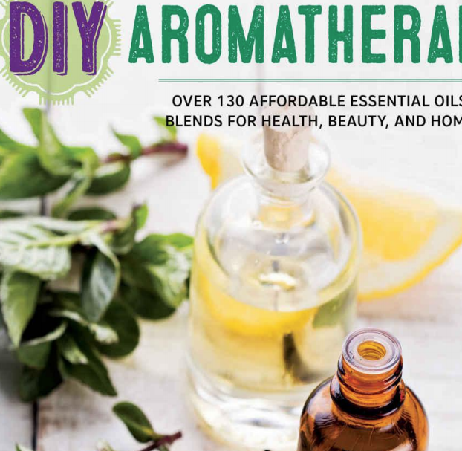
Aromatherapy is a growing industry, and more and more people are becoming interested in learning about and using essential oils. As you may already know, essential oils are very concentrated plant substances. It is our job to learn what we can about them and use them in our homes and on our bodies with great care. One drop of an essential oil might come from thousands of pounds of flower petals, and it might take just one diluted drop to soothe your bug bite.

Slide 3
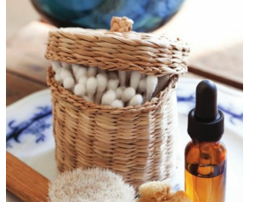
DIY Aromatherapy is a great place to start experimenting safely and affordably with essential oils.
This book tells you about the history of aromatherapy, and then goes on to explain how essential oils are made, the ways in which they work, how to choose and use them, which supplies are useful, how to make your own blends at home … and that is just what you’ll find in the first part!

Slide 4
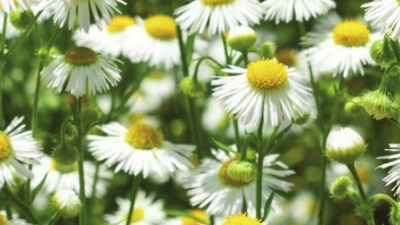
There are so many essential oils, and they can be useful for a variety of issues.
Knowing when and how to use them is key to aromatherapy success.

Slide 5
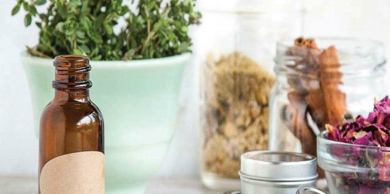

Slide 13
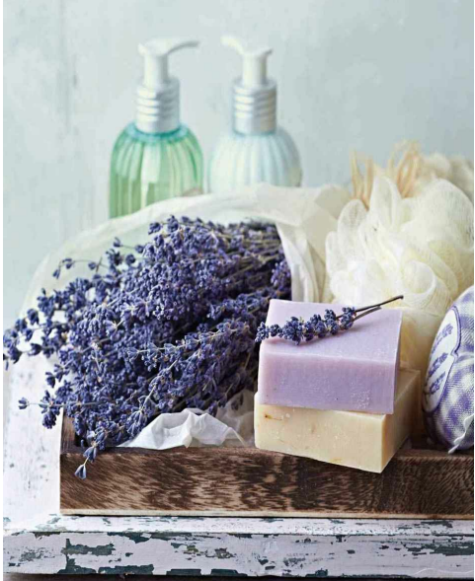
Lea Harris Certified Clinical Aromatherapist
UsingEOsSafely.com

Slide 14
INTRODUCTION
The ancients knew the value of essential oils—aromatic distillations of plant parts they used for medicinal, cosmetic, and ritual purposes.
Egyptians buried their dead with jars of fragrant ointment; Romans treated wounds with poultices of honey and basil; the New Testament speaks of the Magi bringing gifts of precious frankincense and myrrh to the newborn Christ child.
In medieval times every monastery had a “physick” garden and every housewife knew which plants could be used to cure a fever or induce childbirth or numb the pain of a sore tooth.
frankincense : a fragrant gum resin from trees of a genus (Boswellia of the family Burseraceae) of Somalia and southern coastal Arabia that is an important incense resin and has been used in religious rites, perfumery, and embalming
Myrrh : a yellowish-brown to reddish-brown aromatic gum resin with a bitter slightly pungent taste obtained from a tree (especially Commiphora abyssinica of the family Burseraceae) of eastern Africa and Arabiaalso : a mixture of myrrh and labdanum

Slide 15
AROMATHERAPY
Ancient wisdom has been rediscovered, repurposed, and rebranded as “aromatherapy.”
It’s a new word for an old concept. Using essential oils will increase your health, your happiness, and your overall well-being; plus, it’s a lot of fun playing with the scented oils and practicing a modern kind of alchemy.
Whether you’re new to aromatherapy or have dabbled with the volatile plant oils to unlock memory or mend a mood, the simple recipes and directions in this book will help you to use essential oils with confidence.

Slide 16
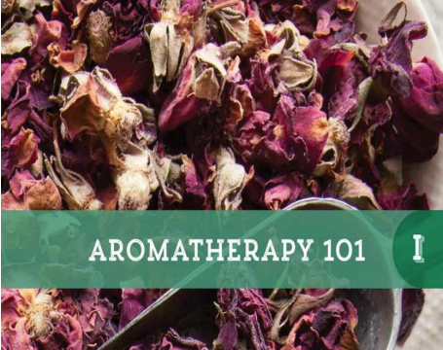

Slide 18
AROMATHERAPY BASICS
Your sense of smell is very powerful.
Many species, including humans, rely partially on their sense of smell to survive.
Scent has the ability to evoke memories, calm or invigorate the senses, help you wake up or fall asleep, and discern whether foods have gone bad, among many other functions.
Many people think, and understandably so, given the name, that aromatherapy is purely about scents.
However, aromatherapy goes far beyond the practice of simply inhaling fragrant oils.

Slide 19
THANKS

