Slide 1
Tishk International University
FACULTY OF PHARMACY
Department of Pharmacognosy
A R O M A t h e r a p y- part 5
BLENDING OILS
Grade 4- Spring semester
Dr. Omji Porwal

Slide 2
BLENDING OILS
To blend essential oils into a combination that’s not only effective but also sensorially pleasing, you’ll need to consider both fragrance notes and aromas.
Notes occur as a scent breaks down and are layered in three parts. Top notes dominate a fragrance when you first apply it and tend to be citrusy or herbal.
Middle notes arise after a few minutes and tend to be softer and more floral, such as rose.
Base notes appear after about 30 minutes and may be deeper or darker, such as musk.
Balanced fragrances contain an artful combination of top, middle, and base notes.
Essential oil aromas fall into broad categories.
Aromas include Citrus Earthy Floral Herbaceous Medicinal Oriental Spicy Woody Minty

Slide 3
Muntjac Deer Have Bizarre Flaring Scent Glands On Their Face

Slide 4
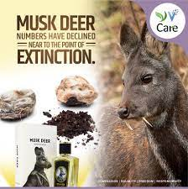

Slide 5
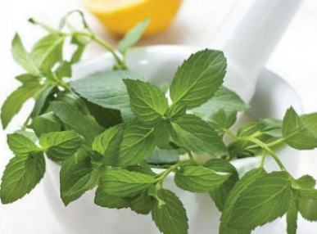

Slide 6
FAQ: WHICH AROMAS BLEND BEST?
When making simple blends, you don’t need to worry too much about breaking down aromas, but when you’re combining oils for a more complex scent, or even for a perfume, you’ll want to start thinking about “notes”(https://www.fragrantica.com/) and how they affect the composition of the scent.
A perfume’s scent is like a story—it has a beginning (the “opening” or “top notes”), a middle (sometimes called the “heart notes,”) and an end (the “base notes” or “the finish”).
Some are longer lasting than others so a perfume can change its olfactory character the longer it is on your skin.
While trying out new blends is part of the fun of DIY aromatherapy, there are some guidelines you can follow so you don’t waste your essential oils by making a blend that creates an unpleasant fragrance.
In general, combine like with like.
You can blend florals and florals, citrus and citrus, woody, and woody, and so forth. Citrus essential oils are incredibly versatile and combine well with almost any other kind of aroma.
Woody aromas (cedarwood, pine, spruce) also blend well across the aroma spectrum.
Florals work with citrus, woody, and spicy aromas.
Herbal and minty aromas blend well with citrus, earthy, and woody, and with medicinal scents but not so well with florals. (There’s a reason you don’t see many candles scented peppermint-rose.)

Slide 7
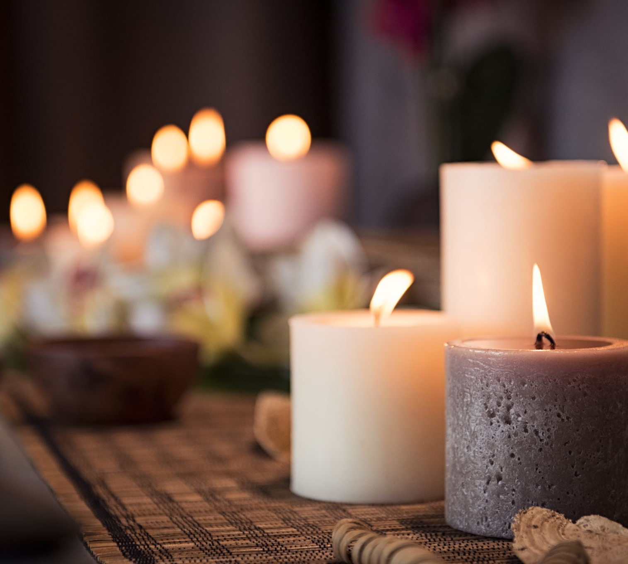
EIGHT REASONS TO DIY AROMATHERAPY
There are many easy and fun products you can make to replace store-bought versions.
But beyond that, there are a number of good reasons to add aromatherapy to your life. To reduce the amount of toxic chemicals in your home.
You know those movies where someone assembles a bomb out of a few household cleaning products or makes a flamethrower out of an aerosol spray can?
There’s a reason rubber gloves were invented.
The chemicals in many household products cause skin irritation, and repeated inhalation of noxious fumes can cause respiratory problems.
Even more important, if you have children in your home, using DIY products based on essential oils rather than synthetic substances it reduce the chance of an accidental poisoning.
Aromatherapy products are cost-effective.
For the cost of one bottle of brightly colored window cleaner, you can make gallons of the DIY equivalent using water, white vinegar, and the essential oil(s) of your choice. Pine- and lemon-scented cleansers and polishes can be whipped up in minutes and will make your house truly smell fresh.

Slide 8
Aromatherapy products do double (or even triple) duty.
Essential oils put the “multi” in multipurpose. Many have a whole medicine kit of properties, including analgesic, antiseptic, antispasmodic, antifungal, anti-inflammatory, and more.
Lavender oil, for instance, is well known for its anxiety-soothing, sleep-inducing properties.
But it also is an essential component of the disinfectant blend known as “Thieves’ Oil,” a combination of essential oils so powerful it was used in the Middle Ages to protect against the plague.
Lavender is also an excellent ingredient for giving linens a sweet, fresh smell and adds a lovely floral scent to add to cosmetic products.
Aromatherapy products can be a safe, non addictive alternative to over-the-counter medicines.
While this knowledge does not advocate replacing traditional medicine with aromatherapy, essential oil treatments do not come with the list of side effects associated with conventional medicines: When used for headache relief, they won’t cause kidney damage the way some common pain-relief remedies do.
Lavender preparations to alleviate insomnia, and peppermint oil spray to sharpen focus and lift spirits will not lead to dangerous dependencies.
Moreover, if you make your own products, you know exactly what’s in them.

Slide 9
You control the quality of the products you use.
There are all sorts of sales ploys used to convince us the products we buy, and use are safe but even broad labels like “natural” can be misleading or even downright deceptive because there are no regulations about the use of similar terms.
If you make your own product, you know the quality of the essential oils and carrier oils you’re using, and you don’t have to guess

Slide 10
Essential oils are cruelty-free.
As a conscious consumer, it’s good to know that the ingredients in the products you use—particularly cosmetics—are cruelty-free.
Despite years of bad press and public shaming, some mega-companies are still testing their products on animals, blinding them (and worse) in the name of beauty.
You can have a “signature scent.”
One scent does not fit all and even a store that stocks a wide range of cosmetics and bath products may not have a scent that draws you in.
Why settle for a generic lemon scent when you can make your own Meyer lemon body scrub, or a shampoo scented with blood orange instead of the more common “sweet orange” scent?
Experimenting at home with oils is an affordable and fun way to create your own signature scent.

Slide 11
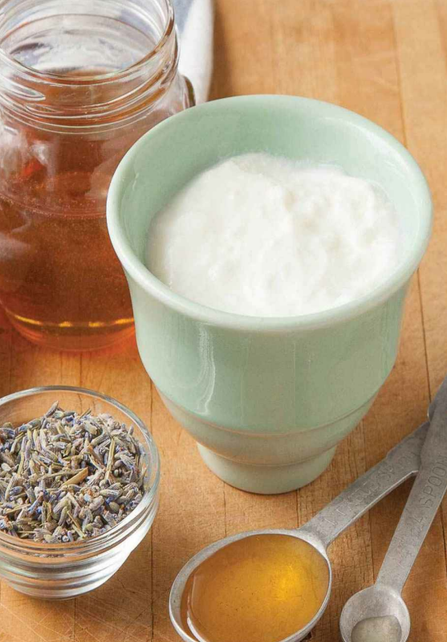

Slide 12
Aromatherapy products make great gifts.
Homemade gifts really are the most personal way to mark an occasion and if you’re on a budget, they allow you to offer the gift of luxury for pennies on the dollar.
The basic ingredients for a pint of decadently desirable hand lotion, for example, can cost less than a bottle of no-name “pink” lotion from the nearest drug store.
Handmade candles made with natural waxes, FDA-approved colorings for use in drugs and cosmetics (D&C), and lead-free wicks are not only fragrant and festive but also much healthier and cheaper than those pricey pillars you can buy.
They might smell lovely, but who knows what you’re inhaling along with the scent

Slide 13
THANKS

