Slide 1
Tishk International University
FACULTY OF PHARMACY
Department of Pharmacognosy
A R O M A t h e r a p y
Oil blending part-2
Grade 4- Spring semester
Dr. Omji Porwal

Slide 2
CORE INGREDIENTS
At the heart of basic DIY aromatherapy are two core ingredients: essential oils and carrier oils.
With these two ingredients you can begin basic projects, adding more items as you need them to create more complex recipes.

Slide 4
ESSENTIAL OILS
When selecting essential oils for projects, you need to use the best quality oils you can afford.
Of course, price is not necessarily an indication of quality when it comes to essential oils. Keep the following in mind as a roadmap to evaluating the quality and versatility of the essential oils.
SCENT Essential oils have nine basic scent categories that can help you identify the type of fragrance you’ll get with each essential oil.
Because essential oils come tightly sealed, you can’t open the lid to smell them in the store.
Knowing the basic aroma category of the essential oil will, at least from a broad perspective, give you an understanding of how the essential oil will smell.
Some essential oils fall into more than one of the nine categories:
Citrus (orange, lemon, grapefruit, bergamot, mandarin, etc.)
Earthy (sandalwood, cypress, patchouli, black pepper, etc.)
Floral (rose, jasmine, lavender, chamomile, ylang ylang, etc.)
Herbaceous/Herbal (rosemary, clary sage, hyssop, basil, etc.)
Medicinal (eucalyptus, cajeput, tea tree, etc.)
Minty (peppermint, wintergreen, etc.)
Oriental (ginger, patchouli, etc.)
Spicy (cinnamon, nutmeg, ginger, clove, etc.)
Woody (cedarwood, rosewood, pine, frank-incense, etc.)

Slide 5
PURITY
The word “purity” as it relates to essential oils is a marketing term.
Much like the label “natural,” it may not have the meaning you think it does.
An essential oil labeled as pure doesn’t mean it is high quality or even that there is only one essential oil in the bottle.
For example, it’s not uncommon to find Melissa oil (also known as lemon balm) diluted with the less expensive lemon oil.
In some cases, the essential oil hasn’t been adulterated with another essential oil but has instead been cut with carrier oil.
One of the best ways to learn about the quality of different brands of essential oils is to do your homework before you shop.
Read company literature to learn how they distill their essential oils and whether their oils are “100 percent pure” and undiluted.
Look for online reviews or talk with experienced users for recommendations of the best oils to use.
As a rule, expect a pure essential oil to last at least a year—and many will last for more.
You can find an excellent A–Z list of the approximate shelf life of popular essential oils, at www.usingeossafely.com/shelflife.

Slide 6
PRICE
Just as a high-priced brand doesn’t necessarily indicate a high-quality essential oil, a low-priced brand may not indicate a poor-quality oil.
That’s why it is so important to also weigh other factors when evaluating which oils, you’d like to try.
Even within one brand, prices range vastly for specific types of essential oils.
Some, such as orange oil, peppermint, or tea tree oil, don’t cost much to produce because the raw materials are inexpensive and easy to obtain.
Others, such as jasmine and rose, require larger quantities of raw materials, or they have raw materials that are more expensive or difficult to obtain, resulting in breathtakingly high prices.
Fortunately, for the very high-priced oils, you can often substitute less expensive oils that have similar properties to make your project more affordable.
One great way to save money is to purchase a starter kit containing several oils from a reputable company, such as Mountain Rose Herbs.

Slide 7
MARKETING CLAIMS
Essential oil manufacturers use a lot of buzzwords as marketing hooks.
While they may sound exciting, they don’t provide meaningful descriptions of the products.
Aromatherapist Jade Shutes has written extensively about the false marketing concept of “therapeutic grade” and has pointed out that claims of an essential oil being “certified” are essentially nothing more than marketing lingo.
There is no official governing body that certifies essential oils or issues grades.
If a brand of essential oils claims that its oils are “more therapeutic than others,” you can be sure that they’re exaggerating for effect.
Something else to consider when purchasing essential oils is that there is a lot of hype surrounding the oils’ beneficial properties.
While solid scientific evidence does exist showing the efficacy of many essential oils, be wary of extraordinary claims, which are most likely marketing hype.

Slide 8
BRAND REPUTATION
The Internet is a wonderful and powerful tool that allows you to do something that wasn’t easily available to generations past.
When used properly, the Internet can help you discover how users feel about the quality of available products and brands.
This is as true for essential oils as it is for any other product on the market.
It’s up to you to do your due diligence on a brand.
Look for brand reviews on sites that have user driven content.
Research people’s praise and concerns about each brand.
It’s best to look at the reviews of consensus—those reviews in which multiple parties agree.
While you should certainly take into account praises and criticisms, realize that those making wildly positive or wildly negative claims may need to be given less weight—unless the bulk of customers and users make those extremely positive or negative reviews.

Slide 9
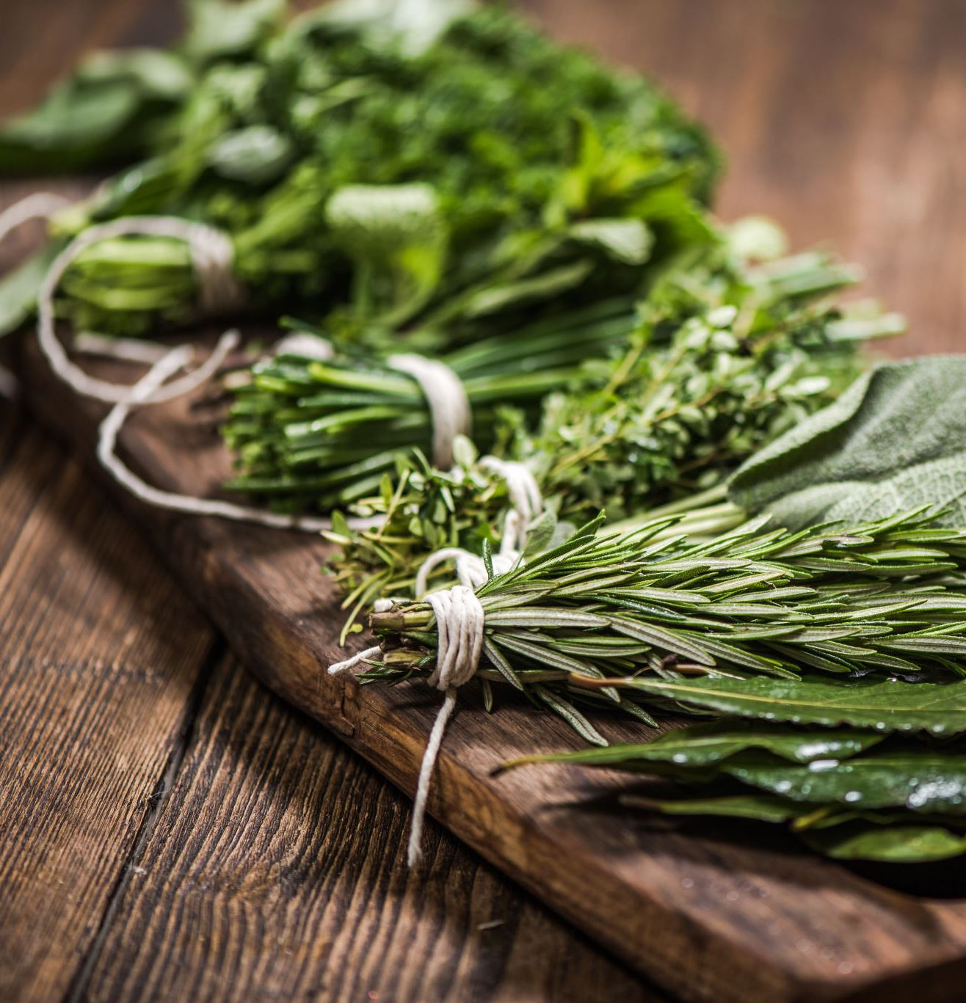
CARRIER OILS
With just a few exceptions, essential oils need to be diluted before they are applied to the skin or inhaled.
Most commonly, they are combined with carrier oils, although you may also dilute them in alcohol, gels, and liquid soap, or add them to water for specific projects.
Carrier oils come in a wide variety of weights and prices.
One of the most affordable and readily available carrier oils is olive oil, but its strong fragrance isn’t ideal for use in formulas with delicate scents.
Fortunately, plenty of other options exist, including plain old (inexpensive) safflower oil, which you can find near the salad dressing in any supermarket.

Slide 10
Six of the most affordable and versatile carrier oils are
Grapeseed oil, which is particularly good for those with sensitive skin because it’s naturally nonallergenic. Because it is so affordable, it is also great for use in large quantities, such as for massage therapy.
Grapeseed oil has a shelf life of between 6 and 12 months.
Refrigeration may make it last a bit longer.
Sweet almond oil is practical for all skin types and has a light, nutty odor that does not conflict with most blends.
It works well as a massage blend, or in some cosmetic applications.
It is extremely affordable and has a shelf-life (unrefrigerated) of about 12 months.
Rosehip seed oil is considered a dry oil because it absorbs in the skin so quickly. It’s not only great for massage but is wonderful in cosmetic applications for dry and aging skin, but not for acne prone skin.
It is more expensive and more perishable than some of the other carrier oils.
Rosehip oil needs to be refrigerated because of its propensity to rancidity, and it lasts about 3 months, so buy it in small quantities if you plan to use it.
Don’t use it if you have oily skin.

Slide 11
carrier oils
Apricot kernel oil is reasonably affordable and great for dry or very dry skin.
It works well in cosmetic applications.
It is high in essential fatty acids and contains vitamins A and E, which are wonderful antioxidants for mature skin.
Because of its light peach color, it may stain clothing.
It has a shelf life of about 12 months and doesn’t require refrigeration.
Jojoba oil is unique in that it is a carrier oil that remains shelf stable for a very long time—2 to 3 years in most cases.
The skin also absorbs it very well, so it’s great for cosmetic use.
Coconut oil has its own, relatively strong coconut fragrance.
However, because it is a solid at room temperature, it’s wonderful for creating salves.
To use it with essential oils, you need to melt it and mix in the essential oils, and then allow it to return to a solid at room temperature.
It is shelf stable for 2 to 3 years and works well in cosmetic and alternative health applications.

Slide 12
carrier oils
ARGAN Oils derived from the fruit of a tree native to Morocco and is used for deeply hydrating nail, skin, and hair treatments.
It is expensive and should only be used for highly fragranced formulas because its own natural scent is strong.
AVOCADO OIL is a thick oil with superior skin-nourishing and moisturizing properties.
It does not have a particularly long shelf life, however, so make small batches of any product that contains this oil.
CASTOR OIL is a thick oil that has antibacterial, antifungal, and antiviral properties.
It works well in preparations like balms and salves that need a little “heft” to them.
Castor oil should not be taken internally but, applied topically, the oil softens skin, eases inflammation, and helps heal boils, carbuncles, and abscesses.

Slide 13
HAZELNUT OIL is slightly astringent, which makes it a good choice for use on oily skin.
It is deeply penetrating and makes a good carrier oil for massage blends.
It has a naturally nutty aroma that blends well with oriental, spicy, and nutty essential oil aromas.
MACADAMIA NUT OIL is extremely regenerative and protective of the skin.
It is highly absorbent and particularly suited for use on aging skin.
It is used as a substitute for mink oil in the production of medicine, cosmetics, and insect repellants.
WALNUT Oils readily available in the oils section of any supermarket.
It works well as a massage oil as well as combined with other carrier oils in cosmetic products.
It is consumed internally for its antioxidant properties and subtle flavor and has a strong scent.

Slide 14
PREP EQUIPMENT
When working with essential oils, you are often using precise measurements and sometimes you need to put liquids into bottles with very small mouths.
You can use the food preparation equipment you already have on hand, but if you plan to do a lot of aromatherapy work, you may wish to have some dedicated glass, ceramic, or stainless-steel equipment that won’t be affected (or affect) the essential oils.
When working with the equipment, make sure it is clean and dry before starting.
Some of the following items will help you prep your essential oil formulas:
Glass, ceramic, or metal bowls for mixing Glass or metal saucepan for melting and mixing Glass or metal stirrers, which provide a nonporous method of stirring Eyedroppers or pipettes for measuring oils Measuring spoons Measuring cups or scoops Glass liquid measuring cups for measuring carrier oils, water, and other ingredients Funnels to transfer products into small-mouthed storage containers Latex gloves to keep pure essential oils from directly contacting skin.

Slide 16
STORAGE EQUIPMENT
While sometimes you make a single batch, more frequently you make a multi-use batch that requires storage items.
This requires a bunch of bottles, tubs, and jars. Consider keeping on hand the following: Small (1- to 2-ounce), dark-colored glass roller bottles with a screw cap.
Small (4- to 8-ounce) dark-colored glass spray bottles Small (1- to 8-ounce) dark-colored glass jars with screw caps Clean mason jars Small (1 dram to 8-ounce) dark-colored screw cap dropper jars Empty push-up deodorant containers.

Slide 17
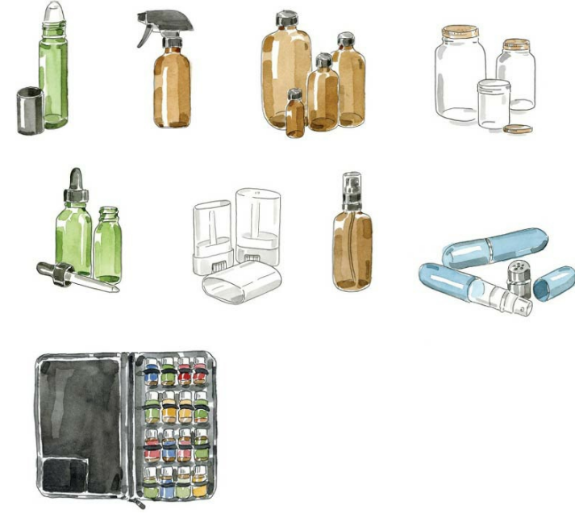

Slide 18
When it comes to dark-colored glass, keep in mind that amber and green bottles provide the best protection from ultraviolet (UV) light.
Cobalt (blue)-colored bottles are not as effective in preventing light from passing through the bottle, and through your oil as a result.

Slide 19
Thanks

